Slide 1
UNSUPERVISED LEARNING – DAY01

Slide 2
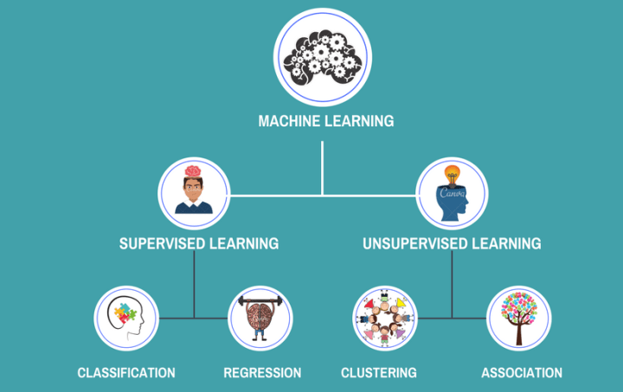
Types of Machine Learning

Slide 3
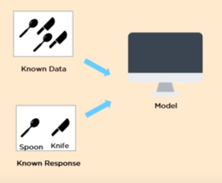
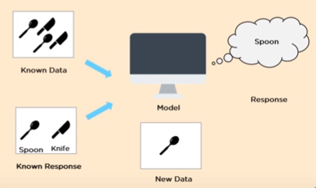
Supervised Learning
In supervised learning, Model is able to predict with the help of the information from the Dataset
Target is known for supervised learning

Slide 4
Supervised Learning Types
Classification
Regression

Slide 5
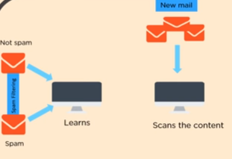
Supervised - Classification
When the Dependent variable or Target Variable is Categorical in Nature
Eg. Mail is spam or not

Slide 6
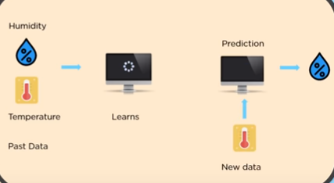
Supervised - Regression
When the Dependent Variable is Continuous in Nature it is a Regression problem

Slide 7
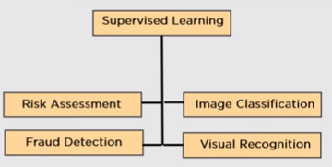
Applications of Supervised Learning

Slide 8
Reinforcement Learning
Reinforcement Learning is an aspect of Machine learning where an agent learns to behave in an environment, by performing certain actions and observing the rewards/results which it get from those actions. Eg. Riding a Bicycle

Slide 9
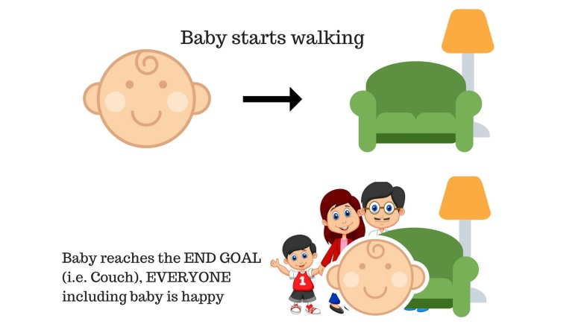
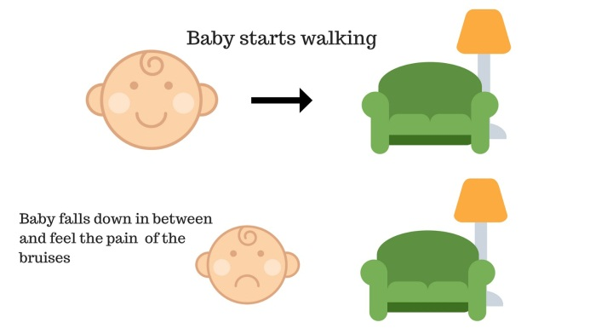
RL - Example
Baby starts walking and successfully reaches the couch
Baby starts walking and falls due to some obstacle in between and gets bruised.
Humans learn — by trail and error. Reinforcement learning is conceptually the same, but is a computational approach to learn by actions.

Slide 10
Unsupervised Learning
Unsupervised learning is where you only have input data (X) and no corresponding output variables.
Algorithm is trained using data that is unlabeled
Machine tries to identify the patterns and gives the response
There is no supervisor to teach the machine what is right and what is wrong

Slide 11
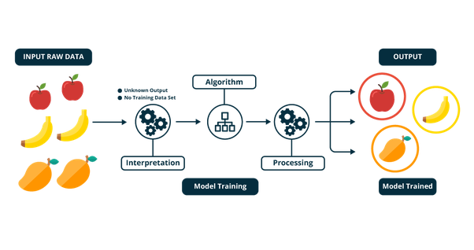
Unsupervised Learning Example

Slide 12
Unsupervised Learning
Clustering
Association
Density Estimation
Dimensionality reduction

Slide 13
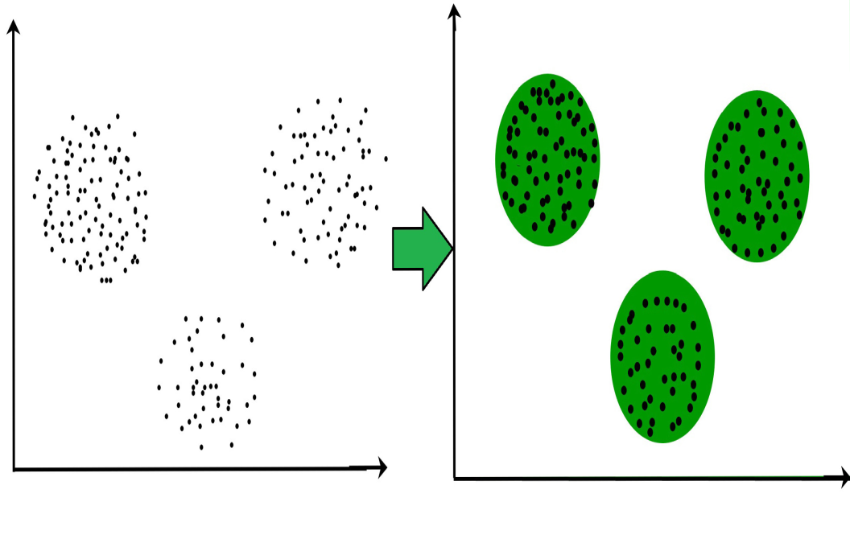
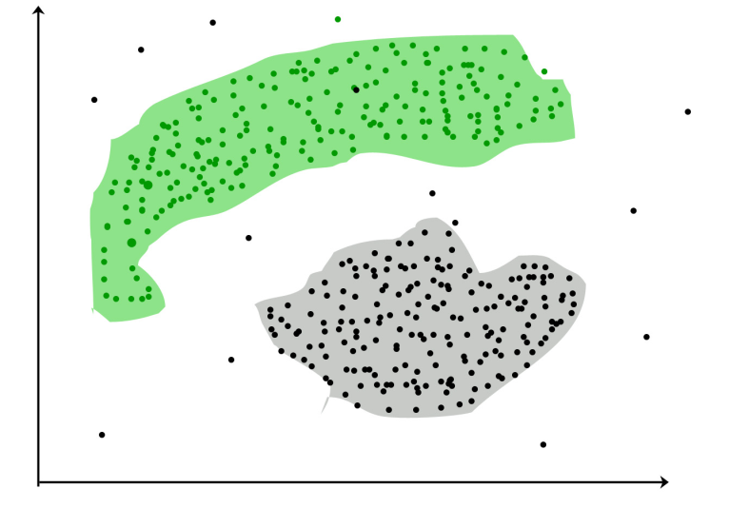
Clustering
Clustering is the task of dividing the population or data points into a number of groups such that data points in the same groups are more similar to other data points in the same group and dissimilar to the data points in other groups.
It is basically a collection of objects on the basis of similarity and dissimilarity between them.
The data points in the graph below clustered together can be classified into one single group
It is not necessary for clusters to be a
spherical

Slide 14
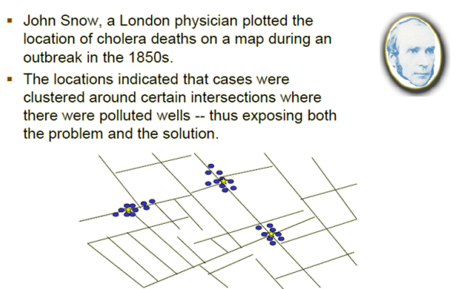
Historic application of clustering

Slide 15
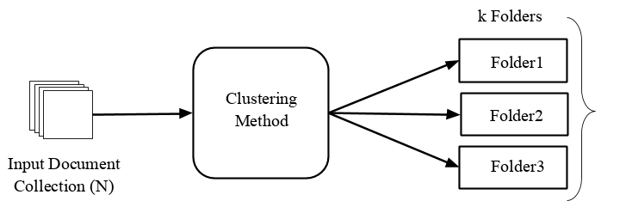
Clustering
Clustering is most popular data segmentation technique
Clustering is a data classification technique.
It is an Unsupervised Machine Learning Technique.
Given a collection of N documents, Clustering segregates them into k groups based on some similarity/dissimilarity measure.

Slide 16
Classification vs Clustering
Classification is a method to assign an observation to one of a finite number of classes.
The classes are defined before hand.
These classes serve as training set.
Based on a measure or analysis incoming
observations are assigned to established classes.
On the other hand statistical clustering attempts to dissect a heterogeneous set of observations into smaller natural homogeneous groups.
Clustering is a unsupervised classification technique.

Slide 17
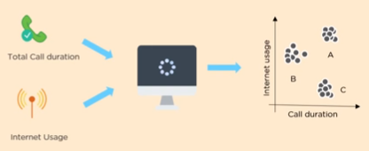
Clustering – case study
A Telecom company wants to reduce the customer churn rate by providing a personalized call and data plans

Slide 18
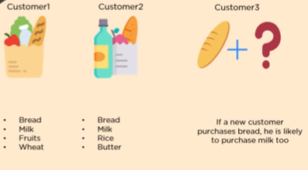
Association
Discover the probability of the co- occurrence of items in a collection
Eg. Which Product will purchased together in a retail shop

Slide 19
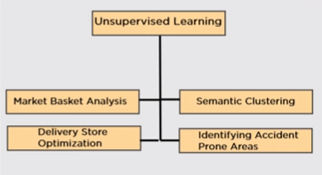
Applications of Unsupervised Learning

Slide 20
Dimensionality reduction
Dimensionality reduction is the process of reducing the dimension of your feature set. For example your dataset might have 100 features and dimensionality reduction is bringing the number of variables say to twenty or thirty
Dimensionality reduction can be divided into
feature selection and
feature extraction.

Slide 21
Feature selection
In this, we try to find a subset of the original set of variables, or features, to get a smaller subset which can be used to model the problem. There are three ways of Feature selection:
Filter
Wrapper
Embedded

Slide 22
Feature Extraction
This reduces the data in a high dimensional space to a lower dimension space,
i.e. a space with lesser no. of dimensions.
Methods of Dimensionality Reduction
Principal Component Analysis (PCA)
Linear Discriminant Analysis (LDA)
Singular Value Decomposition (SVD)
Dimensionality reduction may be both linear or non-linear, depending upon the method used.

Slide 23
K – Means Clustering

Slide 24
Machine Learning (Clustering - Types)
Grouping a set of objects such that objects in the same group (i.e. cluster) are more similar to each other in some sense than to objects of different groups
Being unsupervised learning method, it does not have any concept of training set, test set, training or test labels etc.
Each cluster gets a unique identification number. It is the data scientist responsibility to explore each cluster and assign a meaningful label
Two broad categories of clustering include hierarchical (agglomerative, divisive) and non hierarchical
Agglomerative clustering algorithm uses a bottom-up approach and merges smaller clusters into larger ones
Divisive clustering uses top-bottom approach to break a large cluster into smaller clusters
Non-hierarchical / partitional clusters are formed on assumption that the clusters are disjoint and there is no hierarchical relation between them. K Means is an example

Slide 25
Machine Learning (Clustering - Types)
Irrespective of the clustering algorithm, we need a way of defining and calculating distance between two data points in mathematical space (records in the database)
We also need a way to define and calculate distance between clusters

Slide 26
Machine Learning (Clustering – Distance calculations)
Distance d (p, q) between two points p and q is a dissimilarity measure if it satisfies:
1. Positive definiteness:
d (p, q) ≥ 0 for all p and q and
d (p, q) = 0 only if p = q.
2. Symmetry: d (p, q) = d (q, p) for all p and q.
Examples:
Euclidean distance
Manhattan distance
Chebyshev distance
Minkowski distance
Jaccard Distance

Slide 27
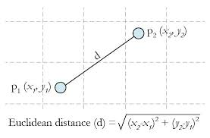
Euclidean Distance
Euclidean distance is the most common use of distance. It examines the root of square difference between coordinates of a pair of objects

Slide 28
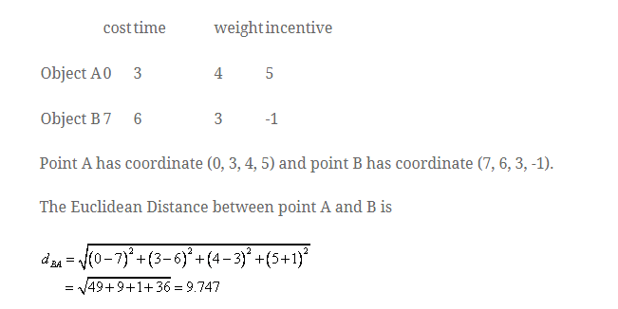
Euclidean Distance Calculation

Slide 29
Manhattan Distance Calculation
It is also know as city block distance or boxcar distance or absolute value distance
It represents the distance between point in a city road grid
It examines the absolute difference between the coordinates of a pair of objects

Slide 30
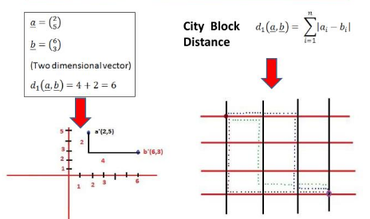
Manhattan Distance Example

Slide 31
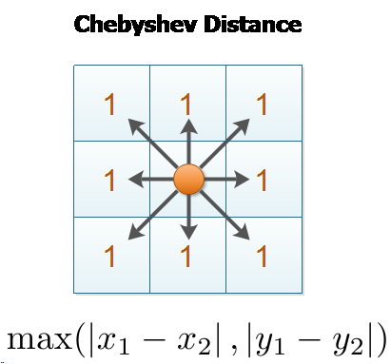
Chebyshev Distance
It is maximum value distance
It examines the absolute magnitude of the difference between coordinates of pairs of objects

Slide 32
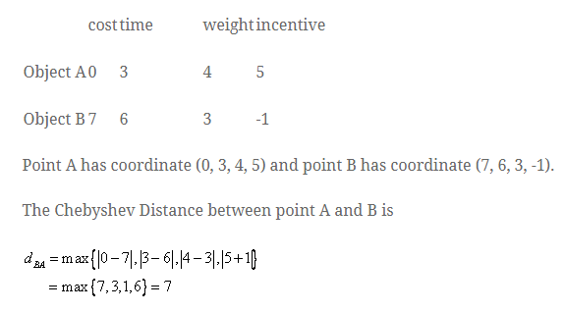
Chebyshev Distance Example

Slide 33
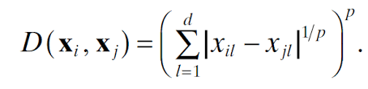
Minkowski Distance
Generalized metric distance
When lamda = 1, city block distance
When lamda = 2, it become Euclidean
When lamda > 2 , it is Chebyshev distance

Slide 34
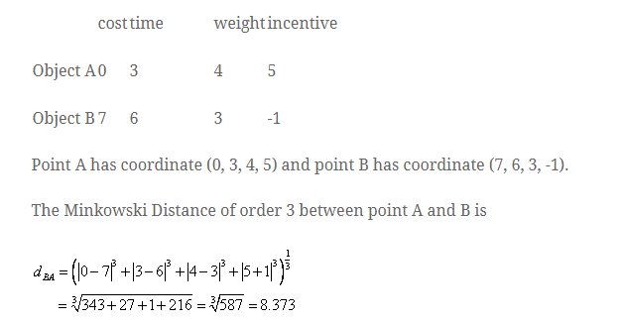
Minkowski Distance

Slide 35
Jaccard Distance
Jaccard distance, is a measure of how dissimilar two sets
J(A,B) = (1-|A∩B| / |A∪B|) *100
= (|{0,2,5}| / |{0,1,2,3,4,5,6,7,9}| )*100
= (1-3/9) *100
= (1-0.33)*100 = .6667 *100
= 66.67%

Slide 36

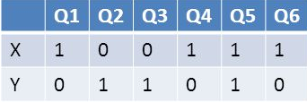
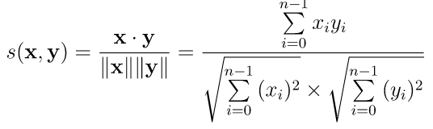
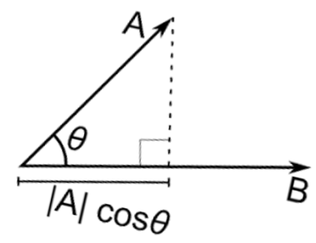
Machine Learning (Clustering – Distance calculations)
Jaccard distance : 1 - ratio of intersecting of two sets (commonalities) / Union of the two sets where the sets are values on various dimensions
Xxx
Jaccard distance (x,y) = 1 - jac(x , y)
Jac(x,y) 1 / 6
Jaccard distance = 1-1/6 = 5/6
Cosine distance :
Similarity measure
Cosine distance = 1 – s(x,y)

Slide 37
Machine Learning (Clustering – Distance calculations)
Edit distance : is a way of quantifying how dissimilar two vectors are to one another by counting the minimum number of operations required to transform one string into the other**. One example of this is Levenshtein distance
For example, the Levenshtein distance between "kitten" and "sitting" is 3, since the following three edits change one into the other, and there is no way to do it with fewer than three edits:
kitten → sitten (substitution of "s" for "k")
sitten → sittin (substitution of "i" for "e")
sittin → sitting (insertion of "g" at the end).
** https://en.wikipedia.org/wiki/Edit_distance

Slide 38
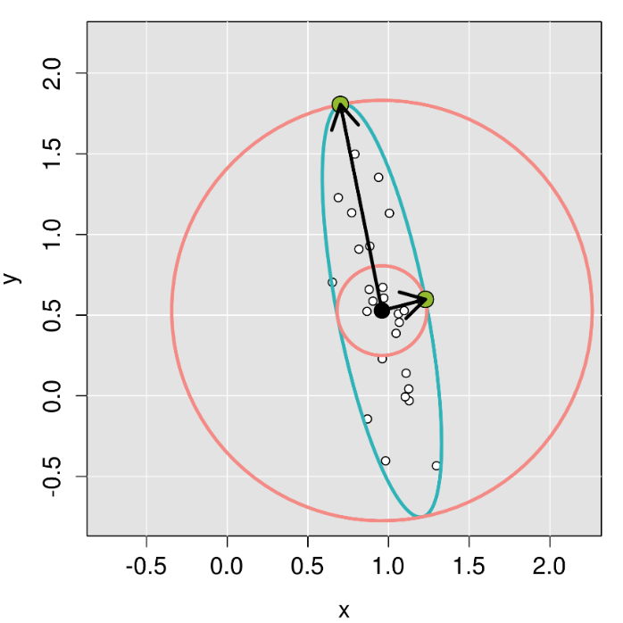
Machine Learning (Clustering – Distance calculations)
Mahalanobis distance : It takes into account the correlation between measurements. Measurements that are highly correlated are closer than measurements that are uncorrelated or mildly correlated.
The Euclidean distance is circular while the Mahalanobis distance (M) is elliptical.
The blue ellipse represents a line of equidistant points in terms of M that scales data to the variance in each direction.
The M between green points and the center are equal. However, the Euclidean distance between each green point and the center is different, as shown by the Euclidean equidistance pink circles.
Source: https://www.intechopen.com/books/soil-fertility/nutrient-balance-as-paradigm-of-plant-and-soil-chemometricsnutrient-balance-as-paradigm-of-soil-and-
** https://en.wikipedia.org/wiki/Edit_distance

Slide 39
Machine Learning (Clustering – Distance calculations)
Distance measures and some key points:
Choice of distance measures play a key role in cluster analysis.
Domain expertise is required to select the most appropriate one
The key point to decide metric is what is being measured.
How are the different measurements related (independent or correlated)
What scale should be used (numerical, ordinal or nominal)
Are their outliers in the data on the various dimensions
Though Euclidian distance is the most commonly used distance metric, it has three main features that should be kept in view
It is highly scale dependent. Changing the units of one variable can have a huge influence on the results. Hence standardizing the dimensions is a good practice
It completely ignores the relationship between measurements (Refer to Mahalanobis distance diagram)
It is sensitive to outliers. If the data has outliers that cannot be handled or removed, use of Manhattan distance is preferred

Slide 40
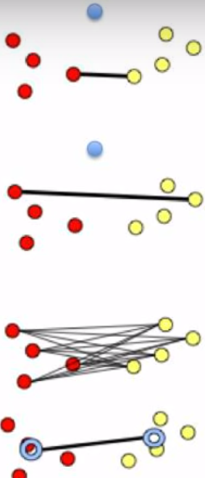
Machine Learning (Clustering – Measuring distance between clusters)
Ideally, a good clustering should result in compact clusters separated from one another by maximal distance. This calls for measuring the distance between cluster. The most widely used methods include :
Minimum distance(single linkage) – is the distance between pair of records Ai and Bj that belong to clusters A and B respectively and are closest
Maximum distance(complete linkage) – is the largest distance between the pair of records Ai and Bj that belong to cluster A and B respectively
Average distance (average linkage) - average distance of all possible distances between records in one cluster to records in other cluster
Centroid distance - the distance between centroids of the different clusters.
Distance between clusters is used in hierarchical clustering

Slide 41
Machine Learning (K Means Clustering – Some considerations )
K-Means (a.k.a Lloyd’s algorithm) clusters data by separating data points into groups of equal variance, minimizing a criterion known as the inertia or within-cluster sum-of-squared errors
It requires the number of clusters to be specified, hence the term “K” in its name
It divides the samples into K disjoint clusters Ci, each described by the mean of the samples in the cluster. The means are commonly called “centroids” (they are not the points from the data)
The K-Means algorithm chooses centroids that minimizes the inertia across all the clusters

Slide 42
Machine Learning (K Means Clustering – Some considerations )
From a computational perspective, the k-means algorithm is indifferent to the units of measure for a given attribute (for example, meters or centimeters for a patient's height). However, the algorithm will identify different clusters depending on the choice of the units of measure.
Choosing different starting points can result in different clusters. The algorithm is sensitive to the initial starting condition
Given enough time, K-means will always converge, however this may be a local minimum. This is highly dependent on the initialization of the centroids
Scikit-learn has implemented K-mean++ initialization scheme, which initializes centroids to be distant to one another which provably leads to better results

Slide 43
Machine Learning (Clustering – Use cases)
Clustering is often used as a lead-in to classification. Once the clusters are identified, labels can be applied to each cluster to classify each group based on its characteristics.
Clustering is primarily an exploratory technique to discover hidden structures of the data, possibly as a prelude to more focused analysis or decision processes.
Some specific applications of k-means are image processing, medical, and customer segmentation
Image processing : used to cluster of pixels representing objects in each frame. The attributes of each pixel can include brightness, color, and location, the x and y coordinates in the frame. Successive frames are examined to identify any changes to the clusters. These newly identified clusters may indicate unauthorized access to a facility.
Medical : Patient attributes such as age, height, weight, systolic and diastolic blood pressures, cholesterol level, and other attributes can identify naturally occurring clusters under various health conditions
Customer segmentation : Cluster customers on basis of frequency of purchase, recency of purchase, value of purchase and look for common attributes among high value customers. Target all potential customers who have similar attributes

Slide 44

Machine Learning (K-means Clustering)
K-means treats feature values as coordinates in the multi-dimensional feature space
The algorithm begins by choosing K points in the feature space. They serve as initial cluster centres
K-means uses same concept of distance measure as in KNN. There are different distance measuring methods
Euclidean distance
Manhattan distance
Minkowski distance (Ref: https://machinelearning1.wordpress.com/2013/03/25/three-famous-metrics-manhattan-euclidean-minkowski/)
If there are n features, the formula for distance between two points X and X2 is –
Using the distance formula, find distance between each sample point and each cluster centre

Slide 45
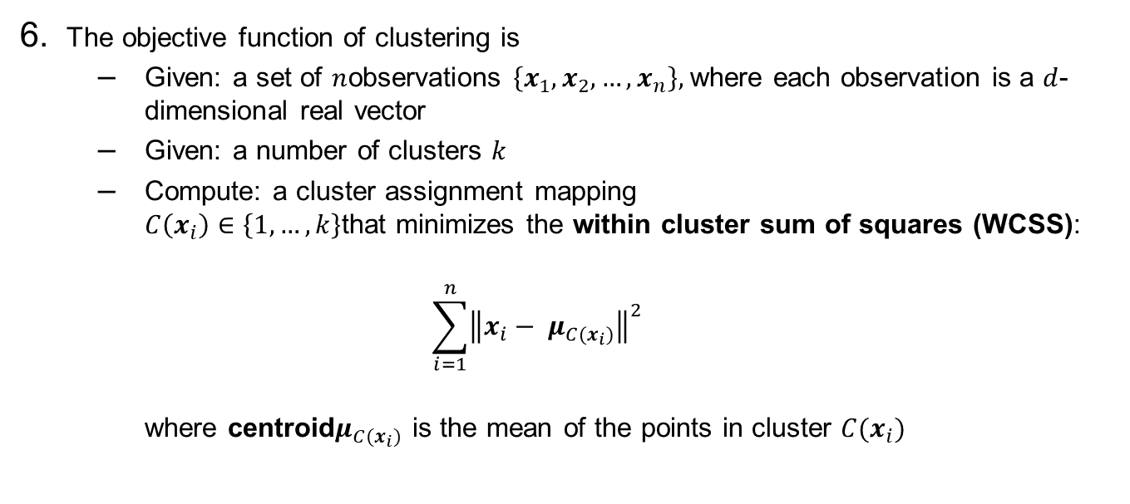
Machine Learning (K-means Clustering)
The objective function of clustering is
Given: a set of $n$observations $\left\{x_{1},x_{2}, …,x_{n}\right\},$where each observation is a $d$-dimensional real vector
Given: a number of clusters $k$
Compute: a cluster assignment mapping $C\left(x_{i}\right)∈\left\{1, …, k\right\}$that minimizes the within cluster sum of squares (WCSS):
$$\sum_{i=1}^{n}{{\left\|x_{i}− μ_{C(x_{i})}\right\|}^{2}}$$
where centroid$μ_{C(x_{i})}$ is the mean of the points in cluster $C(x_{i})$

Slide 46
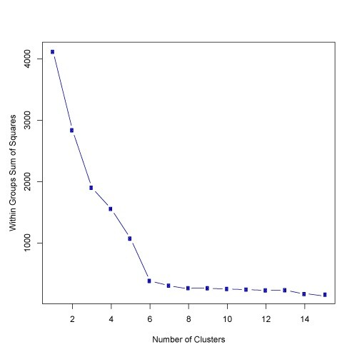

Machine Learning (K-means Clustering)
Without apriori knowledge, one can use elbow method that measures the homogeneity or heterogeneity within clusters as the number of clusters change
(i.e. K is changed). One way to measure is use sum of square errors in each cluster

Slide 47
k-Means Clustering assumes real-valued data distributed in clusters that are:
Separate
Roughly hyper spherical (circular in 2D, spherical in 3D) or easily clustered via a Voronoi partition.
Similar size
Similar density
Even with these assumptions being met, k-Means Clustering is not guaranteed to find the global minimum

Slide 48
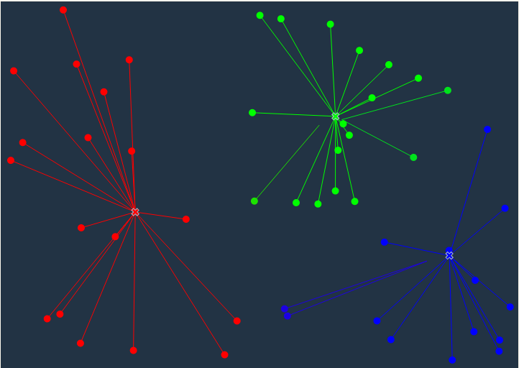
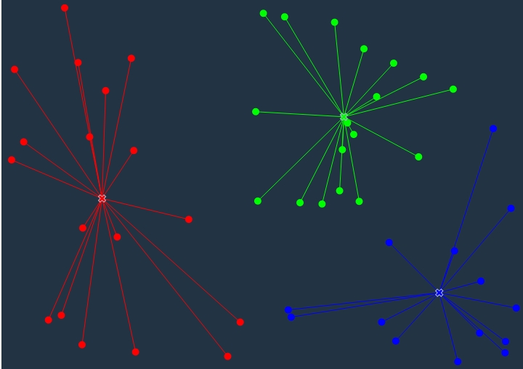
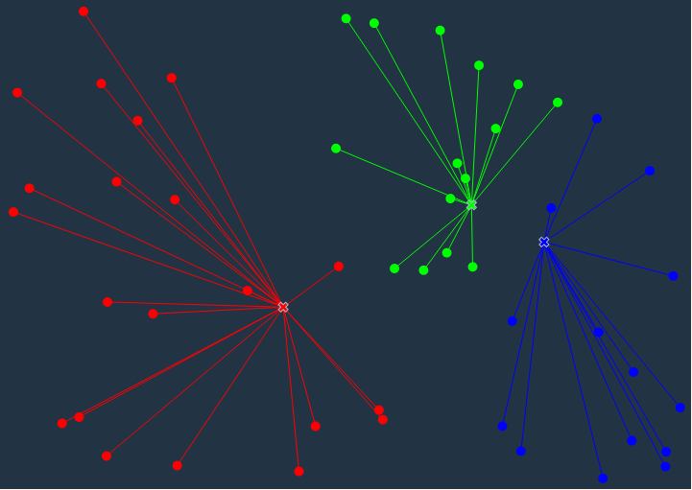
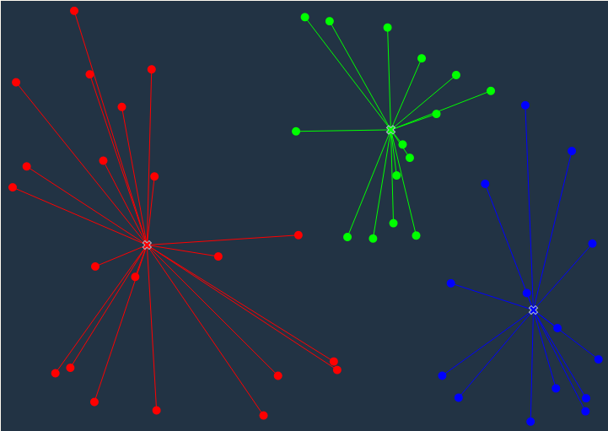
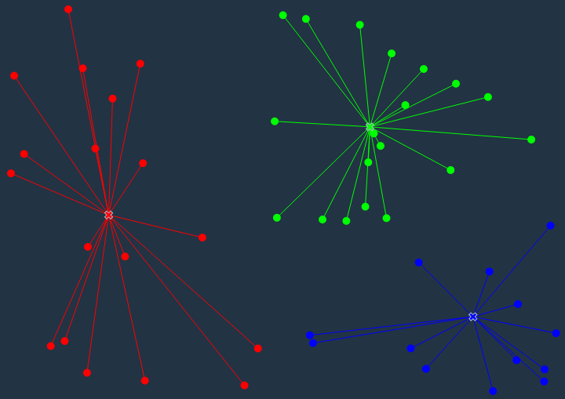
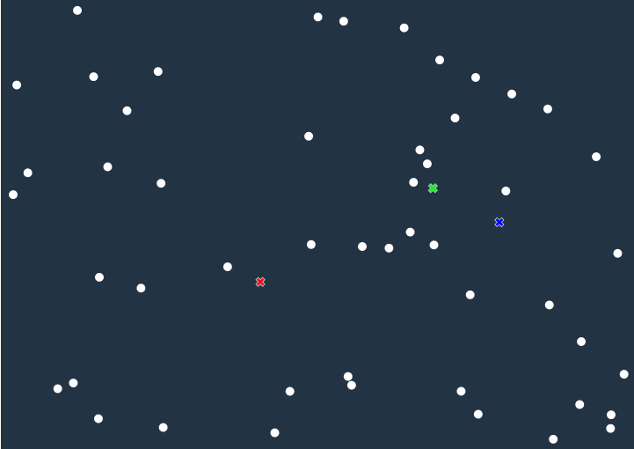
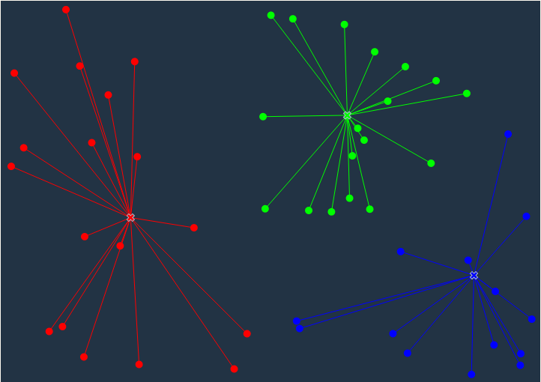
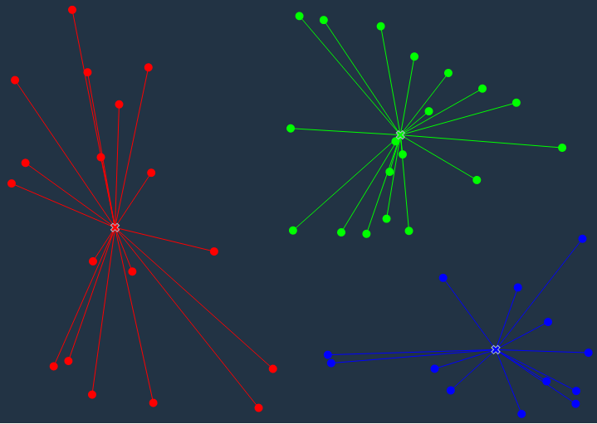
Machine Learning (K-means Clustering)
K-means treats feature values as coordinates in the multi-dimensional feature space
Calculate distance of the points from each of the three selected points. Link to the one closest
In the update phase the average position of each cluster is calculated (based on position of the points in the cluster)
Note : based on the distance of some boundary points from the new centroid, they get reallocated to different cluster
Since K = 3
Select 3 points at random from the data points
Ref: http://tech.nitoyon.com/en/blog/2013/11/07/k-means/

Slide 49
Machine Learning (K-Means Clustering)
Strengths | Weakness
Use simple principles without the need for any complex statistical terms | Computationally intensive How to fix K?
Once clusters and their associated centroids are identified, it is easy to assign new objects (for example, new customers) to a cluster based on the object's distance from the closest centroid | The k-means algorithm is sensitive to the starting positions of the initial centroid. Thus, it is important to rerun the k-means analysis several times for a particular value of k to ensure the cluster results provide the overall minimum WSS
Because the method is unsupervised, using k-means helps to eliminate subjectivity from the analysis. | Assumes linear relation between dependent and independent variables
 | Susceptible to curse of dimensionality

Slide 50
THANK YOU

