Slide 1
UNSUPERVISED LEARNING – DAY02 HIERARCHICAL CLUSTERING

Slide 2
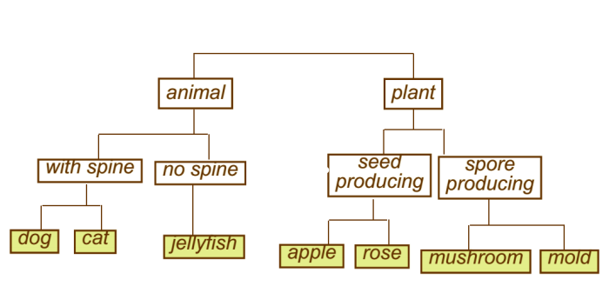
Hierarchical Clustering
Build a tree-based hierarchical taxonomy (Dendogram) from a set of data

Slide 3
Hierarchical Clustering Methods
These methods involve a series of iterations of combining or dividing a group of observations.
Agglomerative or Bottom-up
Divisive or Top-down

Slide 4
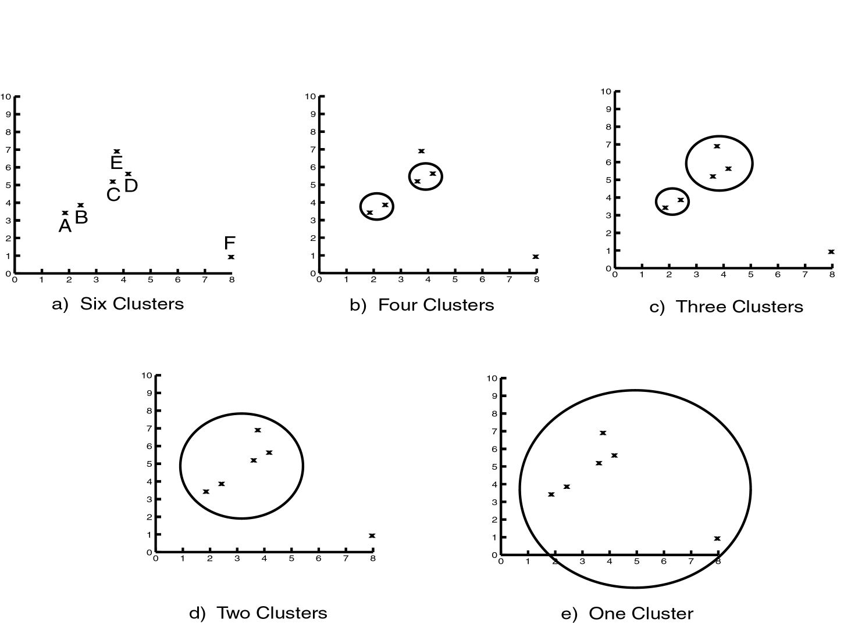
Levels of Clustering

Slide 5
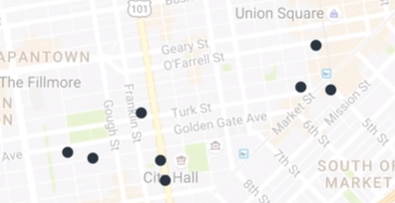
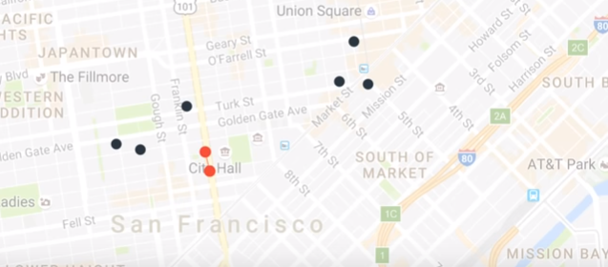
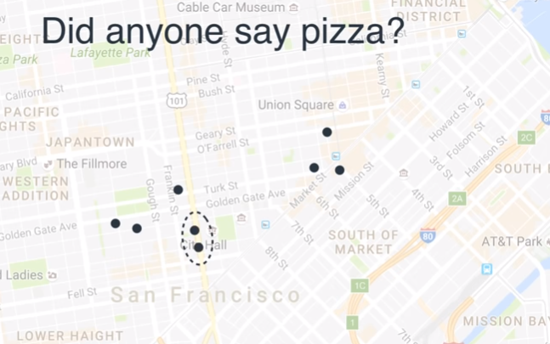
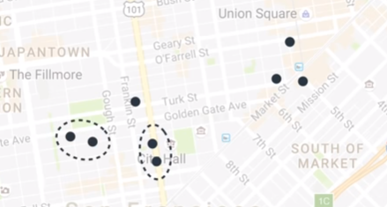
Hierarchical Clustering steps
1
2
3
4

Slide 6
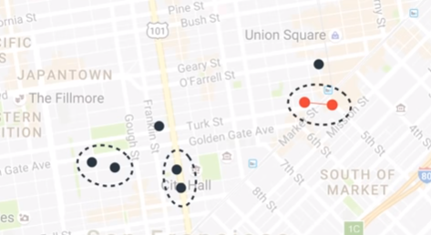
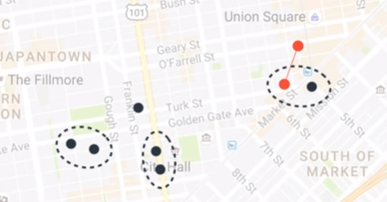
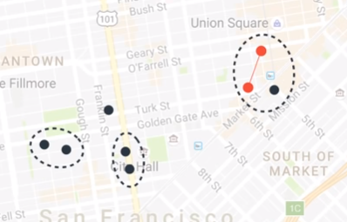
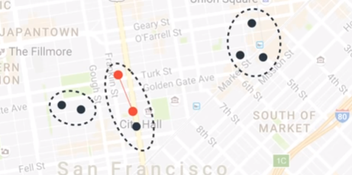
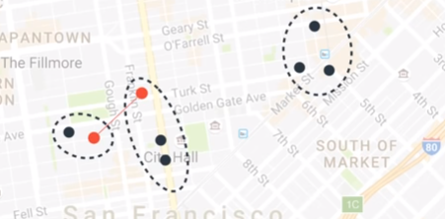
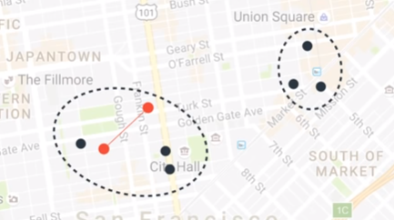
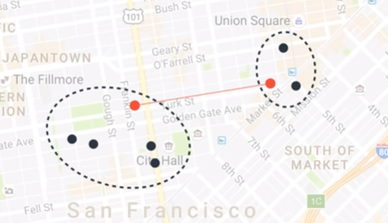
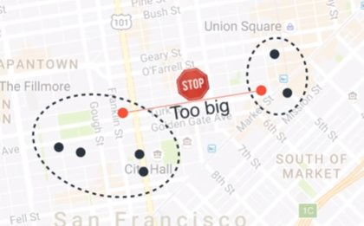
Hierarchical Clustering steps
5
6
7
8
9
10
11
12
Cluster is 2

Slide 7
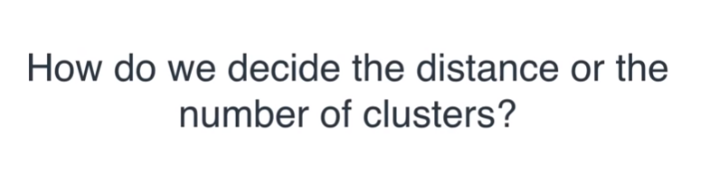

Slide 8
Using Dendogram

Slide 9
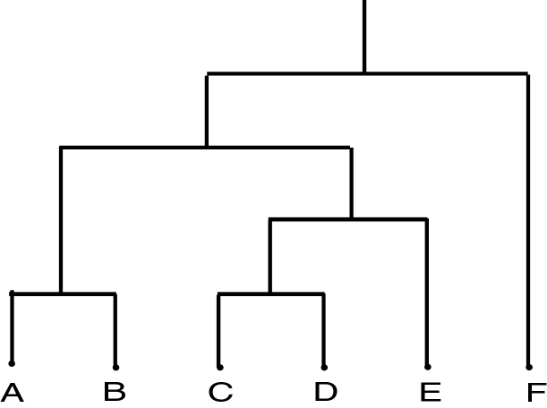
Dendrogram
Dendrogram:
a tree data structure which illustrates hierarchical clustering techniques.
Each level shows clusters for that level.
Leaf – individual clusters
Root – one cluster
A cluster at level i is the union of its children clusters at level i+1.

Slide 10
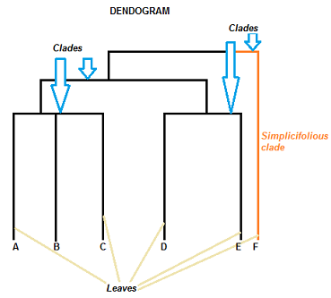
Parts of Dendogram
The clade is the branch. Usually labeled with Greek letters from left to right (e.g. α β, δ…).
Each clade has one or more leaves. The leaves in the above image are:
Single (simplicifolius): F
Double (bifolius): D E
Triple (trifolious): A B C

Slide 11
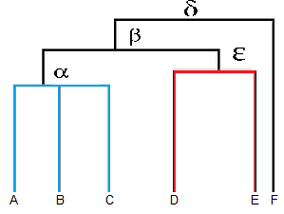
How to read a Dendogram
Clades are the branches and it can have one more leaves attached to it
Leaves A, B, and C are more similar to each other than they are to leaves D, E, or F.
Leaves D and E are more similar to each other than they are to leaves A, B, C, or F.
Leaf F is substantially different from all of the other leaves.
Note that on the above graph, the same clave, β joins leaves A, B, C, D,and E. That means that the two groups (A,B,C & D,E) are more similar to each other than they are to F.

Slide 12
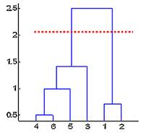
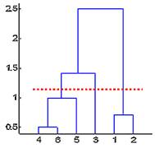
Dendogram Inference
Cutting distance is 2
We obtained 2 clusters out of 6 objects
First cluster has 4 objects (4,6,5,3) and
Second cluster has 2 objects(1,2)
Cutting distance is 1.25
We obtained 3 clusters out of 6 objects
Cluster 1 (1,2)
Cluster 2 ( 4,6,5)
Cluster 3 (3)

Slide 13
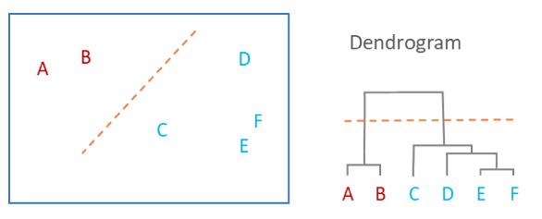
Dendogram Cont..
dendrogram is a summary of the distance matrix
Observations are allocated to clusters by drawing a horizontal line through the dendrogram
we have two clusters, one that combines A and B, and a second combining C, D, E, and F.

Slide 14
How to transform a data point into Dendogram

Slide 15
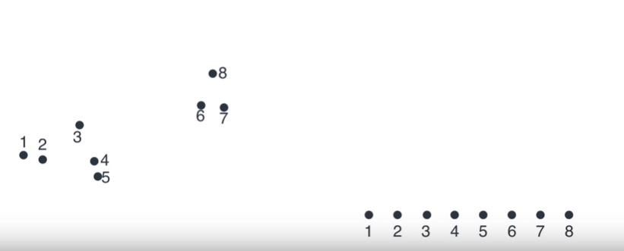
Dendogram

Slide 16
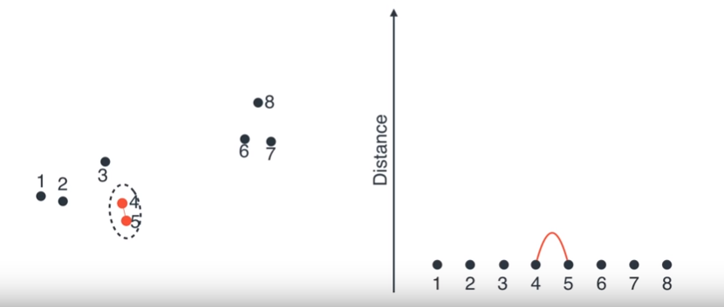
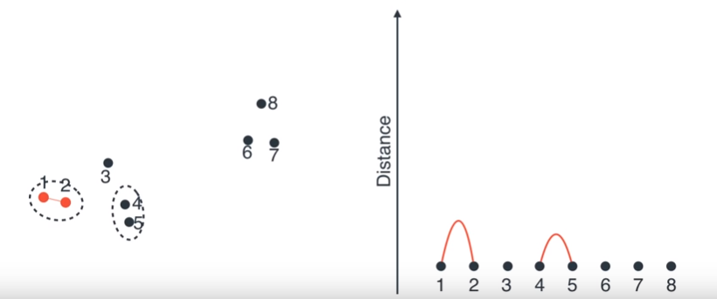
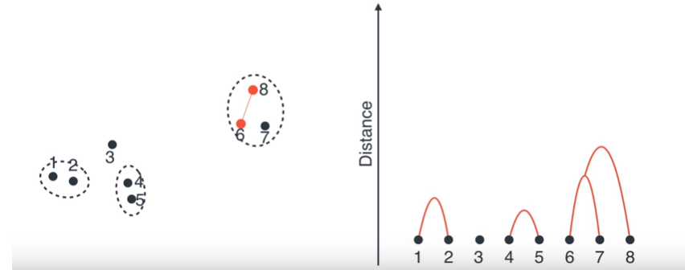
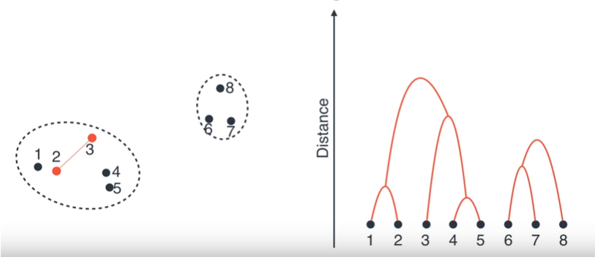

Slide 17
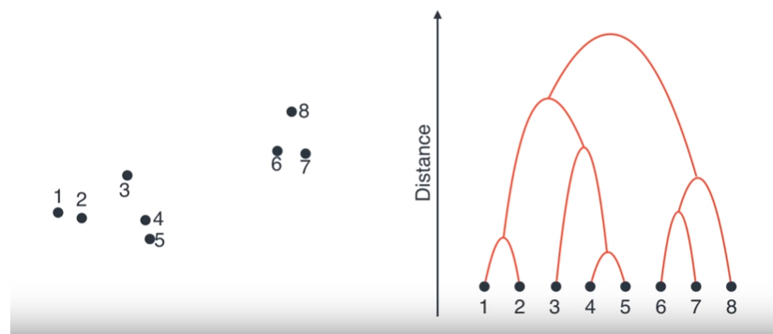
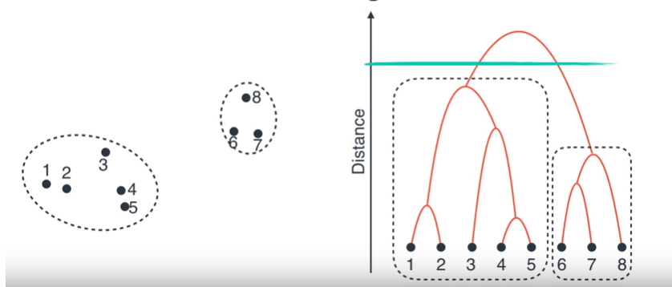
Where do we make a cut ?
# 2 clusters
Cluster 1 : 1,2,3,4,5
Cluster 2 : 6,7,8
Cluster is decided as 2, based on the distance between the clusters

Slide 18
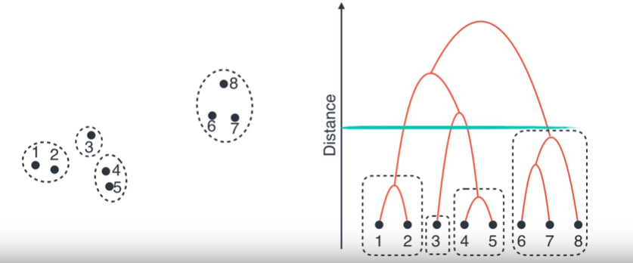
Cluster – 4
Cluster 1 – 1,2
Cluster 2 – 3
Cluster 3 – 4,5
Cluster 4 – 6,7,8

Slide 19
How Hierarchical Clustering works

Slide 20
How to measure the distance between Clusters

Slide 21
Input/ Initial setting
Start with clusters of individual points and a distance/proximity matrix
p1
p2
p3
p4
p5
. . .
p1
p2
p3
p4
p5
.
.
.
Distance/Proximity Matrix

Slide 22
Intermediate State
After some merging steps, we have some clusters
C1
C2
C3
C4
C5
C1
C2
C3
C3
C4
C4
C5
C1
Distance/Proximity Matrix
C2
C5

Slide 23
Intermediate State
Merge the two closest clusters (C2 and C5) and update the distance matrix.
C1
C2
C3
C4
C5
C1
C3
C2
C4
C3
C4
C5
C1
Distance/Proximity Matrix
C2
C5

Slide 24
After Merging
“How do we update the distance matrix?”
C2 U C5
C1
C3
C4
C3
C1
?
C4
C2 U C5
? ? ? ?
C3
?
C1
C4
?
C2 U C5

Slide 25
Distance between 2 clusters
Each cluster is a set of points
Distance between the clusters should be measured using Linkage Methods

Slide 26
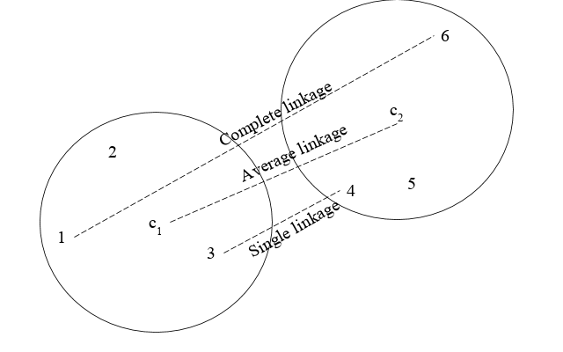
Linkage Methods

Slide 27
Single Linkage
Single-link distance between clusters C_{i} and C_{j} is the minimum distance between any object in C_{i} and any object in C_{j}
The distance is defined by the two most similar objects

Slide 28
Single-link clustering: example
5
1
3
5
2
1
2
3
6
4
4
Nested Clusters
Dendrogram

Slide 29
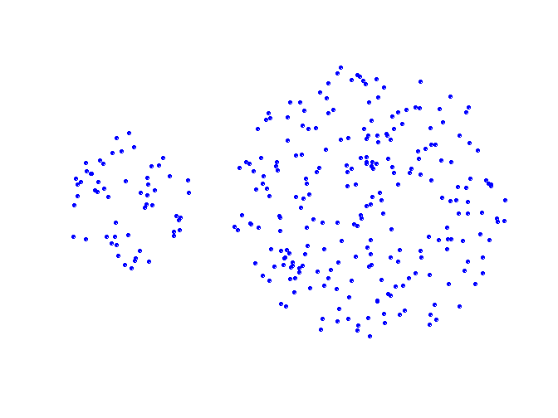
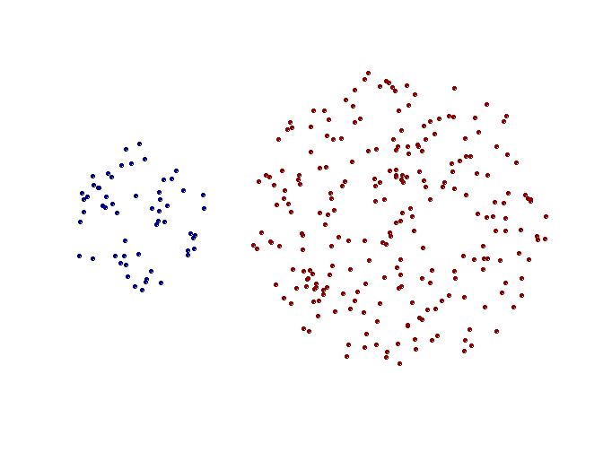
Strengths of single-link clustering
Original Points
Two Clusters
Can handle non-elliptical shapes

Slide 30
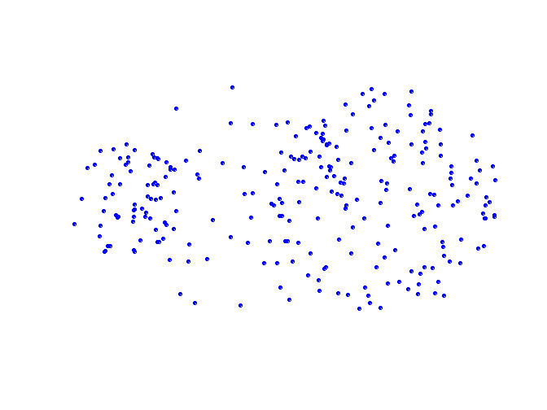
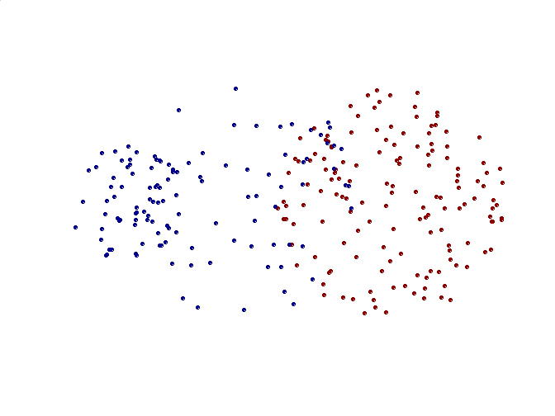
Limitations of single-link clustering
Original Points
Two Clusters
Sensitive to noise and outliers
It produces long, elongated clusters

Slide 31
Complete Link distance
Complete-link distance between clusters C_{i} and C_{j} is the maximum distance between any object in C_{i} and any object in C_{j}
The distance is defined by the two most dissimilar objects

Slide 32
Complete-link clustering: example
4
1
2
5
5
2
3
6
3
1
4
Nested Clusters
Dendrogram

Slide 33
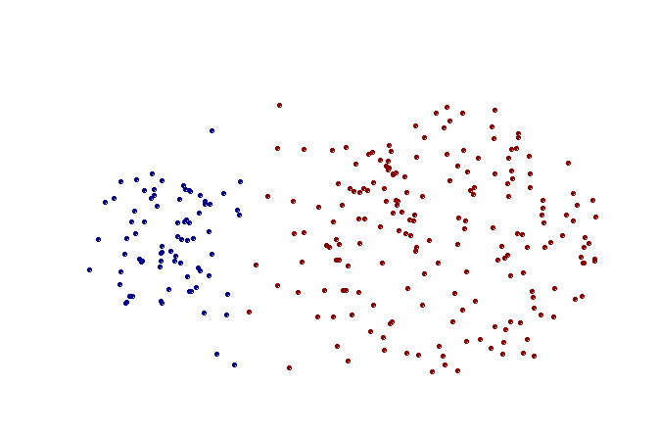
Strengths of complete-link clustering
Original Points
Two Clusters
More balanced clusters (with equal diameter)
Less susceptible to noise

Slide 34
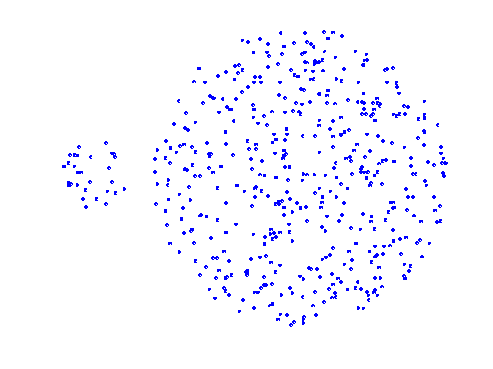
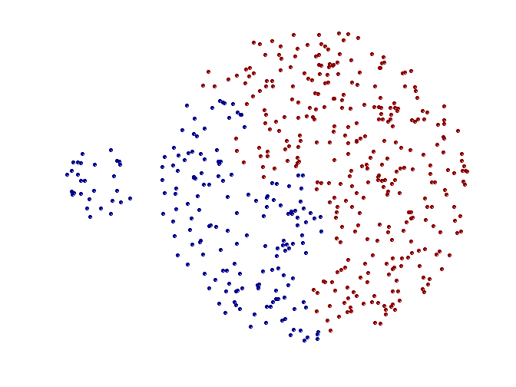
Limitations of complete-link clustering
Original Points
Two Clusters
Tends to break large clusters
All clusters tend to have the same diameter – small clusters are merged with larger ones

Slide 35
Average Distance
Group average distance between clusters C_{i} and C_{j} is the average distance between any object in C_{i} and any object in C_{j}

Slide 36
Average-link clustering: example
5
4
1
2
5
2
3
6
1
4
3
Nested Clusters
Dendrogram

Slide 37
Centroid Distance
Centroid distance between clusters C_{i} and C_{j} is the distance between the centroid r_{i} of C_{i} and the centroid r_{j} of C_{j}

Slide 38
Wards Distance
Ward's method is a criterion applied in hierarchical cluster analysis
Ward’s method (a.k.a. Minimum variance method or Ward’s Minimum Variance Clustering Method)
General agglomerative hierarchical clustering procedure, where the criterion for choosing the pair of clusters to merge at each step is based on the optimal value of an objective function
Ward used the example where the objective function is the error of sum of squares, and this example is known as Ward's method or more precisely Ward's minimum variance method.

Slide 39
Agglomerative Clustering

Slide 40
Agglomerative Clustering
Agglomerative methods - is a type of Hierarchical clustering algorithms
It is a bottom-up cluster hierarchy generation by fusing objects into groups and groups into higher clusters.
Its starts from single data point and clusters keep adding until it become one complete cluster

Slide 41
Agglomerative Clustering
Map all variables as numerical measures.
Create n x n matrix of pair-wise distances between data points
Scan the matrix C for nearest pair of objects and merge them.
Delete rows and columns of merged data point. Add a row and column for merged cluster. Re-compute pair-wise distances.
Keep a count of total number of clusters. If This number equals k stop else go to step 3
No. of required clusters k
No. of observations n

Slide 42
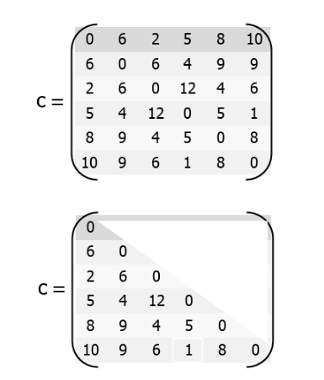
Agglomerative Clustering Example
Clustering starts by computing a distance between every pair of units that you want to cluster.
A distance matrix will be symmetric and will have zeroes on the diagonal

Slide 43
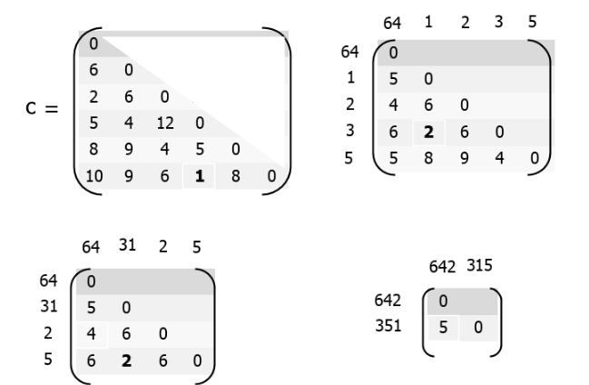
Agglomerative Clustering Example

Slide 44
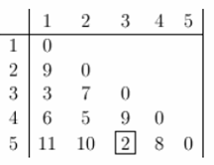
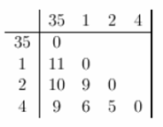
Example
The smallest distance is between three and five and they get linked up or merged first into a the cluster '35'.
new distance matrix, we need to remove the 3 and 5 entries, and replace it by an entry "35" . Since we are using complete linkage clustering, the distance between "35" and every other item is the maximum of the distance between this item and 3 and this item and 5. For example, d(1,3)= 3 and d(1,5)=11. So, D(1,"35")=11. This gives us the new distance matrix.

Slide 45
Example
The smallest distance is between three and five and they get linked up or merged first into a the cluster '35'.
new distance matrix, we need to remove the 3 and 5 entries, and replace it by an entry "35" . Since we are using complete linkage clustering, the distance between "35" and every other item is the maximum of the distance between this item and 3 and this item and 5. For example, d(1,3)= 3 and d(1,5)=11. So, D(1,"35")=11. This gives us the new distance matrix.

Slide 46
Agglomerative clustering algorithm
Most popular hierarchical clustering technique
Basic algorithm
Compute the distance matrix between the input data points
Let each data point be a cluster
Repeat
Merge the two closest clusters
Update the distance matrix
Until only a single cluster remains
Key operation is the computation of the distance between two clusters

Slide 47
Pros and cons of Hierarchical clustering
PROS:-
Dendogram are good for visualization
Provides Hierarchical relations between clusters
Does not require pre-defined no of clusters
Accept any valid measure of distance
Generates Smaller clusters which maybe helpful for discovery
CONS:-
Not easy to define level of clusters
Different Dendogram for different linkage methods

Slide 48
Thank you

