Slide 1




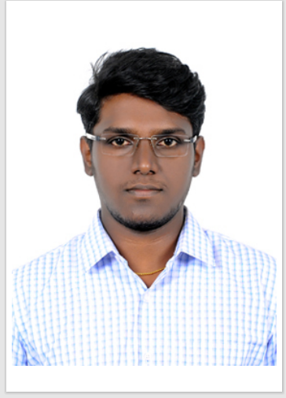
Ashwin
6379508752
ashwin.a.c@capgemini.com
Profile
Overall 5+ Yrs. of Experience in Data science, Generative AI, LLM’s, Prompt Engineering, Parameter tuning. Expertise in Azure and Google Cloud Technologies Google certified - Professional Machine learning Engineering (GCP-PMLE).
Qualification | Branch | Institute
Bachelor of Engineering | Computer Science | Institute of Road and Transport Technology
PostGraduate | Data Science & Eng | Great Lakes Institute of Management and Technology
Skills
Achievements | • Achieved Delivery excellence for extensive contribution in project delivery – Capgemini
Python, Gen AI, Deep Learning, NLP, Cloud
Google Cloud Platform Microsoft Azure
Others
SQL, Data Visualization, Data Analysis , Flask, Streamlit
Professional Experience
Project Name | Project Contribution | Technologies used
Gen AI -Document Translator | • Developed a python web application to translate documents using Azure Open AI and deployed in Azure we app. • Provided an interactive UI where user can be able to translate and download the document | Python, Streamlit Azure Open AI, Microsoft Azure
Gen AI – NPS sentiment Analysis | Worked on POC ,for building generating sentimental analysis using Google Gen AI. Expertise in building model using Vertex AI and loading data in BigQuery and visualizing in Looker Studio | Python, Google Cloud, Vertex AI, BigQuery, Looker
Courses and Certifications
Course | Platform
Certified –Google Cloud Professional Machine Learning Engineer - PMLE | Google
Generative AI and Fundamentals | Google

