Slide 1

Fluke UBI Chatbot
Chaitanya Sunil Kulkarni (Chai)

Slide 2
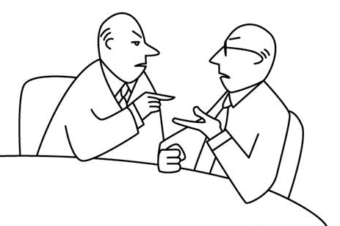
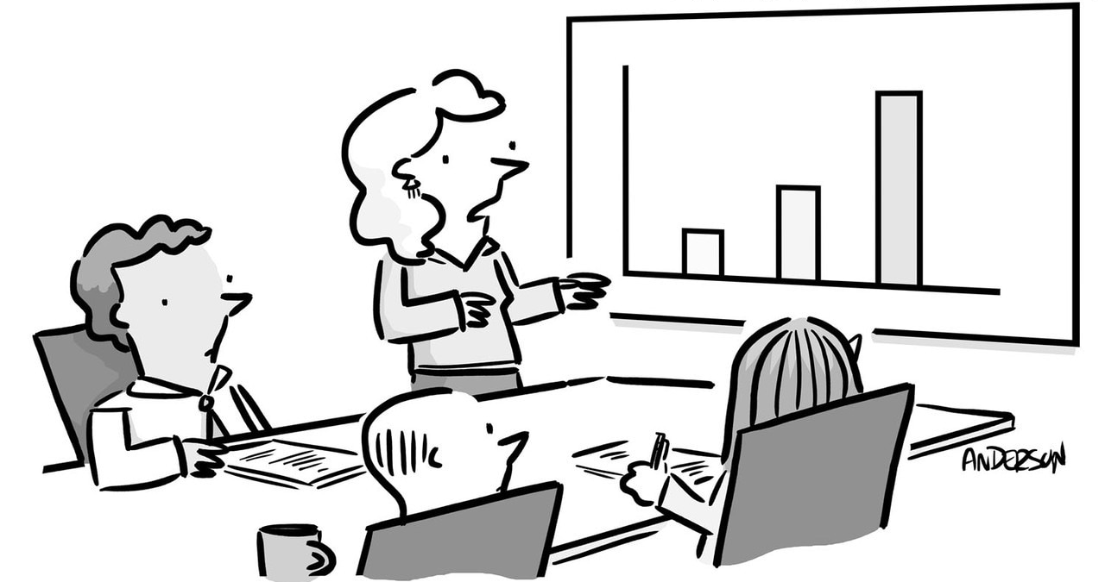
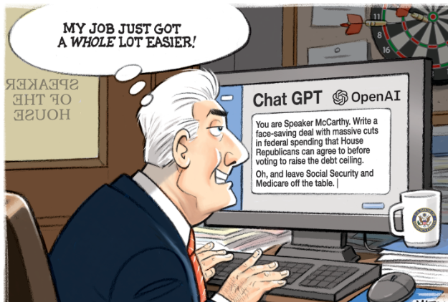
Problem Statement
We have new system but how do we navigate it ?
Great information, but can it chat?
What is UBI?
Our Approach to the Problem
With an abundance of data in the UBI SharePoint website, navigating and locating specific information had become increasingly cumbersome and time-consuming. With multiple files, folders and pages the website was full of useful data being uploaded by people from multiple disciplines
UBI stands for Unified Business Intelligence and is an internal fluke project. UBI is Unified, Governed and Integrated modern data analytics and reporting platform which Unlocks data across organizational, regional, and project driven silos.
We built an Open AI’s GPT powered Chatbot capable of answering any question related to UBI project that is present in the UBI SharePoint website . This Chatbot was built in Microsoft Azure and was also connected to Purview studio to answer questions based on different datasets.

Slide 3
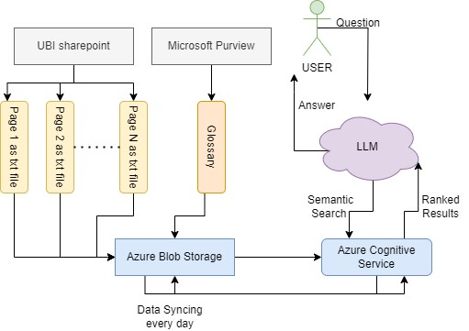
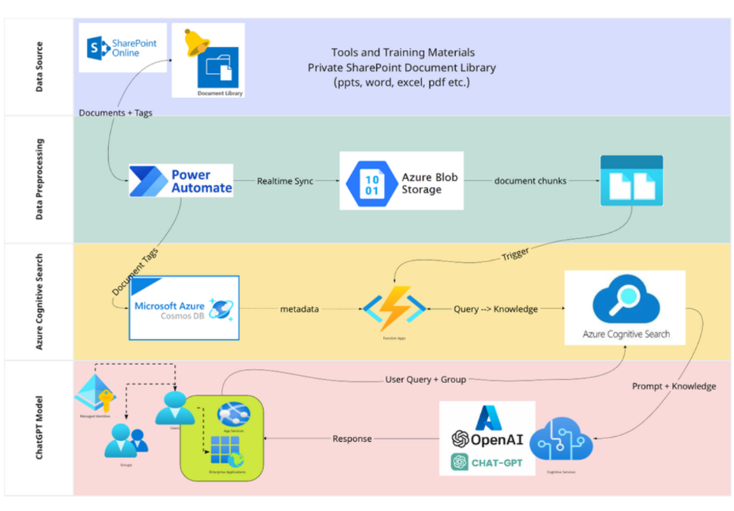
Architecture
Our Architecture
Delphi Architecture

Slide 4





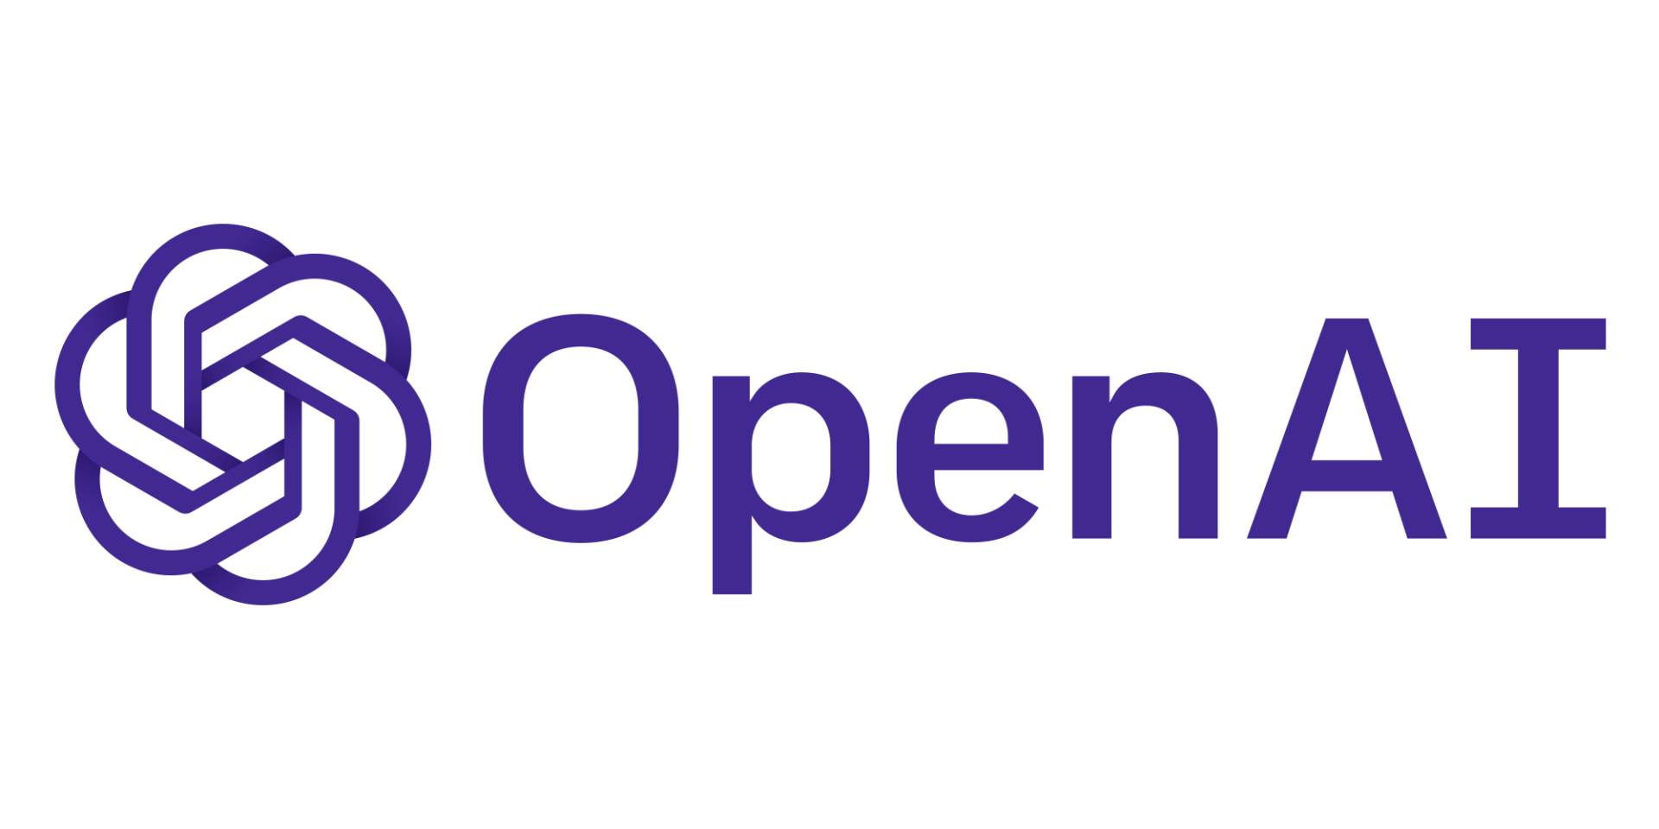
Tech Stack
In my project, I used GPT 3.5 turbo model which powers ChatGPT. It is a Large Language Model which is trained on huge corpus of data.
Azure Cognitive search service is capable of surfing through documents and other contents and generate ranked result. Azure Cognitive Search indexes the documents when a connection is established, and an index search is performed whenever any client requests for a query
Microsoft Purview is a family of data governance, risk, and compliance solutions that can help your organization govern, protect, and manage your entire data estate.

Slide 5
LIVE DEMO

Slide 6

Key Features
User friendly chatbot powered by GPT 3.5 turbo
Chatbot capable of answering any questions related to the project
Chatbot also understands purview glossaries
Model can be accessed using API
Capable of handling simultaneous requests from multiple users

Slide 7
Future Scope
This project can be extended to a full-scale virtual assistant.
Open AI’s models can be used to process images, audio and video to generate responses
Power of Machine Translation can be enabled with which User can chat in any language

Slide 8
References
Fluke Unified Business Intelligence - Home (sharepoint.com)
What is Azure—Microsoft Cloud Services | Microsoft Azure
Introduction to Azure Cognitive Search - Azure Cognitive Search | Microsoft Learn
Azure OpenAI Service – Advanced Language Models | Microsoft Azure

Slide 9
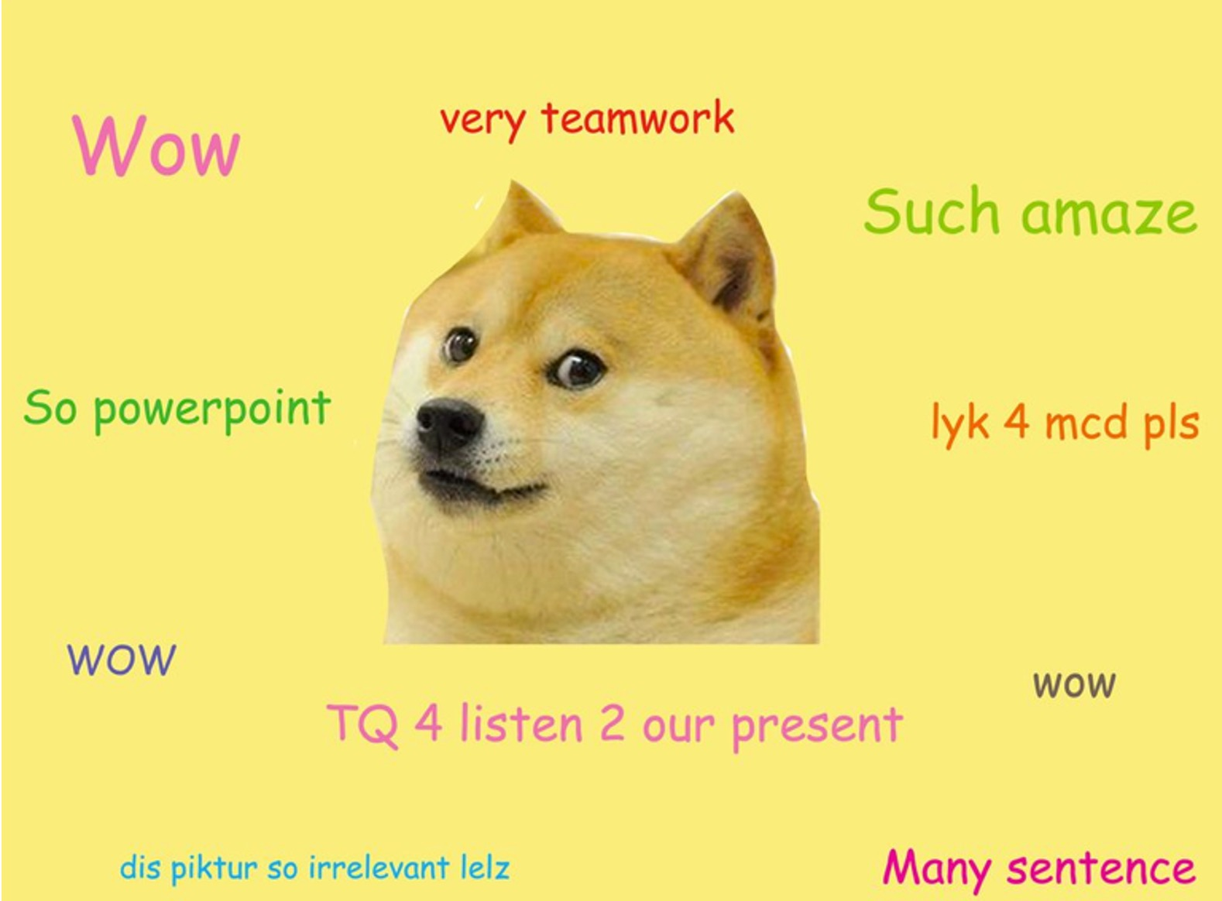
Thank you! Questions?

