Slide 1
Task manager App
Presented By:
Abiral Khadka(750303)
Ashwin Dhougoda(750308)

Slide 2
Introduction
Task Manager App is .NET MVC Project
It is used to create and display task
It contains two table; tasks and Users

Slide 3
TOOLS USED
ASP.Net Web Application (.NET Framework)
Entity Framework for ORM
SQL Server Management System(SSMS)
Bootstrap

Slide 4
Approach
Code First Approach of Entity Framework

Slide 5
Scaffolding Template
MVC 5 Controller with Views, Using Entity Framework

Slide 6
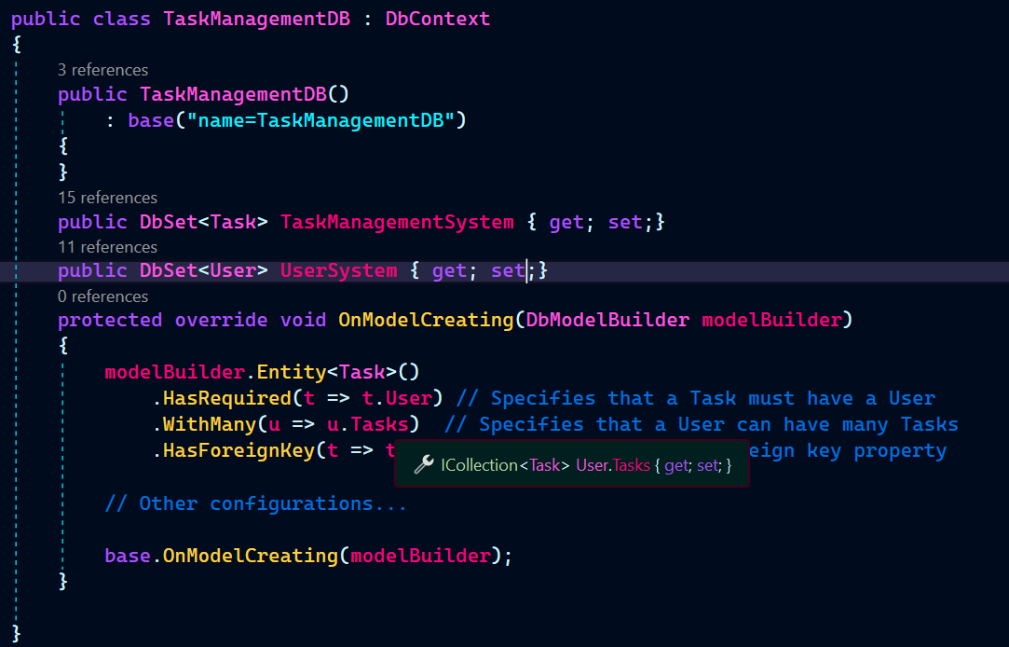
Database Connection
To establish database connection:
TaskManagementDB class was derived from DbContext Class defined in System.Data.Entity

Slide 7
Database Connection
Then connection string was placed in Web.Config file
<connectionStrings>
<add name="TaskManagementDB" connectionString="server=.\SQLEXPRESS;database=TaskManagementSystem;uid=sa;password=sa1234;" providerName="System.Data.SqlClient" />
</connectionStrings>

Slide 8
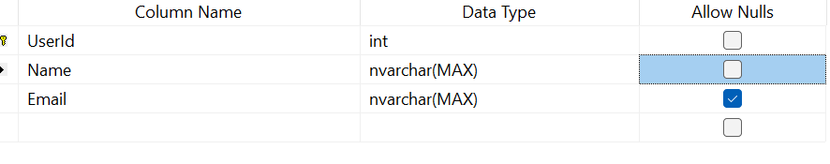
USER Table Structure

Slide 9
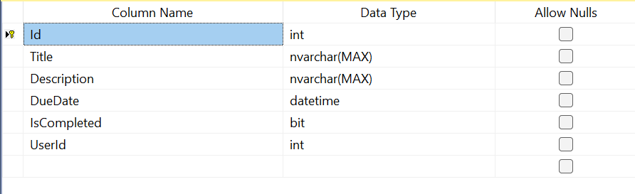
Task Table Structure

Slide 10
THANK YOU

