Slide 1

Task Manager App
Prepared By:
Abiral Khadka(750303)
Ashwin Dhougoda(750308)
AAsihsidh

Slide 2
Objective
To develop student management system web application using dot net MVC.

Slide 3
Approach
A database named “lindaa” was designed.

Slide 4
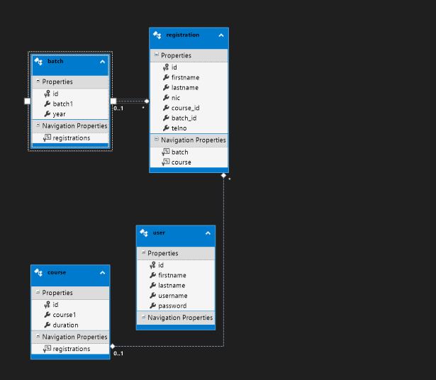
Entity framework

Slide 5
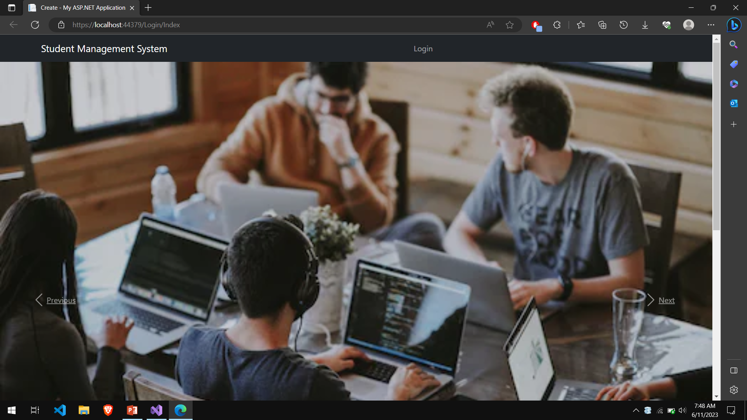
User Interface

Slide 6
User Interface
It contains a webpage with login navbar.

Slide 7
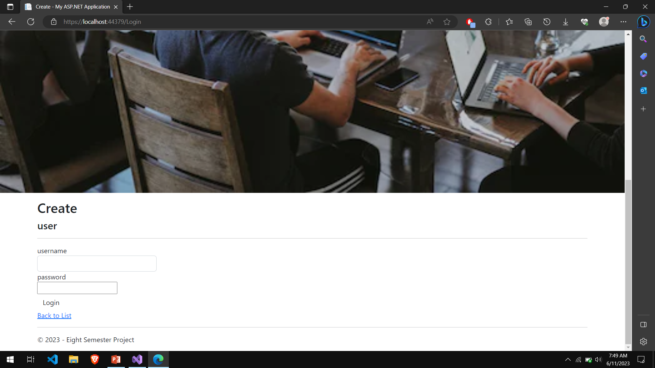
Login Page
.

Slide 8
Login Overview
This page allow you to enter username and password
There are two types of user admin and students.

Slide 9
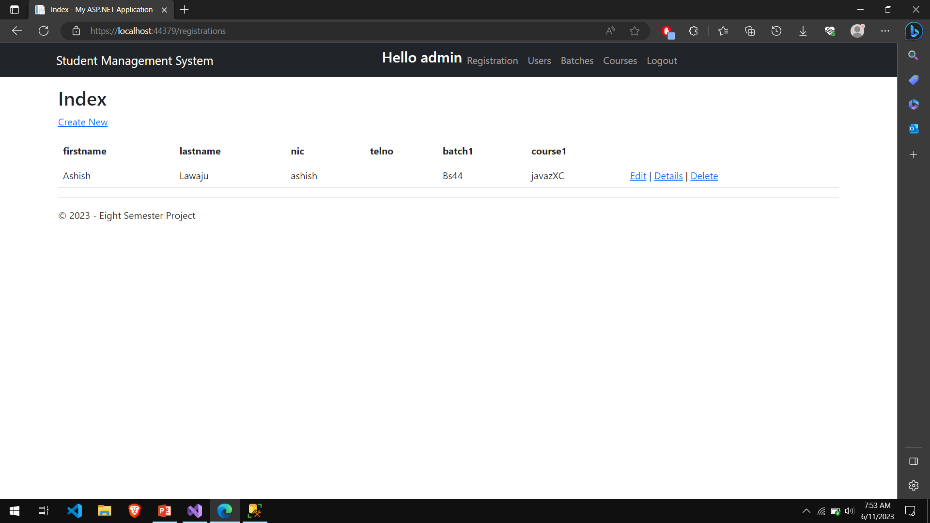
CRUD operation

Slide 10
Create
Any logged in user can create a blog as shown in the picture above.

Slide 11
Conclusion
A fully functional Student Management website was designed using MVC in the .NET framework.
CRUD operations were successfully implemented.

Slide 12
Thank you!!!

