Slide 1

CS 207: Applied Database Practicum
Week 3
Varun Dutt
School of Computing and Electrical Engineering
School of Humanities and Social Sciences
Indian Institute of Technology Mandi, India
Scaling the Heights

Slide 2
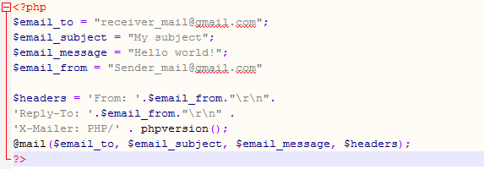
Assignment 2 code Snippet

Slide 3
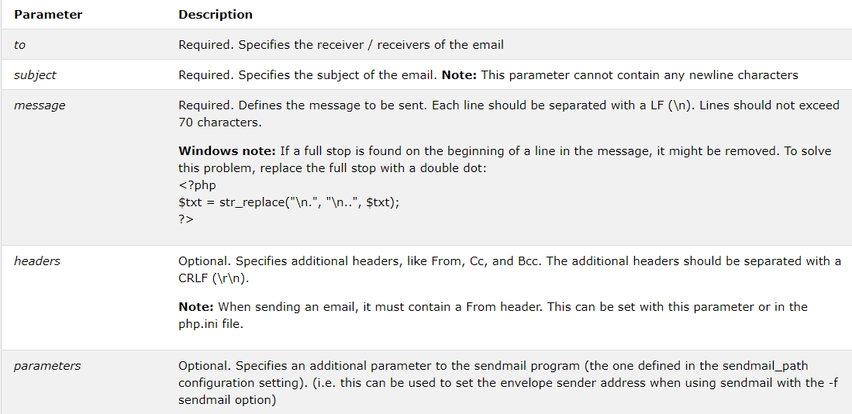
Parameters for the mail()

Slide 4
DATABASE
A database is a kind of repository that stores a collection of data
Each of the database has one or more distinct APIs for creating, accessing, managing, searching and replicating the data it holds
Database are managed by Relational Database Management system(RDBMS)

Slide 5
RDBMS
RDBMS stands for Relational Database Management System
It is a software used to store and manage huge amount of data
It stores data in separate tables rather than putting all data in one big storeroom
It is termed as relational database because all the data is stored into different tables and relations are established using Primary keys or other keys known as Foreign Keys

Slide 6
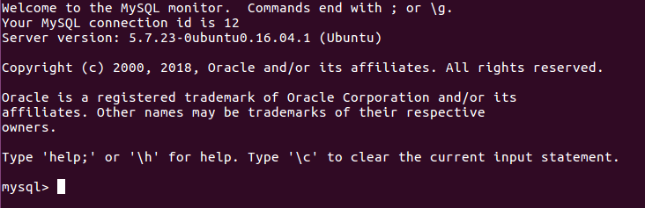
MYSQL
MYSQL is a Relational Database Management System
MySQL uses a standard form of the well-known SQL data language
SQL lets you access and manipulate databases

Slide 7
Why MYSQL is so popular?
MySQL is released under an open-source license. So you have nothing to pay to use it
MySQL works very quickly and works well even with large data sets
MySQL works on many operating systems and with many languages including PHP, PERL, C, C++, JAVA, etc
MySQL is very friendly to PHP, the most appreciated language for web development
It provides a powerful mechanism for ensuring access to only authorized users hence providing data protection

Slide 8
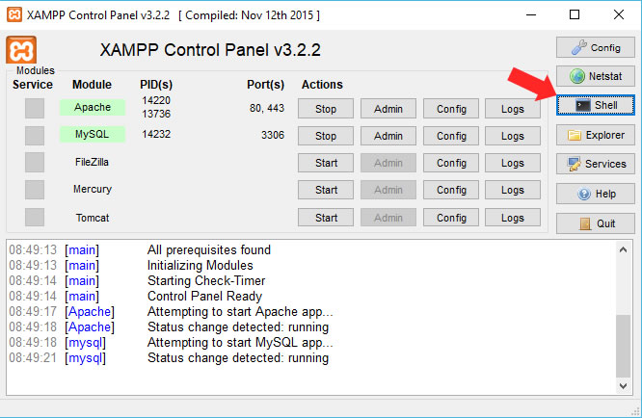
Running Mysql in XAMPP
1. Start the Mysql in the XAMPP
Control Panel
Click on the shell icon as
shown in the image and type
mysql -h localhost -u root
2. If not using the Shell:
For Linux users:
sudo /opt/lampp/lampp startmysql
/opt/lampp/bin/mysql -uroot –p
For Windows users:
cd c:\xampp\mysql\bin
mysql.exe -u root --password

Slide 9
Install and run Mysql
Run Mysql → mysql -u root -p
Install mysql :
Commands used (Linux) -
    sudo apt update
      sudo apt install mysql-server
      sudo mysql_install_db
      sudo /usr/bin/mysql_secure_installation
      (You'll be prompted to create a root password during the installation. Choose a secure one and make sure you remember it, because you'll need it later.)
      For reference - https://www.linode.com/docs/databases/mysql/install-mysql-on-ubuntu-14-04/

Slide 10
Common Terminologies
Database: Database is a systematic collection of data. Databases support storage and manipulation of data. Databases contain tables
Table : The part of a database that stores the data. A table has columns or attributes, and the data stored in rows
Attributes : The columns in a table. All rows in table entities have the same attributes. Each attribute has a data type such as string, integer, or date
Rows : The data entries in a table. Rows contain values for each attribute. Rows are also knows as records or tuples

Slide 11
Database creation in mysql
The CREATE DATABASE statement is used to create a new SQL database.
Syntax:
CREATE DATABASE <databasename>
Eg:
    CREATE DATABASE PROJECT;
It will create a database called ‘PROJECT’.
Once a database is created, you can check it in the list of databases with the following SQL command:
E.g.
        SHOW DATABASES;

Slide 12
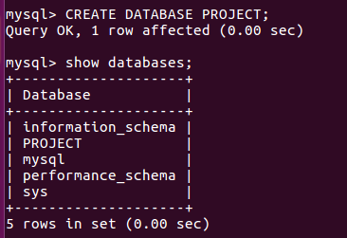
Database creation example

Slide 13
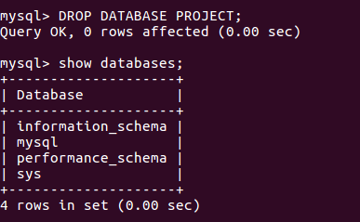
Dropping a Database in mysql
The DROP DATABASE statement is used to drop an existing SQL database
Syntax:
DROP DATABASE <databasename>;
  Eg:
        DROP DATABASE PROJECT;
        It will drop the database named as ‘PROJECT’

Slide 14
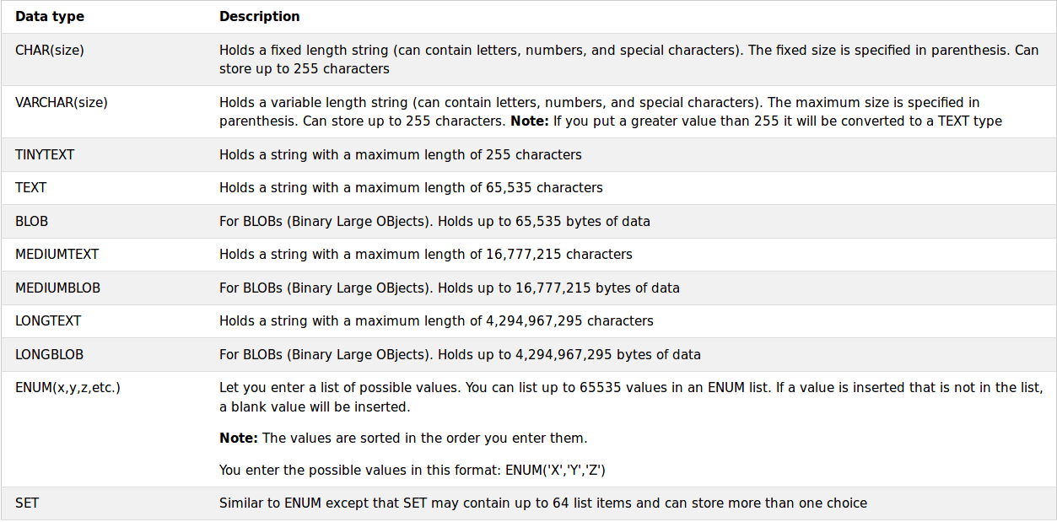
Mysql Datatypes

Slide 15
Table creation in Mysql
The CREATE TABLE statement is used to create a new table in a database
Syntax:
CREATE TABLE table_name (
column1 datatype,
column2 datatype,
… );
Eg:CREATE TABLE Persons (
PersonID int,
LastName varchar(255),
FirstName varchar(255),
Address varchar(255),
City varchar(255)
);

Slide 16
Table creation
The PersonID column is of type int and will hold an integer.
The LastName, FirstName, Address, and City columns are of type varchar and will hold characters, and the maximum length for these fields is 255 characters.

Slide 17
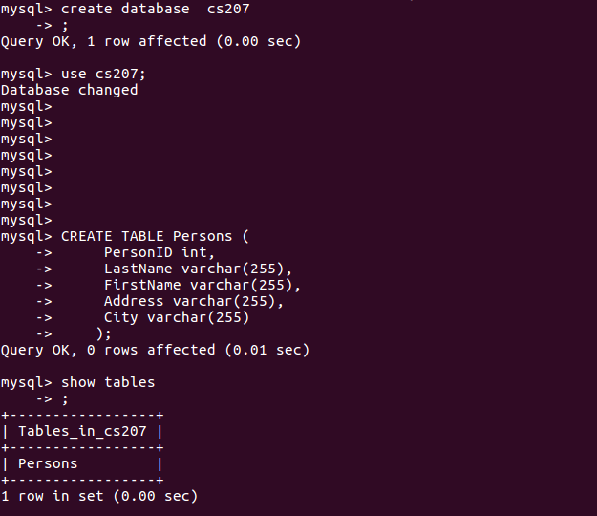
Table creation example

Slide 18
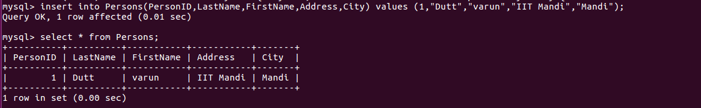
Table insertion
To insert into a new table you have to use INSERT INTO Statement
  Syntax :
    INSERT INTO table_name (column1, column2, column3, ...)
    VALUES (value1, value2, value3, ...);
    E.g.:

Slide 19
SELECT statement
SELECT is used to select data from a database. The data returned is stored in a result table, called the result-set.
Syntax:
SELECT column1, column2, ...
FROM table_name;
Eg:
SELECT * FROM table_name;

Slide 20
Creating Table Using Another Table
A copy of an existing table can be created using a combination of the CREATE TABLE statement and the SELECT statement.
The new table gets the same column definitions. All columns or specific columns can be selected.
If you create a new table using an existing table, the new table will be filled with the existing values from the old table.
      Syntax :
        CREATE TABLE new_table_name AS
        SELECT column1, column2,...
        FROM existing_table_name
        WHERE ....;

Slide 21
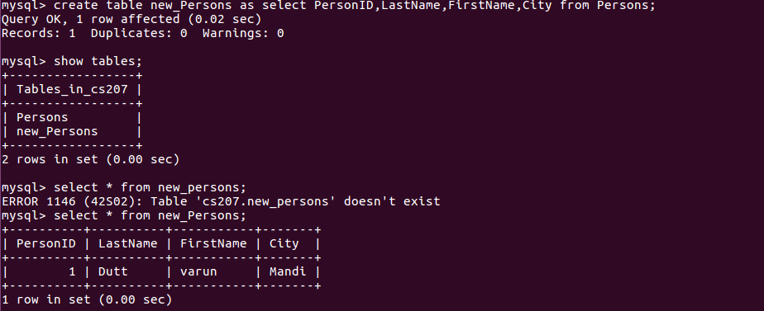
Creating Table Using Another Table example

Slide 22
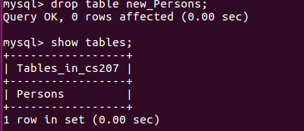
DROP Table
The DROP TABLE statement is used to drop an existing table in a database.
Deleting a table will result in loss of complete information stored in the table
      Syntax :
        DROP TABLE table_name;
        Eg. DROP TABLE Records;

Slide 23
ALTER Table
The ALTER TABLE statement is used to add, delete, or modify columns in an existing table.
The ALTER TABLE statement is also used to add and drop various constraints on an existing table.
To add a column in a table, use the following syntax:
      Syntax :
        ALTER TABLE table_name
        ADD column_name datatype;
To change the data type of a column in a table, use the following syntax:
  Syntax :
    ALTER TABLE table_name
    MODIFY COLUMN column_name datatype;

Slide 24
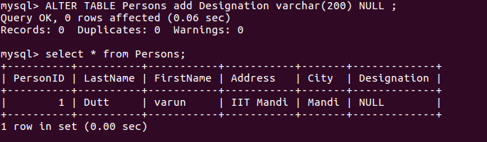
ALTER Table Example

Slide 25
SQL Constraints
SQL constraints are used to specify rules for data in a table.
Constraints can be specified when the table is created with the CREATE TABLE statement, or after the table is created with the ALTER TABLE statement.
  Syntax :
    CREATE TABLE table_name (
    column1 datatype constraint,
    column2 datatype constraint,
    column3 datatype constraint,
    ....
    );

Slide 26
Some common Constraints
The following constraints are commonly used in SQL:
NOT NULL - Ensures that a column cannot have a NULL value.
UNIQUE - Ensures that all values in a column are different.
PRIMARY KEY - A combination of a NOT NULL and UNIQUE. Uniquely identifies each row in a table.
FOREIGN KEY - Uniquely identifies a row/record in another table.
CHECK - Ensures that all values in a column satisfies a specific condition.
DEFAULT - Sets a default value for a column when no value is specified.

Slide 27
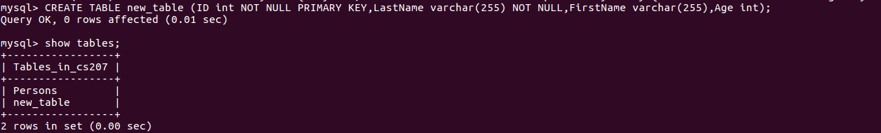
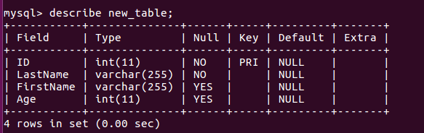
SQL Constraints

Slide 28
WHERE clause
WHERE is used to filter records.It is used to extract only those records that fulfill a specified condition.
Syntax:
SELECT column1, column2, ...
FROM table_name
WHERE condition;
Eg:
SELECT * FROM Customers WHERE Country='Mexico';

Slide 29
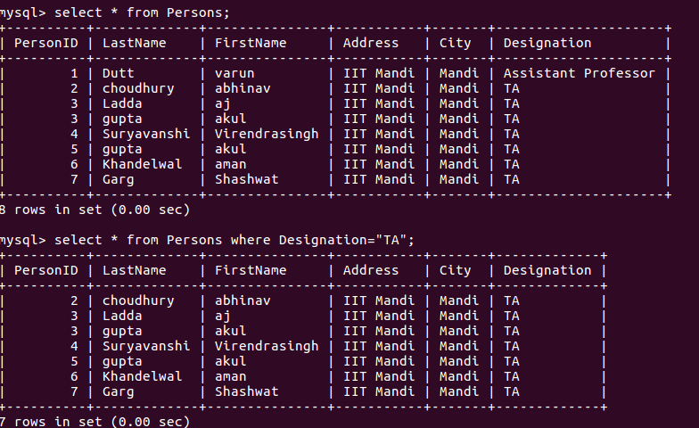
WHERE clause Example

Slide 30
UPDATE statement
The UPDATE statement is used to modify the existing records in a table.
Syntax:
UPDATE table_name
SET column1 = value1, column2 = value2, ...
WHERE condition;
Eg:
UPDATE Customers SET ContactName = 'Alfred Schmidt', City= 'Frankfurt' WHERE CustomerID = 1;

Slide 31
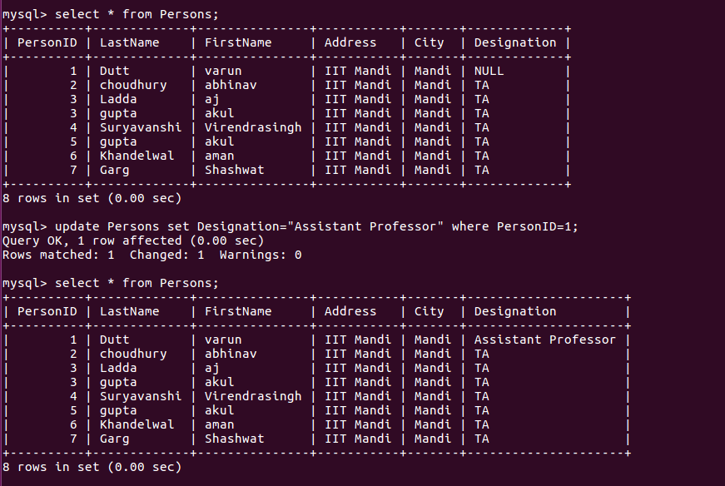
UPDATE clause Example

Slide 32
DELETE statement
The DELETE statement is used to delete existing records in a table.
Syntax:
DELETE FROM table_name
WHERE condition;
Eg:
DELETE FROM Customers WHERE CustomerName = 'Alfreds Futterkiste';

Slide 33
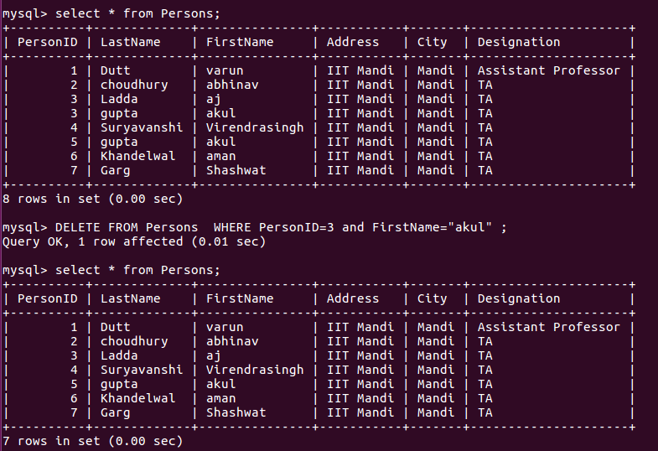
DELETE clause Example

Slide 34
LIKE clause
The LIKE operator is used in a WHERE clause to search for a specified pattern in a column.
There are two wildcards used in conjunction with the LIKE operator:
% - The percent sign represents zero, one, or multiple characters
_ - The underscore represents a single character
Syntax:
SELECT column1, column2, ...
FROM table_name
WHERE columnN LIKE pattern;

Slide 35
LIKE clause
LIKE Operator Description
LIKE 'a%' Finds any values that start with "a"
LIKE '%a' Finds any values that end with "a"
LIKE 'a%o' Finds any values that start with "a" and ends with "o"
LIKE '_r%' Finds any values that have "r" in the second position
Eg:
SELECT * FROM Customers WHERE CustomerName LIKE 'a%';

Slide 36
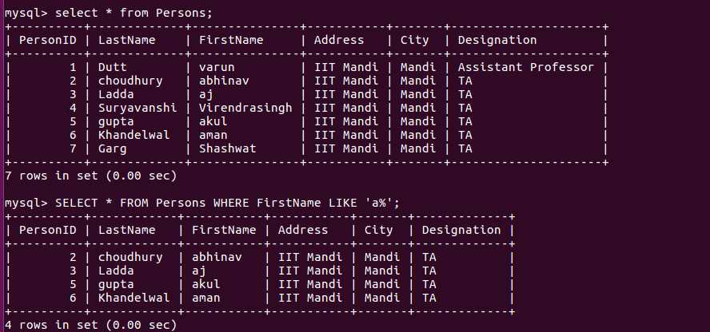
LIKE clause Example

Slide 37
MySql Functions
MIN(): MIN() function returns the smallest value of the selected column
MAX(): MAX() function returns the largest value of the selected column
COUNT(): COUNT() function returns the number of rows that matches a specified criteria
AVG(): AVG() function returns the average value of a numeric column
SUM(): SUM() function returns the total sum of a numeric column

Slide 38
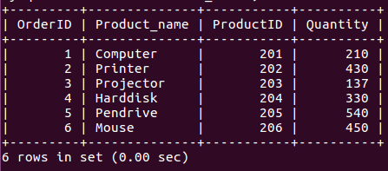
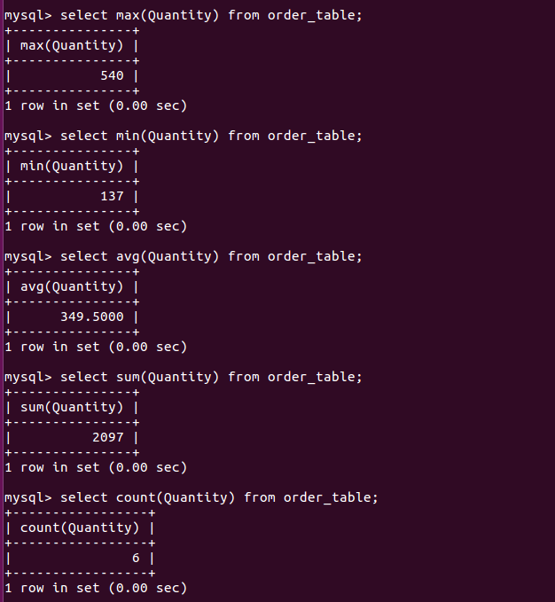
MySql Functions Example

Slide 39
Connecting mysql with php
MySQL works very well in combination of various programming languages like PERL, C, C++, JAVA and PHP. Out of these languages, PHP is the most popular one because of its web application development capabilities.
The PHP functions for use with MySQL have the following general format-
mysqli_function(value,value,…);
For eg
        $conn=mysqli_connect($connect);
        mysqli_query($conn,"SQL statement");

Slide 40
Connection
The mysqli_connect() function opens a new connection to the MySQL server.
Syntax: mysqli_connect(host,username,password,dbname);
Parameter Description
Host Specifies a host name or an IP address
Username Specifies the MySQL username
Password Specifies the MySQL password
Dbname Specifies the default database to be used

Slide 41
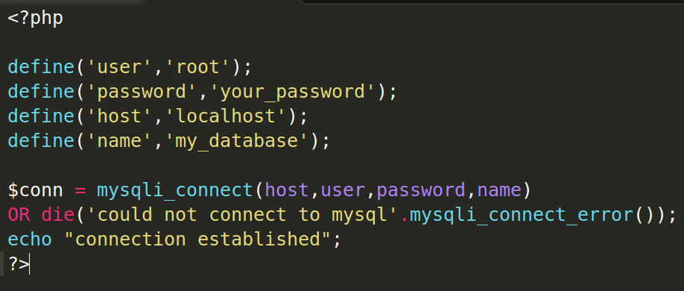

Connecting to Mysql using PHP

Slide 42
Mysql Dump
Creating mysqldump to backup and restore mySQL databses/tables.
To create dump file, write in shell (terminal) :
To dump a single database:
mysqldump db_name > dump.sql
To dump some specific databases:
mysqldump --databases db1 db2 > dump.sql
To dump all databases:
mysqldump --all-databases > dump.sql

Slide 43
Restoring from dump
For restoring from dump file, write in shell (terminal) :
mysql -u <user> -p < db_backup.dump
If the dump is of a single database you may have to add a line at the top of the dump file:
USE <database-name-here>;

Slide 44
Some important SQL commands
SELECT - extracts data from a database
UPDATE - updates data in a database
DELETE - deletes data from a database
INSERT INTO - inserts new data into a database
CREATE DATABASE - creates a new database
ALTER DATABASE - modifies a database
CREATE TABLE - creates a new table
ALTER TABLE - modifies a table
DROP TABLE - deletes a table
Keep in Mind : SQL keywords are NOT case sensitive: select is the same as SELECT

Slide 45
References
https://dev.mysql.com/doc/refman/5.7/en/mysqldump-sql-format.html
https://www.w3schools.com/php/func_mysqli_connect.asp
https://www.tutorialspoint.com/mysql/mysql-database-export.htm

