Slide 1

CS 207: Applied Database Practicum
Week 4
Varun Dutt
School of Computing and Electrical Engineering
School of Humanities and Social Sciences
Indian Institute of Technology Mandi, India
Scaling the Heights
1

Slide 2
GROUP BY STATEMENT
The GROUP BY statement is used to group the result-set by one or more columns or group rows that have the same values.
It is often used with aggregate functions (COUNT, MAX, MIN, SUM, AVG)
GROUP BY Syntax :
SELECT column_name(s)
FROM table_name
WHERE condition
GROUP BY column_name(s)
ORDER BY column_name(s);
2

Slide 3
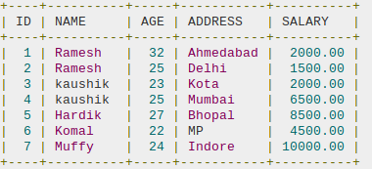
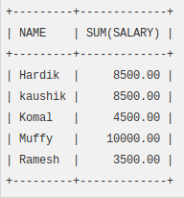
EXAMPLE – GROUP BY
The following SQL statement lists he total amount of salary on each customer:
SELECT NAME, SUM(SALARY) FROM CUSTOMERS
GROUP BY NAME;
3

Slide 4
EXAMPLE – GROUP BY WITH COUNT FUNCTION
The following SQL statement lists the number of customers in each country, sorted high to low:
SELECT Name, COUNT(*), FROM Customers
GROUP BY Name
ORDER BY COUNT(Name) DESC;
4

Slide 5
ORDER BY CLAUSE
The SQL ORDER BY clause is used to sort the data in ascending or descending order, based on one or more columns.
Some databases sort the query results in an ascending order by default.
Syntax :
SELECT column-list
FROM table_name
[WHERE condition]
[ORDER BY column1, column2, .. columnN]
[ASC | DESC];
5

Slide 6
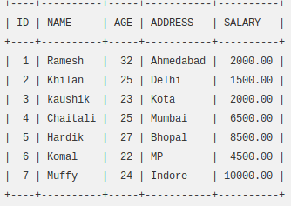
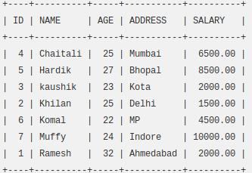
ORDER BY EXAMPLE
The following SQL statement lists the customers information in an ascending order by the NAME and the SALARY
SELECT * FROM CUSTOMERS
ORDER BY NAME, SALARY;
6

Slide 7
UNION Operator
The UNION operator is used to combine the result-set of two or more SELECT statements.
Each SELECT statement within UNION must have the same number of columns
The columns must also have similar data types
The columns in each SELECT statement must also be in the same order
The UNION operator selects only Distinct values by default.
To allow duplicate values, use UNION ALL.
7

Slide 8
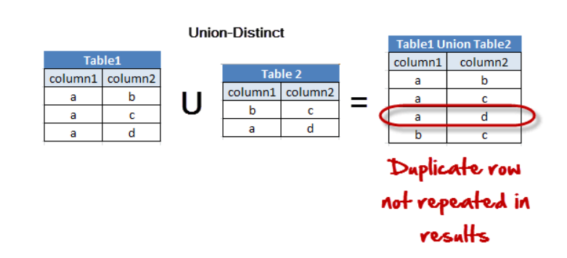
UNION SYNTAX
UNION syntax
SELECT column_name(s) FROM table1 UNION SELECT column_name(s) FROM table2;
8

Slide 9
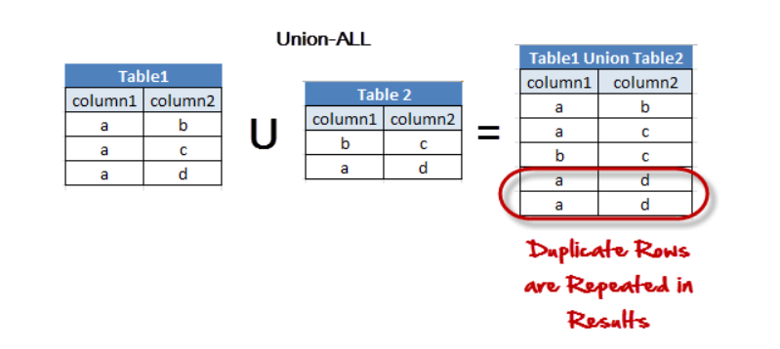
UNION ALL SYNTAX
UNION ALL syntax
SELECT column_name(s) FROM table1
UNION ALL
SELECT column_name(s) FROM table2;
9

Slide 10
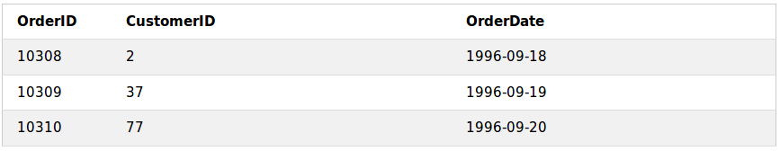
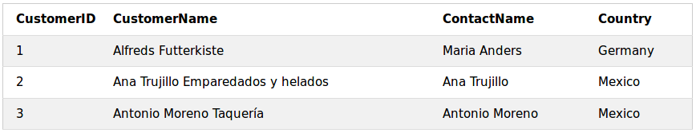
Joins in MySQL
A JOIN clause is used to combine rows from two or more tables, based on a related column between them.
For example, have a look at the tables:
"Orders":
“Customers”:
10

Slide 11
Joins in MySQL
Notice that the "CustomerID" column in the "Orders" table refers to the "CustomerID" in the "Customers" table. The relationship between the two exemplar tables is the "CustomerID" column.
Then, we can create the following SQL statement (that contains an INNER JOIN), that selects records that have matching values in both tables:
11

Slide 12
Joins in MySQL
The output of the previous statement would be:
12

Slide 13
Different Types of MySQL Joins
INNER JOIN - Returns records that have matching values in both tables
LEFT (OUTER) JOIN: Returns all records from the left table, and the matched records from the right table
RIGHT (OUTER) JOIN: Returns all records from the right table, and the matched records from the left table
NATURAL JOIN: It performs the same task as an INNER or LEFT JOIN, in which the ON or USING clause refers to all columns that the tables to be joined have in common.
CROSS JOIN: Returns the complete cross product of the two tables
13

Slide 14

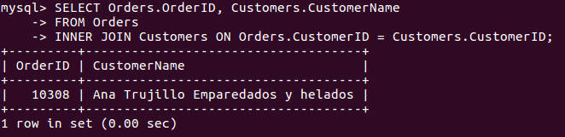
MySQL Inner Join
The INNER JOIN keyword selects records that have matching values in both tables.
Syntax:
For example:
14

Slide 15
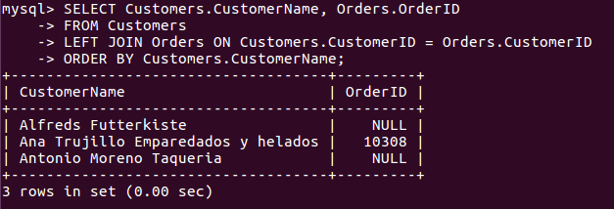
MySQL Left Join
The LEFT JOIN keyword returns all records from the left table (table1), and the matched records from the right table (table2). The result is NULL from the right side, if there is no match.
Syntax:
For example:
15

Slide 16

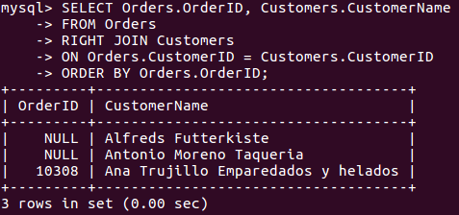
MySQL Right Join
The RIGHT JOIN keyword returns all records from the right table (table2), and the matched records from the left table (table1). The result is NULL from the left side, when there is no match.
Syntax:
For example:
16

Slide 17
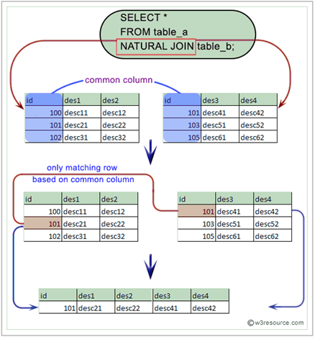
MySQL Natural join
Syntax:
SELECT column_name(s) FROM Table 1 NATURAL JOIN Table2;
In MySQL, the NATURAL JOIN is a join that performs the same task as an INNER JOIN except it does not return any redundant columns.
17

Slide 18

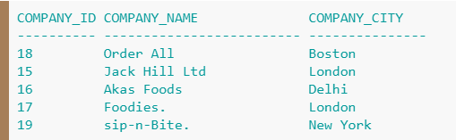

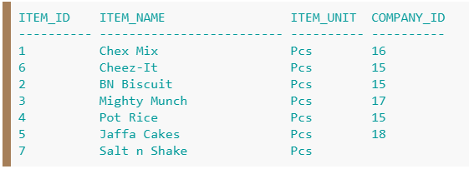
Difference between Natural join and Inner join
Table 1
Table 2
18

Slide 19

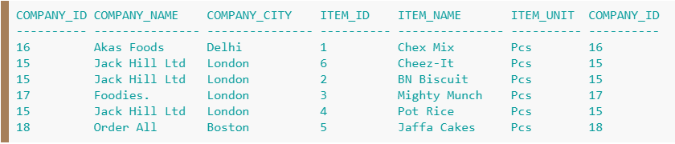

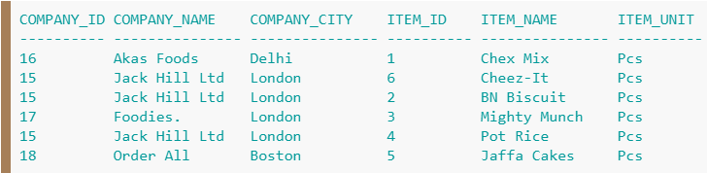
Difference between Natural join and Inner join
Inner Join
Natural Join
19

Slide 20
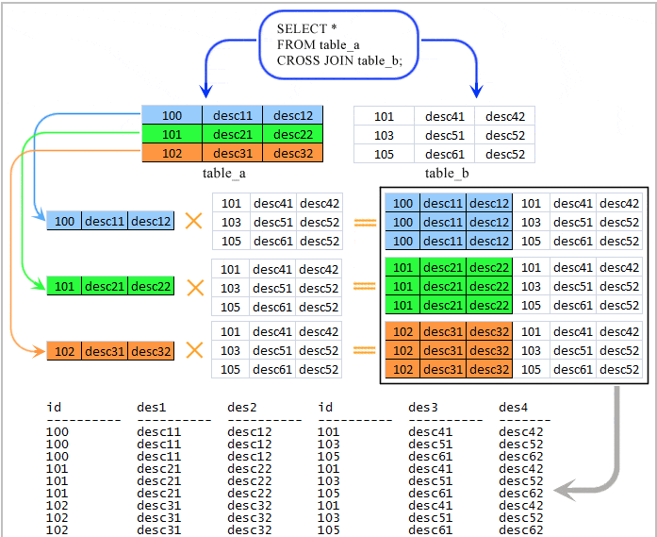
MySQL cross join
Syntax:
SELECT column_name(s) FROM Table 1 CROSS JOIN Table2;
In this join, the result table is obtained by multiplying each row of the first table with all rows in the second table if no condition is introduced with CROSS JOIN.
20

Slide 21

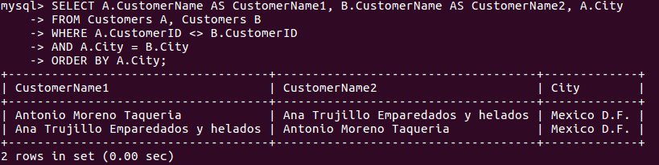
MySQL Self Join
A self JOIN is a regular join, but the table is joined with itself.
Syntax:
For example:
21

Slide 22
REFERENCES
https://www.w3schools.com/sql/sql_groupby.asp
https://www.tutorialspoint.com/sql/sql-order-by.htm
https://www.w3schools.com/sql/sql_union.asp
https://www.w3resource.com/mysql/mysql-union.php
https://www.w3schools.com/sql/sql_join.asp
http://www.mysqltutorial.org/mysql-join/
22

