Slide 1

CS 207: Applied Database Practicum
Week 5
Varun Dutt
School of Computing and Electrical Engineering
School of Humanities and Social Sciences
Indian Institute of Technology Mandi, India
Scaling the Heights

Slide 2
MySQL – Stored Procedure
A stored procedure is a prepared SQL code that you can save, so the code can be reused over and over again.
A stored procedure has three main parts:
Input: Store procedure can accept parameter values as inputs. Depending on how the parameters are defined, modified values can be passed back to the calling program
Execution: Stored procedures can execute SQL statements, utilize conditional logic such as IF THEN or CASE statements and lopping constructs to perform tasks.
Outputs: A stored procedure can return a single values such as a number or text value or a result set.

Slide 3
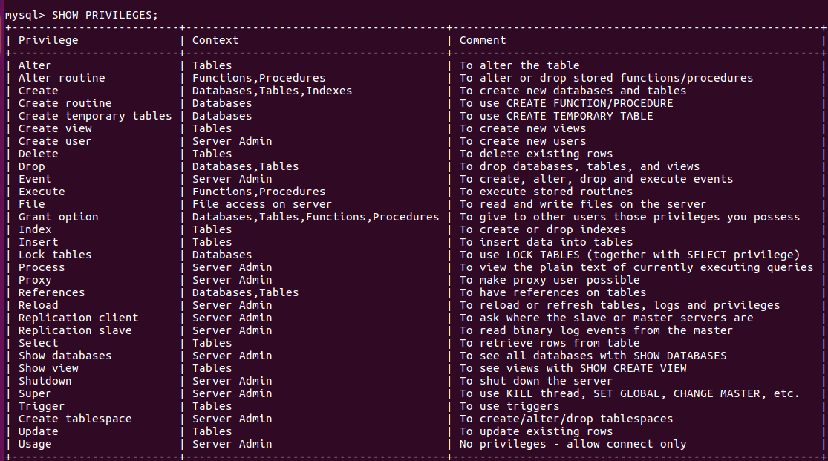
Stored Procedure
For creating and executing a stored procedure the user should have “create routine” privilege

Slide 4
Stored Procedure Syntax
PROCEDURE procedure_name ([proc_parameter[,...]])
proc_parameter: [ IN | OUT | INOUT ] param_name type
type:
Any valid MySQL data type
routine_body:
Valid SQL routine statement
Executing a Stored Procedure:
CALL procedure_name;
Deleting a Stored Procedure:
DROP PROCEDURE procedure_name;

Slide 5
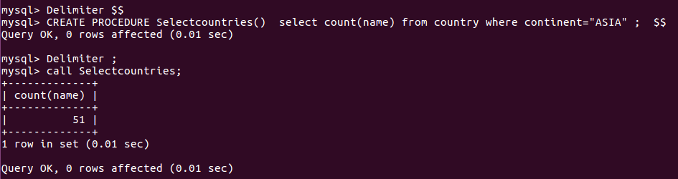
Stored Procedure:Example
Delimiter is used to tell that statement ending with ‘delimiter’ denotes the end of one statement. Here, the use of delimiter is necessary to so that the MySQL treats the statements inside (BEGIN...END) as part of one statement.

Slide 6
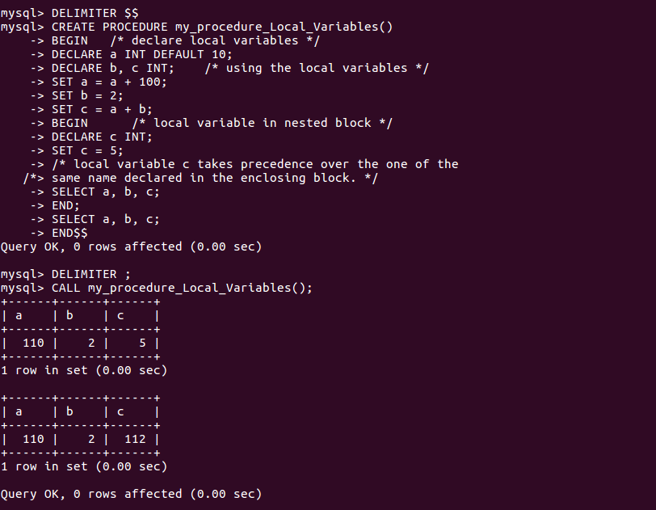
Stored Procedure: Compound Statement
BEGIN ... END block is used to write compound statements, i.e. when you need more than one statement within stored programs (e.g. stored procedures, functions, triggers, and events)

Slide 7
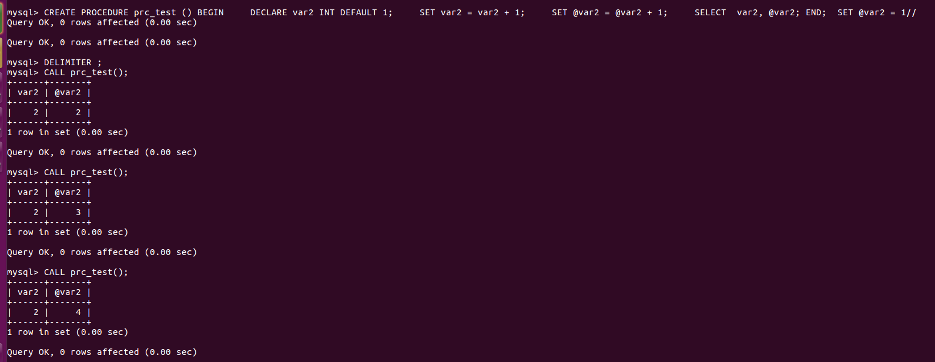
Stored Procedure: User Variables
In MySQL stored procedures, user variables are referenced with an ampersand (@) prefixed to the user variable name (for example, @x and @y).
The difference between a procedure variable and a session-specific user-defined variable is that procedure variable is reinitialized to NULL each time the procedure is called, while the session-specific variable is not

Slide 8
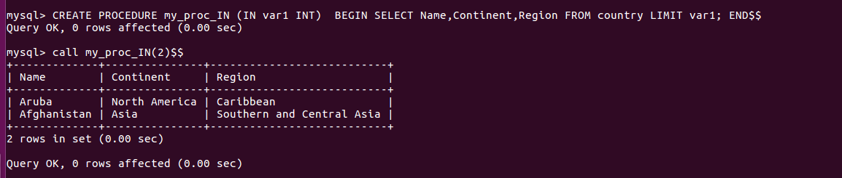
Parameters:IN
In the following procedure, we have used a IN parameter 'var1' (type integer) which accept a number from the user. Within the body of the procedure, there is a SELECT statement which fetches rows from 'country' table and the number of rows will be supplied by the user.

Slide 9
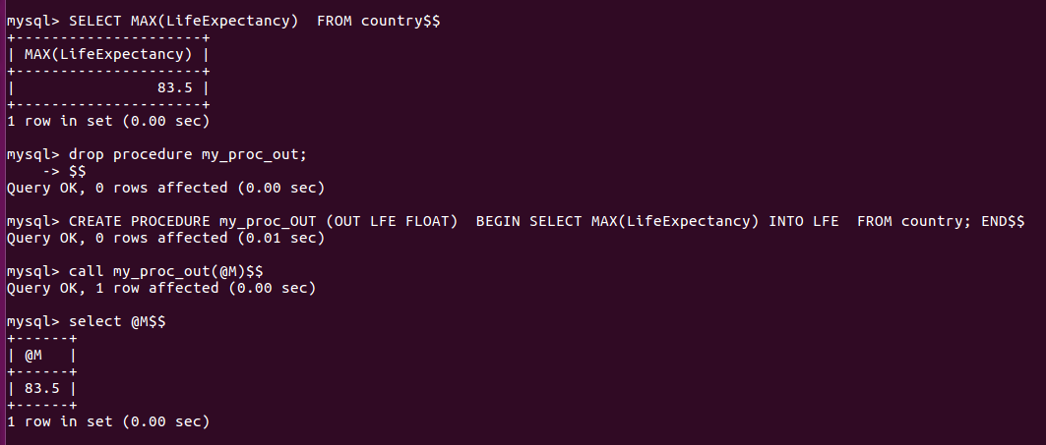
Parameters:OUT
In the body of this procedure, the parameter will get the highest Life Expectancy from LifeExpectancy column. After calling the procedure the word OUT tells the DBMS that the value goes out from the procedure. Here LFE is the name of the output parameter and we have passed its value to a session variable named @M, in the CALL statement.

Slide 10
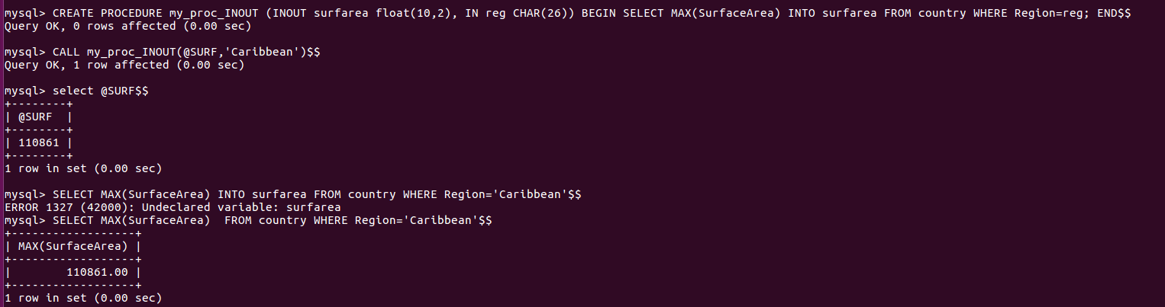
Parameters:INOUT
In this stored procedure that uses an INOUT parameter and an IN parameter. The user will supply a Region name through IN parameter (reg) to find the highest Surface Area in the region given by the user . The INOUT parameter (surfarea) will return the result to a user.

Slide 11

MySQL Stored Functions
A stored function is a special kind stored program that returns a single value.
It is different from a stored procedure in the sense that we can use a stored function in SQL statements wherever an expression is used.
Syntax
Parameters of the stored function are listed inside the parentheses. By default, all parameters are the IN parameters. One cannot specify IN , OUT or INOUT modifiers to the parameters.

Slide 12
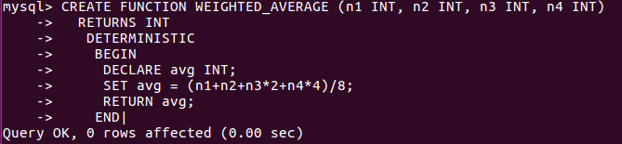
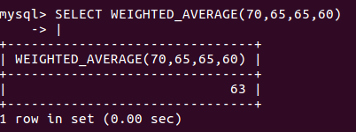
Stored Function example
Result:

Slide 13
MySQL Cursors
To handle a result set inside a stored procedure, a cursor is used.
A cursor allows you to iterate a set of rows returned by a query and process each row accordingly.
MySQL cursor has three properties:
Read-only: you cannot update data in the underlying table through the cursor.
Non-scrollable: you can only fetch rows in the order determined by the SELECT statement. You cannot fetch rows in the reversed order. In addition, you cannot skip rows or jump to a specific row in the result set.

Slide 14
MySQL Cursors
Asensitive: There are two kinds of cursors: asensitive cursor and insensitive cursor. An asensitive cursor points to the actual data, whereas an insensitive cursor uses a temporary copy of the data. An asensitive cursor performs faster than an insensitive cursor because it does not have to make a temporary copy of data. However, any changes made to the data (from other connections) will affect the data that is being used by an asensitive cursor, therefore, it is safer if you do not update the data that is being used by an asensitive cursor. MySQL cursor is asensitive.
You can use MySQL cursors in stored procedures, stored functions, and triggers.

Slide 15
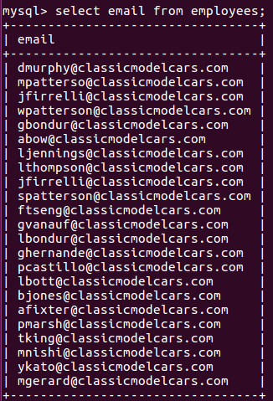
MySQL Cursor Example
We are going to develop a stored procedure with a cursor that concatenates the email of all customers in the employees table:

Slide 16
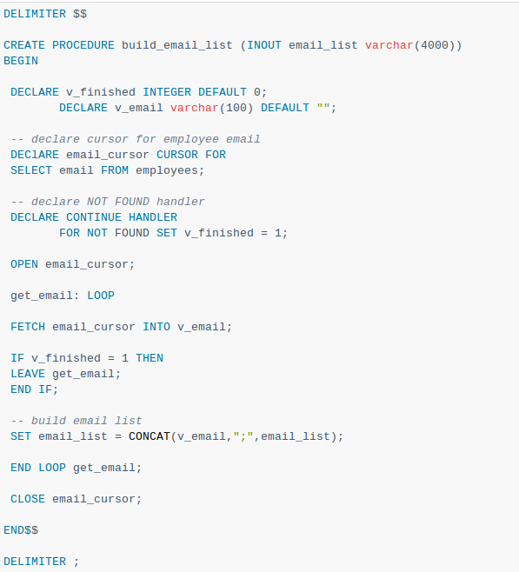
MySQL Cursor Example
The build_email_list stored procedure is as follows:

Slide 17

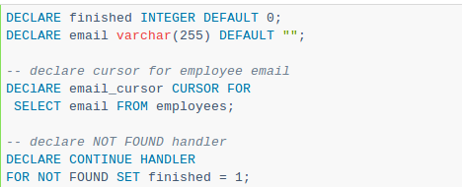
MySQL Cursor Example
Declare a HANDLER variable and an email variable (for storing the email Ids)
A cursor for looping over the email_address of customers, and a NOT FOUND handler:
Next, open the email_cursor by using the OPEN statement:

Slide 18
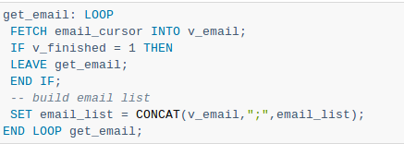
MySQL Cursor Example
Then, iterate the email list, and concatenate all email where each email is separated by a semicolon(;):
After that, inside the loop we used the v_finished variable to check if there is an address in the list to terminate the loop.

Slide 19

MySQL Cursor Example
Finally, close the cursor using the CLOSE statement:
You can test the build_email_list stored procedure using the following script:

Slide 20
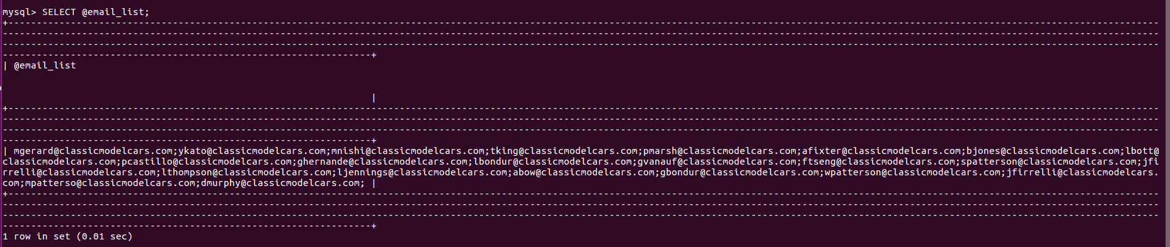
MySQL Cursor Result

Slide 21
Using MySQL Cursor
First, you have to declare a cursor by using the DECLARE statement:
DECLARE cursor_name CURSOR FOR SELECT_statement;
The cursor declaration must be after any variable declaration. If you declare a cursor before variables declaration, MySQL will issue an error. A cursor must always be associated with a SELECT statement.
Next, you open the cursor by using the OPEN statement. The OPEN statement initializes the result set for the cursor, therefore, you must call the OPEN statement before fetching rows from the result set.
OPEN cursor_name;

Slide 22
Using MySQL Cursor
Then, you use the FETCH statement to retrieve the next row pointed by the cursor and move the cursor to the next row in the result set.
FETCH cursor_name INTO variables list;
After that, you can check to see if there is any row available before fetching it.
Finally, you call the CLOSE statement to deactivate the cursor and release the memory associated with it as follows:
CLOSE cursor_name;
When the cursor is no longer used, you should close it.

Slide 23
NOT FOUND Handler
When working with MySQL cursor, you must also declare a NOT FOUND handler to handle the situation when the cursor could not find any row. Because each time you call the FETCH statement, the cursor attempts to read the next row in the result set. When the cursor reaches the end of the result set, it will not be able to get the data, and a condition is raised. The handler is used to handle this condition.
To declare a NOT FOUND handler, you use the following syntax:
DECLARE CONTINUE HANDLER FOR NOT FOUND SET finished = 1;
The finished is a variable to indicate that the cursor has reached the end of the result set. Notice that the handler declaration must appear after variable and cursor declaration inside the stored procedures.

Slide 24
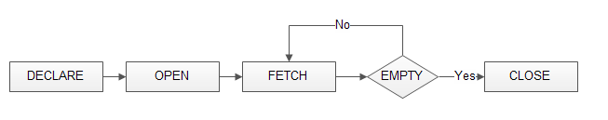
Flow Diagram for MySQL Cursor
The following diagram illustrates how MySQL cursor works.

Slide 25
References
https://dev.mysql.com/doc/refman/8.0/en/cursors.html

