Slide 1

CS 207: Applied Database Practicum
Week 6
Varun Dutt
School of Computing and Electrical Engineering
School of Humanities and Social Sciences
Indian Institute of Technology Mandi, India
Scaling the Heights
1

Slide 2
MySQL - Triggers
A SQL trigger is a set of SQL statements stored in the database catalog. A SQL trigger is executed or fired whenever an event associated with a table occurs e.g., insert, update or delete.
A SQL trigger is a special type of stored procedure. It is special because it is not called directly like a stored procedure. The main difference between a trigger and a stored procedure is that a trigger is called automatically when a data modification event is made against a table whereas a stored procedure must be called explicitly.
2

Slide 3
Advantages of triggers
Provides an alternative way to check the integrity of data.
Provide a way to automatically run scheduled tasks because triggers are invoked automatically before or after a change is made in the table.
Very useful to audit the changes in the table.
Provide transparent event logging
Prevent invalid transactions.
3

Slide 4
Types of triggers
A trigger can be defined to be invoked either before or after the data is changed by INSERT, UPDATE or DELETE statement.
BEFORE INSERT - activated before data is inserted into the table.
AFTER INSERT - activated after data is inserted into the table.
BEFORE UPDATE - activated before data in the table is updated.
AFTER UPDATE - activated after data in the table is updated.
4

Slide 5
Types of Triggers
BEFORE DELETE - activated before data is removed from table.
AFTER DELETE - activated after data is removed from table.
5

Slide 6
Syntax for Triggers
CREATE
[DEFINER = { user | CURRENT_USER }] (Optional)
TRIGGER trigger_name
trigger_time trigger_event
ON table_name FOR EACH ROW
trigger_body
trigger_time: { BEFORE | AFTER }
trigger_event: { INSERT | UPDATE | DELETE }
Within the trigger body, the OLD and NEW keywords enable you to access columns in the rows affected by a trigger. OLD and NEW are not case-sensitive.
6

Slide 7
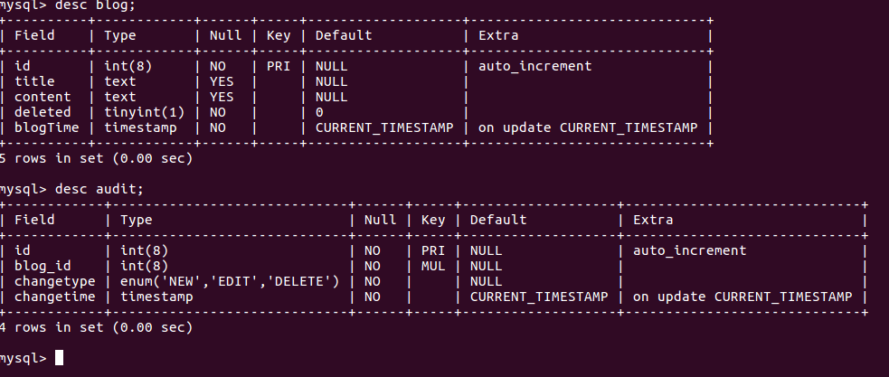
Example on triggers
Tables description-
7

Slide 8
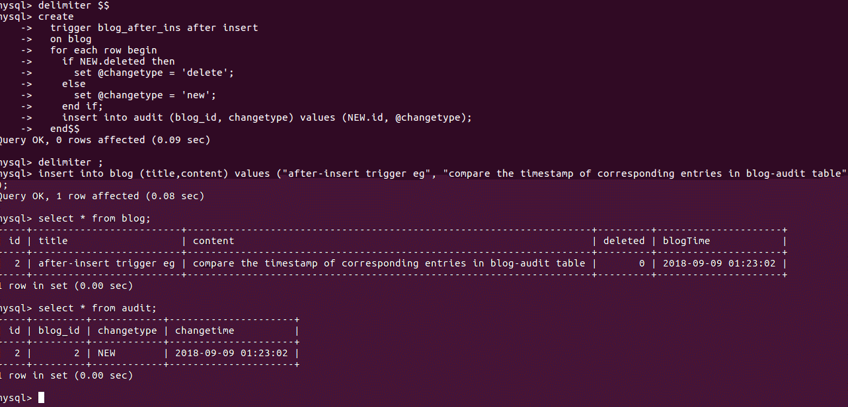
Example using after-insert
8

Slide 9
Example Explanation
In above example whenever some new entry is inserted in blog table, new entry in audit table gets create automatically to keep note the changetype and timestamp. Next example deal with same table and show how any modification in table blog causes new entry in table audit referring to corresponding modified entry.
9

Slide 10
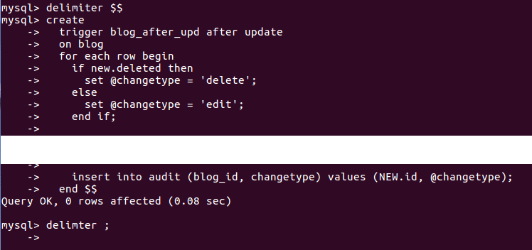
Example of after-update
Creation of trigger
10

Slide 11
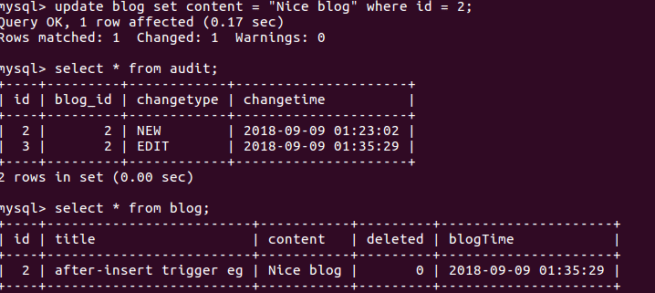
Example of after-update
Realization of trigger -
Above example shows the modification of entry in blog table causes new entry in audit table automatically.
11

Slide 12
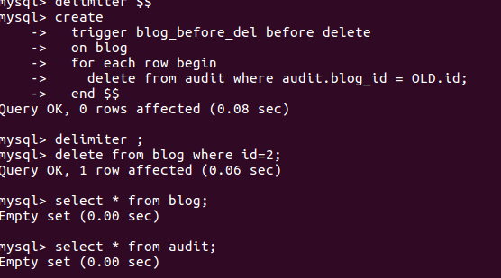
Example on before delete
o
Using same table as above:
Trigger creation and realization -
12

Slide 13
Example
Above example shows how one can save him/her from error.
As per the example, before deleting entry of primary key, we have to be sure that we first delete foreign key entries of it in another table. So we can use trigger before -delete here, so before deleting primary key entry clear all entries of it as foreign key in another table.
13

Slide 14
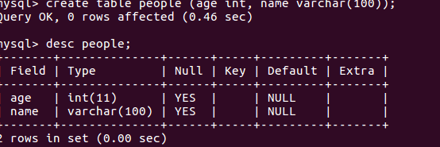
Example on before insert
For next two examples we’ll using following table:
Table description-
14

Slide 15
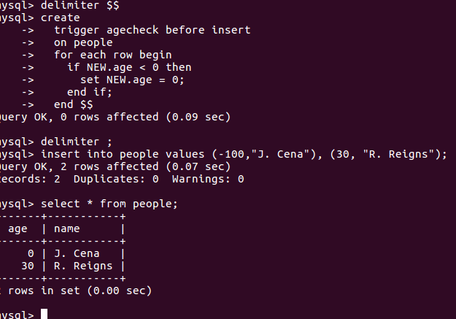
Example on before insert
Trigger creation and realization
15

Slide 16
Example on before insert
In above example upon insertion of invalid negative age, MySQL with triggers modify it to zero.
16

Slide 17
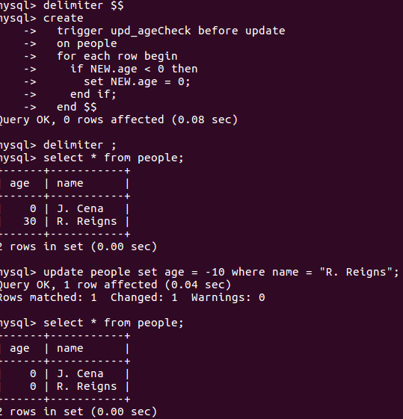
Example on before-update
Trigger creation and realization-
17

Slide 18
Example on before-update
In above eg. upon modification of entry in table people MySQL trigger checks if there is invalid modification (age < 0), set age to zero.
18

Slide 19
References
http://w3schools.com/
http://www.mysqltutorial.org/mysql-triggers.aspx
19

