Slide 1

Nepal Chamber of Commerce
“An Insight into Nepal’s Leading Business Voice”
Ashwin Maharjan
Lasta Maharjan
Nischal Shakya

Slide 2


Introduction of
Nepal Chamber of Commerce
Established in 1952 A.D.
First non-governmental business organization in Nepal.
Represents traders, exporters, importers, and entrepreneurs.
Functions as a bridge between government and private sector
Slide - 2

Slide 3

HISTORICAL BACKGROUND
1952
1990s
2010s
Founded as Nepal’s first non-governmental business organization
Advocated for market-friendly policies, tax reforms, and reduction of trade barriers
Focus shifted toward digital trade facilitation and entrepreneurship support
Slide - 3
Notes:
1. 1952 A.D. – Establishment of NCC : Aimed to organize traders and entrepreneurs and facilitate economic modernization after the Rana regime
Marked the beginning of private sector representation in policy discussions
2. 1990s – Policy Advocacy & Economic Liberalization: NCC became active in lobbying during Nepal’s transition to democracy
Helped influence the government’s liberal economic policies during this decade
3. 2010s–Present – Global Engagement & Digitalization: Expanded international relations (SAARC, China, WTO consultations)
Started issuing digital Certificates of Origin
Supported small and medium businesses during COVID-19 through online platforms and policy support

Slide 4

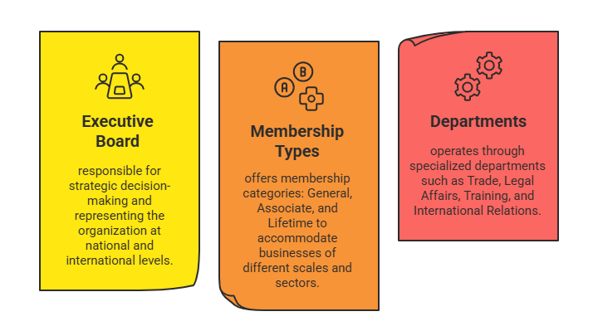
Organizational
STRUCTURE
Slide - 4
Notes:
1. Executive Board: The Executive Board is the top governing body of the Nepal Chamber of Commerce, responsible for strategic decision-making, policy direction, and representing the organization at national and international levels.
2. Membership Types: NCC offers various membership categories—General, Associate, and Lifetime—to accommodate businesses of different scales and sectors, providing them with access to resources, advocacy, and networking opportunities.
3. Departments: NCC operates through specialized departments such as Trade, Legal Affairs, Training, and International Relations, each dedicated to delivering targeted services and addressing specific needs of its members.

Slide 5
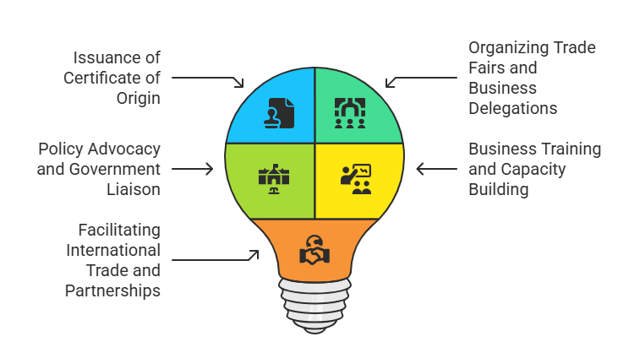
Key Functions of
Nepal Chamber of Commerce
Slide – 5
Notes:
1. Issuance of Certificate of Origin (CO)
NCC is authorized to issue the Certificate of Origin, a vital export document that verifies goods are produced in Nepal. This helps exporters gain trade benefits under various international agreements and ensures compliance with import regulations abroad.
2. Organizing Trade Fairs and Business Delegations
The Chamber regularly hosts national and international trade fairs, exhibitions, and sends delegations abroad. These events create platforms for business networking, product promotion, and foreign investment opportunities.
3. Policy Advocacy and Government Liaison
NCC plays a major role in representing the private sector in policymaking. It provides recommendations to the government on trade, taxation, and business regulations, ensuring that business interests are reflected in national policies.
4. Business Training and Capacity Building
To support entrepreneurship and skill development, NCC conducts seminars, workshops, and training programs on topics like export procedures, legal compliance, digital trade, and business strategy—especially for SMEs.
5. Facilitating International Trade and Partnerships
NCC builds bilateral and multilateral relationships with chambers and trade bodies globally. It works to create trade linkages, joint ventures, and technology transfers, helping Nepali businesses expand internationally.

Slide 6
Objectives of
Nepal Chamber of Commerce
Promote Trade & Commerce
Support Entrepreneurs
Advocate For Business Interests
Encourage Fair Practices
Slide - 6

Slide 7
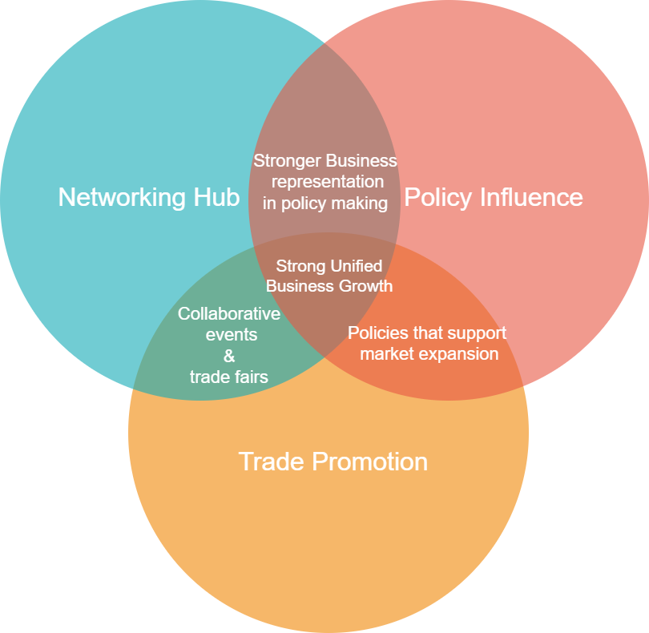
Importance in
Nepal’s Business Ecosystem
Slide - 7
Notes:
1. Issuance of Certificate of Origin (CO)
NCC is authorized to issue the Certificate of Origin, a vital export document that verifies goods are produced in Nepal. This helps exporters gain trade benefits under various international agreements and ensures compliance with import regulations abroad.
2. Organizing Trade Fairs and Business Delegations
The Chamber regularly hosts national and international trade fairs, exhibitions, and sends delegations abroad. These events create platforms for business networking, product promotion, and foreign investment opportunities.
3. Policy Advocacy and Government Liaison
NCC plays a major role in representing the private sector in policymaking. It provides recommendations to the government on trade, taxation, and business regulations, ensuring that business interests are reflected in national policies.
4. Business Training and Capacity Building
To support entrepreneurship and skill development, NCC conducts seminars, workshops, and training programs on topics like export procedures, legal compliance, digital trade, and business strategy—especially for SMEs.
5. Facilitating International Trade and Partnerships
NCC builds bilateral and multilateral relationships with chambers and trade bodies globally. It works to create trade linkages, joint ventures, and technology transfers, helping Nepali businesses expand internationally.

Slide 8
1
Boosts Exports
Support for
2
Encourages Investment
Economic Development
3
Job Creation
4
Economic Growth Catalyst
Slide - 8

Slide 9
Nepal’s economy is still developing and largely reliant on Small and Medium Enterprises.
1
The Need for NCC
2
There is a gap between the government and private sector communication.
IN NEPAL
3
NCC provides a unified voice for trade, policy advocacy, and business capacity development.
Slide - 9

Slide 10
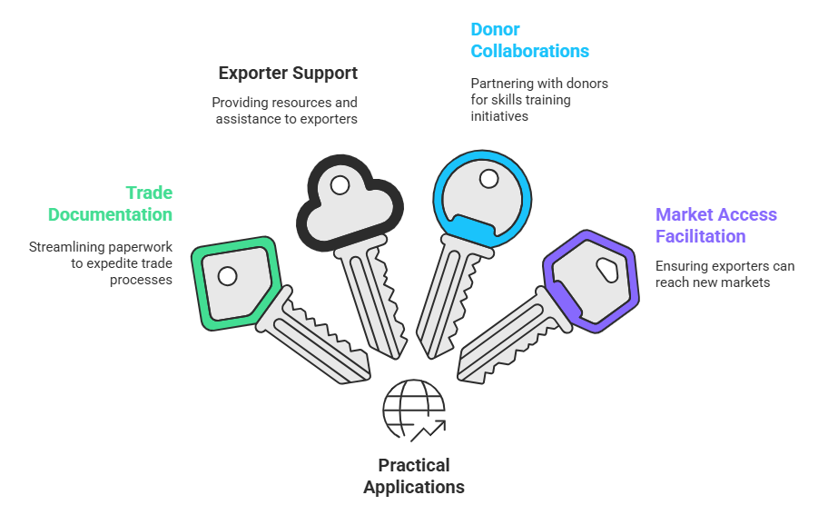
Practical Applications of
Nepal Chamber of Commerce
Slide - 10
Notes:
1. Issuance of Certificate of Origin (CO)
NCC is authorized to issue the Certificate of Origin, a vital export document that verifies goods are produced in Nepal. This helps exporters gain trade benefits under various international agreements and ensures compliance with import regulations abroad.
2. Organizing Trade Fairs and Business Delegations
The Chamber regularly hosts national and international trade fairs, exhibitions, and sends delegations abroad. These events create platforms for business networking, product promotion, and foreign investment opportunities.
3. Policy Advocacy and Government Liaison
NCC plays a major role in representing the private sector in policymaking. It provides recommendations to the government on trade, taxation, and business regulations, ensuring that business interests are reflected in national policies.
4. Business Training and Capacity Building
To support entrepreneurship and skill development, NCC conducts seminars, workshops, and training programs on topics like export procedures, legal compliance, digital trade, and business strategy—especially for SMEs.
5. Facilitating International Trade and Partnerships
NCC builds bilateral and multilateral relationships with chambers and trade bodies globally. It works to create trade linkages, joint ventures, and technology transfers, helping Nepali businesses expand internationally.

Slide 11
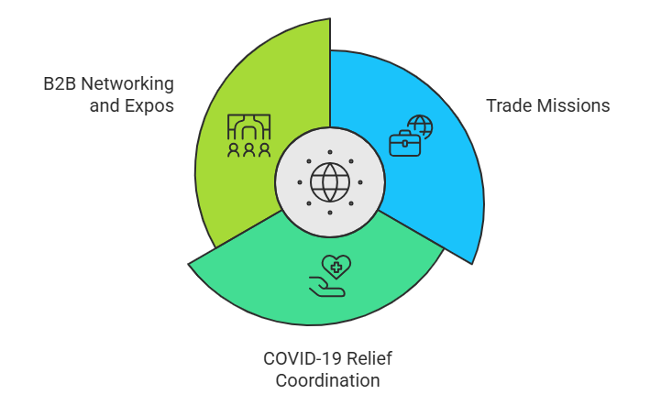
Real World Impacts of
Nepal Chamber of Commerce
Slide - 11
Notes:
Trade Missions : NCC frequently organizes international trade missions to countries like China, Bangladesh, and India. These missions involve delegating business leaders and entrepreneurs to visit foreign markets, interact with potential buyers, suppliers, and investors, and explore trade and collaboration opportunities.
COVID-19 Relief Coordination: During the COVID-19 pandemic, NCC played a key role in coordinating between the private sector and the government. It acted as a voice for struggling businesses, advocated for policy adjustments like tax relief and loan rescheduling, and partnered with NGOs and international donors to deliver aid packages.
Regular B2B Networking and Trade Expositions: NCC regularly hosts Business-to-Business (B2B) networking events and trade expos that bring together entrepreneurs, investors, and sector-specific professionals under one roof. These platforms allow direct interaction, deal-making, brand showcasing, and knowledge exchange.

Slide 12




CONCLUSION
Global Trade Support
NCC isn’t just an institution, it’s a bridge between businesses and policymakers.
It is essential as Nepal integrates more deeply into the global trade system.
Skill Development Programs
With its continued support, Nepal’s private sector is empowered to grow and innovate.
B2B Networking Events
Slide - 12

Slide 13

THANK YOU
VISIT US

