Slide 1
Hotel Booking Demand Analysis
BY ASHWIN MUTHURAMAN
26 March, 2024

Slide 2
INTRODUCTION
This project explores a major hotel chain's booking data to reveal key insights into booking behaviors, customer demographics, and operational efficiencies.
Our goal is to predict cancellation rates, optimize revenue, and improve customer satisfaction through strategic, data-driven decisions.

Slide 3
OBJECTIVES
Booking Patterns
Customer Behavior Analysis
Revenue Optimization
Geographical Analysis
Operational Efficiency
Impact of Deposit Types
Analysis of Corporate Bookings

Slide 4
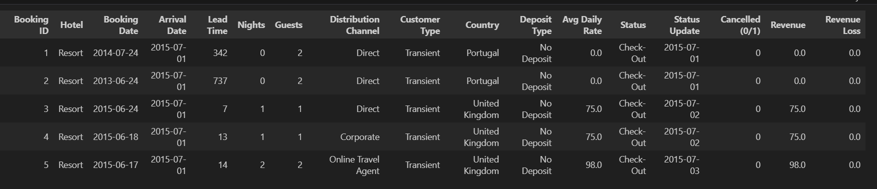
DATASET OVERVIEW

Slide 5
METHODOLOGY
Data Exploration and Preprocessing
Exploratory Data Analysis (EDA)
Predictive Modeling
Predictive Modeling Approaches:
Logistic Regression (LR): Utilizes class weights for balance, enhancing model accuracy on imbalanced datasets.
MLP Classifier (MLPC): Incorporates early stopping to prevent overfitting, optimizing performance.
Random Forest Classifier (RFC): Employs class weights to handle class imbalance, improving predictive reliability.
Histogram-based Gradient Boosting Classifier (HGBC): Leverages gradient boosting for efficient handling of large datasets.
Handling date-time variables
Transforming date-time variables for analysis
Handling missing data
Imputing missing values to maintain data integrity
Understanding the descriptive statistics
Booking Patterns
Customer Behavior Analysis
Revenue Optimization
Geographical Analysis
Operational Efficiency
Impact of Deposit Types
Analysis of Corporate Bookings

Slide 6
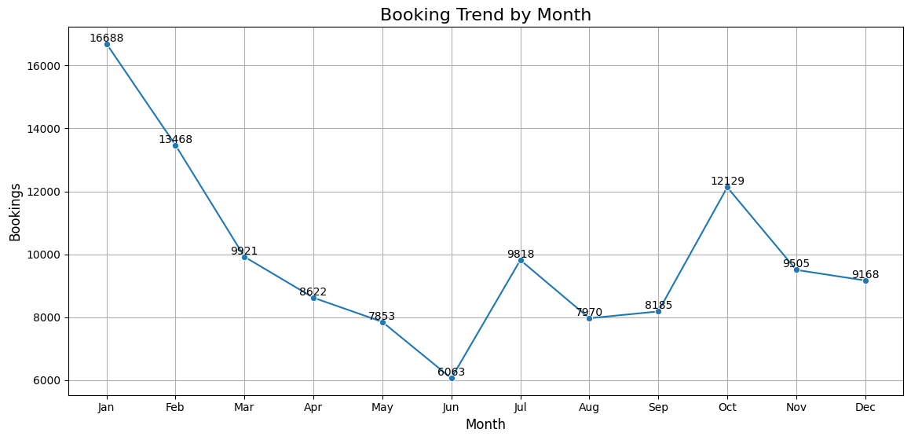
BOOKING PATTERNS
Booking Trend by Month:
The booking numbers start high in January and experience a sharp decrease by April.
There's a significant dip in bookings in May, with a slight increase in June, followed by the lowest point in July.
A peak occurs in September, suggesting a strong seasonal effect with a decrease again towards the end of the year.

Slide 7
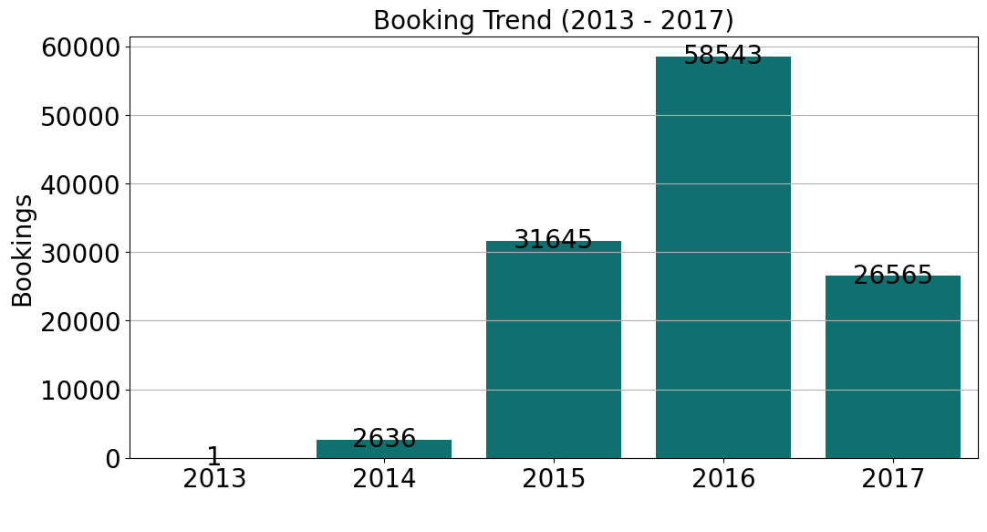
BOOKING TREND (2013 - 2017)
Bookings have shown a dramatic increase from 2013 to 2014, more than doubling in numbers.
The year 2016 sees the highest number of bookings, indicating a growing trend over the years.
There is a slight decrease in bookings in 2017 compared to 2016, which may require further investigation to understand the cause.

Slide 8
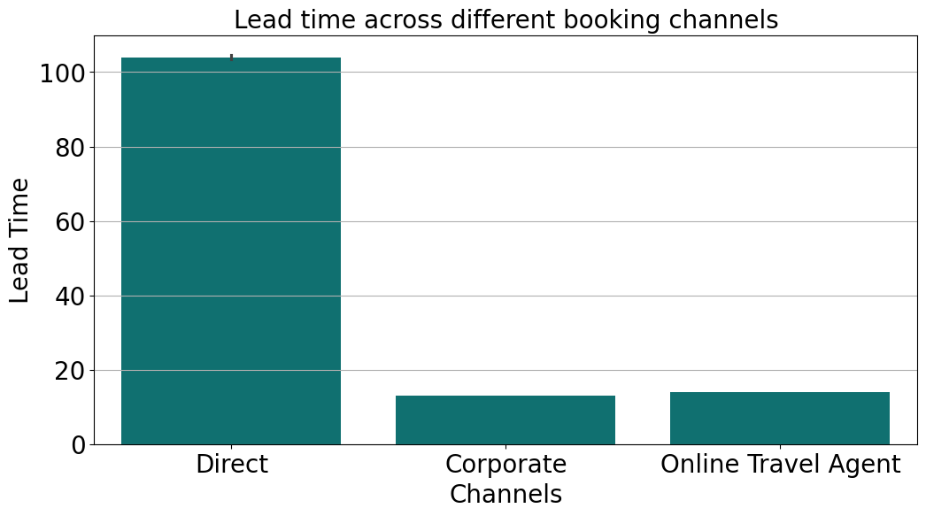
LEAD TIME ACROSS DIFFERENT CHANNELS
Direct bookings show the longest lead time, suggesting customers plan well in advance when booking directly.
Corporate channels show a significantly shorter lead time, which may imply last-minute or short-term planning associated with business travel.
OTAs have the shortest lead time, indicating these channels may be used for more spontaneous or last-minute travel.

Slide 9
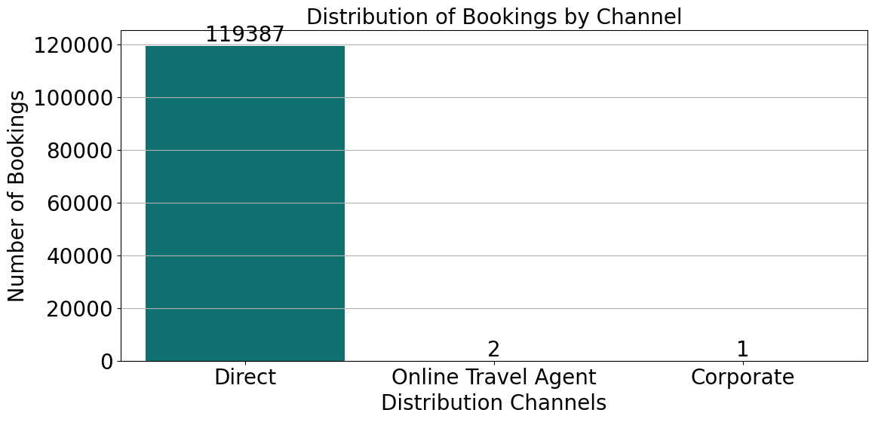
CUSTOMER BEHAVIOR ANALYSIS
Which distribution channels contribute the most to bookings, and how does the average daily rate (ADR) differ across these channels?

Slide 10
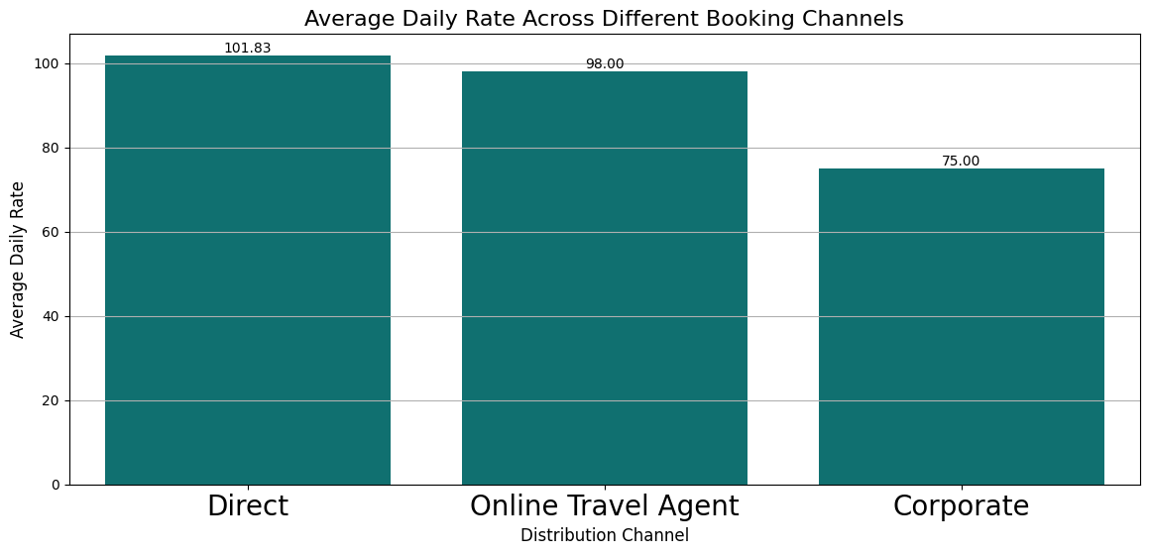
CUSTOMER BEHAVIOR ANALYSIS#2
How does the average daily rate (ADR) differ across these channels?

Slide 11
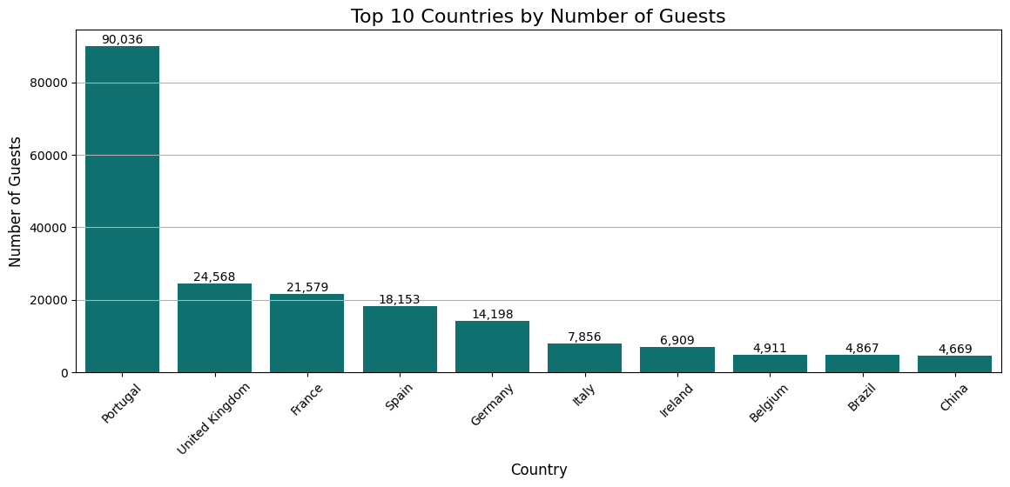
CUSTOMER BEHAVIOR ANALYSIS #3
Can we identify any patterns in the distribution of guests based on their country of origin, and how does this impact revenue?

Slide 12
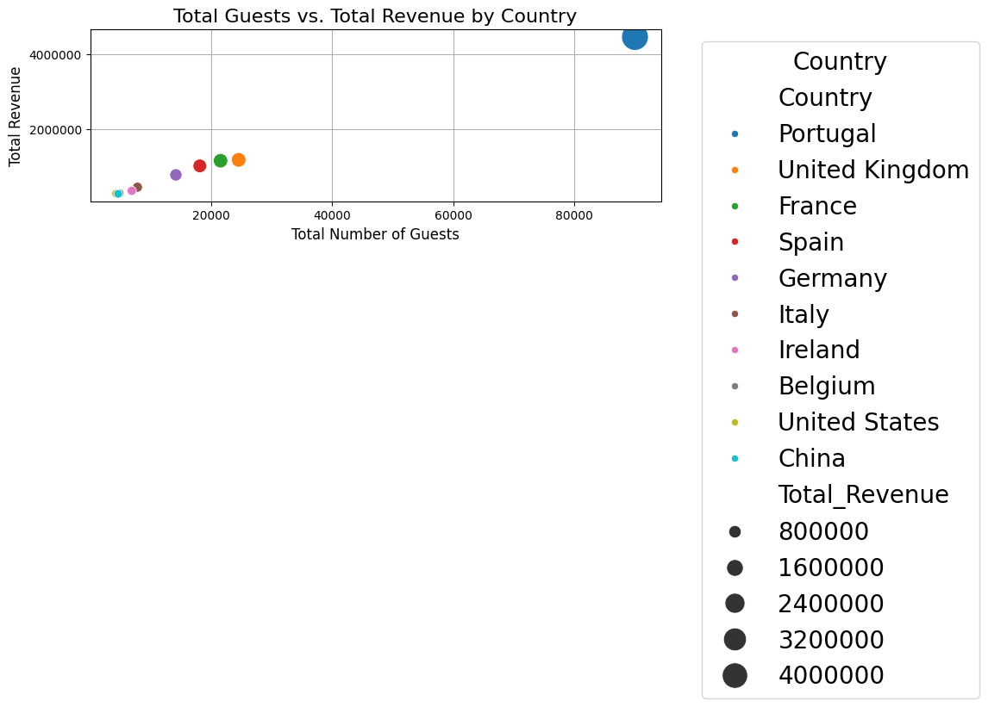
CUSTOMER BEHAVIOR ANALYSIS #3
Can we identify any patterns in the distribution of guests based on their country of origin, and how does this impact revenue?

Slide 13
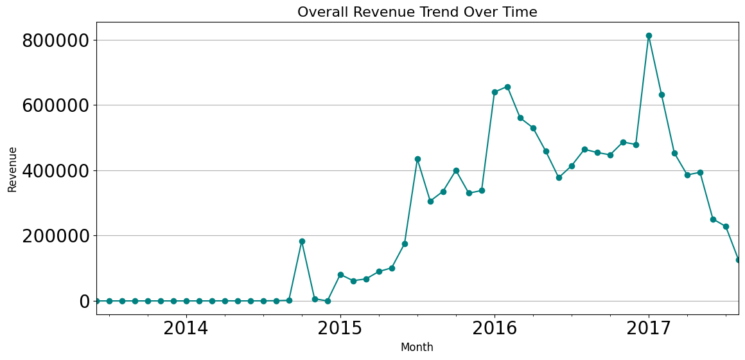
REVENUE OPTIMIZATION
What is the overall revenue trend, and are there specific customer segments or countries contributing significantly to revenue?

Slide 14
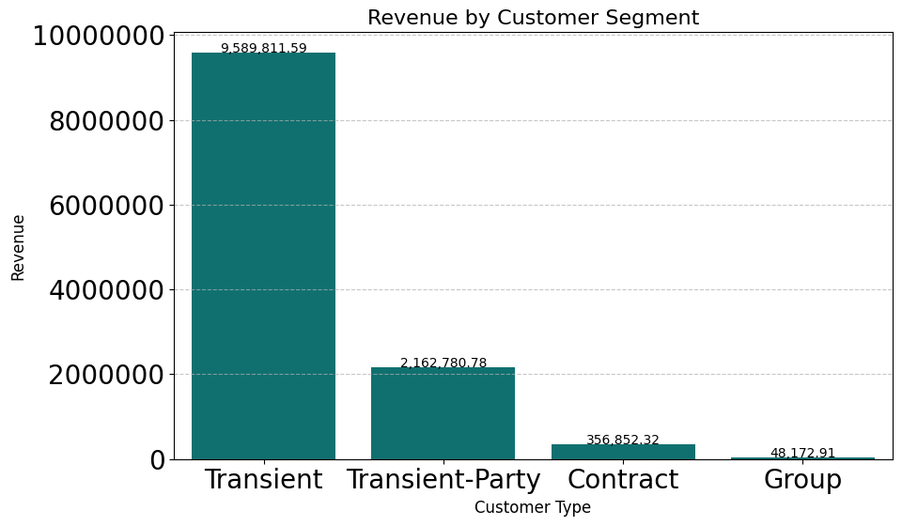
REVENUE OPTIMIZATION#2
Are there specific customer segments or countries contributing significantly to revenue?

Slide 15
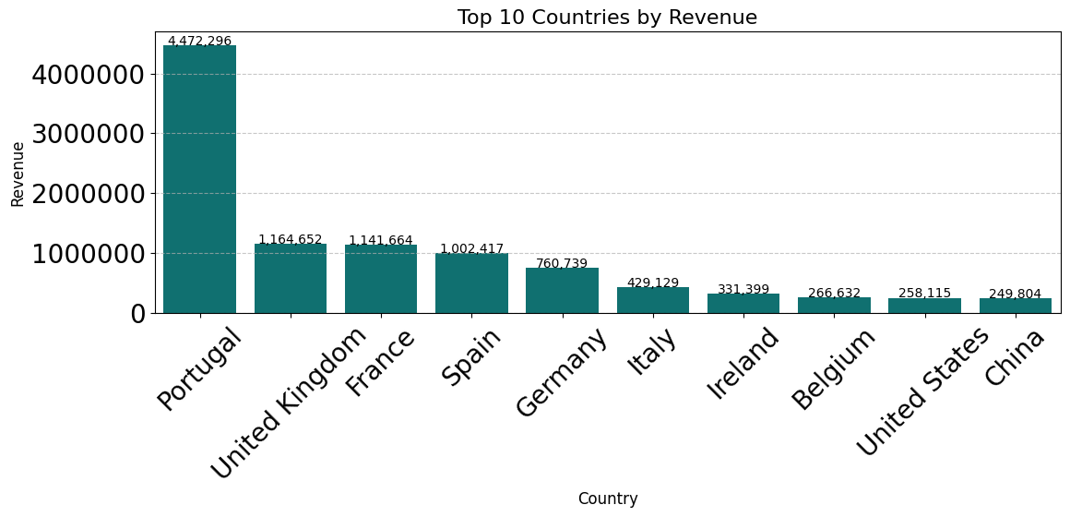
REVENUE OPTIMIZATION#2
Are there specific customer segments or countries contributing significantly to revenue?

Slide 16
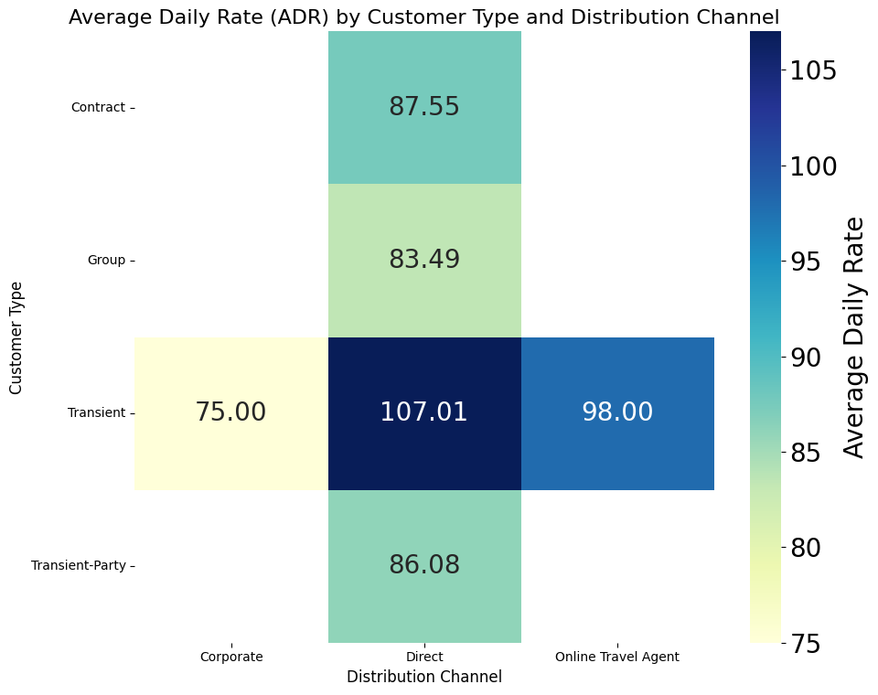
REVENUE OPTIMIZATION#2
Can we identify optimal pricing strategies based on the Average Daily Rate (ADR) for different customer types and distribution channels?

Slide 17
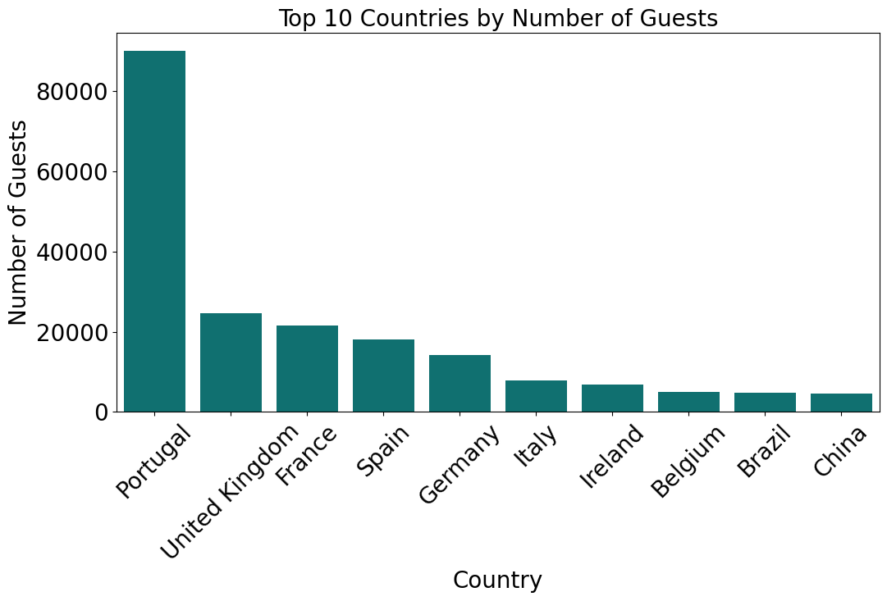
GEOGRAPHICAL ANALYSIS
How does the distribution of guests vary across different countries, and are there specific countries that should be targeted for marketing efforts?

Slide 18
GEOGRAPHICAL ANALYSIS#2
Is there a correlation between the country of origin and the likelihood of cancellations or extended stays?
PEARSON'S CORRELATION COEFFICIENT: -0.013577215623924305, P-VALUE: 2.71231620336648E-06

Slide 19
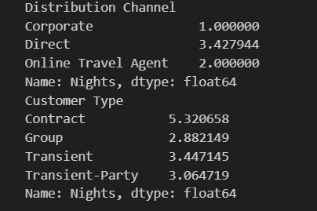
OPERATIONAL EFFICIENCY
What is the average length of stay for guests, and how does it differ based on booking channels or customer types?

Slide 20
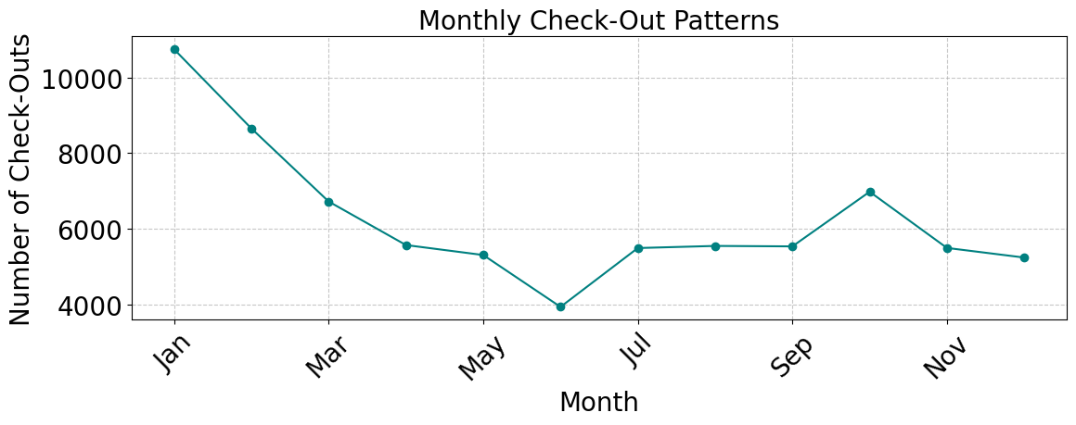
OPERATIONAL EFFICIENCY#2
Are there patterns in check-out dates that can inform staffing and resource allocation strategies?

Slide 21
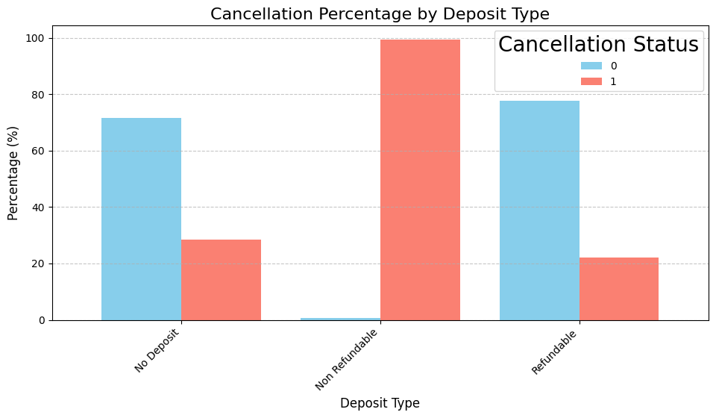
IMPACT OF DEPOSIT TYPES

Slide 22
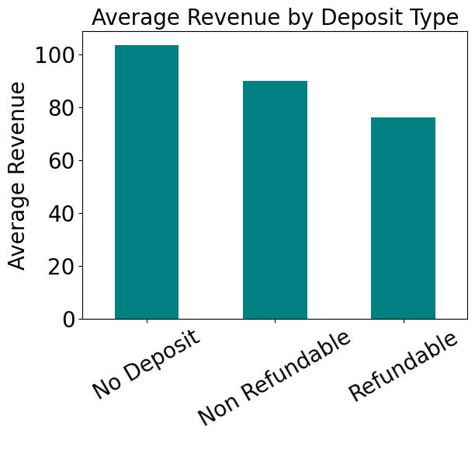
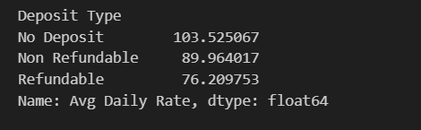
IMPACT OF DEPOSIT TYPES

Slide 23
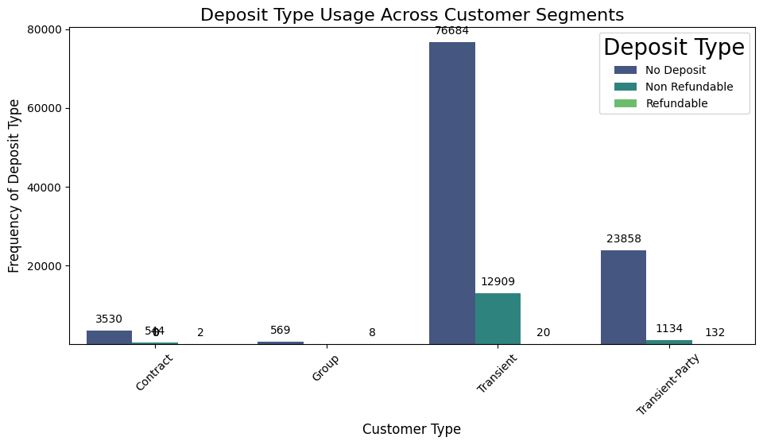
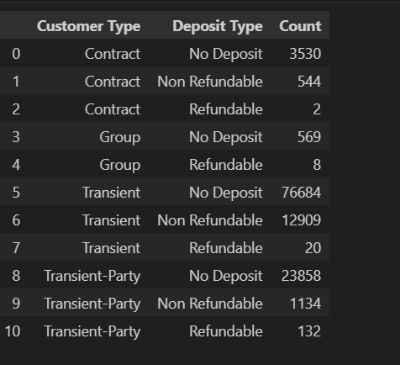
IMPACT OF DEPOSIT TYPES
Can we identify any patterns in the use of deposit types across different customer segments?

Slide 24
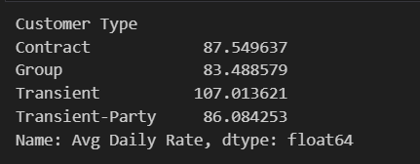
ANALYSIS OF CORPORATE BOOKINGS
What is the proportion of corporate bookings, and how does their Average Daily Rate (ADR) compare to other customer types?
Average rate for each corporate bookings = 75.0

Slide 25
KEY FINDINGS
Monthly Booking Trends: Highlight the marked seasonal pattern, with January showing the highest bookings and June experiencing the lowest.
Annual Booking Trends (2013 - 2017): Showcase the dramatic increase in bookings from 2013 to 2016, with a slight decline in 2017, emphasizing the peak in 2016.
Lead Time Across Booking Channels: Illustrate the variation in lead times across different booking channels, with direct bookings having longer lead times compared to corporate channels and online travel agents.
Distribution of Bookings by Channel: Highlight the dominance of direct bookings over online travel agents and corporate channels.
Average Daily Rate Across Booking Channels: Present the difference in average daily rates among booking channels, with direct bookings yielding the highest rates.

Slide 26
KEY FINDINGS
Top 10 Countries by Number of Guests: Display the dominance of Portugal in terms of the number of guests, followed by the United Kingdom and France.
Total Guests vs. Total Revenue by Country: Discuss the disparity between guest count and revenue, particularly in Portugal, suggesting variations in stay duration or spending per guest.
Overall Revenue Trend Over Time: Show the significant volatility in revenue over the years, with notable peaks and troughs, aligning with booking trends.
Revenue by Customer Segment: Emphasize the contribution of the transient segment to overall revenue, with other segments contributing less.
Average Daily Rate for Customer Types: Highlight the difference in average daily rates among customer types, with transient customers paying the highest rates, reinforcing their importance in the hospitality industry.

Slide 27
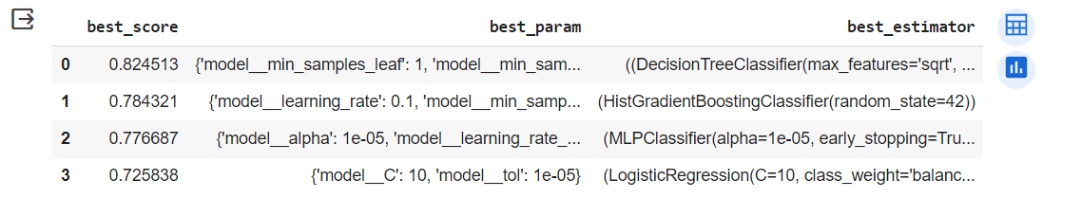
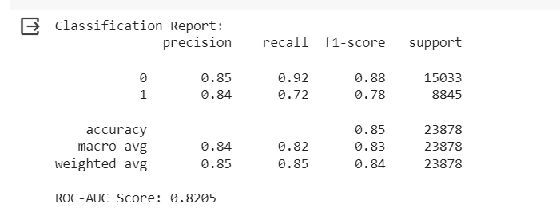
PREDICTIVE MODELING
Model Selection: Four models were evaluated: Logistic Regression (lr), Multi-layer Perceptron Classifier (mlpc), Random Forest Classifier (rfc), and Histogram Gradient Boosting Classifier (hgbc).

Slide 28
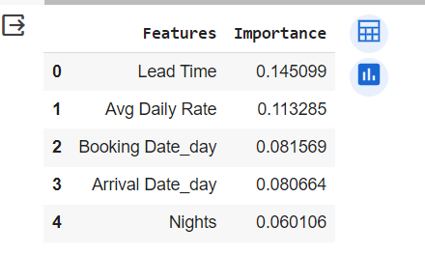
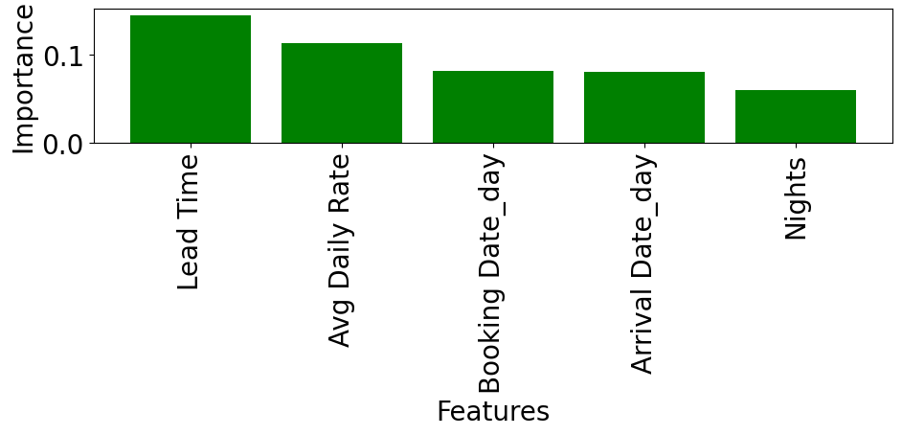
PREDICTIVE MODELING- FEATURE IMPORTANCE

Slide 29
RECOMMENDATIONS
Cancellation Risk Mitigation: Utilize the predictive power of these models to develop strategies for mitigating cancellation risks, leveraging insights from lead time, booking channels, and customer segments.
Dynamic Pricing Strategies: Implement dynamic pricing strategies based on average daily rates across different customer types and booking channels to optimize revenue generation.
Targeted Marketing Campaigns: Tailor marketing campaigns towards countries with high revenue potential, considering both guest count and revenue disparity.
Enhanced Customer Experience: Focus on enhancing the customer experience for transient guests, considering their significant contribution to overall revenue.
Operational Efficiency Improvements: Streamline operations by aligning staffing and resources with monthly and annual booking trends to optimize efficiency during peak and off-peak seasons.

Slide 30
CONCLUSION
The decision tree classifier performed the best with a score of 82.45%, optimized with minimum samples per leaf.
Histogram gradient boosting achieved a score of 78.43% with tuned hyperparameters.
MLP classifier scored 77.67% with early stopping and optimized parameters.
Logistic regression scored 72.58% with adjusted regularization and tolerance.
Key influential features include lead time, average daily rate, booking date, arrival date, and duration of stay.
In summary, decision tree-based models showed the highest performance, offering valuable insights into influential features for outcome prediction.

