Slide 1
Visualize all major parts of New York City that has great Indian Restaurants.

Slide 2
Intro…
New York City's demographics show that it is a large and ethnically diverse metropolis. It is the largest city in the United States with a long history of international immigration.
With it's diverse culture , comes diverse food items. There are many resturants in New york City, each beloning to different categories like Chinese , Indian , French etc.
So as part of this project , we will list and visualize all major parts of New York City that has great indian resturants.

Slide 3
Data Source
New York City data that contains list Boroughs, Neighborhoods along with their latitude and longitude.
Data source : https://cocl.us/new_york_dataset
Description : This data set contains the required information. And we will use this data set to explore various neighborhoods of new york city.
Indian resturants in each neighborhood of new york city.
Data source : Fousquare API
Description : By using this api we will get all the venues in each neighborhood. We can filter these venues to get only indian resturants.
GeoSpace data
Data source : https://data.cityofnewyork.us/City-Government/Borough-Boundaries/tqmj-j8zm
Description : By using this geo space data we will get the New york Borough boundaries that will help us visualize choropleth map.

Slide 4
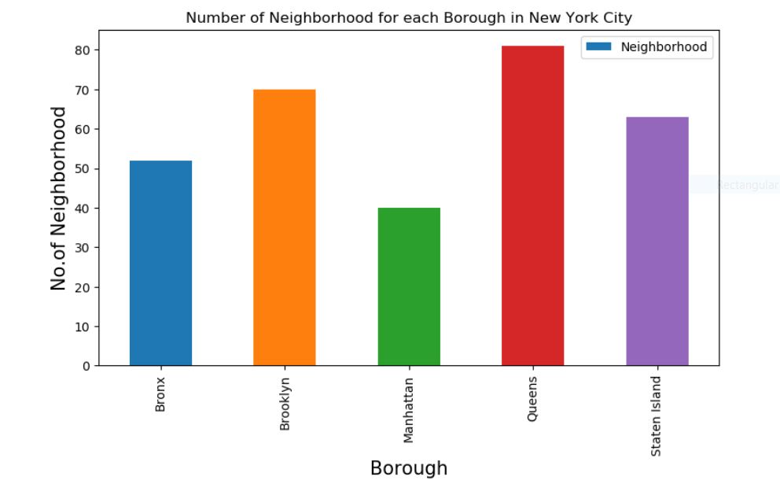
Loading New York City Neighborhoods

Slide 5
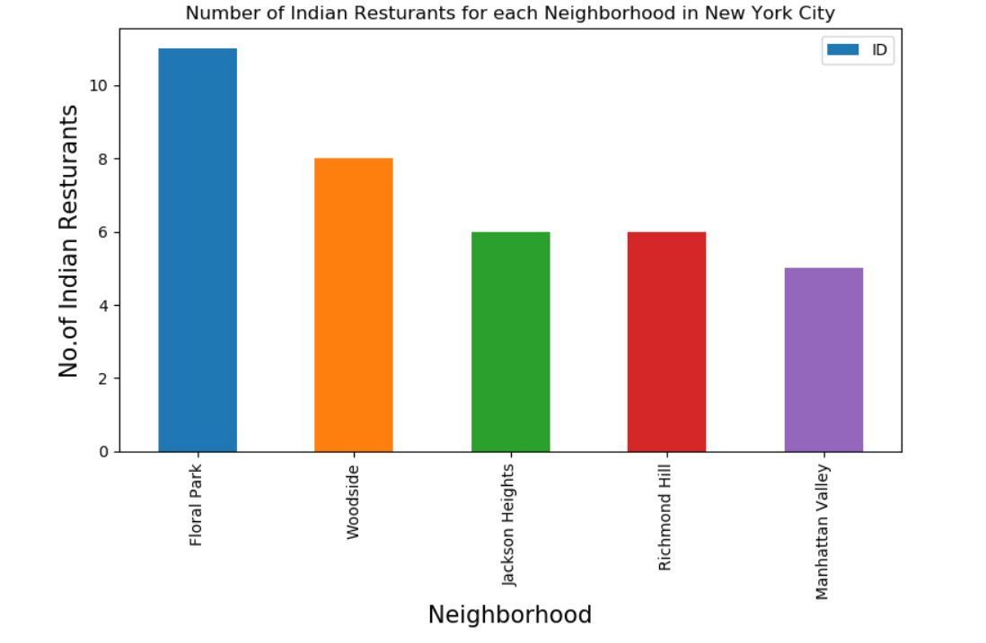
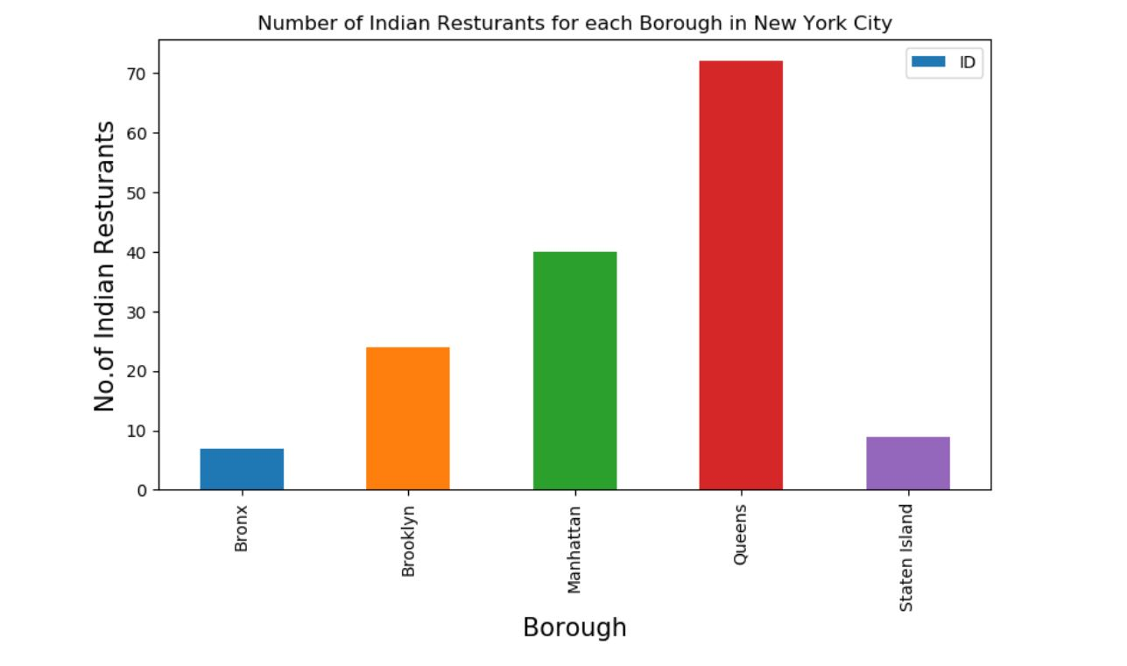
Indian Restaurants in each Neighbourhood and Borough of New York city

Slide 6
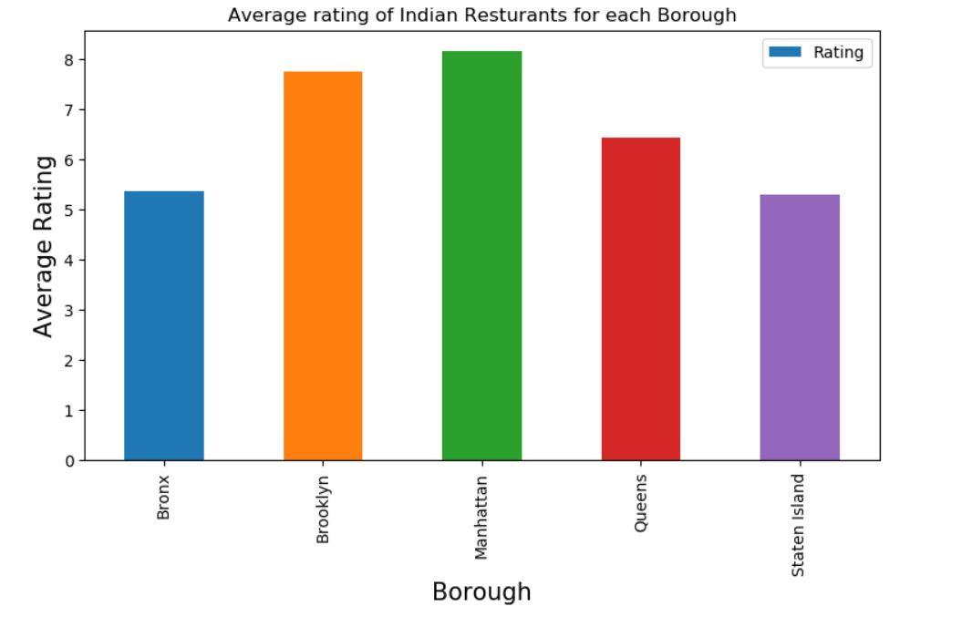
Average rating of Indian Restaurants for each Borough

Slide 7
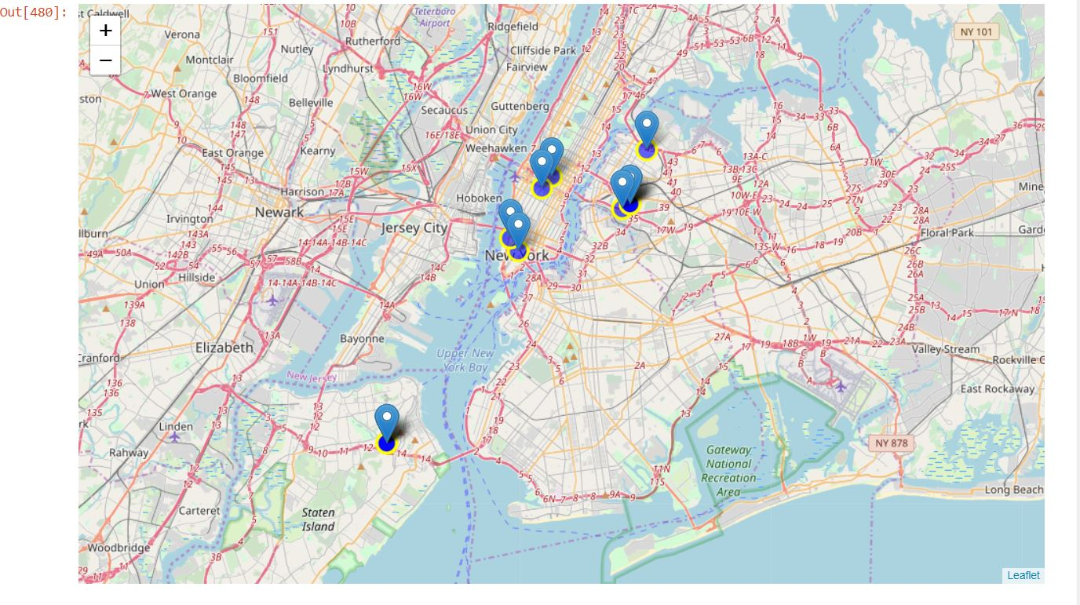
Visualize the top 5 Neighbourhoods.

Slide 8
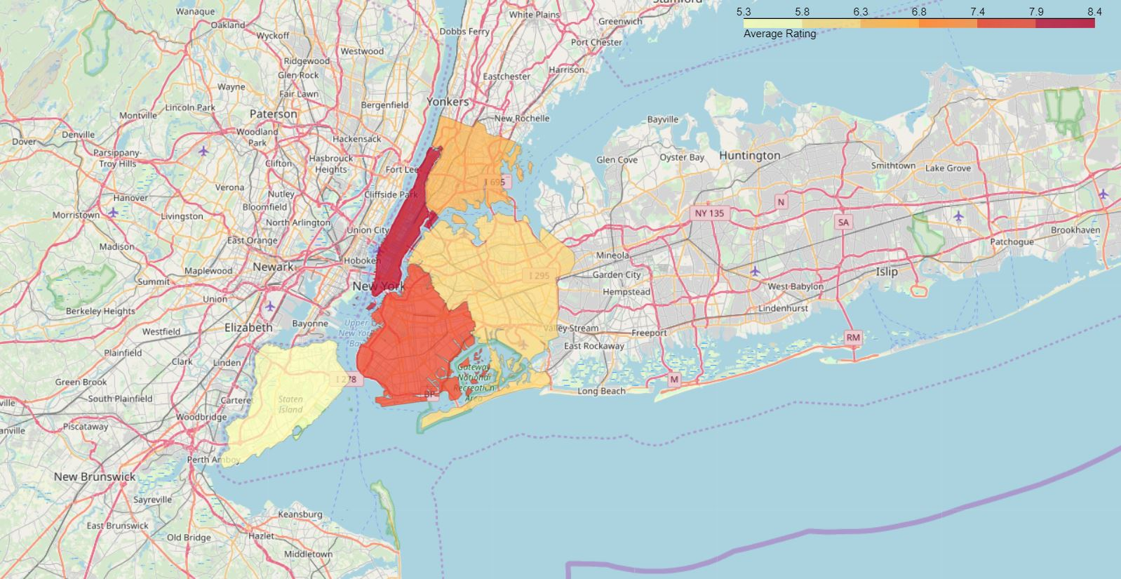
Visualize Boroughs based on average Rating

Slide 9
Conclusion
Astoria(Queens), Blissville(Queens), Civic Center(Manhattan) are some of the best neighborhoods for indian cuisine.
Manhattan have potential Indian Restaurant Market
Staten Island ranks last in average rating of Indian Restaurants.
Manhattan is the best place to stay if you prefer Indian Cuisine.

