Slide 1
L’ORÉAL INDIA · GEN Z HAIR CARE
ROOTED
Care that starts at the scalp.
ROOTED
Winning Gen Z in Hair Care
Notes:
Hold on this slide during Speaker 1’s opening lines.

Slide 2
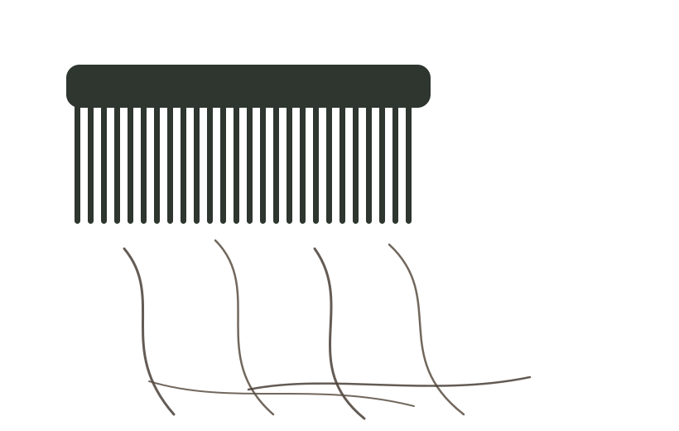
SPEAKER 1 · THE PROBLEM
At 22, she isn’t worried about wrinkles. She’s counting the hairs on her pillow.
For India’s Gen Z, hair fall isn’t vanity — it’s anxiety they can see. In a generation that lives on camera, a receding hairline at 22 attacks the one thing they care about most: how they show up online.
shedding, made visible
Hard water
Pollution
Stress
No sleep
35–40% of India is Gen Z — the fastest-growing beauty segment.
Notes:
Speaker 1 (0:00–0:35). Optional: hold a comb with loose strands to camera.

Slide 3
SPEAKER 1 · THE INSIGHT
Everyone’s talking scalp.
Nobody’s cracked affordable scalp science.
THE MARKET TODAY
THE REAL GAP
Premium Ayurveda prices Gen Z out — ₹2,000–₹4,000 jars. Mass brands just print “scalp” on an anti-dandruff shampoo.
Gen Z searches for scalp serums. They find anti-dandruff shampoo.
No one has built credible, science-backed scalp care for the ₹400–600 wallet.
WHO’S ALREADY HERE
Kama / Forest Essentials
Root Botanié
Mass anti-dandruff
ROOTED
premium Ayurveda, ₹2k–₹4k
scalp microbiome, indie scale
“scalp” in name only
science + Gen Z price + reach
Notes:
Speaker 1 (0:35–0:55). Be honest: scalp is crowded. The gap is AFFORDABLE, credible scalp science. The strip shows we know the competition. Hand off.

Slide 4
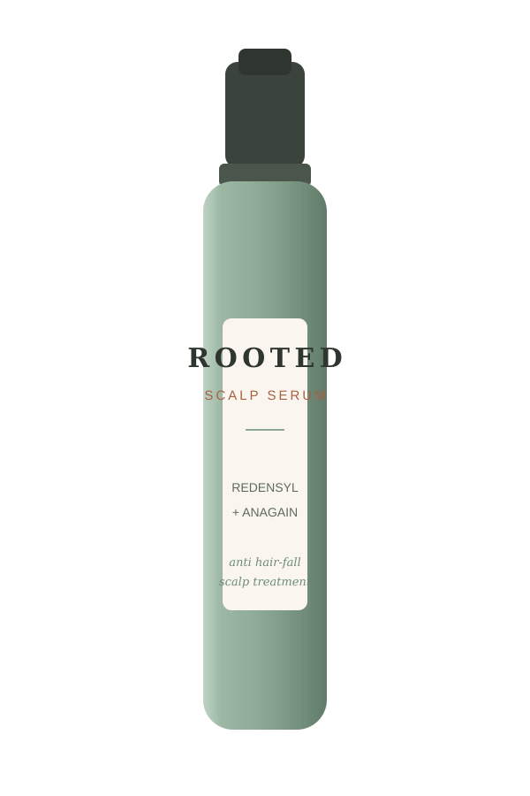
SPEAKER 2 · THE SOLUTION
ROOTED
Scalp-first hair care, built like skincare — backed by L’Oréal’s dermatological science.
LAB meets LAND
CLINICAL ACTIVES
Redensyl · Anagain · Niacinamide · Salicylic Acid · Prebiotics
THE MOAT
INDIAN BOTANICALS
Bhringraj · Cold-pressed Kalonji · Rice Water
Luxury owns premium. Indie owns cheap. Only L’Oréal can put clinical scalp science on the ₹400 shelf — at Blinkit speed.
Notes:
Speaker 2 (0:55–1:20). Introduce ROOTED + Lab meets Land.

Slide 5
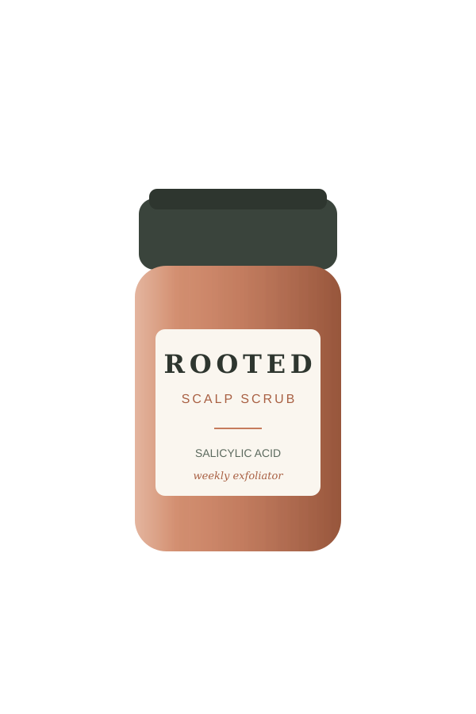
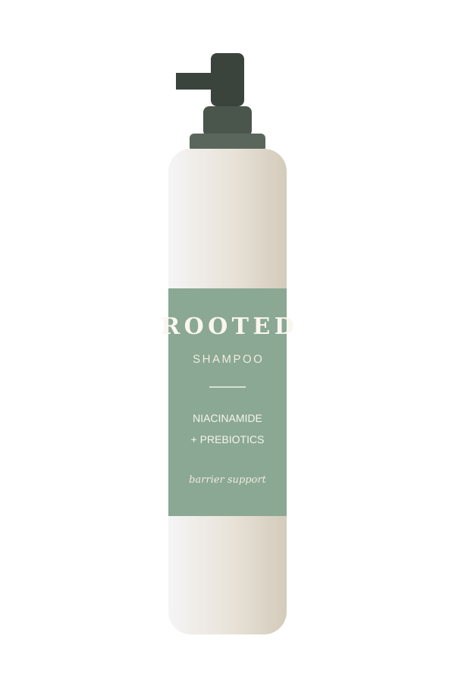
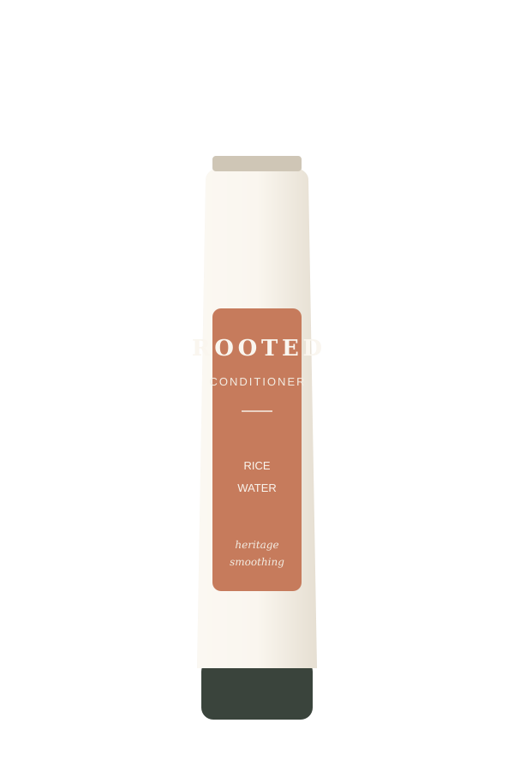
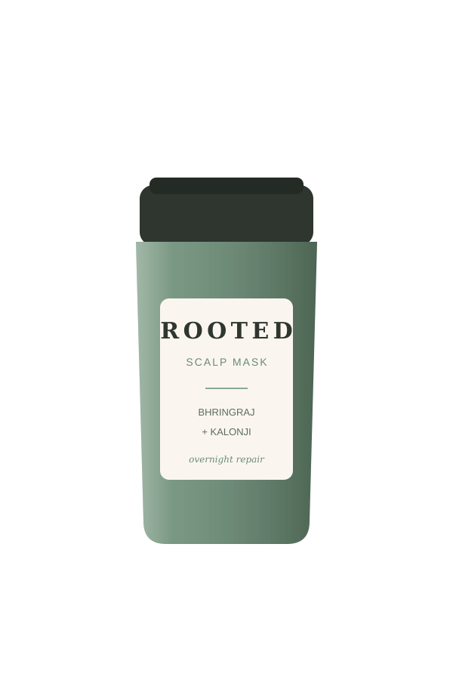
THE RANGE · FIVE HERO SKUs
Premium science, at indie prices.
Scalp Serum
Scalp Scrub
Shampoo
Conditioner
Scalp Mask
₹599
₹449
₹399
₹399
₹549
Starter “Scalp Reset” Kit — ₹899 · all five priced ₹399–₹599, below the impulse-buy ceiling
Notes:
Speaker 2 (1:20–1:35). Gesture across the five bottles.

Slide 6
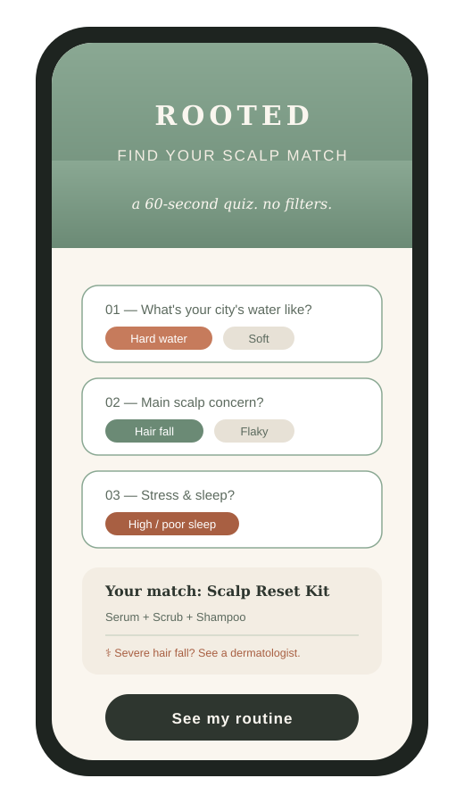
THE UNFAIR ADVANTAGE
Find Your Scalp Match
An honest 60-second quiz — not a fake diagnosis. It reads your city’s water, your symptoms and your stress, then routes you to the right routine.
1
Honest
We promise to help — never to “cure.” Claims stay truthful.
2
Useful
Routes you to the right products, capturing first-party data.
3
Safe
Severe hair fall? It tells you to see a dermatologist.
A brand that says “this helps” survives a bad review. One that says “this fixes you” does not.
Notes:
Speaker 2 (1:35–1:55). Emphasize honesty = trust. Hand off to Speaker 3.

Slide 7
SPEAKER 3 · GO-TO-MARKET
Go where Gen Z already is.
PHASE 1
PHASE 1
PHASE 2
PHASE 3
Quick Commerce
D2C + Nykaa
Modern Trade
Salons
Blinkit & Zepto — ₹99 minis, in-hand in 10 minutes, zero commitment.
Owns the Scalp-Match data, margin and the loyal core.
Month 4+: shelf legitimacy once online demand is proven.
Month 8+: L’Oréal’s salon halo — the at-home extension of pro care.
Prove velocity online first — then unleash the Modern Trade & salon reach no indie brand can touch.
Notes:
Speaker 3 (1:55–2:25). Walk the four phases left to right.

Slide 8
THE CAMPAIGN
“Fix the Root,
Not the Reel.”
Real creators. Real derms. Real hair-fall stories. No filters, no fake promises.
Reframe
Emotion
Muscle
Scalp, not strands — a category no one owns.
We answer anxiety, not vanity.
L’Oréal R&D + distribution indie brands can’t match.
ROOTED
Indie brands sell strands. We own the root.
Notes:
Speaker 3 (2:25–3:00). Close slow: “Indie brands sell strands. We own the root. This is ROOTED. Thank you.”

