Slide 1
WOMEN’S HEALTH
Why do sex differences in mortality and morbidity continue to exist?
How do socioeconomic position, race, and other dimensions of social status interact with gender to produce variations in gender inequity and its health consequences?
How do socially constructed gender roles and differential opportunities shape men’s and women’s lives and turn affect their health?

Slide 2
WOMEN’S HEALTH …
Improved living conditions, better public health and sanitation, better nutrition, and improved medical care and services have benefited both men and women
Mortality rates have fallen and life expectancy has consistently increased for both men and women
Health gains have been greater for women

Slide 3
WOMEN’S HEALTH TRENDS
Current lower mortality for women is a relatively recent occurrence
The present patterns of longer life expectancy for women emerged at the end of the nineteenth century and only in developed countries
Before then, women suffered from excess mortality, attributable to a comparatively harsher life for women and factors such as frequent pregnancies and poor maternal care

Slide 4
WOMEN’S HEALTH TRENDS
Social and health advantages have not accrued to all women because women are not a homogeneous group.
Social diversity and social stratification among women produce different life chances and variations in health status across individuals and subgroups
The health of Canadians has been consistently improving over the years

Slide 5
WOMEN’S HEALTH TRENDS …
Table 1 indicates a female born in 1996 could expect to live for 81.4 and male to the age of 75.7, a difference of 5.7 years
The life expectancy continue to narrow for both sexes
Some differences:
7.8 years in 1978
5.9 years in 1995

Slide 6
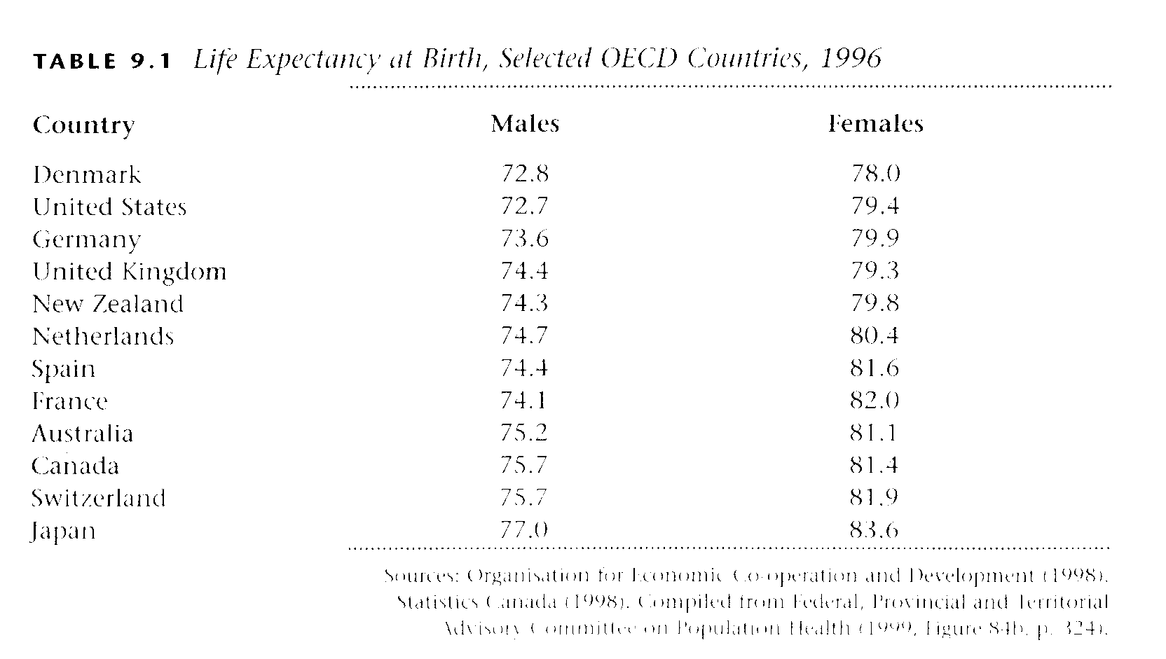
WOMEN’S HEALTH TRENDS …
Bolaria & Dickson, 2002

Slide 7
WOMEN’S HEALTH TRENDS …
Though women in the developed countries have fared well, those in developing countries have not.
Men lived longer (use to???) than women in the Asia and Africa
Bolaria & Dickson, 2002

Slide 8
WOMEN’S HEALTH TRENDS …
The lives of women in these countries continue to be harsher, due to factors such as:
  feudal cultural practices
  excessive violence
  lack of control by women over their bodies and reproduction
  frequent pregnancies
  poor nutrition
  poor obstetric care (UN, 1995)
Bolaria & Dickson, 2002

Slide 9
WOMEN’S HEALTH TRENDS …
There is some variation in mortality and causes of death
The data on Canadian standardized death rates by cause and sex are reported in Table 2.
Bolaria & Dickson, 2002

Slide 10
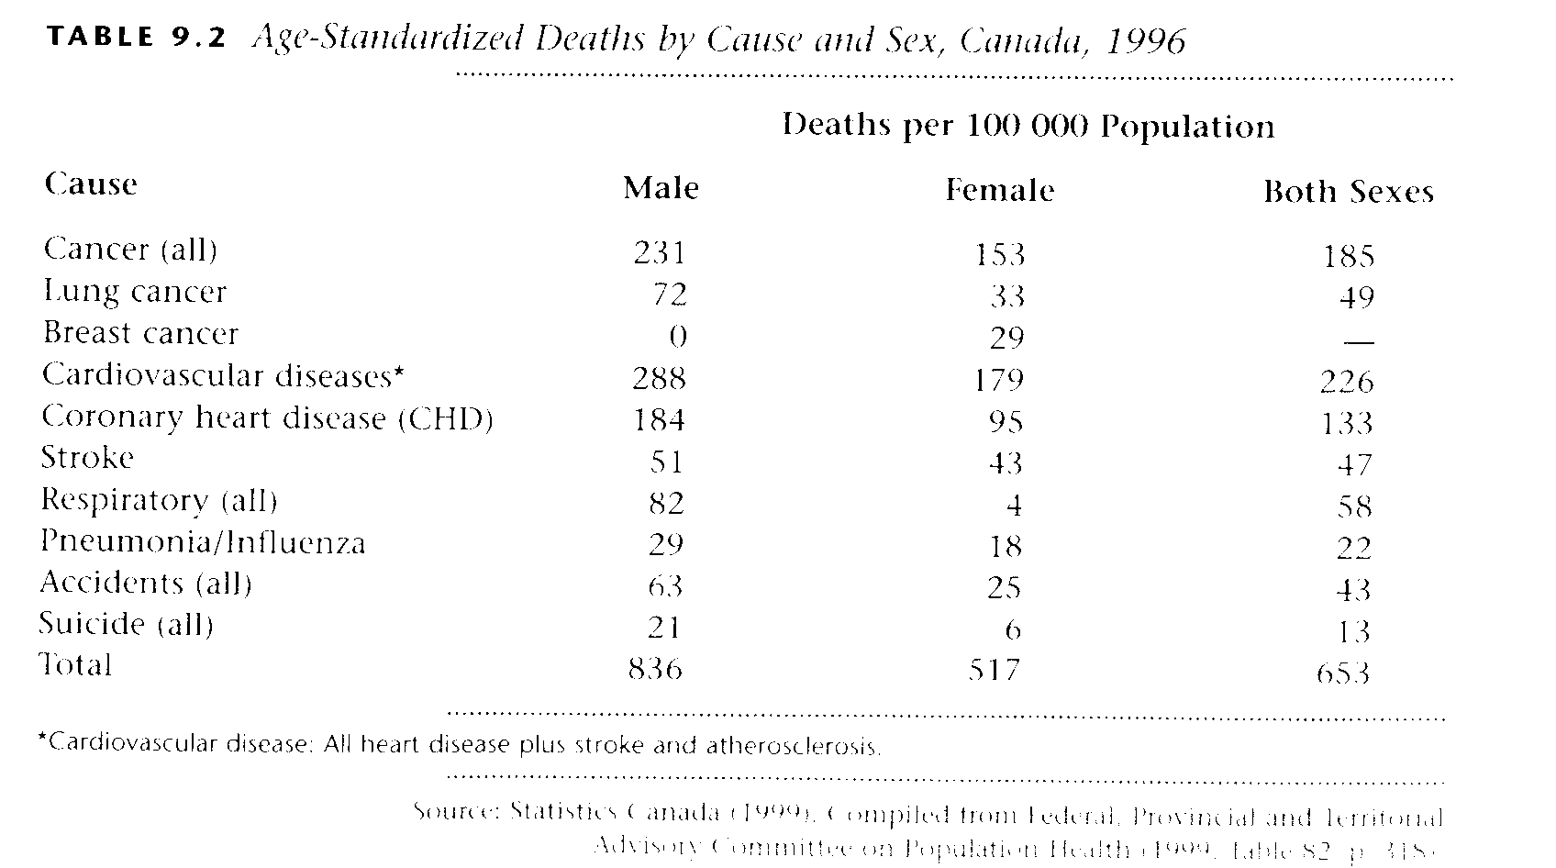
WOMEN’S HEALTH TRENDS …
Bolaria & Dickson, 2002

Slide 11
WOMEN’S HEALTH TRENDS …
In 1996, the male mortality rate (per 100,000 population) was 836, compared with 517 for women.
Overall, the mortality rate in 1996 was 653 per 100,000 which is among the lowest rates in industrialized countries.
Bolaria & Dickson, 2002

Slide 12
WOMEN’S HEALTH TRENDS …
The major causes of deaths for both men and women were:
  cardio­vascular diseases: 226 per 100,000
  cancers: 185 per 100,000
  Among the specific causes of deaths, coronary heart disease (CHD) was the most important: 185 per 100,000
  Male mortality rates are significantly higher than female rates for general and specific causes
Bolaria & Dickson, 2002

Slide 13
WOMEN’S HEALTH – A PARADOX?
Women on average live longer than men, but they also report more illness than men
Women are more likely than men to be hospitalized
The causes for hospitalization are different for males and females
Differences in morbidity and mortality patterns between men and women are evident in other areas
Bolaria & Dickson, 2002

Slide 14
WOMEN’S HEALTH – A PARADOX? …
For example, men are more likely than women to commit suicides, women are twice more likely as men to be depressed and their depression last longer
Women are more likely than men to report conditions such as allergies, headaches etc
While conditions such as arthritis as a cause of activity limitation are frequently reported by women, men report conditions such as heart, back, and limb problems as causing activity limitation
Bolaria & Dickson, 2002

Slide 15
WOMEN’S HEALTH – A PARADOX? …
Women are more likely than men:
  To visit health professionals
  Make more frequent visits
  Use emergency health services
  Have recent check-ups
  Use more antidepressant drugs than men – consistent with their higher levels of depression
Bolaria & Dickson, 2002

Slide 16
WOMEN’S HEALTH – A PARADOX? …
“Women get sicker, but men die quicker" sums up the morbidity and mortality patterns of men and women in developed countries
How can this paradox be explained?

Slide 17
“Women get sicker, but men die quicker”: Explaining gender differences in health
Artefact explanation
Genetic causation
Social causation

Slide 18
Artefact explanation
Some researchers argue that the differences between men and women are an "artefact," rather then real
Their main argument is that while women's health status is not any worse than men's, women are more likely:
  to take notice of their symptoms
  are inclined to see a physician
  seek treatment
  are more willing to respond to health surveys (Miles, 1991)

Slide 19
Biological and genetic explanation
Biological and genetic differences (sex chromosomes and hormones) have also been used to explain morbidity and mortality differences between men and women

Slide 20
Biological and genetic explanation …
Statistics that are often used to show female "superiority" refer to differences in male and female conception, fetal mortality, stillbirths, and infant mortality rates
It is also argued that females, due to their biological and genetic constitution, reproductive anatomy, and physiology, may be endowed with resistance to certain diseases.

Slide 21
Social causation explanation
Social and economic inequalities and socially constructed gender roles have important consequences for men's and women's lives and produce variations in health and illness patterns
Social and economic inequalities produce differential opportunities and life chances; social roles and related activities expose men and women to different health risks
The focus here is on the social production of health and illness

Slide 22
Social causation explanation …
Social and economic inequality produce negative health outcomes and poor health status for women
Also it is argued that male socialization and lifestyles expose men to riskier, aggressive, and dangerous behaviour,
For instance, men have higher mortality due to motor vehicle accidents
Men are also more likely to indulge in excessive smoking, drinking, and substance abuse, with negative health consequences

Slide 23
Social causation explanation ...
On the other hand, it is pointed out that the often demanding and contradictory social roles of women produce negative health outcomes
For instance, domestic work responsibility and a caring role in the family, combined with the increasing participation of women in the paid work force, may contribute to elevated stress levels among women

Slide 24
Explaining Gender Differences – Theoretical Perspectives
Two theoretical perspectives are advanced to explain gender differences in psychological health:
  differential exposure theory
  differential vulnerability theory
  Both theories attribute gender differences in psychological well-being to the social organization of men's and women's lives.
  The former emphasizes the extent to which men and women are exposed to particular stressors, whereas the latter focuses on men's and women's responses to those stressors (Rieker & Bird, 2000, p, 102).

Slide 25
Differential exposure theory
According to this, women experience hardships and stressors to a greater extent than do men because of their disadvantaged position relative to men in the work force and the inequitable division of work in the household
Married women in particular experience work overload due to work outside home and at home
This overload produce higher psychological distress

Slide 26
Differential vulnerability theory
This theory argues that, the effects of particular stressors differ for men and women for a variety of reasons.
For instance, men and women may attach different meanings and significance to paid work and family roles because of different normative expectations about work and family responsibilities

Slide 27
Differential vulnerability theory …
Sociocultural beliefs and normative expectations may affect men's and women's self evaluations as parents and spouses.
Women are more likely than men to experience role conflict and to see their work and family roles as competing rather than integral, and thus they experience more guilt and stress than men
That the consequences of housework and employment differ for men and women and produce different health outcomes

Slide 28
Differential vulnerability theory …
Patterns of health and illness have everything to do with women's lives, work, employment opportunities, life experience, and social and economic circumstances.
However, it should be noted that social, economic, and other disadvantages do not accrue to all women equally (Macintyre, Hunt, & Sweeting, 1996).

Slide 29
Differential vulnerability theory …
Women are not a homogeneous group, but, rather, are diversified and stratified by class, race, and ethnicity.
The social patterning of health and disease are also differentially experienced by various subgroups.
For instance …

Slide 30
Differential vulnerability theory …
Racial minority women often experience ill health because of unhealthy work environments and harsher working conditions in areas such as farm labour, textiles and sewing, and domestic work
Health status inequalities and the social patterning of disease between diverse groups of women are supported by research findings from other countries

Slide 31
Differential vulnerability theory …
Racial minority women are doubly disadvantaged
Social and economic differentiation and heterogeneity among women produce subgroup differences in health effects and health outcomes.

Slide 32
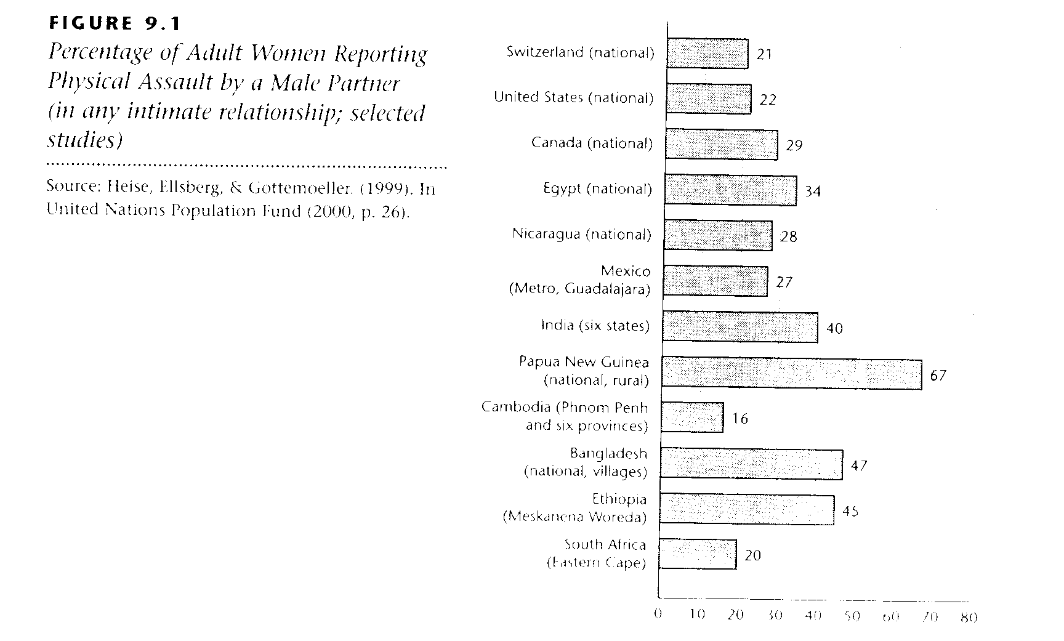
Inequity, Violence and Women’s Health

Slide 33
Inequity, Violence and Women’s Health …
Inequities compound the impact of violence
Examples:
Less privilege means:
  More violence
  More costly disclosure
  Fewer choices

Slide 34
Inequity, Violence and Women’s Health …
Inequities create barriers to support
Examples:
Inequities means less:
  Access
  Appropriate support
  Power
  Inequity fosters violence, which in turn fosters inequity

