Slide 1
Report: AI Profiling for Specific Sectors (Part 2)
AUTHOR
Anand Veerarahavan

Slide 2
AGRICULTURE INDUSTRY
OBJECTIVES
MINDMAP OF AGRICULTURE INDUSTRY
IMPACT OF AI ON AGRICULTURE INDUSTRY
APPLICATIONS OF AGRICULTURE INDUSTRY
PROJECTS, COMPANIES INVLOLVED

Slide 3
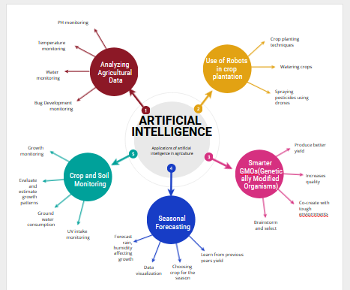
MIND MAP OF AGRICULTURE INDUSTRY

Slide 4
IMPACT OF AI IN AGRICULTURE INDUSTRY
Robots
Firstly, companies are now gradually adopting AI powered machines to automate agricultural tasks such as harvesting larger volumes of crops faster than human workers. For
instance, companies are using robots to remove weeds and unwanted plants from fields.
Computer Vision
Secondly, companies are using computer vision and deep learning algorithms to process and study crop and soil health. For instance, farmers are using unmanned drones to survey
their lands in real time to identify problem areas and areas of potential improvement. Farms can be monitored frequently using these machines than they can be with farmers doing
so on foot.
Seasonal Forecasting
Thirdly, AI is used to track and predict environmental impacts such as weather changes. Seasonal forecasting is particularly valuable for small farms in developing countries as
their data and knowledge can be limited. Keeping these small farms operational and growing bountiful yields is important as these small farms produce 70% of the world’s crops,
The India story
In India, for instance, farmers are gradually working with technology to predict weather patterns and crop yield. Since 2016, Microsoft and a non-profit have together developed an
AI sowing application which is used to guide farmers on when to sow seeds based on a study of weather patterns, local crop yield and rainfall.
Chatbots
Moreover, farmers across the world have begun to turn to chatbots for assistance and help, getting answers to a variety of questions and queries regarding specific farm
problems.
Precision Farming
Research predicts the precision agriculture market to touch $12.9 billion by 2027. Precision agriculture or farming, also called site-specific crop management or satellite farming,
is a concept of farm management that utilizes information technology to ensure optimum health and productivity of crops. With this increase in the volume of satellite farming, there
is bound to be an increase in the demand for sophisticated data-analysis solutions. One such solution has been developed by the University of Illinois. The system developed aims to
“efficiently and accurately process precision agricultural data.”

Slide 5
IMPACT OF AI IN AGRICULTURE INDUSTRY
Food quality & quantity
It is one of the best methods to improve the food quality with the help of an automated process for sorting the products which is referred as optical sorting. The major
innovation in the food supply is the UAV(Unmanned Aerial Vehicle). They offer the solutions to many of the problems of large farms by scanning vast areas of land in real
time for soil analysis, plant protection, crop anomalies, etc. Another crucial application is through sensor networks which have been a part of greenhouse climates
controllers for a while, but the addition of AI-based techniques like neural networks have improved the yield and decreased the use of water and energy.
Lack of human labor
There are many technologies which help to reduce the requirements of human labor in the agricultural sector. Optical sorting system, autonomous UAVs etc have efficiently
replaced the humans, but other innovations are also been designed specifically for this purpose
Water & land management
Several institutions and universities have been still researching on how to create a more efficient irrigation system and AI techniques have shown to be the promising factor
in this area. There are many innovative systems that rely on the sensors or parameter modeling
Maximum potential
While the digital transformation is disrupting the agricultural world much more, the data come to feed the systems solution like Watson IoT platform that helps to enhance
the value by applying machine learning abilities for sensing the transformational management system.
Image reorganization
The agricultural drones have already helped farmers to scan fields, monitor crops, and seeding or analyzing the plant health. According to very recent reports of IBM, IBM
has partnered with the aircraft system to recognize APIs for commercial droned in order to capture the images, identify areas, etc.
Skills and workforce
In recent World Urbanization Prospect reports, UN has predicted that by the year 2050 around 66% of the world’s population will live in urban areas. This increasing
urbanization will lead to a reduction of the workforce in rural areas.
Maximize return
The massive use of cognitive technologies in agricultural could help for determining the best crop choice or the best hybrid seed choice for crop mix that is adapted to
various objectives, conditions and better suited for farm’s seed.

Slide 6
APPLICATIONS OF AGRICULTURE INDUSTRY
Blue River Technology
Specialises in Weed Control
Companies like Blue River Technology are using automation and robotics to discover efficient ways in order to protect crops from weeds. The company has developed See &
Spray robot which leverages computer vision to monitor and spray weed on cotton plants precisely. Spraying with precision can be helpful in preventing herbicide
resistance. Reportedly, the company claims that’s its precision technology eliminates around 80 percent of volume of chemicals sprayed on crops and is also helpful in
reducing herbicide expenditure by 90 percent.
Harvest CROO Robotics
Specialises in Crop Harvesting
Harvest CROO Robotics is a company that developed a robot to assist strawberry farmers pick and pack their crops. Due to lack of labourers, millions of dollars’ revenue
has loss has been reported key farming regions of US including California and Arizona. The company claims that its robot is capable of harvesting
PEAT
Specialises in Machine Vision for Diagnosing Pests / Soil Defects
PEAT is a Berlin-based technology start-up which created deep learning for identifying potential defects and nutrient deficiencies in soil. The Deep Learning-empowered image
recognition application is termed as Plantix. It detects possible defects through images and provides users with soil restoration techniques, tips and other significant
solutions. PEAT claims that Plantix can quickly achieve pattern detection with approximately 95 percent accuracy.
Trace Genomics
Specialises in Machine Learning for Diagnosing Soil Defects
Trace Genomics is a California-based company that provides soil analysis to farmers. With the help of its lead investor Illumina, the company developed a system that
provides clients with a sense of their soil’s strengths and weaknesses using machine learning. The analysis emphasises on prevention form defective crops and optimizing
the potential production a healthy crop.

Slide 7
APPLICATIONS OF AGRICULTURE INDUSTRY
SkySquirrel Technologies Inc.
Specialises in Drones and Computer Vision for Crop Analysis
SkySquirrel Technologies Inc. brings drone technology to vineyards. It aims to help farmers improve their crop yield and to reduce costs. Also users can pre-program the
drone’s route and the device can further apply computer vision to record images for future use. SkySquirrel employs algorithms in order to integrate and analyze the
captured images and data. Consequently, it will provide a detailed report on the health of the vineyard. After a successful joint venture, in January of 2018 SkySquirrel
Technologies and VineView Scientific Aerial Imaging Inc. merged to form VineView.
FarmShots
Specialises in Satellites for Monitoring Crop Health and Sustainability
FarmShots is a startup which focuses on analyzing agricultural data derived from images captured by satellites and drones. The company is based in Raleigh, North Carolina. In
particular, FarmShots has goals to detect diseases, pests, and poor plant nutrition on farms.
Abundant Robotics
Specialises in Apple Harvesting Technology
With a mission of delivering robotic systems for the hardest jobs in agriculture the Abundant Robotics team has broken new ground in a variety of domains. Although the
company majorly focuses on apple harvesting, for last two years it has been focused on hard problems in agriculture and rolling out products based on their successful
research. Abundant Robotics’ first product was apple picking machine.
Ibex Automation
Specialises in Agricultural Robot Systems
The Wortley, United Kingdom-based company develops autonomous agricultural robot systems for farmers. Ibex Automation system also includes an autonomous precision weed
detection and spraying system that could be used in grassland. Ibex Automation Ltd was developed from an InnovateUK project which prototyped this technology.

Slide 8
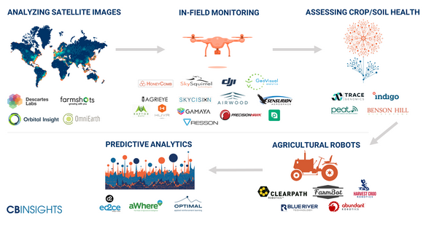
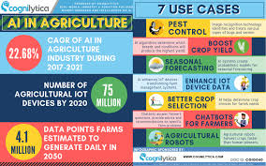
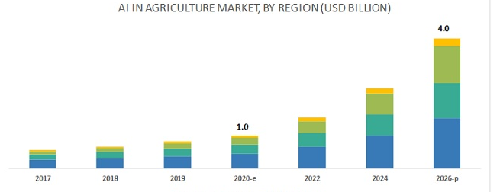
AGRICULTURE INDUSTRY

Slide 9
INSIGHTS AND RECOMMENDATIONS FOR AGRICULTURE
1. Using AI and machine learning-based surveillance systems to monitor every crop field's real-time video feeds identifies animal or human breaches, sending an alert
immediately.
AI and machine learning reduce domestic and wild animals' potential to accidentally destroy crops or experience a break-in or burglary at a remote farm location. Given the rapid
advances in video analytics fueled by AI and machine learning algorithms, Everyone involved in farming can protect their fields and buildings' perimeters.
2. AI and machine learning improve crop yield prediction through real-time sensor data and visual analytics data from drones.
The amount of data being captured by smart sensors and drones providing real-time video streaming provides agricultural experts with entirely new data sets they've never had
access to before. It's now possible to combine in ground sensor data of moisture, fertilizer and natural nutrient levels to analyze growth patterns for each crop over time.
3.Yield mapping is an agricultural technique that relies on supervised machine learning algorithms to find patterns in large-scale data sets and understand the
orthogonality of them in real-time – all of which is invaluable for crop planning.
It’s possible to know the potential yield rates of a given field before a vegetation cycle is ever started. Using a combination of machine learning techniques to analyze 3D mapping,
social condition data from sensors and drone-based data of soil colour, agricultural specialists can now predict the potential soil yields for a given crop.
4.The UN, international agencies and large-scale agricultural operations are pioneering drone data combined with in-ground sensors to improve pest management.
Using infrared camera data from drones combined with sensors on fields that can monitor plants' relative health levels agricultural teams using AI can predict and identify pest
infestations before they occur.
5.Today, there’s a shortage of agricultural workers, making AI and machine learning-based smart tractors, agribots and robotics a viable option for many remote
agricultural operations that struggle to find workers.
Large-scale agricultural businesses can’t find enough employees and turn to robotics for hundreds of acres of crops while also providing an element of security around the
perimeter of remote locations.
6.Improving the track-and-traceability of agricultural supply chains by removing roadblocks to getting fresher,
safer crops to market is a must-have today.
The pandemic accelerated track-and-traceability adoption across all agricultural supply chains in 2020 and will continue to drive its adoption this year. A well-managed track-and
trace system helps reduce inventory shrinkage by providing greater visibility and control across supply chains.

Slide 10
E-COMMERCE INDUSTRY
OBJECTIVES
MINDMAP OF E-COMMERCE INDUSTRY
IMPACT OF AI ON E-COMMERCE INDUSTRY
APPLICATIONS OF E-COMMERCE INDUSTRY
PROJECTS, COMPANIES INVLOLVED

Slide 11
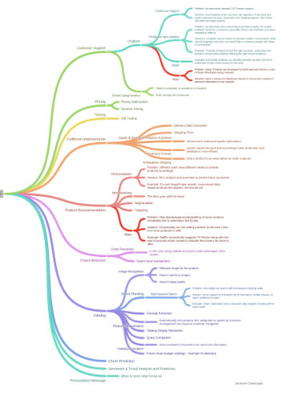
MIND MAP OF E-COMMERCE INDUSTRY
ART
I
F
I
C
I
AL
I
NTELL
I
GENCE

Slide 12
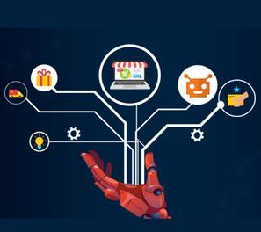
IMPACT OF AI IN E-COMMERCE INDUSTRY
The use of artificial intelligence in online shopping is transforming the E-commerce industry by predicting shopping patterns based on the products that shoppers buy and when they
buy them. For example, if online shoppers frequently buy a particular brand of rice every week, then the online retailer could send a personalized offer to these shoppers for this
product, or even use a machine learning-enabled recommendation for a supplementary product that goes well with rice dishes.
Areas of Impact :
AI-enabled Email Marketing that sends out marketing emails for products (or services) that are of interest to the recipient. Apart from reading more human than automated, these email marketing tools make an intelligent user analysis based on their response and are more aligned to individual customer needs.
AI-enabled Supply Chain Automation that enable effective management of supply chains for E-commerce platforms. Other benefits include enabling business decisions related to vendors, delivery schedules, and market needs.
AI-based data analytics tools for the E-commerce sector that provide a host of benefits such as business intelligence, customer profiles, and online sale analysis.
Omnichannel AI solutions that are creating a consistent and seamless customer experience across online and brick-and-mortar retail stores. For instance, AI-based omnichannel solutions from Sephora are utilizing a combination of AI and machine learning, natural language processing, and computer vision to reduce the gap between in-store and online customer experiences.
Benefits of AI in E-commerce :
Product Recommendation
Chatbot Services
Analyzing Customer Comments
Personalized shopping experience
Predicting Shopping patterns
Inventory Management
Artificial Intelligence in Ecommerce is playing a leading role in driving innovative solutions and customer experiences.

Slide 13
IMPACT OF AI IN E-COMMERCE INDUSTRY
DOMINANCE OF ARTIFICIAL INTELLIGENCE IN E-COMMERCE
1. Visual Search Engine
The e-commerce sector has started the use of artificial intelligence by using visual search engines. This helps the user by allowing them to search for whatever they desire
with a single click. The visual representation of the products has proved to be more appealing to the customers. The customers can now view the size, dimensions, design,
and color of the product before ordering it. This helps in improving the consumer experience of the brand.
2. Provides Personalized Recommendations
Artificial Intelligence uses pop-ups, texts, and emails to provide product recommendations to the buyers. It tracks the searches made by the users to understand consumer
behaviour. The search engines and other social media platforms also display images and ads of the product related to the interest of the user which is also tracked by
Artificial Intelligence in e-commerce.
3. Voice and Virtual Assistance
Artificial Intelligence is focusing to provide more interactive solutions to the customers. It provides real-time voice assistance to the users. This has largely contributed to
improving the user experience. This makes it easy for users to interact with service providers
4. Use of AI in Lead Generation and Sales
One of the most significant uses of AI is in generating sales for e-commerce platforms. It extracts the data of the consumers and tracks the purchasing patterns of the
buyers. Imagine how time-consuming it would be if humans had to collect data and track consumer behaviour. AI has lowered the burden and has made these tasks easy.
5. AI Offers Services at Lower Costs
The services provided by AI are quite affordable. It makes the daily processes automatic and improves the shopping experience.
One of the most cost-effective services provided by Artificial Intelligence is Chatbots.
6. AI Helps in E-commerce Marketing
Marketing in any business is an expert’s work. AI solutions provide a cost-effective way to assist in the marketing of various brands.
These businesses can offer their marketing plans and campaigns to AI platforms like Acquisio. Marketing operations are handled quite efficiently with the use of these
platforms. It provides marketing solutions on various social platforms like Facebook, Google Adwords, Bing, and more. The AI solutions help in minimizing the Cost Per Click
and utilize the marketing budget in the most feasible manner.

Slide 14
APPLICATIONS OF E-COMMERCE INDUSTRY
1) SRAX
This AI tool uses an advanced algorithm to automatically optimize PPC campaigns on Google, Facebook, and other platforms. By matching keywords to site content and using a
real-time bid optimization system, this tool puts relevant messages in front of the right customers. Best of all, the technology backing this system focuses on
maximizing your cost-effectiveness, helping reduce the cost per click associated with each campaign.
2) Liveperson
Liveperson uses AI and machine learning to help your store deploy highly effective chatbots that can work in tandem with a human customer support team. With
the use of a quality chatbot, customers can quickly get answers to their basic questions, resolving concerns and increasing the likelihood of a sale.
3 & 4) Phrasee and Seventh Sense
Phrasee takes this challenge out of your hands by using an advanced AI system that determines what type of content will have the biggest impact on your
target audience. Machine learning doesn’t just ensure that the AI system produces content that sounds like it was written by a human being, it also writes content that
matches your brand voice. Allowing AI to craft more effective email content is a surefire way to increase store sales. Now you want to get that email to the interested
individual at just the right time. Seventh Sense delivers your emails at personally optimized times, getting the right email, to the right
person, at the right time. This platform integrates with Hub Spot.
5) Betaout
Betaout’s AI tool uses customer data to send real-time updates to a customer after their cart has been abandoned. Betaout pulls information directly from your
site and the customer’s cart to send emails or even text messages to customers who abandoned their shopping cart. Inventory updates, limited-time sales and
other alerts will greatly increase the likelihood of your customers returning to their carts to make a purchase.
6) Twiggle
Twiggle ensures that customers who visit your online store won’t be frustrated by search tools that don’t understand what they typed. This AI product uses
advanced knowledge of human linguistics to understand what your customers are looking for and display the right results—just like in a real search engine
that will help you make additional sales.

Slide 15
APPLICATIONS OF E-COMMERCE INDUSTRY
AI tools available for mobile apps
There are several machine learning APIs that can be integrated into mobile platforms and reap the benefits of AI. Here is the list:
AT&T Speech
The popularity of virtual assistants has made voice recognition technology more relevant. The AT&T speech API delivers speech recognition capabilities to the
mobile app. It is powered by AT&T Watson speech engine which is natural language understanding and speech recognition technology. The AT&T speech API has
the capabilities to convert voice into text and vice-versa that further refines the custom centric search and deliver relevant results.
IBM Watson
IBM Watson is a combination of machine learning with cognitive computing. IBM offers a range of APIs that can be utilized to embed machine learning
capabilities in mobile apps. With IBM Watson API integrated, mobile apps will have the capability of natural language processing, prediction, and computer vision.
The IBM Watson API suite includes speech to text and vice-versa, personality insights, question and answers, trade-off analytics, visual recognition and tone
analyzer.
Google Prediction
The Google Prediction API gives access to machine learning capabilities including recommendation engine, prediction, pattern recognition, and natural language
processing. The Google Prediction API comes with getting started page, code samples, client libraries, and API documentation guide. Large ecommerce retailers
like Amazon are using AI in different ways to boost e-commerce and make it safer.
Amazon uses machine learning in making recommendations based on browsing pattern. The global retailer also uses AI to know whether the customer will become a paying
customer based on their activities during the first week/month. It also uses AI to detect spammers, bots and fake users based on their activity records.
Netflix also uses AI to know what you want to watch before you watch it. The AI algorithm used by Netflix learns from user actions. For example, imagine you
watch the first video of a series but you don’t like it. You are generally asked to give your feedback after watching content on Netflix. If you rate it low, Netflix
draws a conclusion that you won’t be interested in watching the second episode and you don’t like that kind of shows. Hence, it will keep such shows far away
from your recommendation list.

Slide 16
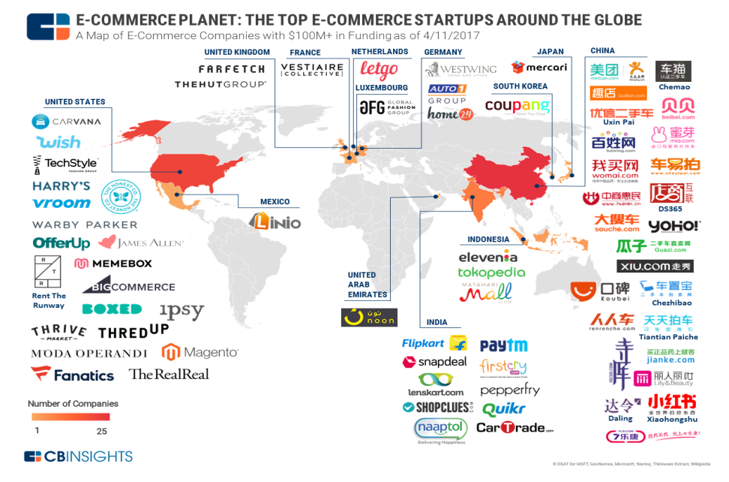
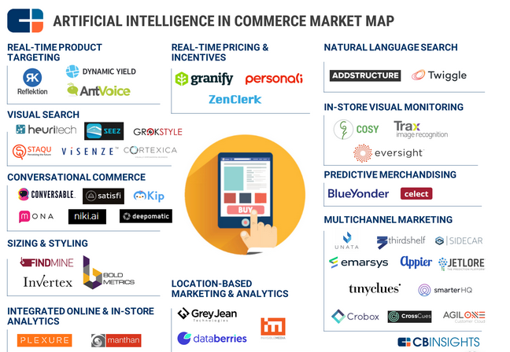
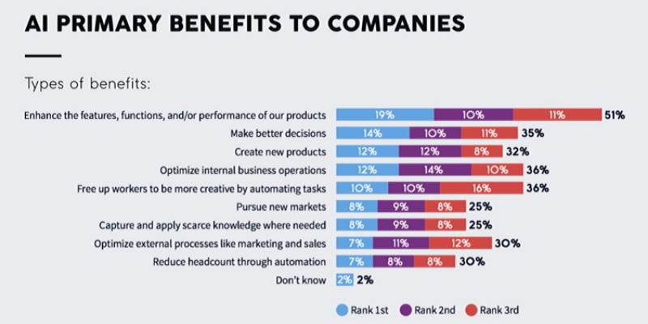
E-COMMERCE INDUSTRY

Slide 17
INSIGHTS AND RECOMMENDATIONS FOR E-COMMERCE
Custom centric search
Though technology plays an important role in our lives, we still love the human element in everything we do. A large number of people abandon e-commerce experiences because
the results displayed in search are not relevant. AI can be used to improve e-commerce search and tackle this problem. With AI integrated in ecommerce apps, customers need not
search by typing keywords but they can use visuals/images to find something similar in e-commerce stores. For example, if they like their friend’s dress or shoes, they can find
something similar for them in e-commerce stores.
Retarget potential customers
Today, businesses are overloaded with customer data, but that is seldom put to good use. The data is a goldmine of intelligence that can be used to enhance sales cycle. For
example, if a customer spends a notable amount of time browsing through a certain category of products, that information can be used for their next visit. When the consumer
opens the ecommerce app next time, the e-commerce stores can flash special offers on the category of items based on customer’s dwell time.
Create efficient sales process
Today’s customers are heavily influenced by different streams of media and you need to understand your customer better before offering custom-made solutions. You can embed AI
in ecommerce apps in order to ask right question to the customers. For example, if the customer is looking for a jacket, AI can be used to frame questions like where and when the
customer will be using the jacket.
Create a personalized experience with mobile devices
Today’s customer uses multiple channels to complete a purchase. For example, the customer may browse the products on a larger screen (desktop or laptop) and complete the
purchase on mobile device. Ecommerce companies need to embed AI in every platform to ensure a consistent and personalized experience for the customer. They need to use the AI
engine to monitor customers on all platforms, devices, and channels, create a universal view that will help in delivering seamless experience to customers.
Improve recommendations
AI can be used to predict a customer behavior by scanning the browsing data. It can be used to make meaningful, relevant, and helpful recommendations. This can help in
personalizing experience for the customer. The AI algorithm uses a variety of inputs including user preferences, account information, purchase history, contextual information and
data from 3rd parties to deliver more personalized suggestions.

Slide 18
REFERENCES
https://medium.com/@Countants/how-artificial-intelligence-is-transforming-the-e-commerce-industry-countants-scalable-custom-73ae06836d35
http://wiredsoft.org/cloud-blog.aspx?ID=1072
https://www.appfutura.com/blog/how-use-ai-ecommerce-apps/
https://www.revenueriver.co/thedigitaloutdoorsman/6-ai-tools-to-drive-e-commerce-sales-for-brands
https://www.marketsandmarkets.com/Market-Reports/ai-in-agriculture-market-159957009.html
https://www.dexlabanalytics.com/blog/applications-of-artificial-intelligence-agriculture
https://usmsystems.com/ai-in-agriculture-applications-of-ai-its-tools/
https://www.plugandplaytechcenter.com/resources/10-agriculture-automation-companies-shaping-future-farming/
https://www.analyticsinsight.net/top-10-ai-and-robotics-companies-transforming-agriculture-sector/
https://usmsystems.com/ai-in-agriculture-applications-of-ai-its-tools/

Slide 19

THE END

