Slide 1
Introduction:-
The purpose of the project is to build an web application, which can cancel SCL contract.
Advantages:
Existing System don’t have provision to cancel SCL contract
Technologies Used:
Frontend: React JS (VS Code, Version: 1.75.1)
Backend: SpringBoot (SpringToolSuite4, Version: 4.17.2.RELEASE)
Database: Oracle SQL(Version 22.2.1.234)
Testing: Insomnia(Version 2023.2.0)
Tables Used:
PS_TB_LN_CONTRACT_DEFN
PS_TB_COM_CONTACT_DEFN
PS_TB_BRANCH_DEFN
PS_TB_HP_CONTRACT_STATUS_DICT

Slide 2





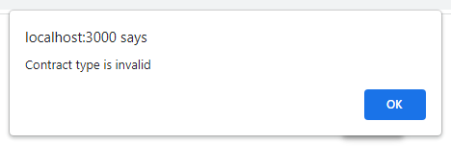
Work flow:
Three steps to complete the task to cancel a contract:
Click on Cancel Contract Feature
Enter the contract number
Screen two having few validations which are
2.1: Contract number should not be blank
2.2: Contract number must have SCL type else error

Slide 3
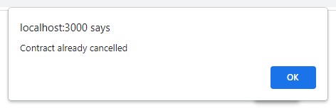
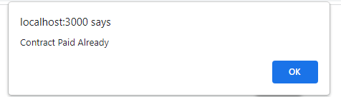
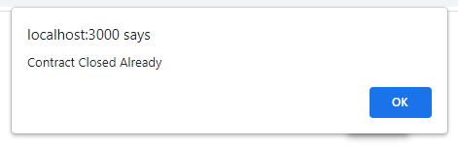
2.3: Contract number should not already cancelled (contract_status=N) else error
2.4: Contract number should not paid (contract_status=P) else error
2.5: Contract number should not paid (contract_status=L) else error
2.6: Contract number should only accept when Contract status is approved, Entry or Initial Stage (contract_status=A, E and I) else error

Slide 4
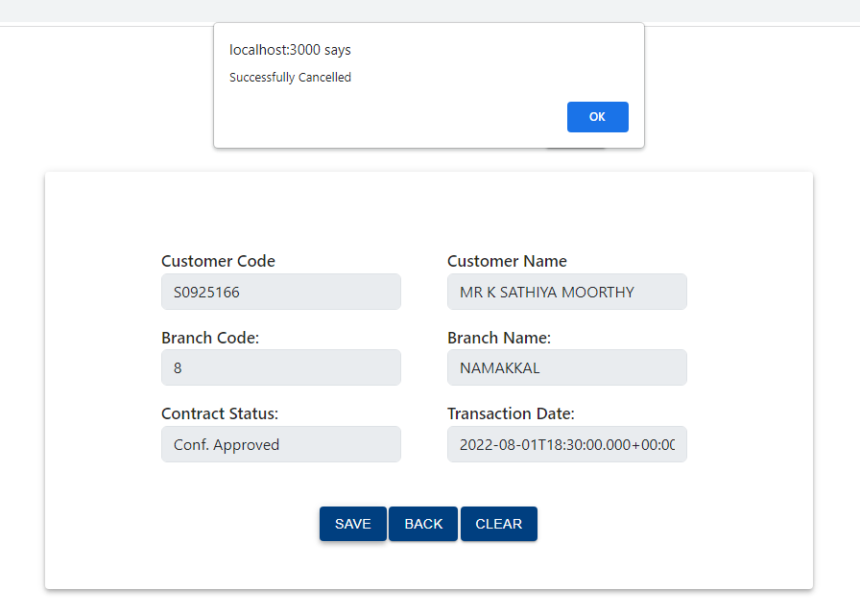
3. Click on the save button to cancel the running contract, back button to return back to the root page and clear button to clear the screen

Slide 5
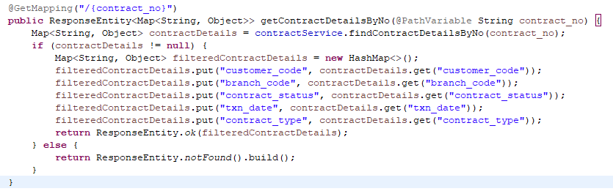
API : we have created 4 particular API which allow the URL to pass the data from one platform to another platform in the form of json.
http://localhost:8080/contracts/${contract_no}
Table Used : PS_TB_LN_CONTRACT_DEFN
Request Mapping : Get
Work : fetching the Customer_code, Branch_code, Contract_status, txn_date and Contract_type from table

Slide 6
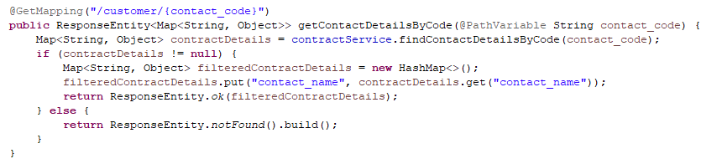
2. http://localhost:8080/contracts/customer/${contact_code}
Table Used : PS_TB_COM_CONTACT_DEFN
Request Mapping : Get
Work : Fetching the contact_name by customer_code
Need : to show the name of a customer in the screen from master contact table

Slide 7
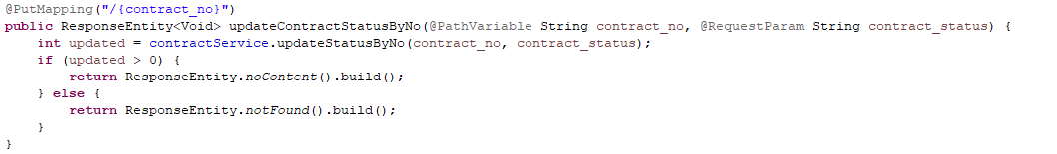
3. http://localhost:8080/contracts/${contract_no}
Table Used : PS_TB_LN_CONTRACT_DEFN
Request Mapping : Put
Work : to update the Contract_status to cancel

Slide 8
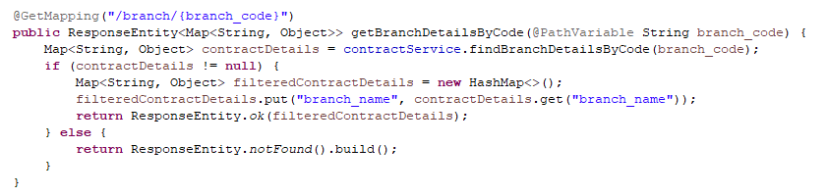
4. http://localhost:8080/contracts/branch/${branch_code}
Table Used : PS_TB_BRANCH_DEFN
Request Mapping : Get
Work : Fetch the branch_name by branch_code
Need : to show the name of a branch in the screen from master branch table

Slide 9
Thank You

