Slide 1
Employee Management System
By Ashwini Harish Poojary

Slide 2
Introduction to EMS
This is console based python project - Employee Management System In this project user can add, update, list, remove the employees.
Add employee: In this module first it check whether the employee id or exist or not. If id does not exist than it accept other details and stores the details.
Update employee: Checks the existence of employee id and then it prompts the user which value they want to change, accordingly it accepts the new value from user and update it.
List employee: List all the employee details
Remove employee: Checks the existence of employee id and removes the details of that employee.

Slide 3
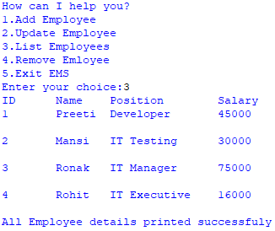
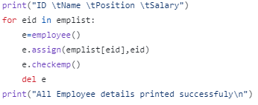

Listing all employee record
List all the employee records in the database (in dictionary)
Ems1.py:
Ems2.py
Output:

Slide 4
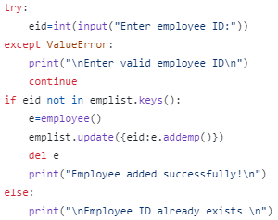
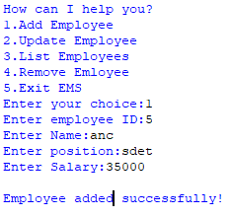
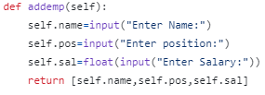
Addition of new Employee record.
Ems1.py:
Output:
User enters new employee id
Checks if new id already exists or not.
If entered id does not exist, accept other details and store in database.
If entered id already exists, prompts message –”ID already exists”
Ems2.py:

Slide 5

Thank You

