Slide 1

Customer Shopping Behavior Analysis
Analysis of 3,900 transactions to reveal spending patterns, segments, product preferences, and subscription behavior to guide strategy.

Slide 2
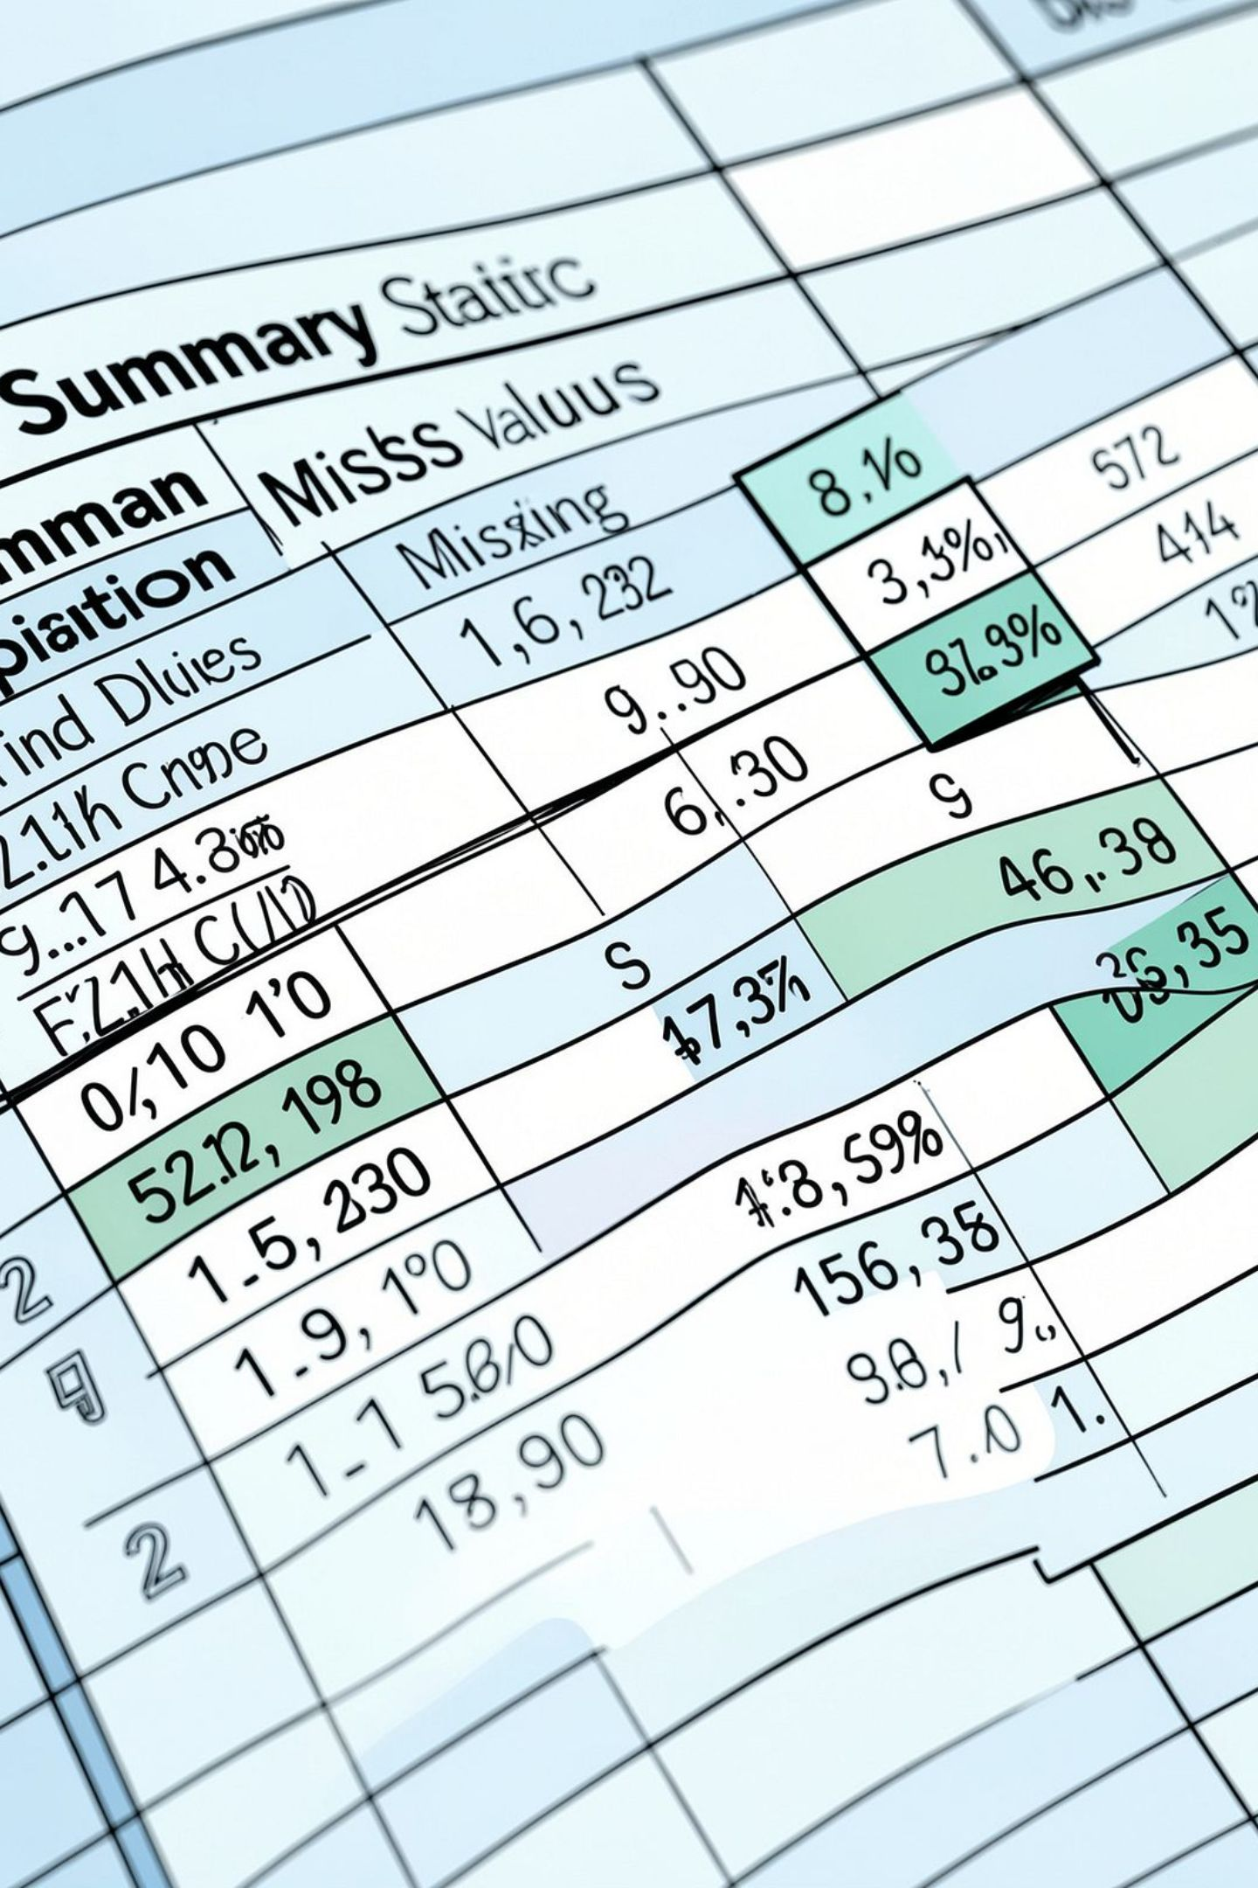
Dataset at a Glance
Scope
Key Features
3,900 rows × 18 columns — customer demographics, purchase details, and shopping behavior.
Age, Gender, Location, Item, Category, Purchase Amount, Season, Rating, Subscription, Shipping, Discounts.
Data Quality
37 missing values in Review Rating column — handled during cleaning.

Slide 3

Data Preparation & Feature Engineering
Loaded with pandas; used df.info() and .describe().
Imputed Review Rating by category median.
Renamed columns to snake_case.
Engineered age_group and purchase_frequency_days.
Dropped promo_code_used after redundancy check with discount_applied.
Exported cleaned table to PostgreSQL for SQL analysis.

Slide 4
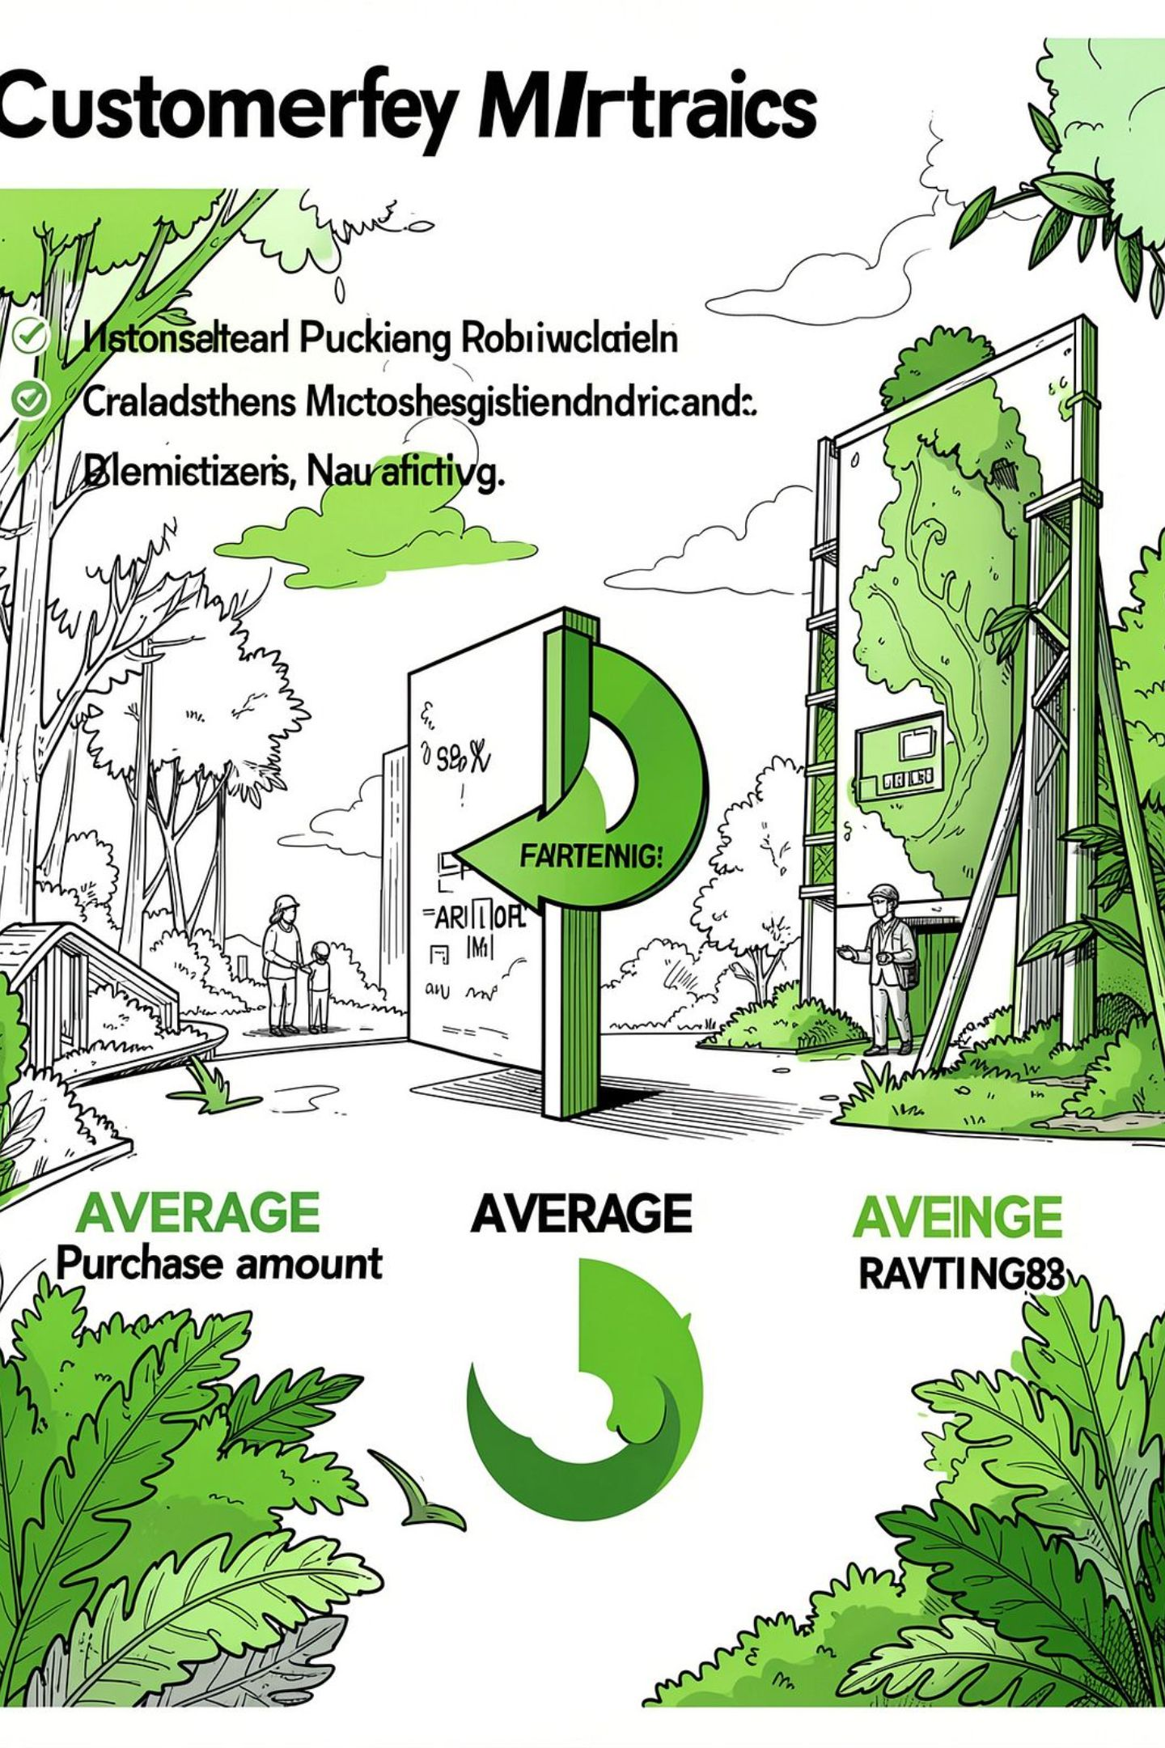
High-Level Statistics
3.9K
$59.76
Customers
Avg Purchase
Total transactions / unique customers.
Average purchase amount across dataset.
3.75
Avg Rating
Average review rating (after imputation).

Slide 5
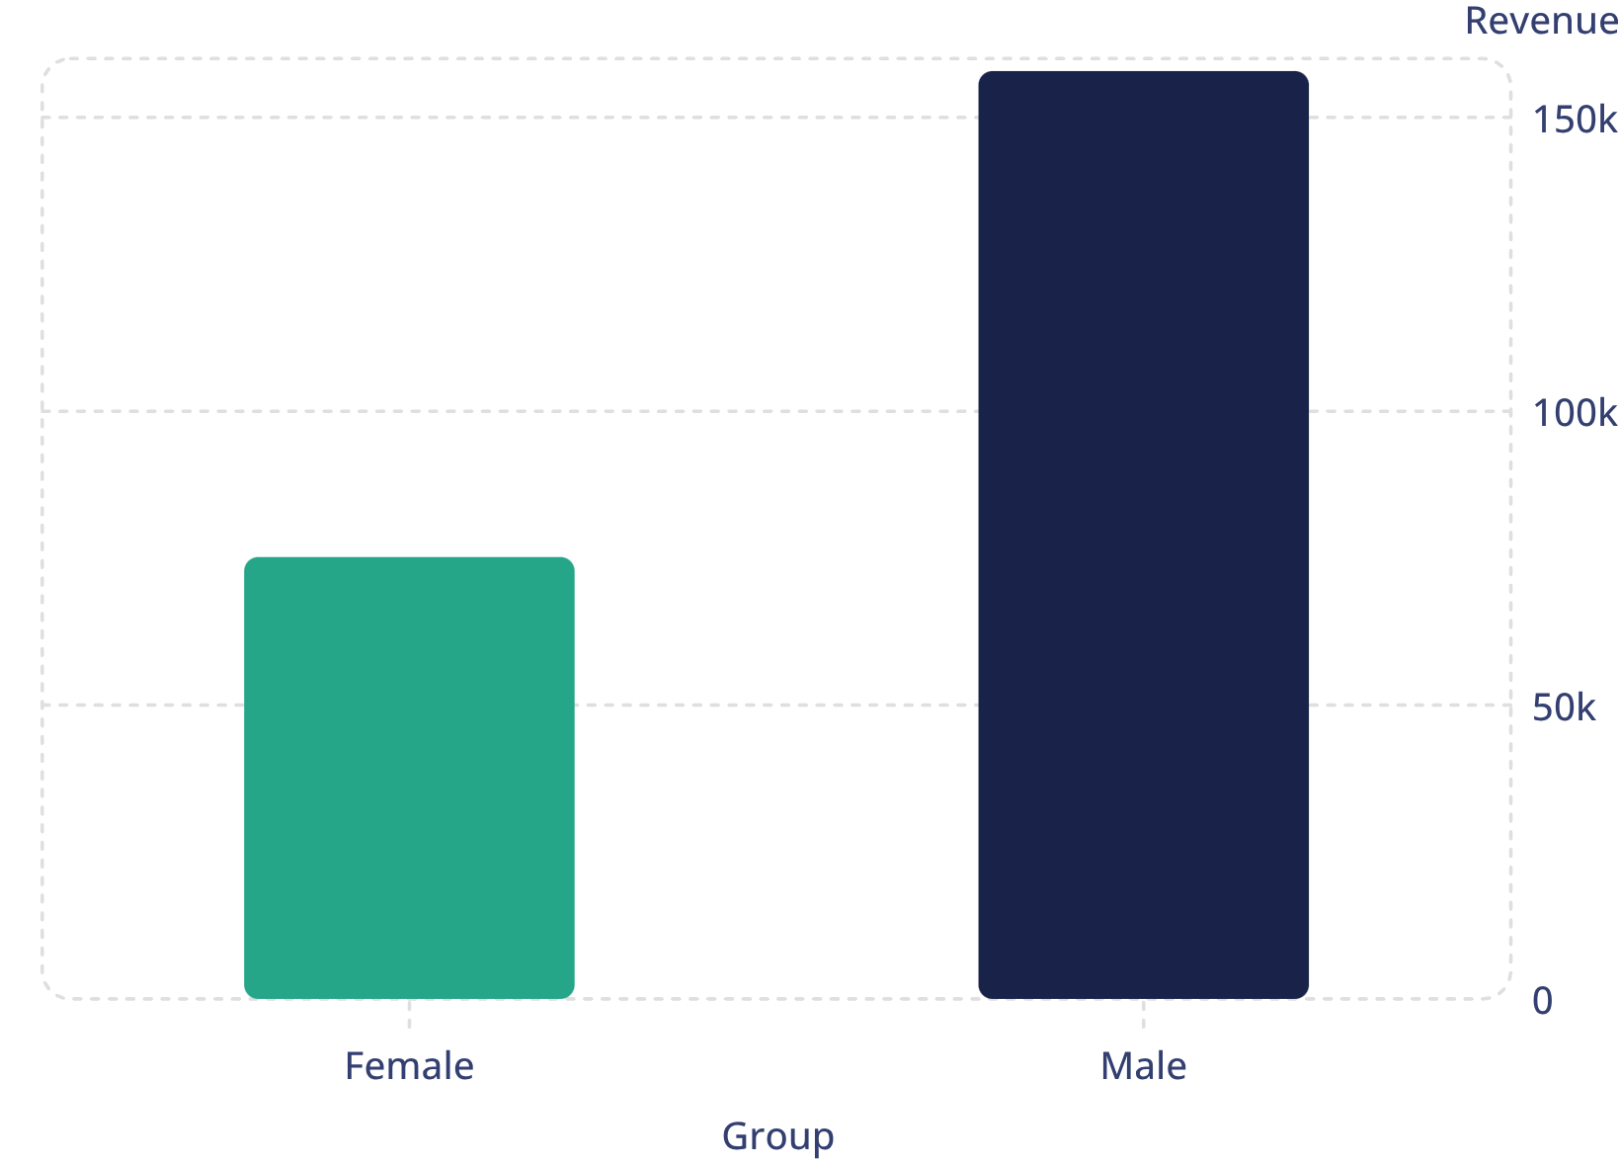
Revenue & Spending Insights (SQL)
Male customers generated higher total revenue. SQL queries also identified high-spending discount users (839 rows) who used discounts yet spent above average.

Slide 6


Top Products & Discount Dependence
Top Rated
Discount-Dependent
Gloves (3.86), Sandals (3.84), Boots (3.82), Hat (3.80), Skirt (3.78)
Highest discount rates: Hat 50.00%, Sneakers 49.66%, Coat 49.07%, Sweater 48.17%, Pants 47.37%.

Slide 7
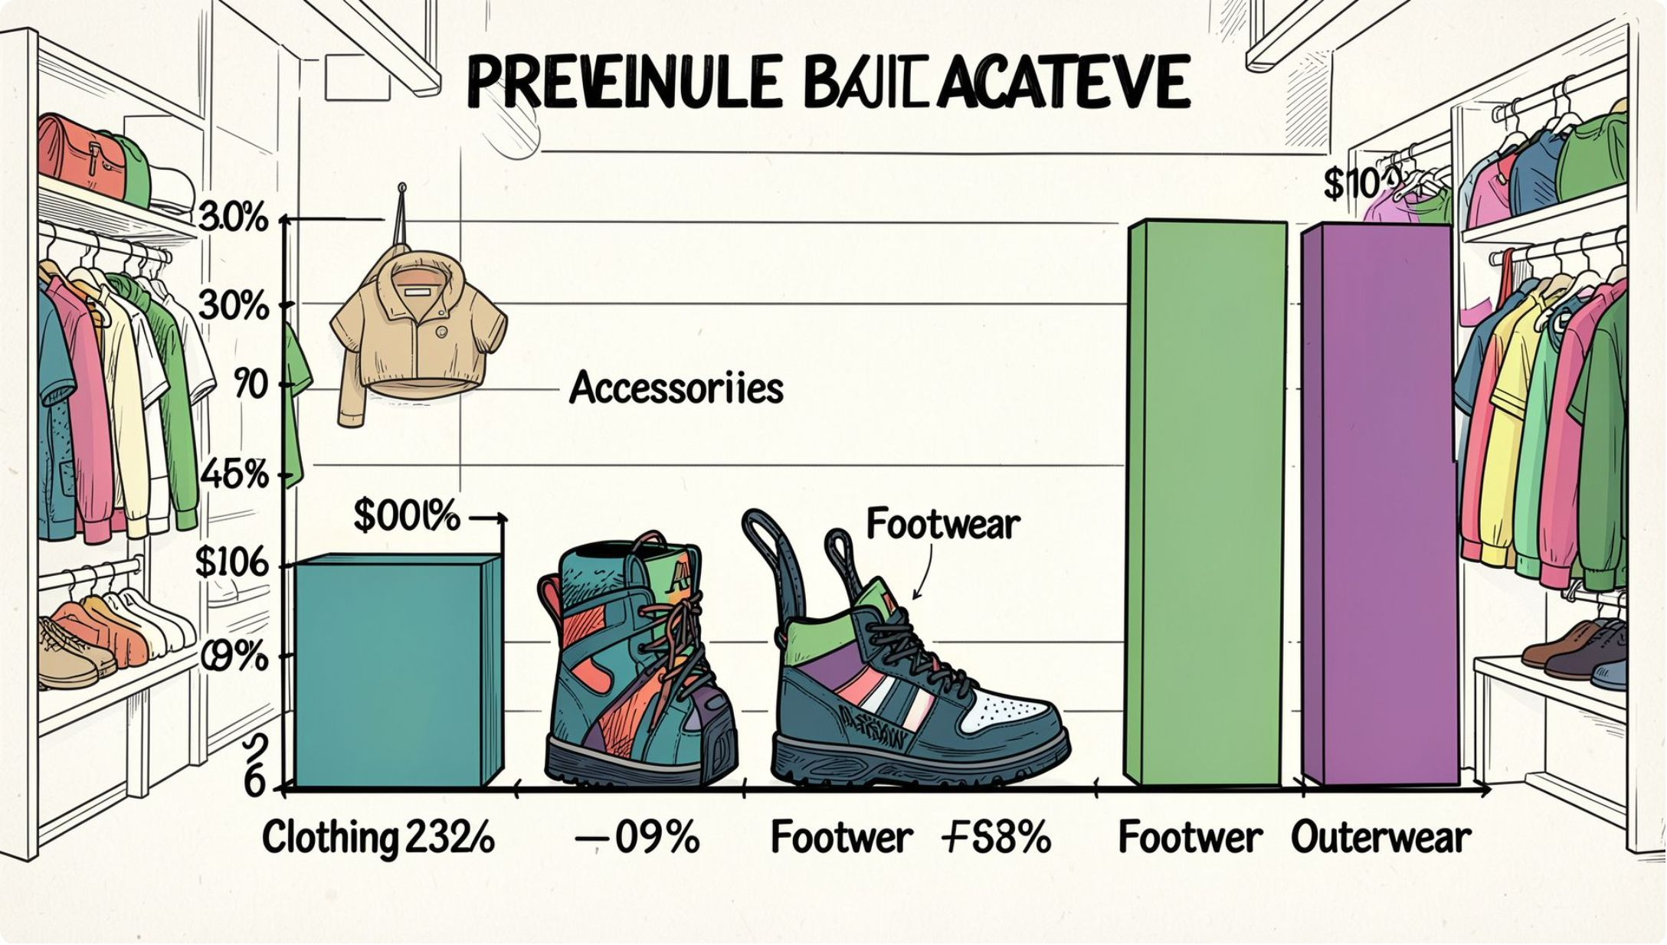
Category Performance & Top Items
Top items by category (most orders):
Accessories: Jewelry, Sunglasses, Belt
Clothing: Blouse, Pants, Shirt
Footwear: Sandals, Shoes, Sneakers
Outerwear: Jacket, Coat
Clothing drives the largest revenue and sales volume.

Slide 8
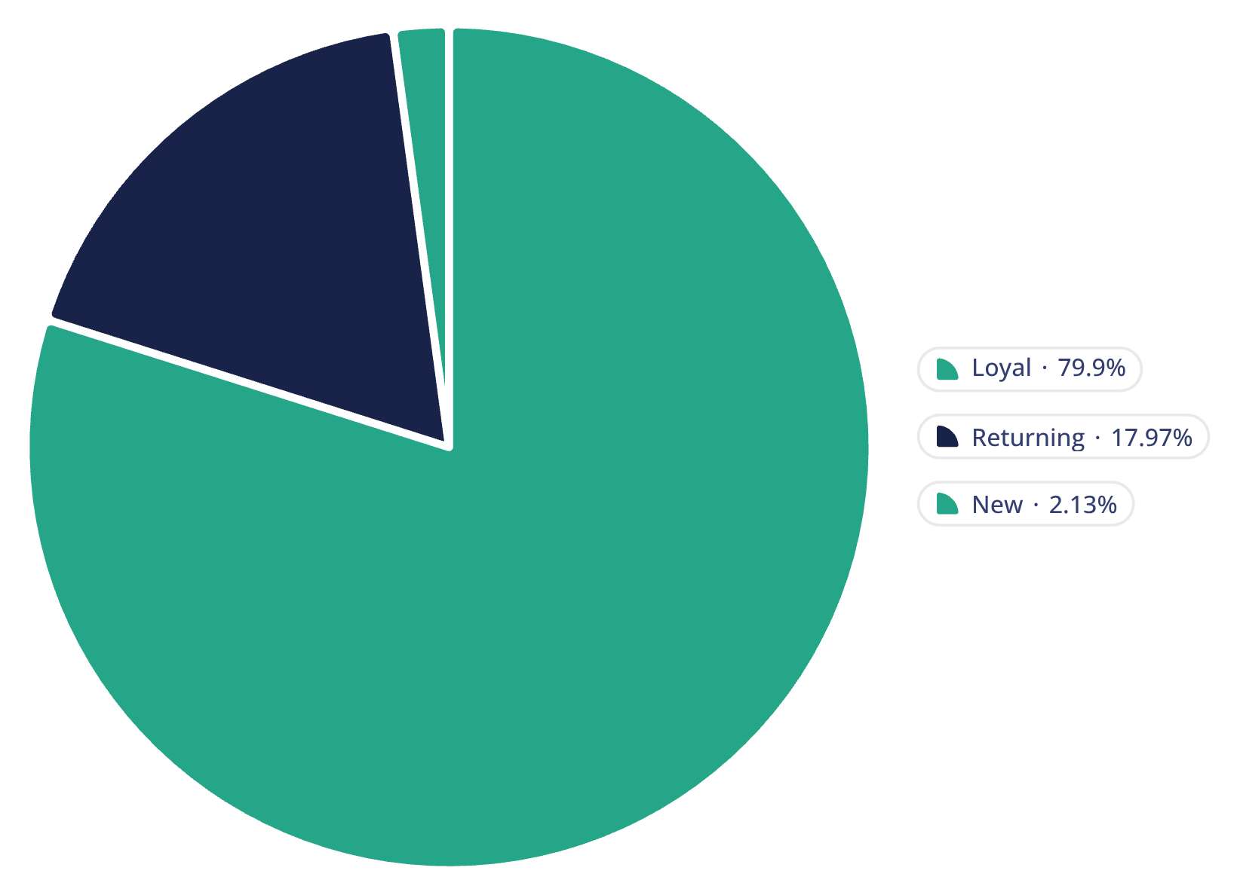
Customer Segments & Behavior
Segments defined by purchase history: Loyal customers dominate (3,116). Repeat buyers: 958 subscribers vs. 2,518 non-subscribers among repeat buyers.
Subscribers (1,053) vs Non-subscribers (2,847): avg spend ~ $59.5 and total revenue shown in SQL analysis.

Slide 9
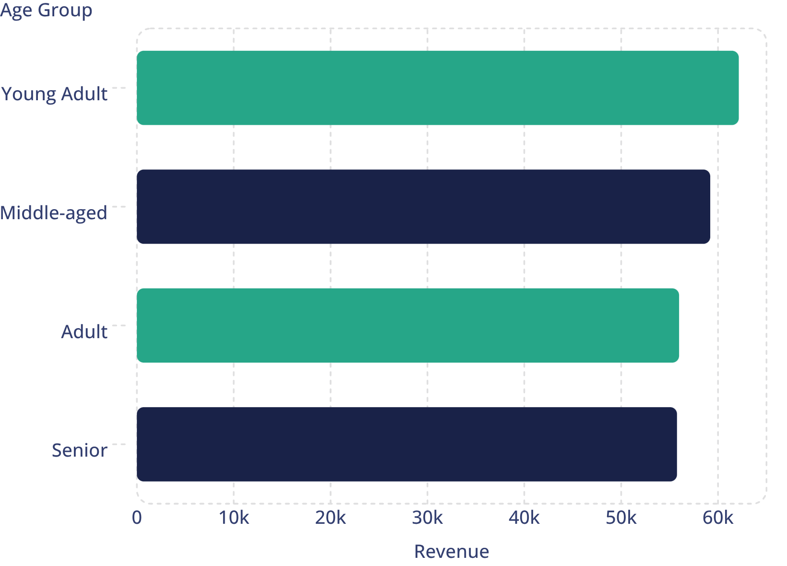
Age & Shipping Insights
Revenue by age group: Young Adults lead. Shipping comparison: Express average $60.48 vs Standard $58.46 — both similar but Express slightly higher.

Slide 10
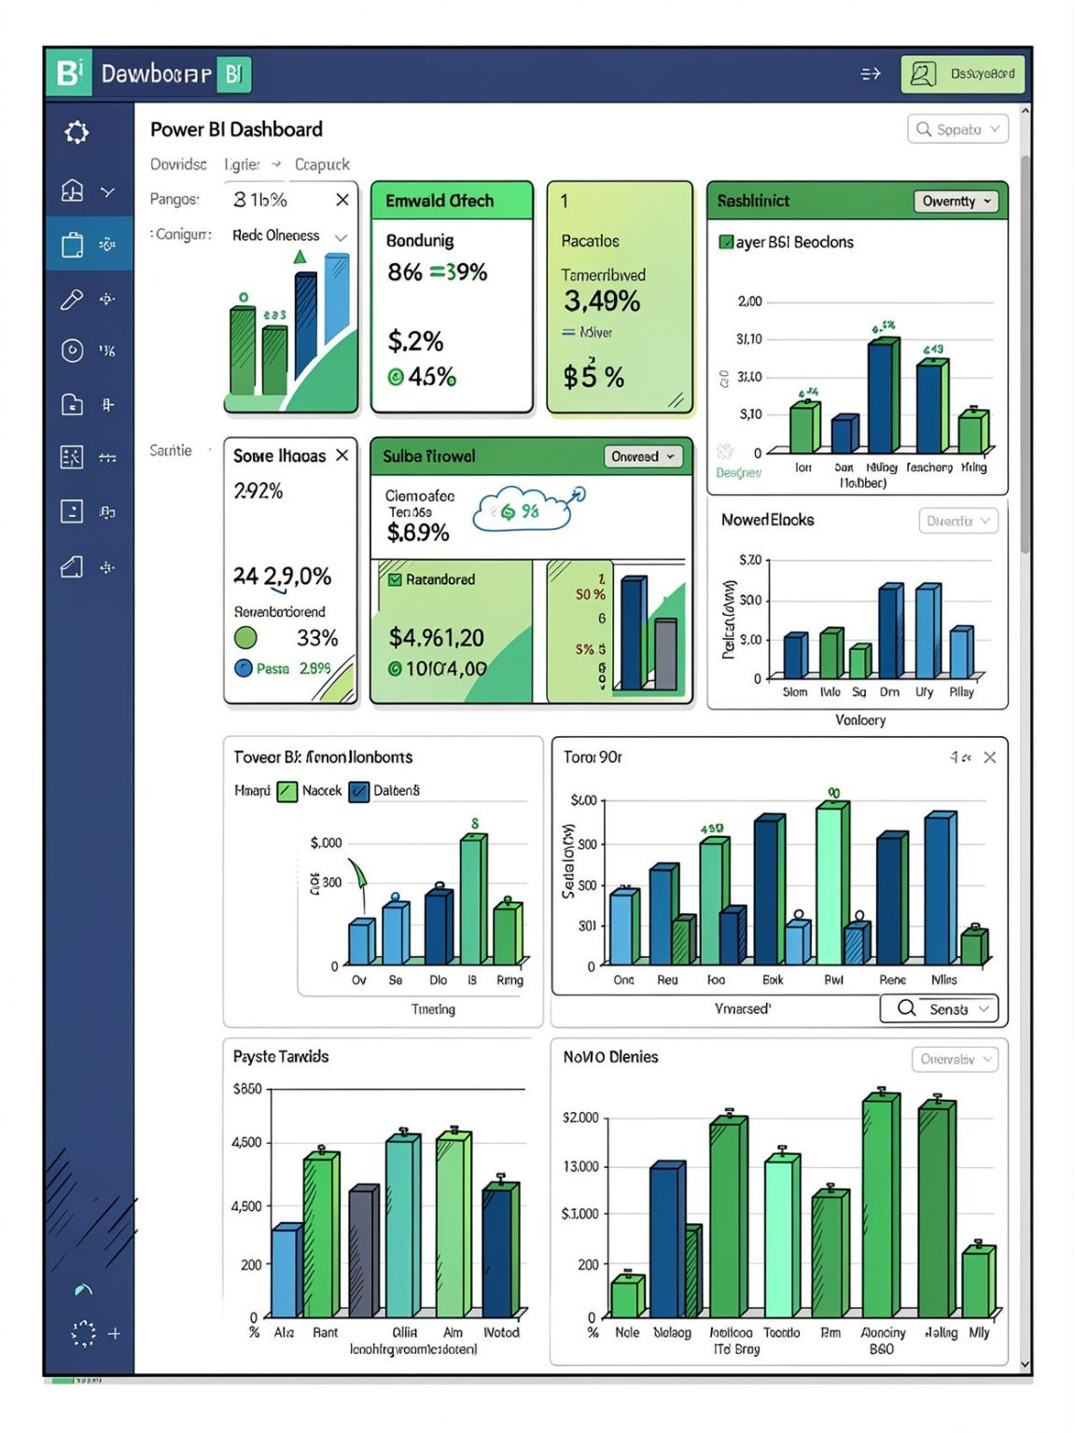
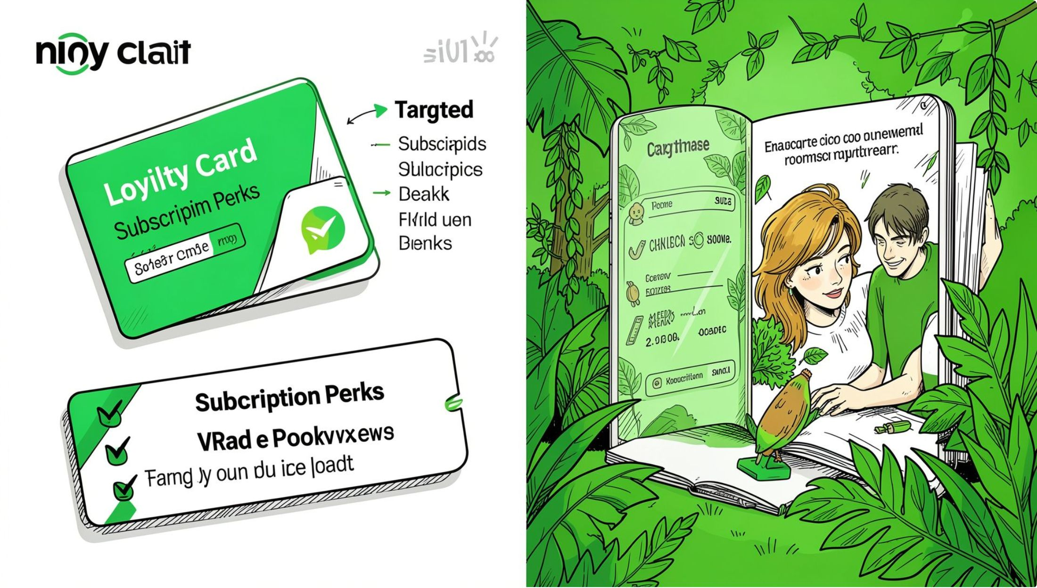
Recommendations & Dashboard
Interactive Power BI dashboard summarizes metrics: 3.9K customers, $59.76 avg purchase, 3.75 avg rating, revenue and sales by category and age group — supports these recommendations.
Boost Subscriptions
Loyalty Programs
Review Discounts
Product Positioning
Promote exclusive subscriber benefits to increase recurring revenue.
Reward repeat buyers to grow the Loyal segment.
Balance discount-driven sales with margin controls for dependent products.
Highlight top-rated and best-selling items in campaigns.
Targeted Marketing
Focus on high-revenue age groups and express-shipping customers.

