Slide 1


Linear Discriminant Analysis
Data: iris100_2 and iris

Slide 2
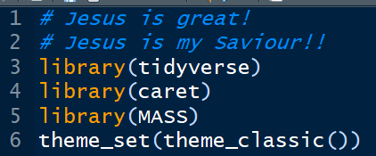
Packages

Slide 3


See data

Slide 4



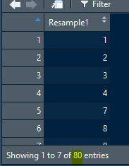
Training & Testing Data sets

Slide 5
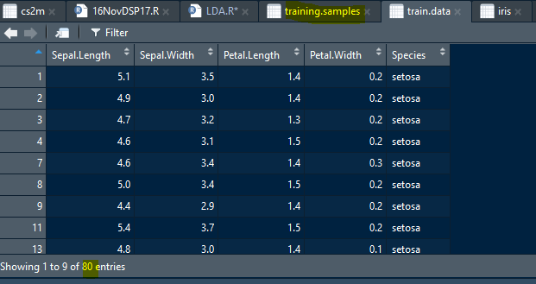
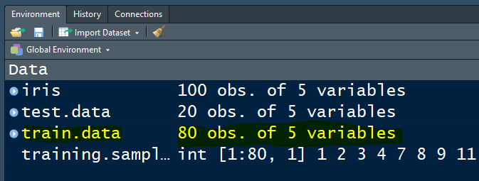
Training & Testing Data sets

Slide 6
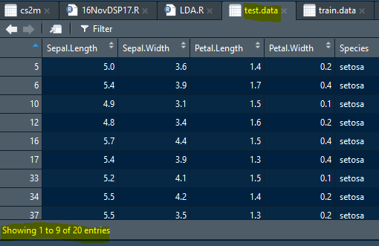
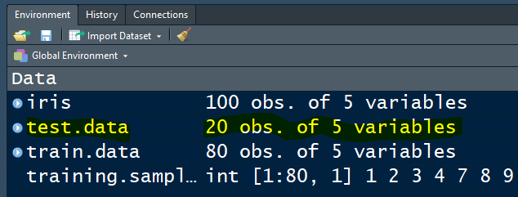
Training & Testing Data sets

Slide 7

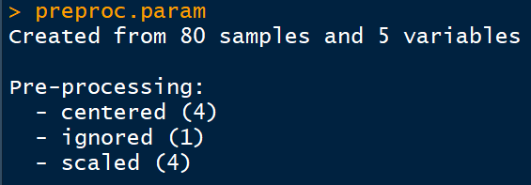
Pre-processing data

Slide 8
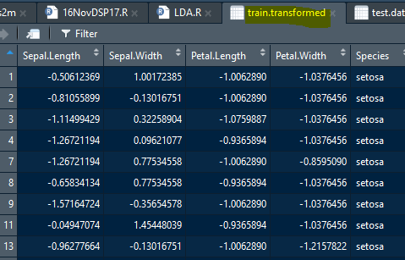
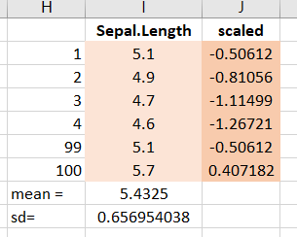

Train data, transformed
$${scaled}_{x_{i}}= \frac{x_{i}−average}{standard deviation}$$

Slide 9
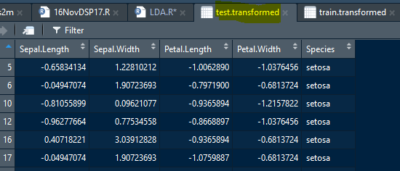
Test data, transformed

Slide 10

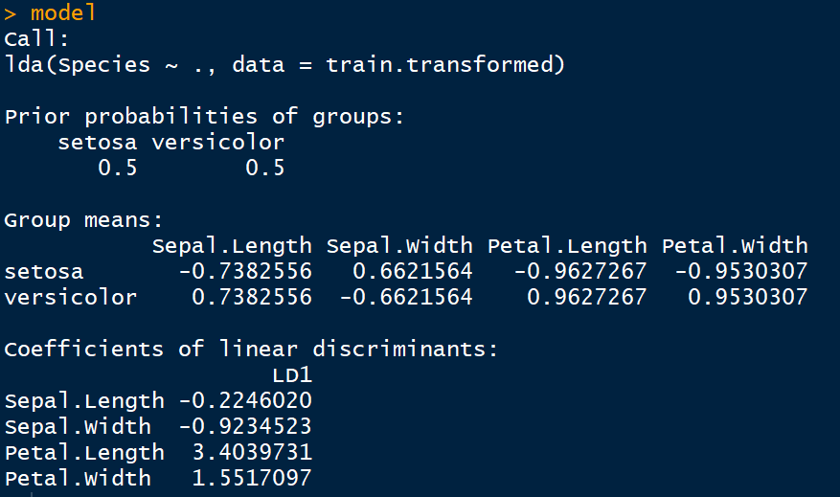

LDA Model

Slide 11

Group Means

Slide 12


Predictions

Slide 13
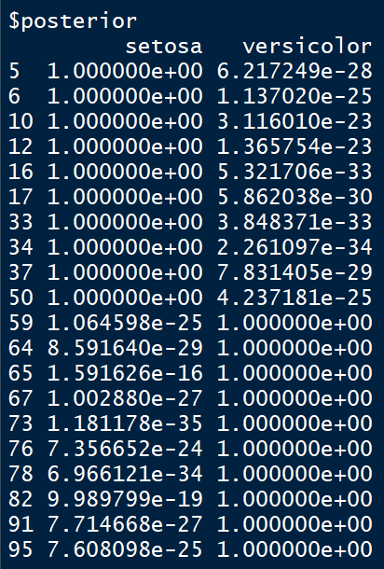
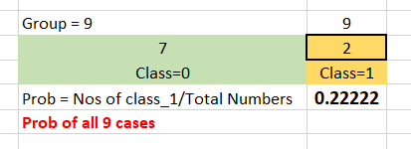
Probabilities
Probability calculation is complicated, park it for the time being!

Slide 14
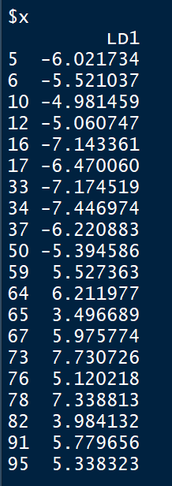
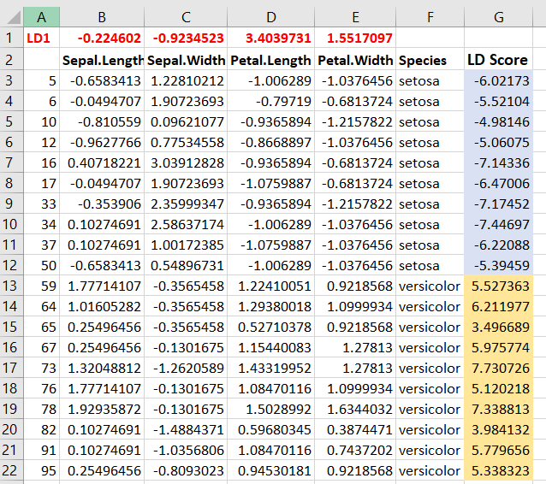
LD Score

Slide 15


Confusion Matrix

Slide 16


Confusion Matrix

Slide 17

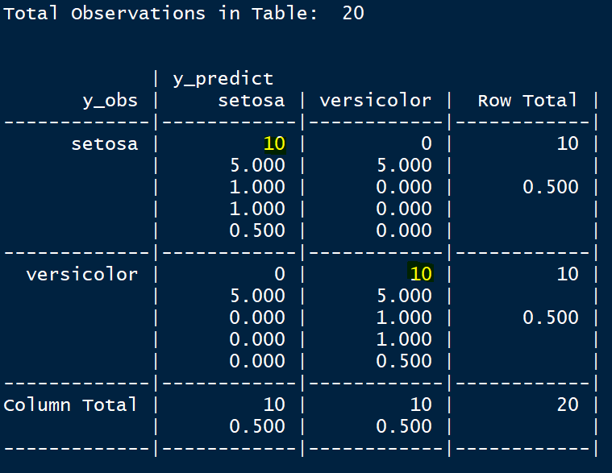
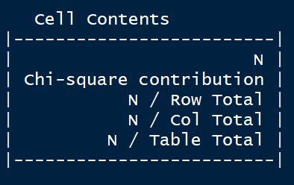
Aha!

Slide 18

Accuracy

Slide 19

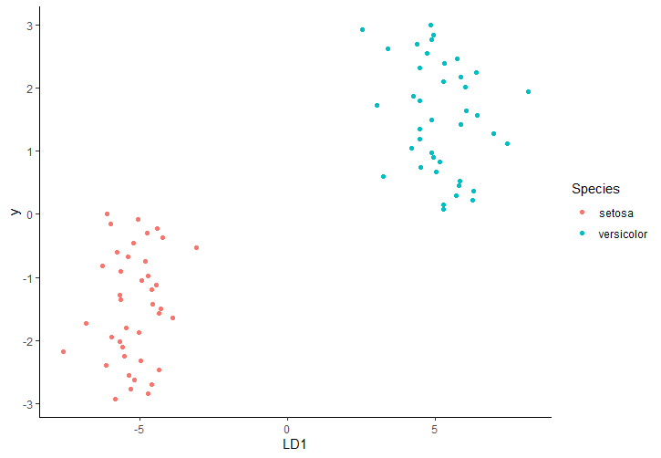
Plot

Slide 20

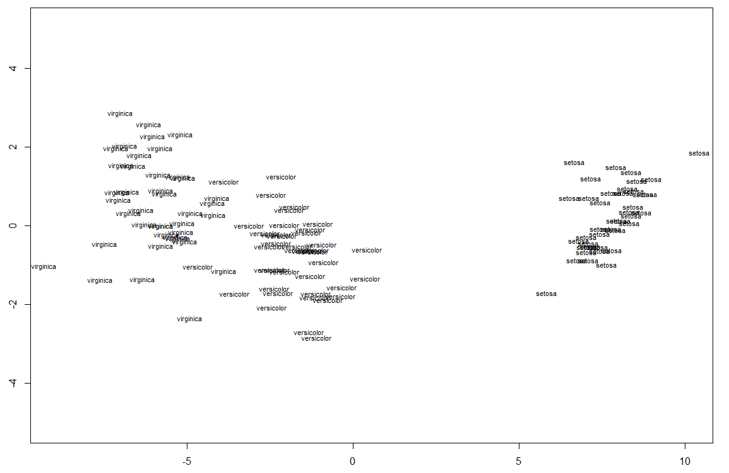

Multi Class
Load data like this
Do this after confusion matrix

Slide 21
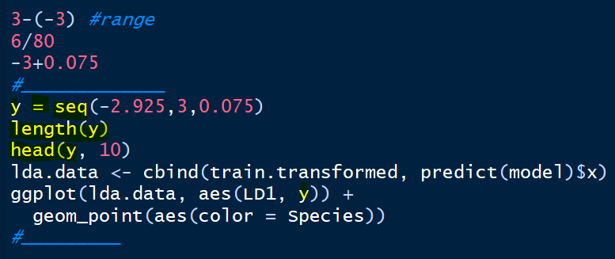

Last Part- Multi Class
From existing code, remove from 1st line till head(y, 10); AND
In place of y , write LD2

Slide 22
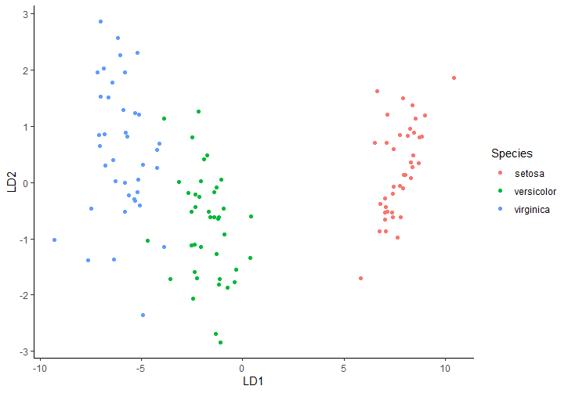
Multi Class Plot

Slide 23


