Slide 1

Cost of Living Analysis

Slide 2
Problem Statement
The cost of living is a crucial metric that impacts individuals and businesses alike. Understanding the cost
of living in different cities and countries is vital for making informed decisions regarding relocation,
investment, or business expansion. This project aims to address several key questions:
• What are the cities and countries with the highest and lowest costs of living?
• What are the major cost components contributing to the overall cost of living in a region
• How do factors like average salary, housing costs, and transportation expenses correlate with the cost of living?
• Are there any trends or patterns in the data that can help individuals and organizations make strategic decisions?

Slide 3
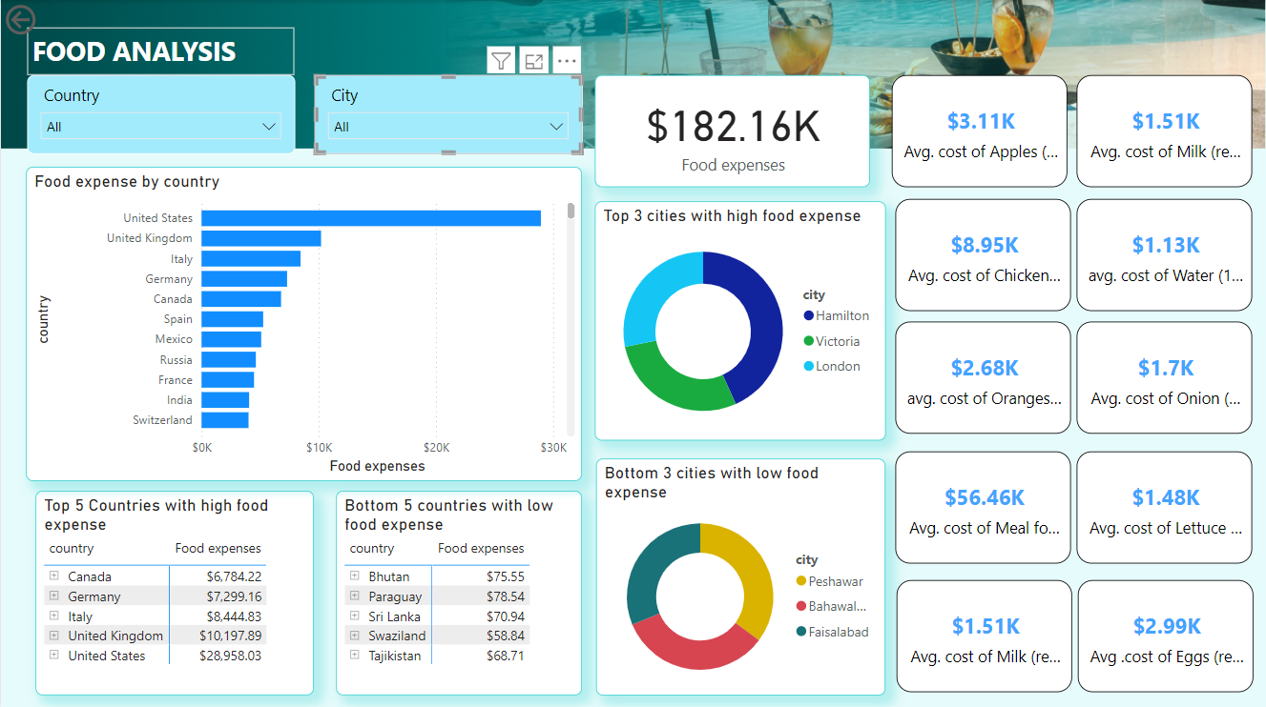

Slide 4
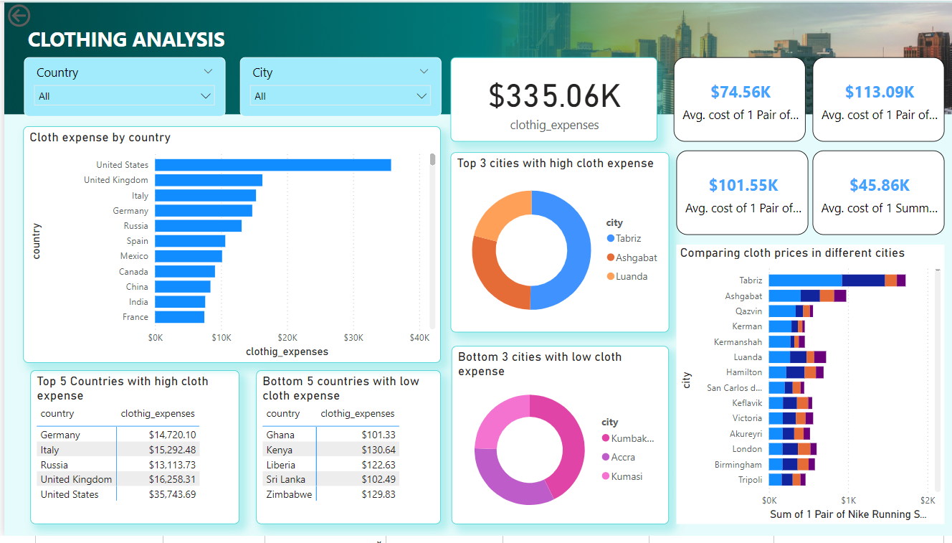

Slide 5
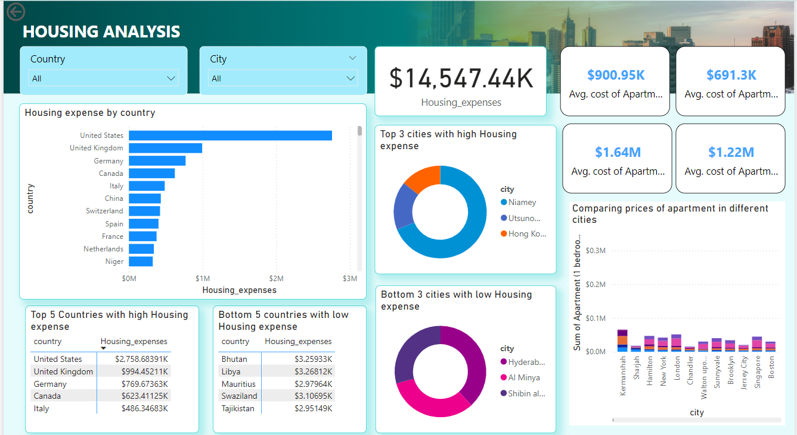

Slide 6
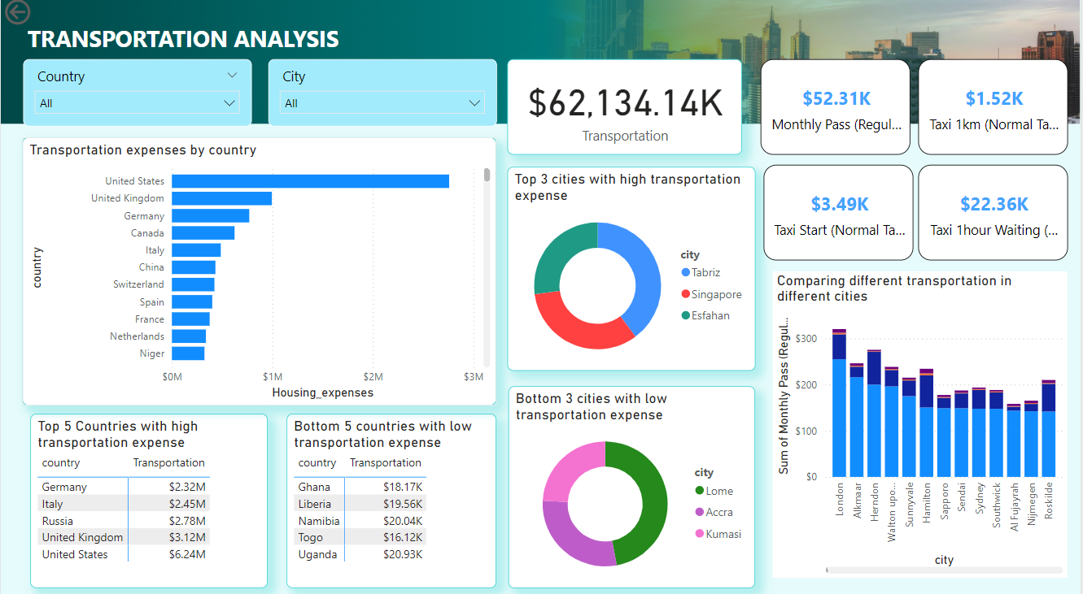

Slide 7
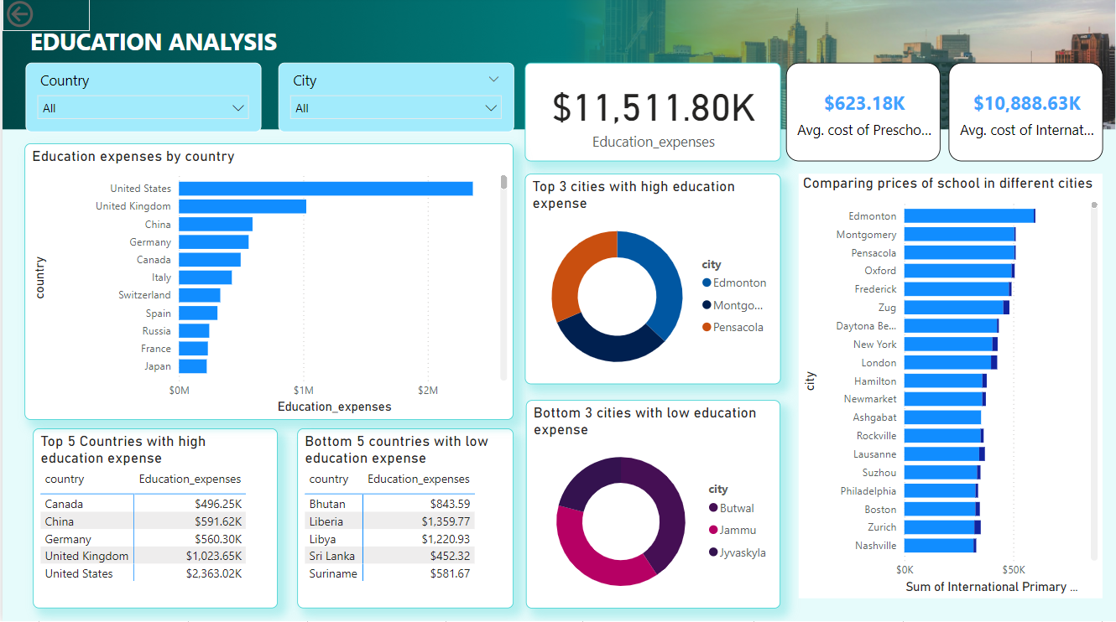

Slide 8
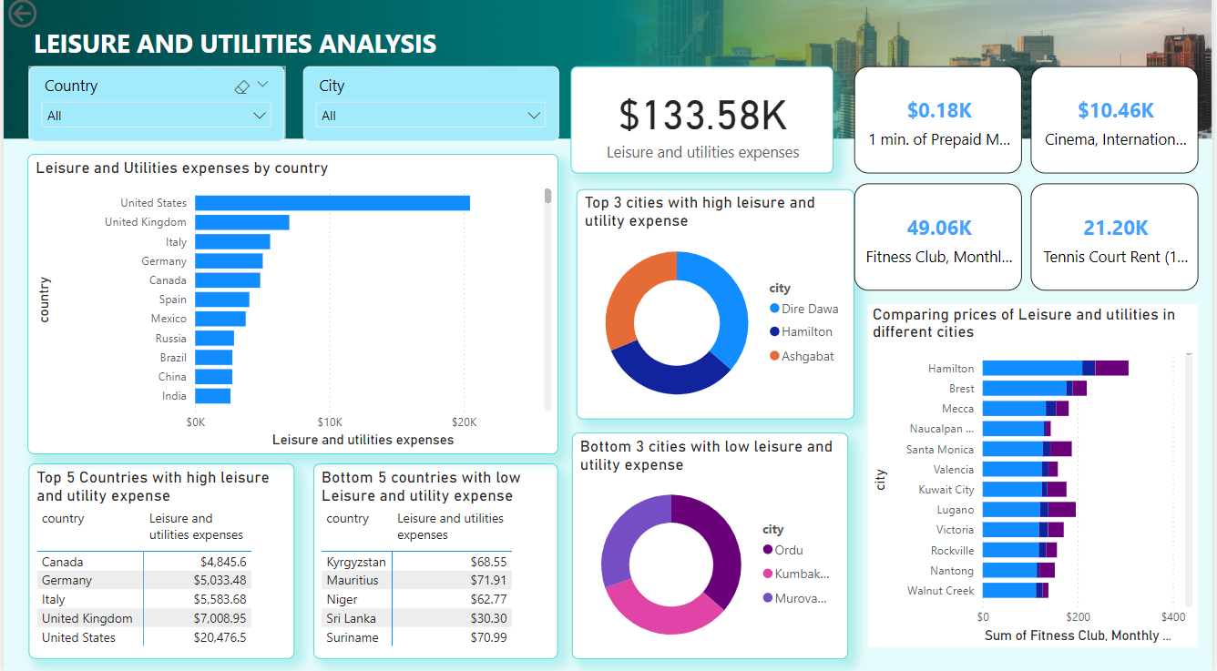

Slide 9
Thank You

