Slide 1
Predict to Prevent: AI-Driven Innovations in Breast Cancer Diagnosis
Team Members:
1. Ashwini Khedkar (002738717)
2. Vipul Rajderkar (002700991)
3. Tanmay Zope (002767087)

Slide 2
PROBLEM STATEMENT
Medical Challenge: The traditional diagnosis of breast cancer through histopathology is not only time-consuming but also prone to variability and subjective interpretations by pathologists, leading to potential misdiagnoses.
Technical Challenge: "Applying machine learning to this medical field introduces complexities, including the need for highly accurate, reliable, and interpretable models capable of handling imbalanced and nuanced medical data."

Slide 3
WHAT ARE WE TRING TO SOLVE
Objective: "Our primary goal is to automate the classification of breast tumors into benign or malignant categories using predictive analytics, thereby supporting pathologists with a reliable second opinion."
Importance: "Enhancing diagnostic accuracy can directly impact treatment decisions and outcomes, potentially increasing survival rates while decreasing unnecessary invasive procedures."

Slide 4
Exploratory Data Analysis (EDA)
Data Description: The dataset originates from the UCI Machine Learning Repository, featuring characteristics extracted from fine needle aspirates of breast masses in 569 cases.
Distribution of Diagnosis: Visualized the balance between benign and malignant cases through histograms and boxplot.
Correlation Heatmap: Displayed a heatmap to identify strong predictors of malignancy and interdependencies among variables, crucial for feature selection.

Slide 5
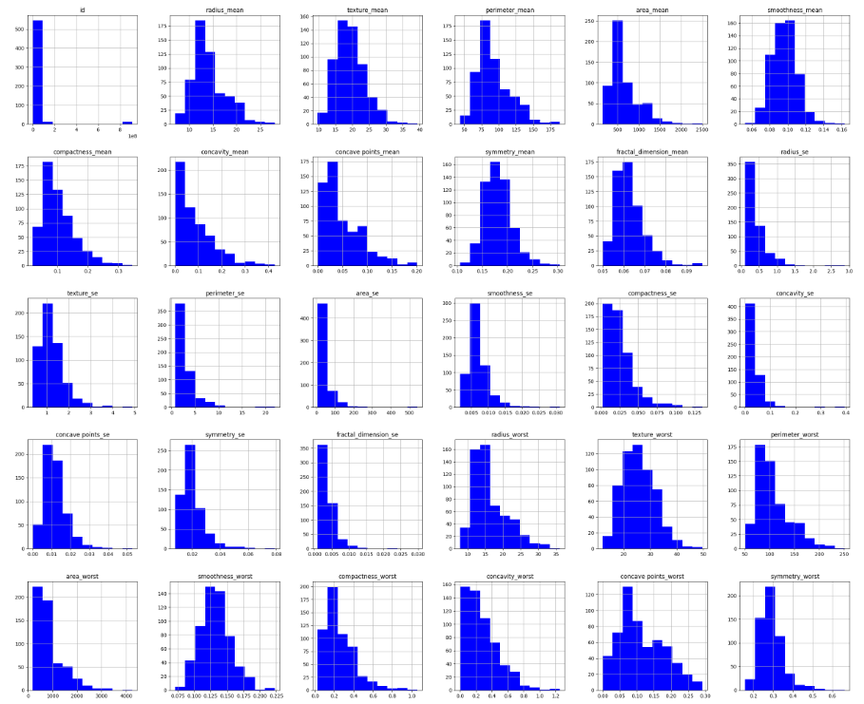
Exploratory Data Analysis (EDA)

Slide 6
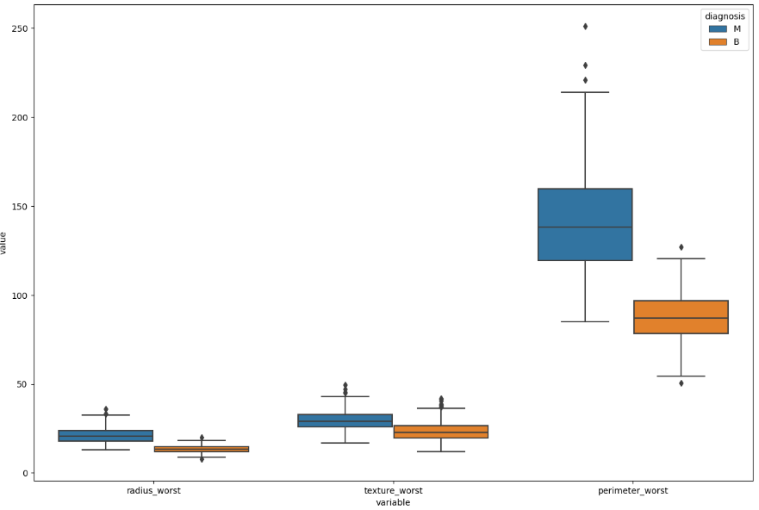
Exploratory Data Analysis (EDA)

Slide 7
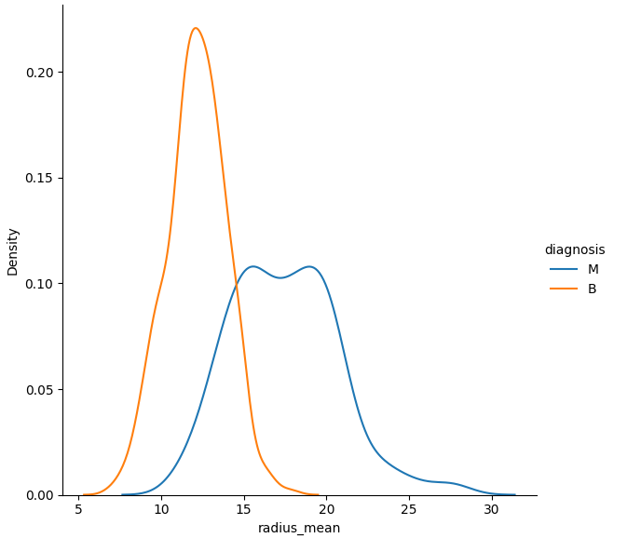
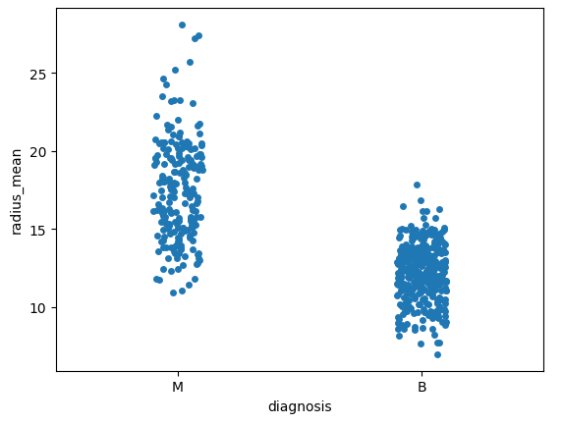
Exploratory Data Analysis (EDA)

Slide 8
MODELS
We explored several models to ensure robustness and reliability:
Logistic Regression: Known for its simplicity and interpretability.
Accuracy obtained : 98.24%
Support Vector Machine (SVM): Effective in high-dimensional spaces.
Accuracy obtained : 97.07%
Random Forest: Excellent for handling overfitting and providing feature importance insights.
Accuracy obtained : 98.24%
K-Nearest Neighbors (KNN): Good for classification by exploiting the locality of data points.
Accuracy obtained : 95.90%

Slide 9
MODEL USED
Why We Chose Logistic Regression:
Simplicity and Efficiency: Despite the availability of more complex models, Logistic Regression offers a good balance between accuracy and computational efficiency.
Interpretability: Its ability to provide probabilities along with classifications makes it invaluable for medical applications where understanding 'why' is as crucial as 'what'.
Performance: Detail its competitive accuracy and precision metrics, and why these are particularly relevant in a medical diagnostic context.

Slide 10
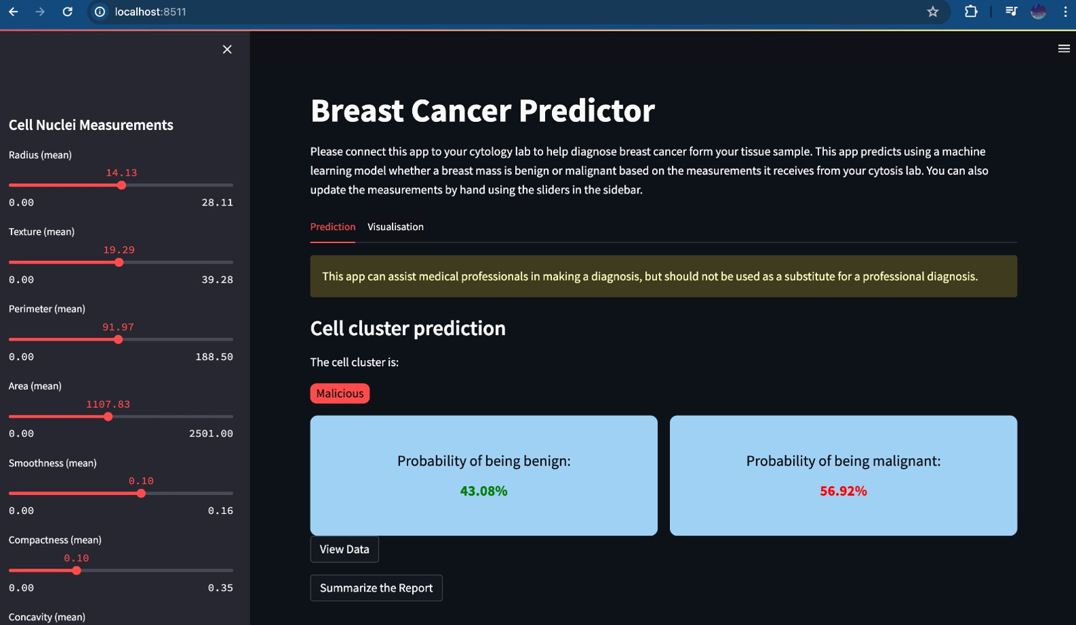
STREAMLIT APPLICATION

Slide 11
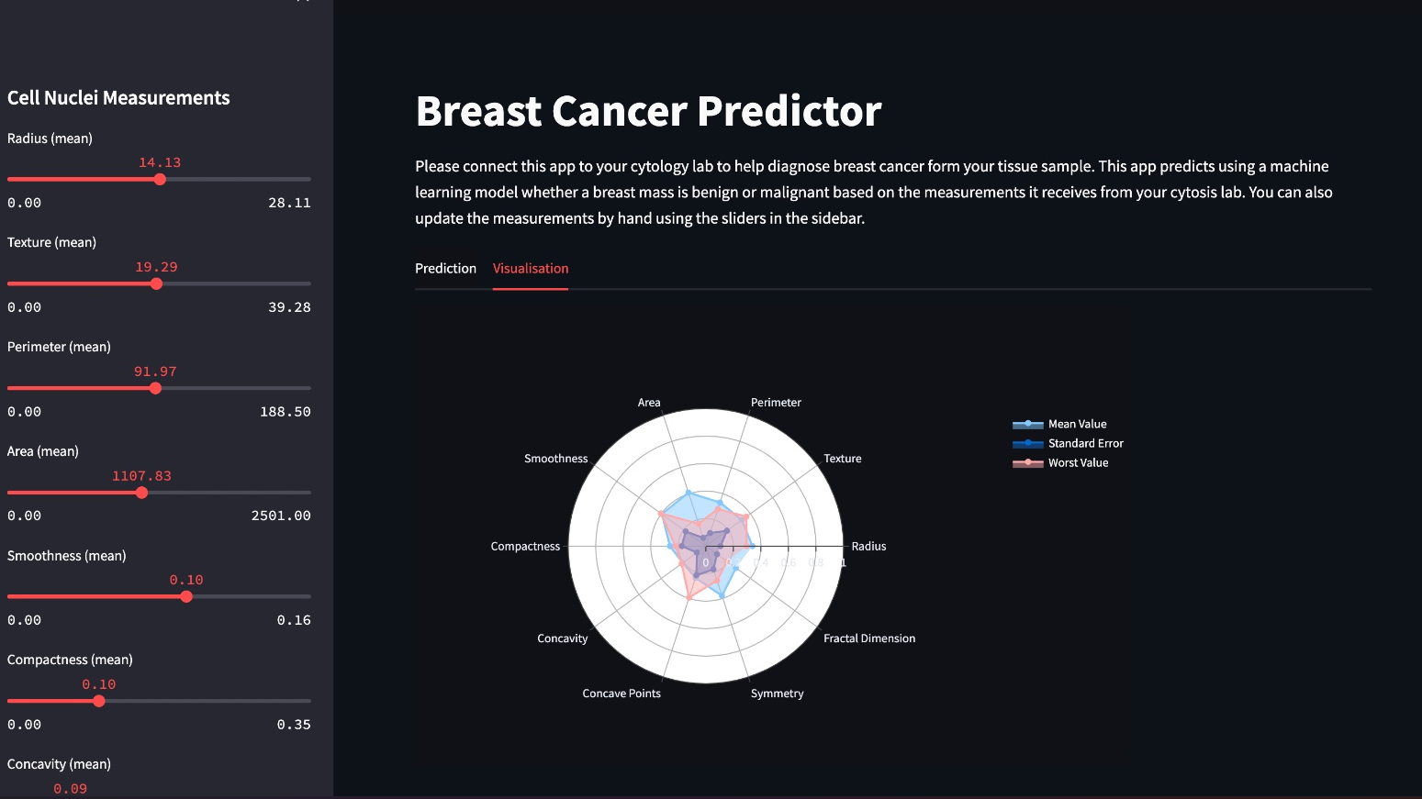
STREAMLIT APPLICATION

Slide 12
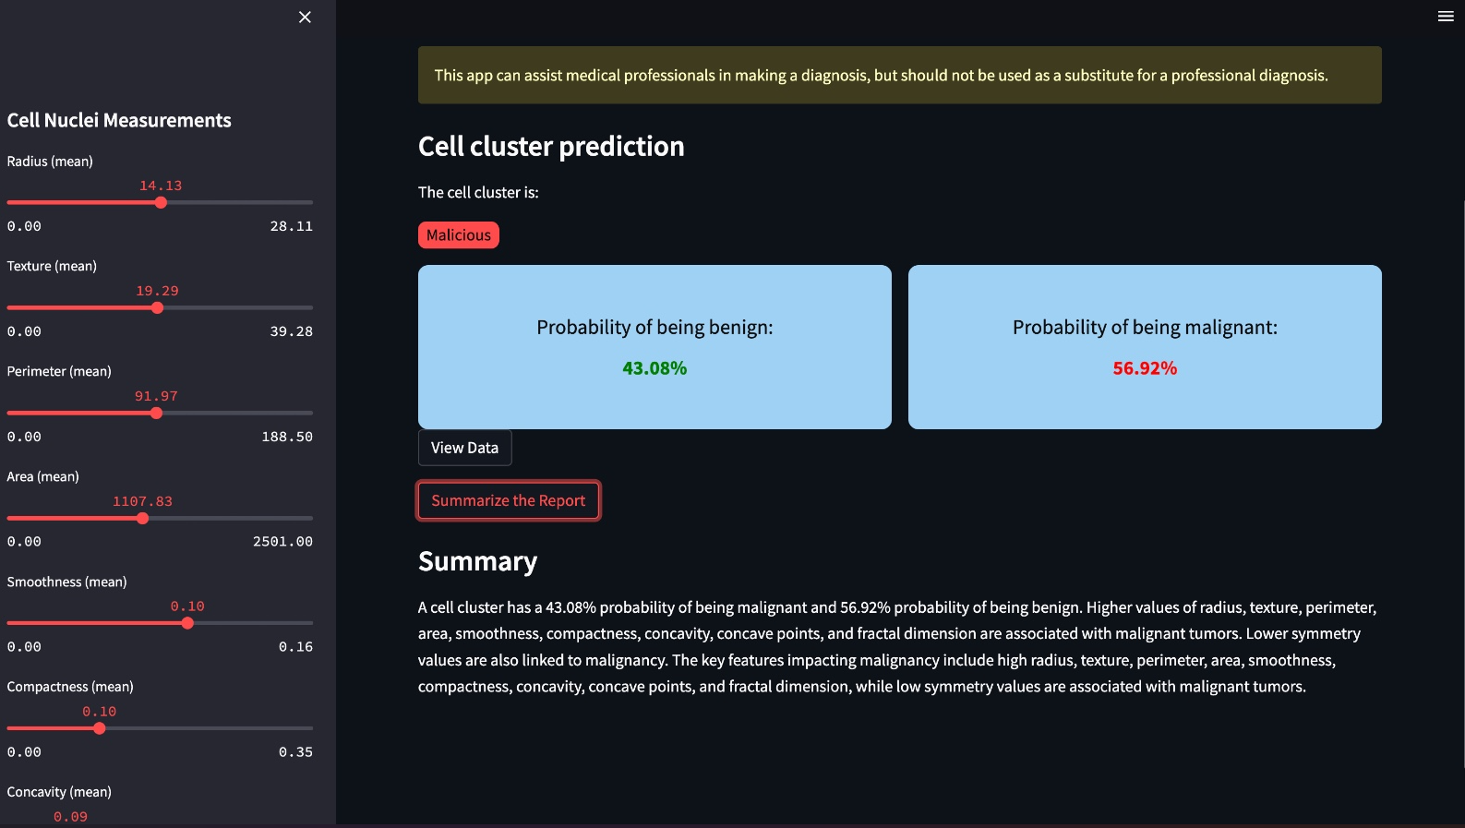
STREAMLIT APPLICATION

Slide 13
CONCLUSION
Project Outcomes:
Successfully developed and validated a predictive model that outperforms traditional methods.
Integrated a text summarization feature using OpenAI's GPT to enhance user interaction.
Future Directions:
Expand dataset collection for robust validation across varied demographic groups.
Implement real-time data processing for live diagnostic support.
Explore mobile platform deployment to increase reach in underserved areas.

Slide 14
THANK YOU

