Slide 1
• DATA ENGINEERING •DATA SCIENCE & AI • BUSINESS INTELLIGENCE
Banking Analytics & AI ASSISTANT
Data Engineering Pipeline with AI-Powered Insights
An end-to-end pipeline that ingests raw banking data, refines it through a Bronze–Silver–Gold architecture, automates it with Airflow, and layers a Gemini-powered AI application on top for natural-language insights.
Ashwini Giri
B.E. Information Technology | Data Engineering & AI Project

Slide 2
This is an end-to-end Banking Data Engineering pipeline that extracts raw banking customer data, processes it using Py-Spark, transformed through a Medallion Architecture Bronze-Silver-Gold architecture, stores the processed data in PostgreSQL, automates the workflow using Airflow, containerized with Docker, provides analytics through Power BI and build Gemini-based AI application.
01 INTRODUCTION
Project Overview
What This Project Covers
•
Ingestion
Raw CSV loaded with PySpark
•
Transformation
Cleaning + business logic across 3 layers
•
Warehousing
45,211
3
6
PostgreSQL with bronze / silver / gold schemas
•
Automation
Customer Records Processed
Medallion Layers
Summary Tables
Apache Airflow DAG orchestration
•
Deployment
Fully containerized with Docker
•
Analytics + AI
Power BI dashboard + Gemini AI application
Data Engineering & AI Project

Slide 3
OBJECTIVES
Project Objectives
Eight core goals guided the design of this end-to-end pipeline.
1
Build an End-to-End ETL Pipeline
2
Implement Medallion Architecture
From raw CSV to business-ready tables
Bronze, Silver, and Gold data layers
3
Clean & Transform Data
4
Create Business Summary Tables
Deduplicate, validate, and standardize records
Customer, deposit, job, education, marital, month
5
Store Data in PostgreSQL
6
Automate with Apache Airflow
Structured, query-ready data warehouse
Scheduled, monitored, retry-safe workflow
7
Containerize with Docker
8
Build a Power BI Dashboard & AI Application
Portable, consistent runtime environment
Interactive, business-facing visual insights
Data Engineering & AI Project

Slide 4
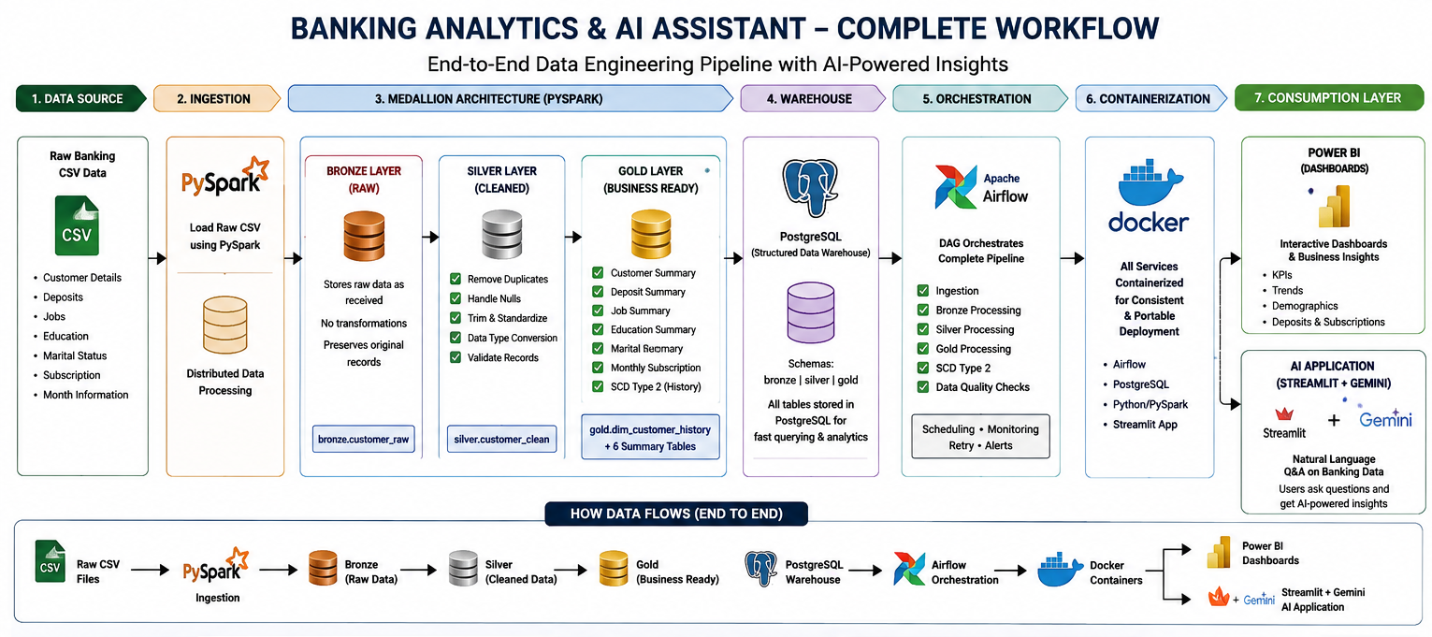

Slide 5
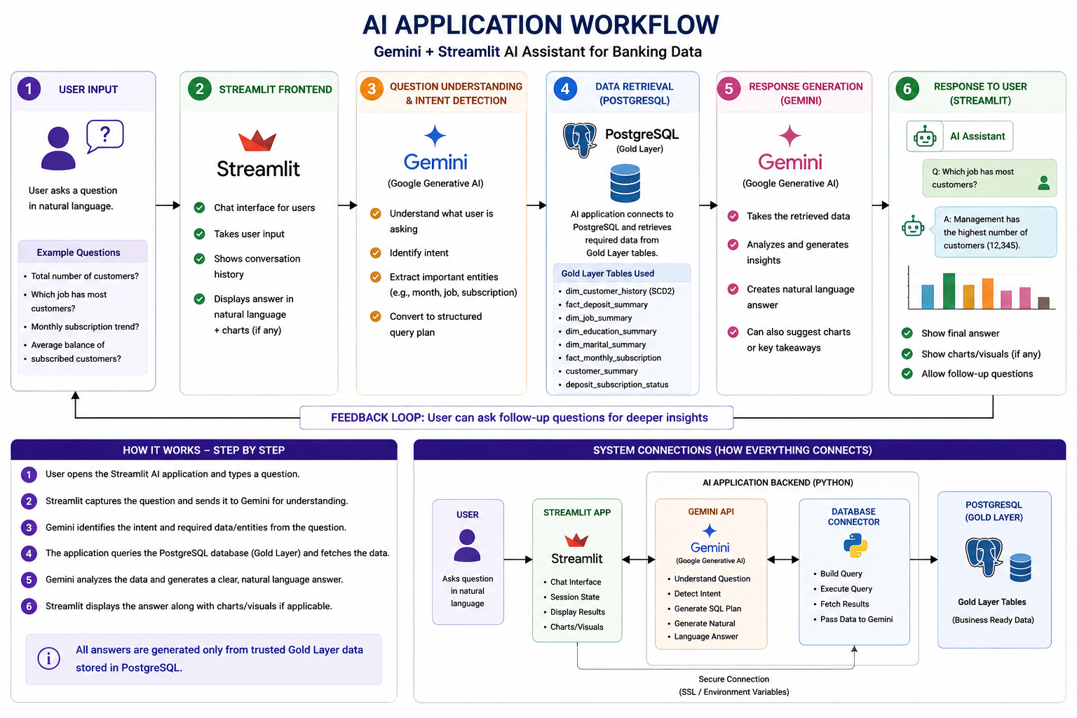

Slide 6
TECHNOLOGY STACK
Tools & Technologies Used
Every layer of the pipeline — from processing to automation to visualization — uses an industry-standard tool.
Py
Python
Sp
PySpark
Pg
SQL & PostgreSQL
Core programming language
Distributed data processing
Querying & transformations
Data warehouse (bronze/silver/gold)
str
Streamlit
Af
Apache Airflow
Dk
Docker
AI Application
Workflow orchestration
Containerization & deployment
BI
Power BI
AI
Gemini AI
Git
Git & GitHub
Dashboards & reporting
AI application layer
Version control

Slide 7
OUTCOMES
Conclusion :
Added a Gemini AI application for natural-language insights.
Built a complete end-to-end Data Engineering pipeline for banking data.
Used Medallion Architecture to clean and organize raw data.
Automated the entire workflow using Apache Airflow.
Used Docker to make the project portable and easy to deploy.
Stored all data in PostgreSQL for structured access.
Built a Power BI dashboard for visual business insights.
Project shows strong skills in both Data Engineering and AI integration.
Skills Demonstrated :
•
Data Engineering
ETL / ELT
Medallion Architecture
•
PySpark & SQL
PostgreSQL
Docker
Apache Airflow
•
Power BI
SCD
Gemini AI Integration
•
Data Engineering & AI Project

