Slide 1
• DATA ENGINEERING •DATA SCIENCE & AI • BUSINESS INTELLIGENCE
Banking Analytics & AI ASSISTANT
Data Engineering Pipeline with AI-Powered Insights
An end-to-end pipeline that ingests raw banking data, refines it through a Bronze–Silver–Gold architecture, automates it with Airflow, and layers a Gemini-powered AI application on top for natural-language insights.
Ashwini Giri
B.E. Information Technology | Data Engineering & AI Project

Slide 2
This is an end-to-end Banking Data Engineering pipeline that extracts raw banking customer data, processes it using PySpark, transformed through a Medallion Architecture Bronze-Silver-Gold architecture, stores the processed data in PostgreSQL, automates the workflow using Airflow, containerized with Docker, provides analytics through Power BI and build Gemini-based AI application.
01 INTRODUCTION
Project Overview
What This Project Covers
•
Ingestion
Raw CSV loaded with PySpark
•
Transformation
Cleaning + business logic across 3 layers
•
Warehousing
45,211
3
6
PostgreSQL with bronze / silver / gold schemas
•
Automation
Customer Records Processed
Medallion Layers
Summary Tables
Apache Airflow DAG orchestration
•
Deployment
Fully containerized with Docker
•
Analytics + AI
Power BI dashboard + Gemini AI application
Data Engineering & AI Project
02

Slide 3
02 OBJECTIVES
Project Objectives
Eight core goals guided the design of this end-to-end pipeline.
1
Build an End-to-End ETL Pipeline
2
Implement Medallion Architecture
From raw CSV to business-ready tables
Bronze, Silver, and Gold data layers
3
Clean & Transform Data
4
Create Business Summary Tables
Deduplicate, validate, and standardize records
Customer, deposit, job, education, marital, month
5
Store Data in PostgreSQL
6
Automate with Apache Airflow
Structured, query-ready data warehouse
Scheduled, monitored, retry-safe workflow
7
Containerize with Docker
8
Build a Power BI Dashboard & AI Application
Portable, consistent runtime environment
Interactive, business-facing visual insights
Data Engineering & AI Project
03

Slide 4
03 TECHNOLOGY STACK
Tools & Technologies Used
Every layer of the pipeline — from processing to automation to visualization — uses an industry-standard tool.
Py
Python
Sp
PySpark
Pg
SQL & PostgreSQL
Core programming language
Distributed data processing
Querying & transformations
Data warehouse (bronze/silver/gold)
str
Streamlit
Af
Apache Airflow
Dk
Docker
AI Application
Workflow orchestration
Containerization & deployment
BI
Power BI
AI
Gemini AI
Git
Git & GitHub
Dashboards & reporting
AI application layer
Version control
04

Slide 5
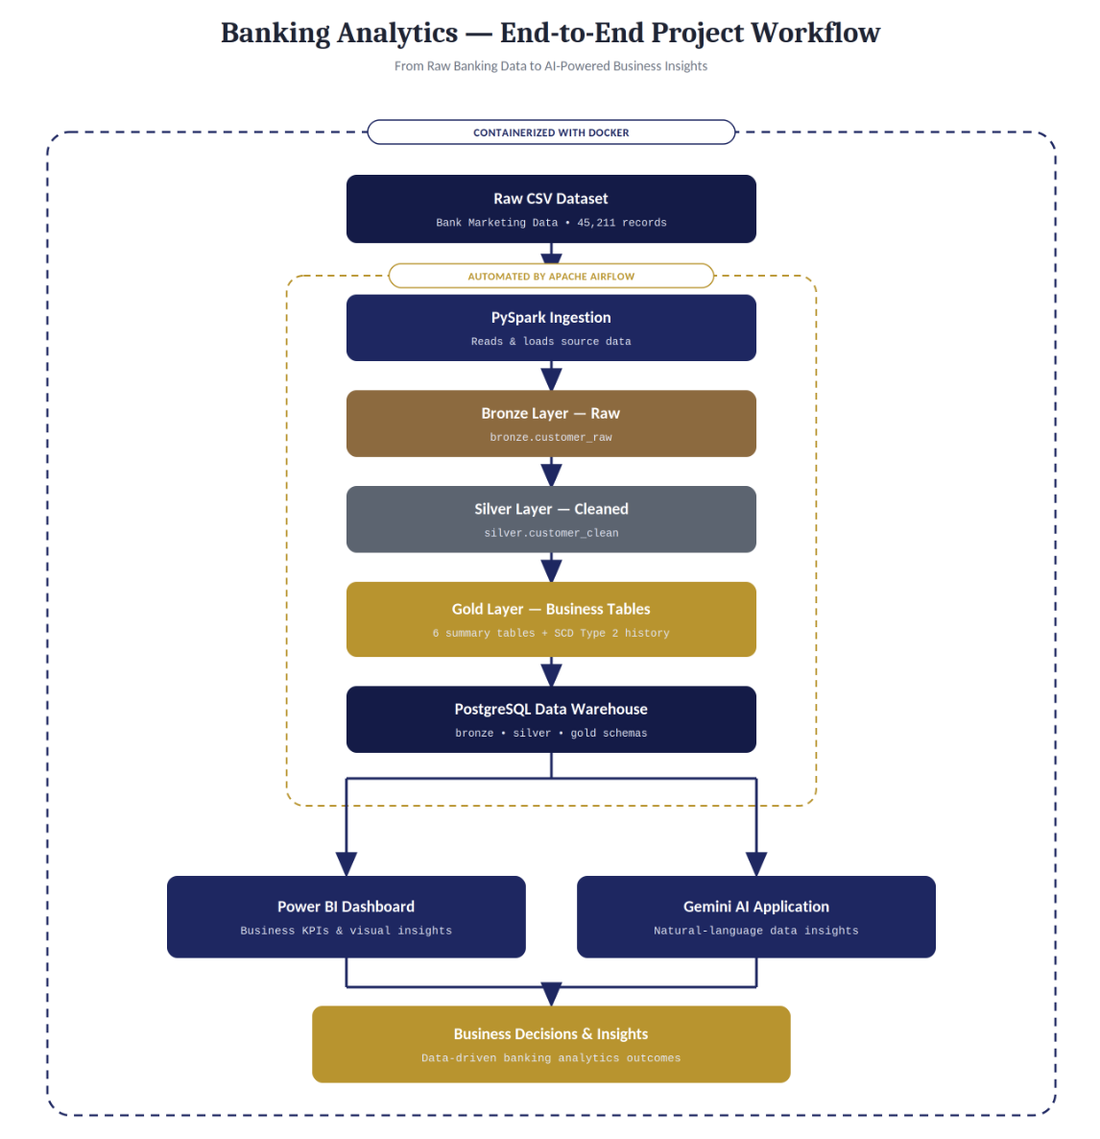
04 ARCHITECTURE
Pipeline Architecture & Workflow
From the Warehouse, the pipeline fans out:
Af
Apache Airflow • Automation
Orchestrates Bronze → Silver → Gold → SCD Type 2 as a scheduled, monitored DAG with retry logic.
BI
Power BI Dashboard • Business Insights
Visualizes KPIs — customers, deposits, demographics, and monthly trends — for stakeholders.
Gm
Gemini AI Application • AI Layer
Adds a natural-language interface on top of the gold-layer data for conversational insights.
Docker containerizes every component for consistent, portable deployment across environments.
05

Slide 6
05 DATA ENGINEERING
Medallion Architecture
Bronze Layer
Silver Layer
Gold Layer
RAW
CLEANED
BUSINESS-READY
•
Stores raw ingested data exactly as received
•
Removes duplicate records
•
Builds customer, deposit & job summaries
•
No transformations or modifications applied
•
Handles null values and trims whitespace
•
Builds education & marital summaries
•
Preserves original records for traceability
•
Standardizes text and converts data types
•
Builds monthly subscription analysis
•
Validates records for consistency
•
Implements SCD Type 2 for history tracking
bronze.customer_raw
silver.customer_clean
gold.dim_customer_history +
6 summary tables
Data Engineering & AI Project
06

Slide 7
06 AI APPLICATION
AI Layer & Power BI Analytics
Processed gold-layer data powers both a visual dashboard and a Gemini-based AI application.
AI
AI Application
BI
Power BI Dashboard
Built on top of the cleaned and summarized gold-layer tables, the AI application uses Google's Gemini model to let users interact with the banking data through natural language — turning structured warehouse data into conversational, easy-to-understand answers.
Interactive dashboard refreshed directly from the gold-layer warehouse:
Total Customers
Subscribed Customers
Average Age & Balance
Customers by Job
•
Connects to the PostgreSQL gold layer as its data source
•
Uses Gemini to interpret questions and generate insights
Customers by Education
Monthly Subscription Trend
•
Turns raw KPIs into plain-language summaries
Deposit Subscription Status
Business Insights Panel
•
Complements the Power BI dashboard with a conversational interface
Data Engineering & AI Project
07

Slide 8
07 OUTCOMES
Conclusion & What's Next
Built a complete end-to-end Data Engineering pipeline for banking data.
Used Medallion Architecture to clean and organize raw data.
Automated the entire workflow using Apache Airflow.
Used Docker to make the project portable and easy to deploy.
Stored all data in PostgreSQL for structured access.
Added a Gemini AI application for natural-language insights.
Built a Power BI dashboard for visual business insights.
Project shows strong skills in both Data Engineering and AI integration.
Skills Demonstrated :
•
Data Engineering
ETL / ELT
Medallion Architecture
•
PySpark & SQL
PostgreSQL
Docker
Apache Airflow
•
Power BI
SCD
Gemini AI Integration
•
Future Enhancements
Incremental Loading • Kafka Streaming • Delta Lake • Azure Data Factory • Snowflake • AWS S3 • Databricks • CI/CD Integration
Data Engineering & AI Project
08

