Slide 1
OTP VERIFICATION SYSTEM Python - Capstone Project

Slide 2
Problem Statement:
Developing an OTP (One-Time Password) verification system in Python. The system should generate a 6-digit OTP and send it to the user's email address for verification. Upon receiving the OTP, the user should enter it into the system for validation. If the entered OTP matches the generated OTP, access should be granted; otherwise, access should be denied.
Project Requirements:
Implement a function to generate a 6-digit OTP randomly.
Develop a function to simulate sending the OTP to the user's email address.
Create a function to prompt the user to enter the OTP received in their email.
Implement a function to verify if the entered OTP matches the generated OTP.
Ensure proper error handling and user-friendly prompts throughout the system.
Allow the user to retry OTP entry in case of incorrect input.

Slide 3
Technologies Used:
Python
smtplib
email libraries

Slide 4
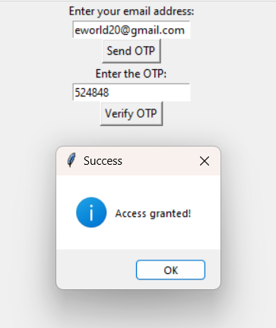
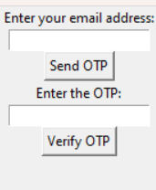
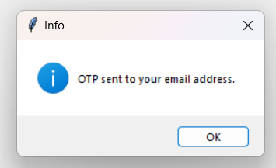
Visualization

Slide 5
OTP Generation
Function: generate_otp()
Generate a random 6-digit OTP using random.randint
Purpose:
To create a secure and random 6-digit OTP for user verification.
Implementation:
Uses python ‘random’ module.
‘random.randint(100000,999999)’ ensures a 6-digit number.
Code:
import random
def generate_otp():
otp = random.randint(100000, 999999)
return otp

Slide 6
Sending OTP via Email
Function: send_otp_via_email(otp,user_email)
The ‘send_otp_via_email’ function is responsible for sending the generated OTP to the user’s email address.
This function ensures that the OTP reaches the intended user securely and promptly.
Purpose:
The main purpose of this function is to deliver the generated OTP to the user’s email.This step is crucial for the user to receive the OTP, which they will use for verification.

Slide 7
Implementation:
The function uses Python’s ‘smtplib’ and ‘email.mine’ libraries.
‘smtplib’: This module defines an SMTP client session object that can be used to send mail to any internet machine with an SMTP listener daemon.
‘email.mine’: This module is used to create MIME objects, which are necessary for composing email content.

Slide 8
OTP Verification
Function : verify_otp(gernerated_otp, user_otp)
The ‘verify_otp’ function is responsible for verifying whether the OTP entered by the user matches the OTP that was generated and sent to their email.
Purpose:
The main purpose of this function is to ensure that the user has entered the correct OTP, which confirms their identity and allows them to proceed with accessing the system or service.
Result:
The function returns a Boolean value: ‘True’ if the OTP match, and ‘False’ if they do not. This result is used to determine whether access should be granted or denied.

Slide 9
Conclusion
Summary of OTP system:
Enhances user authentication security by generating, sending, and verifying OTPs.
Ensures only authorized users gain access with a temporary, unique OTP sent to their email.
Key Functionalities:
OTP Generation : Generates a random 6-digit OTP using ‘random.randint’.
Sending OTP via Email : Uses ‘smtplib’ and ‘email.mime’ to send the OTP securely.
OTP Verification: Compares the user’s input with the generated OTP and returns a validation result.
Error Handling and User Interaction : Provides clear prompts and allow retries for incorrect OTP input.

Slide 10
Conclusion
Future Enhancements:
Enhanced Security Features: Add rate limiting and encryption for OTP storage.
Improved User Experience: Develop a GUI and support OTP delivery via SMS.
Scalability and Performance: Optimize for large user bases and implement logging and monitoring.

