Slide 1

Dr. D. Y. Patil Pratishathan's Institute for Advanced Computing and Software Development PG-DAC
A Project
on
“Secondhand Book selling and Buying online portal”
Presented By: Ashwini Surwase
Sayali Jangam
Under guidance of
Mr. Kashinath Patil

Slide 2
Contents:
Introduction
Problem domain
Scope
Goal and Objective
Advantages
ER Diagram
Conclusion
References

Slide 3
Introduction
Students have many course based literature text books that they have stopped reading and these books are laying on their book shelves unused. These books can be sold and the proceeds can be used to buy another book the student currently needs. This website buy second hand books or wants to empty their book shelves and make financial gain from it.
These books can just be simply be uploded to the website and another student or person can have access to buy the book by just visiting the website.
All these can be achieved by creating a user friendly complete online shopping system for buying and selling secondhand books.

Slide 4
Problem domain:
The design and implement an online bookstore.
In the bookstore customer searches for his required book & purchases them.

Slide 5
Scope:
To Provide user friendly environment.
To provide users to purchase book online.
To add/delete user, manage their accounts.
To reduce users searching time.
To provide great discount over purchasing.
To provide wide collection of book ranges.

Slide 6
Existing System:
The Customer needs to go directly to the merchant and purchase the used books.
It is a time consuming job.
Presently, people have limited option with some very rare old book stores within a city where they live.
The disadvantage is offline stores are restricted by time.
They charge a lot more money for their books than online bookstores.

Slide 7
Objective:
The aim is to build a website as a front end of a bookstore to eliminate this physical presence at sale spot.
To provide a second hand book at convenient price.
To save the time of users by providing books online
To provide service to distant areas.
User can buy used book according to their need.
The main goal of this project are User friendly navigations and maximize search options

Slide 8
Proposed System:
This secondhand book online portal provides facilities to access the book system from anywhere.
The customer can visit the site and purchase the used book according to their requirement and all transactions can be done through a common network.
Online shopping is very convenient.
Online stores are not limited.

Slide 9
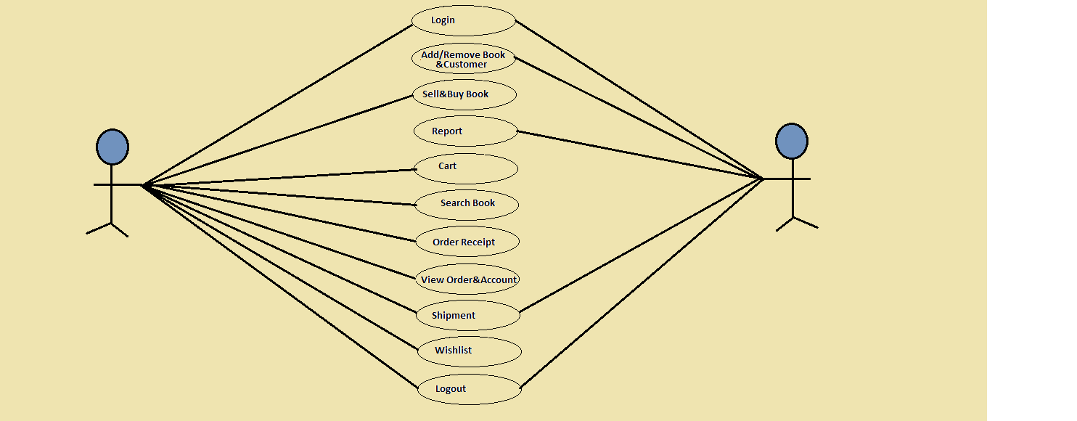
Use Case Diagram

Slide 10
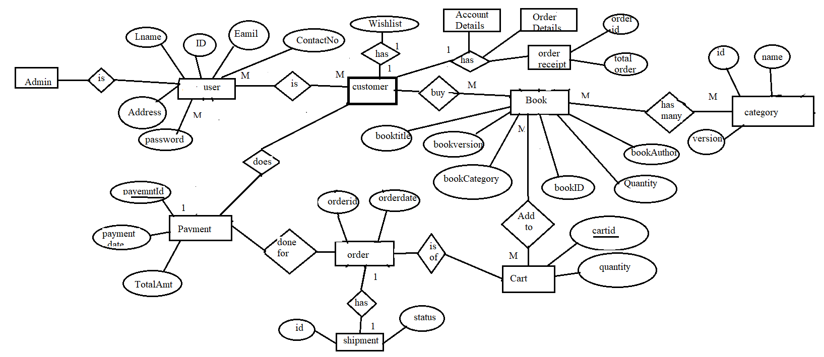
ER Diagram

Slide 11
Advantages:
Convenient way to buy book online
Wide range of books are available which speed up our decision process.
Searching becomes easy.
Wastage of time didn’t take place.
Global availability-from anywhere we can purchase books online.
Cost savings-Cost of books reduces by having discounts over it.

Slide 12
Conclusion:
Online Book store is an online web application where the customer can purchase used books online.
Provide easy search to find required second hand book.
Through a web browser the customers can search for a book by its title or author, later can add to the shopping cart and finally purchase the books.

Slide 13
References:
[1] Vamsi Krishna, “Online Book Store”, Mummaneni Kansas State University Manhattan.
[2] Vishal Ambhore, “SECOND HAND BOOK STORE”, International Journal of Advanced Technology & Engineering Research (IJATER), ISSN No: 2250-3536 Volume 8, Issue 3, May 2018.
[3] Talla Ngala Yiga, Design and Implementation of a Secondhand E-bookshop

Slide 14
Thank You

