Slide 1



Exploring the causes of Maternal mortality in Karnataka and
Crafting Strategies for Prevention
(Paper id : 243)
Dr P.G Sunitha Hiremath, Alwyn .D. Fernandes , Ashwini Shrigan

Slide 2



Introduction
Maternal mortality indicates the number of women dying during childbirth.
One of the UN’s Sustainable Development Goals (SDGs) is SDG 3 (Good Health and Well Being Ensure Healthy Lives and Promote Well Being for All at All Ages)
SDG 3.1 aims to reduce global MMR below 70 per 100,000 live births by 2030 .
MMR of India has declined from 384 in 2000 to 103 in 2020 and Karnataka's MMR has declined from 83 in 2017 to 69 in 2020.
Even though overall MMR has decreased in Karnataka , few districts face varying MMRs.
The objective of this study is to investigate & analyze the factors that cause MM in each of the district and strategies developed & applied by the Govt. to address this issue.(2017-2020)
17-07-2024

Slide 3
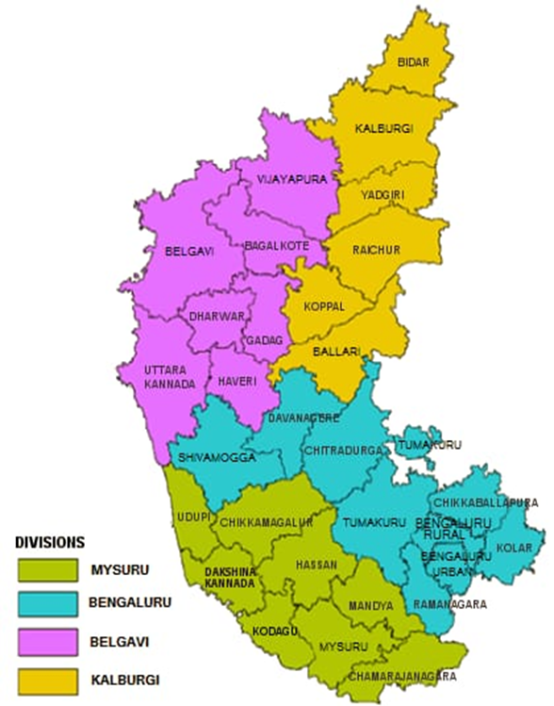
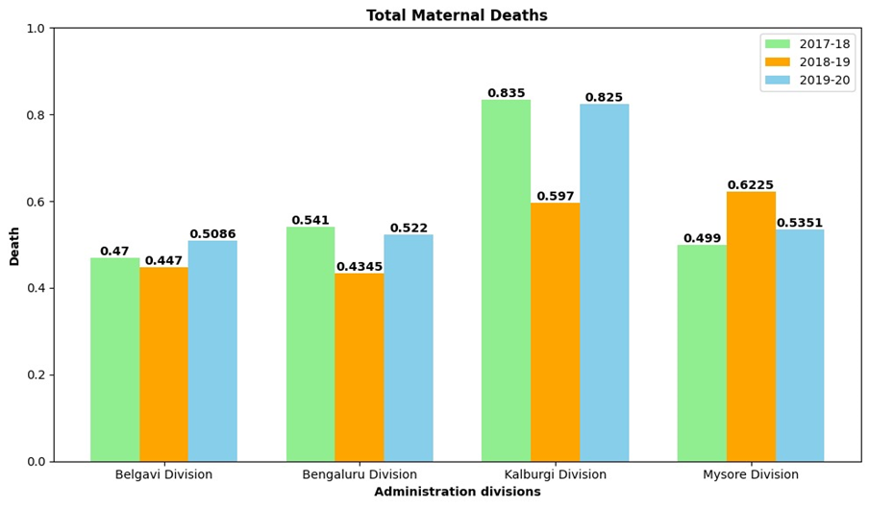
Data ,Preprocessing & Analysis
Three years data (2017-2020: Reproductive and Child Health : 192 attributes ,30 tuples) collected from karnataka.data.gov.in.
Attributes: Health ,Serious medical conditions, Medicine, Successful operations of treatments, Negligence of faculty.
“Mortality Rate"= "Total Deaths" /"Total ANC Registrations" ∗1000
We employed the "Linear Regression" method for feature selection, removing attributes with variance below 0.7, focusing on "Total number of maternal deaths," resulting in 53 selected attributes out of 192.
(Sample data)
Table 1:MMR Year wise
Year | Total ANC registrations | Total Maternal Deaths | Total % of Deaths
2017 -2018 | 10,97,344 | 758 | 0.718%
2018 - 2019 | 11,40,111 | 657 | 0.576%
2019 -2020 | 11,51,533 | 724 | 0.628%
Fig 2:DivisionwiseMMR
Total maternal deaths reduced by 0.09% when compared with the year 2017-18.
Kalburgi division has highest MM when compared to other divisions.
Fig 1:Karnataka Divisions
17-07-2024
ERCICA-2024

Slide 4
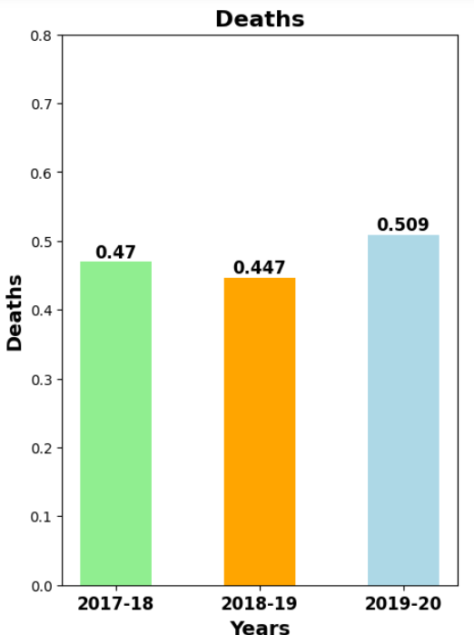
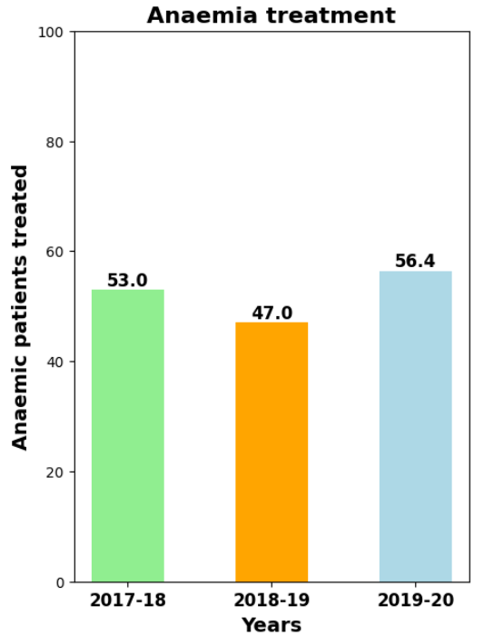
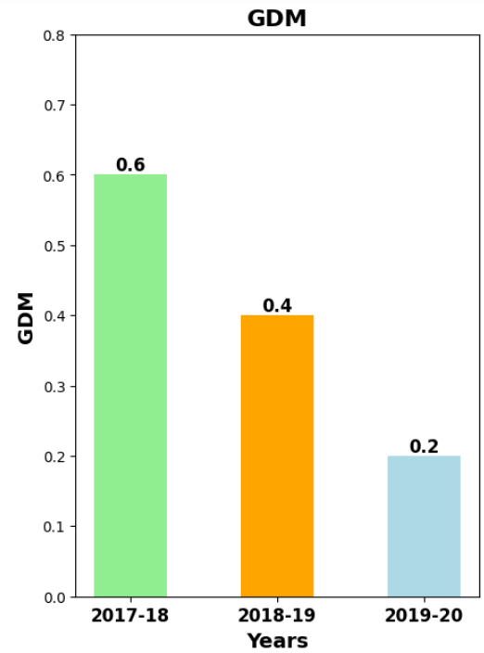
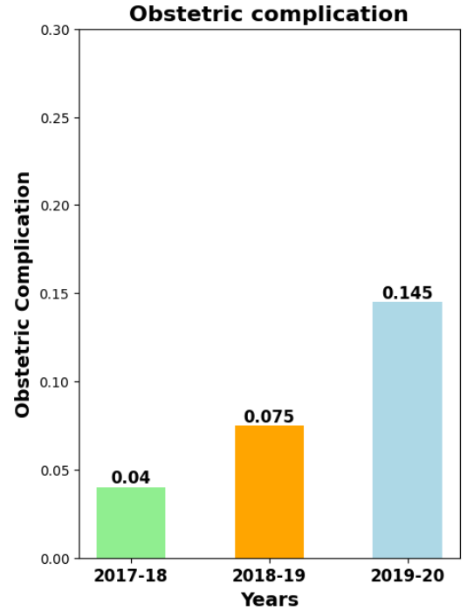
Belagavi Division
Fig 1
Deaths in Belgavi division
Fig 1
Causes(Anaemia)
Fig 1
Causes(GDM)
Fig 1
Causes(Obstetric complication)
Districts | % rise in Deaths(2017-20) | Causes
 |  | Anaemia | GDM | Obstetric Complications
Gadag | 34% | ✓ | - | ✓
Haveri | 8% | ✓ | - | -
Bijapur | 7% | ✓ | - | ✓
Gadag: Anaemia Obstetric Complication Deaths
Haveri: Anaemia Deaths
Bijapur: Anaemia Obstetric Complication Deaths
GDM cases have not increased in any districts.
Anaemia has increased among districts in Belagavi division.

Slide 5
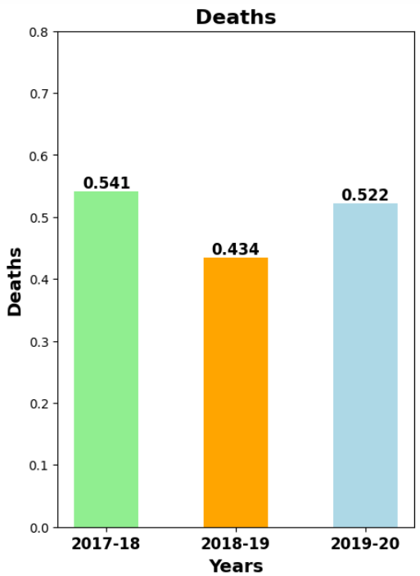
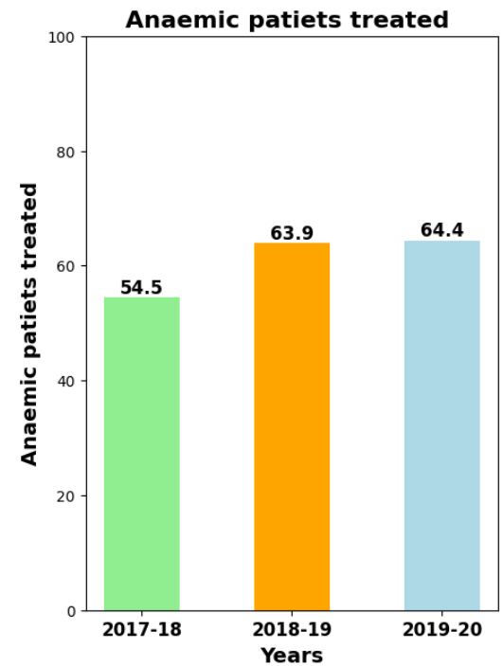
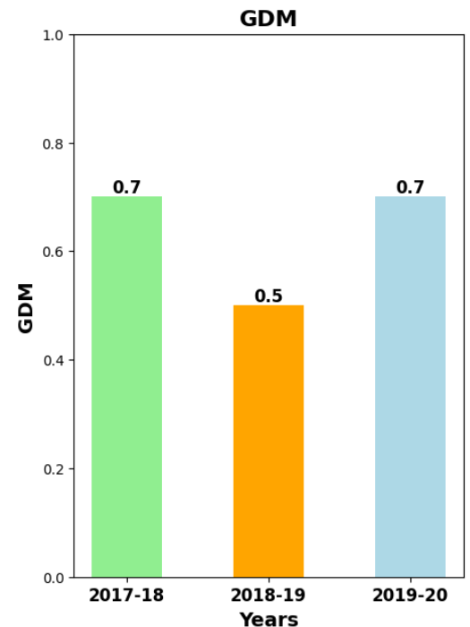
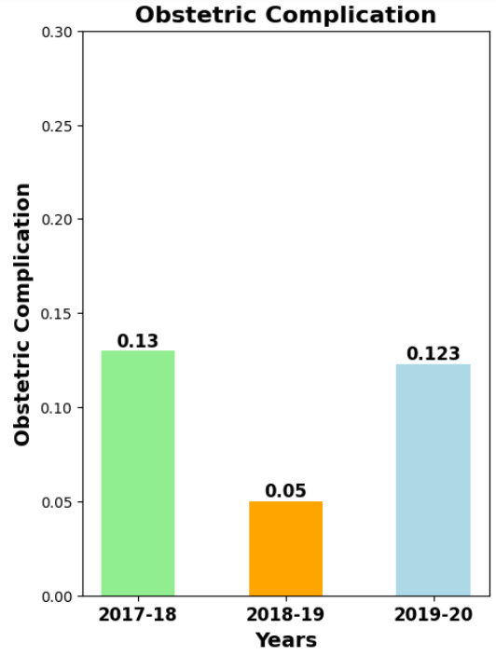
Bengaluru Division
Fig 1
Deaths in Bengaluru division
Fig 1
Causes(Anaemia)
Fig 1
Causes(GDM)
Fig 1
Causes(Obstetric complication)
Districts | % rise in Deaths(2017-20) | Causes
 |  | Anaemia | GDM | Obstetric Complications
Davanagere | 124.78% | - | ✓ | ✓
Ramnagar | 322.66% | - | ✓ | ✓
Davangere: GDM Obstetric Complication Deaths
Ramnagar : GDM Obstetric Complication Deaths
GDM and Obstetric Complication is common among districts in Bengaluru division.
The deaths have increased by over 100%, indicating that the number of deaths have doubled compared to the previous year.

Slide 6
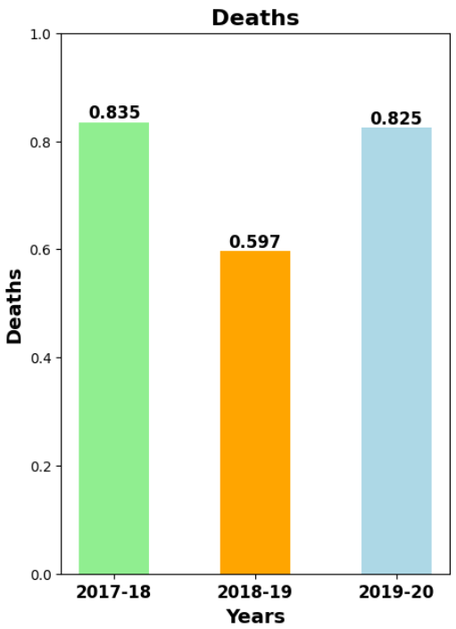
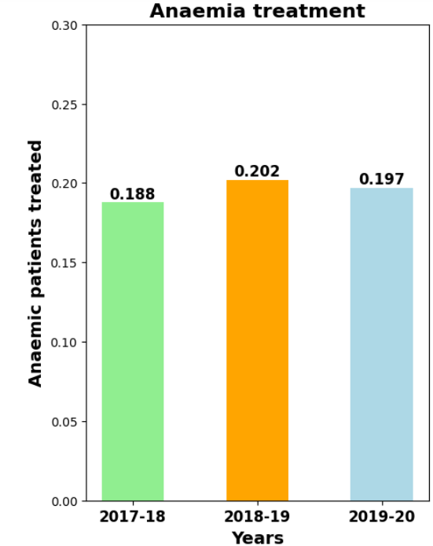
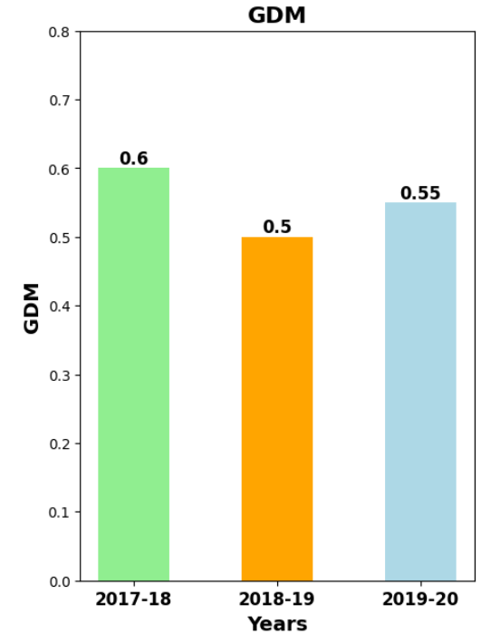
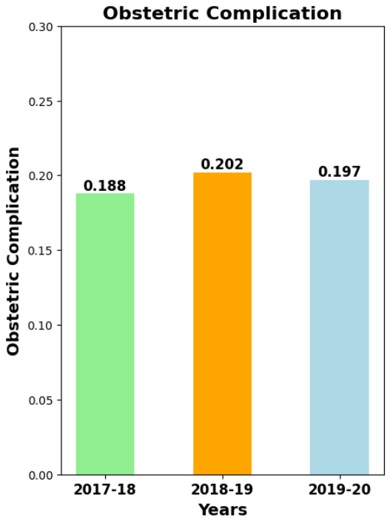
Kalburgi Division
Fig 1
Deaths in Kalburgi division
Fig 1
Causes(Anaemia)
Fig 1
Causes(GDM)
Fig 1
Causes(Obstetric complication)
Districts | % rise in Deaths(2017-20) | Causes
 |  | Anaemia | GDM | Obstetric Complications
Ballari | 9.5% | - | - | ✓
Yadgir | 121% | ✓ | - | -
Yadgir : GDM Obstetric Complication Deaths
Ballari : Obstetric Complication Deaths

Slide 7
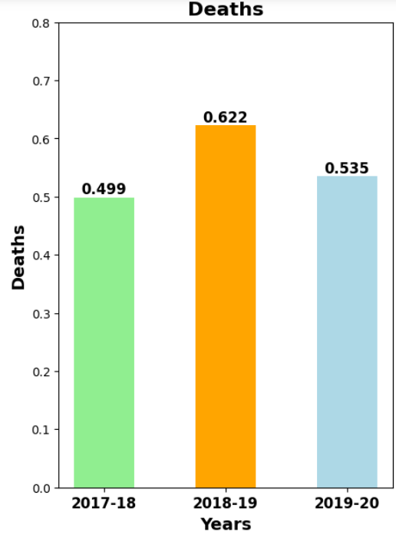
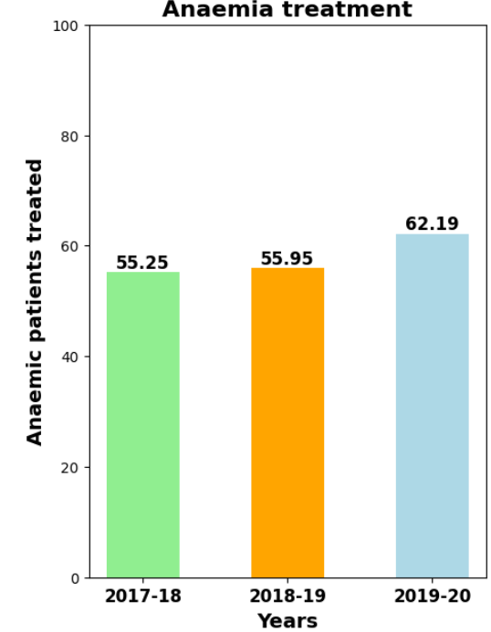
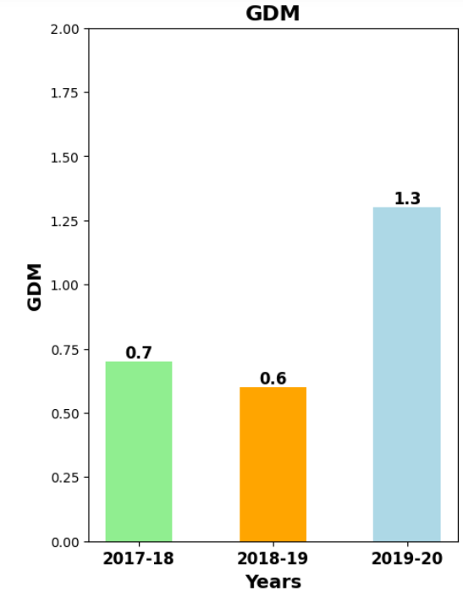
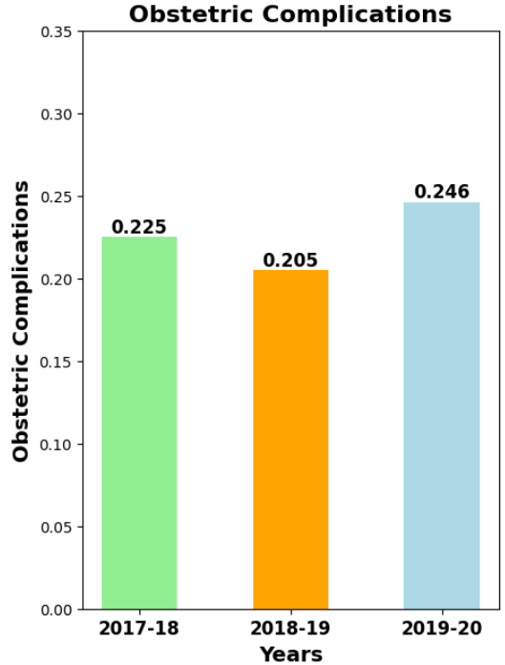
Mysore Division
Fig 1
Deaths in Mysore division
Fig 1
Causes(Anaemia)
Fig 1
Causes(GDM)
Fig 1
Causes(Obstetric complication)
Districts | % rise in Deaths(2017-20) | Causes
 |  | Anaemia | GDM | Obstetric Complications
Chikmagalur | 27.2% | - | - | ✓
Dakshina kannada | 47.4% | - | ✓ | ✓
Mysore | 14.4% | ✓ | ✓ | ✓
Chikmaglur : Obstetric Complication Deaths
Dakshin Kannada : GDM Obstetric Complication Deaths
Mysore : Anemia GDM Obstetric Complications Deaths
The deaths in Mysore district was affected by all 3 ,GDM , Obstetric Complication and Anaemia.

Slide 8
Preventions:
Increased distribution of 180 IFA tablets has led to decreased maternal deaths in districts like Belgaum and Dharwad.
District-Specific Observations:
Dharwad: Declining anaemia treatment has contributed to higher mortality rates, underscoring the importance of maintaining IFA tablet distribution.
Davangere, Kolar, Ramanagar, Shivamogga, Tumkur: Significant decrease in anemia cases and maternal deaths has been observed due to proactive IFA tablet distribution.
Bidar, Gulbarga, Koppal: Enhanced distribution has led to a decline in anemia cases and improved maternal health outcomes.
Challenges and Areas Needing Attention:
Raichur and Yadgir: Reduced IFA tablet distribution has resulted in increased anemia cases and higher mortality rates.
Mysore and Udupi: An increase in anemia cases in Mysore has led to higher deaths.
Comprehensive Government Intervention:
Success stories from various districts have demonstrated that increased IFA tablet distribution improves maternal health, advocating for broader implementation.
Consistent use of 180 IFA tablets has had a significant impact on reducing anemia and maternal deaths.
Success stories from various districts should serve as models for implementing similar strategies in regions with high maternal mortality rate.

Slide 9

Conclusion:
The alarming increase in maternal deaths observed in districts such as Dharwad, Gadag, Bijapur, Haveri, Davangere, Ballary, Yadgir, Chikmagluru, Dakshin Kannada, and Mysore underscores the urgent need for targeted interventions to address the multifaceted factors contributing to this trend.
Factors contributing to maternal mortality include Gestational Diabetes Mellitus (GDM), obstetric complications, and anemia.
To achieve Goal 3 of the Sustainable Development Goals (SDGs), the government must prioritize maternal healthcare initiatives in these high-risk districts
Policy Implementation:
Promote Antenatal Care (ANC) registrations.
Ensure access to essential healthcare services.
Distribute vital supplements, such as 180 IFA (Iron and Folic Acid) tablets, to combat anemia
Comprehensive Strategies and Community Participation:
Implement comprehensive strategies involving healthcare providers and communities.
Encourage active participation from all stakeholders to reduce maternal mortality rates.

Slide 10
THANK YOU!!

