Slide 1
Review
15th May 2020

Slide 2
Vignette – (Arm H M1:RT comparison) - Summary
Statistical analysis plan pre-specified two subgroup analyses
Test for interaction was statistically significant
Men with 3 or fewer metastatic sites
Derive a significant benefit of radiotherapy (RT) to the prostate
No benefit apparent in men with more than 3 mets
Outcome:
Men with low burden metastatic now receive RT to the prostate
Choice of cut-point:
Clinician input and roughly splitting the data in the middle.

Slide 3
Questions of Interest
Evaluate presence of treatment effect heterogeneity
Identify subgroups that represent differential treatment effects
What patient characteristics determine such subgroups?
Relevant biomarkers and their threshold values?
Machine learning:
Move away from the need to test for interactions.
Determine subgroups and characterise them.

Slide 4
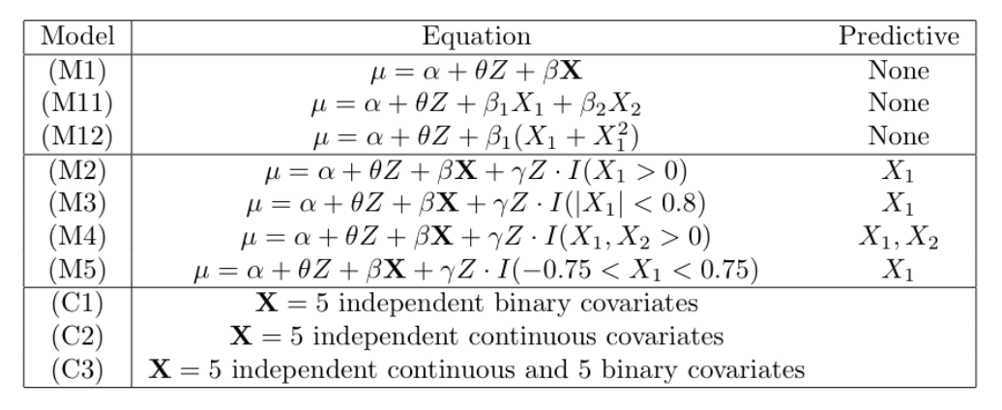
Simulation scenarios
No treatment effect heterogeneity
Introduce effect heterogeneity

Slide 5
Interest
Type I error:
Given the absence of a subgroup, does the method still detect heterogeneity?
Power:
Given the presence of a subgroup, is the method able to detect effect heterogeneity?

Slide 6
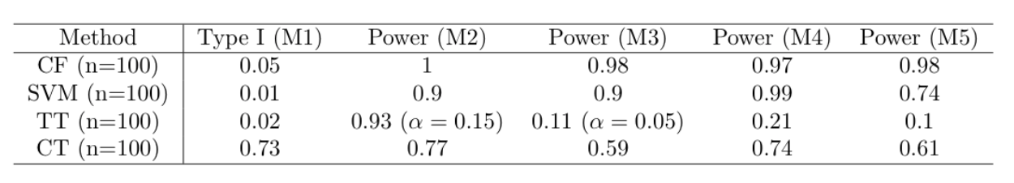
Results
Causal Forest (CF)
TT (TEHTrees)
CT (Causal Trees)
SVM (Support vector machine; Penalised model with double LASSO constraints)

Slide 7
Methods
Causal Tree:
Modify the MSE based criterion to optimise for effect heterogeneity
Use separate samples to account for the problem of overfitting
TEHTree:
Use a statistical inference framework to select covariates
Adjust the size of the tree (Bonferroni correction for multiple comparison – rather conservative)
Causal Forest:
Ensemble over Causal Trees
Penalised model – double lasso constraints
Both CF and this model generate Individual treatment effects

