Slide 1
SPRING BOOT
Ashwini Moolya

Slide 2
CONTENTS
Spring @RequestParam Annotation
Spring Boot Data JPA sort
Spring Boot Registration and Login application

Slide 3
Spring @RequestParam Annotation
Spring @RequestParam annotation maps request parameters to the arguments of a request handler method in Spring Controllers.
There are only three attributes in this annotation.
name attribute
required attribute
default attribute

Slide 4
Spring Boot Data JPA sort
In Spring Data JPA query results can be sorted in two ways:
using an ORDER BY clause in a JPQL query
adding a parameter of type Sort to the query method

Slide 5
Spring Boot Registration and Login
Backend
Create Spring Boot Project and Configure Dependencies.
Create Database and Configure Data Source.
Creating USER ROLE entity
Create New User Service
Creating WEB SERVICE
JWT Authentication Spring Security
Securing Password using BCryptPasswordEncoder
Sending a confirmation mail to User

Slide 6
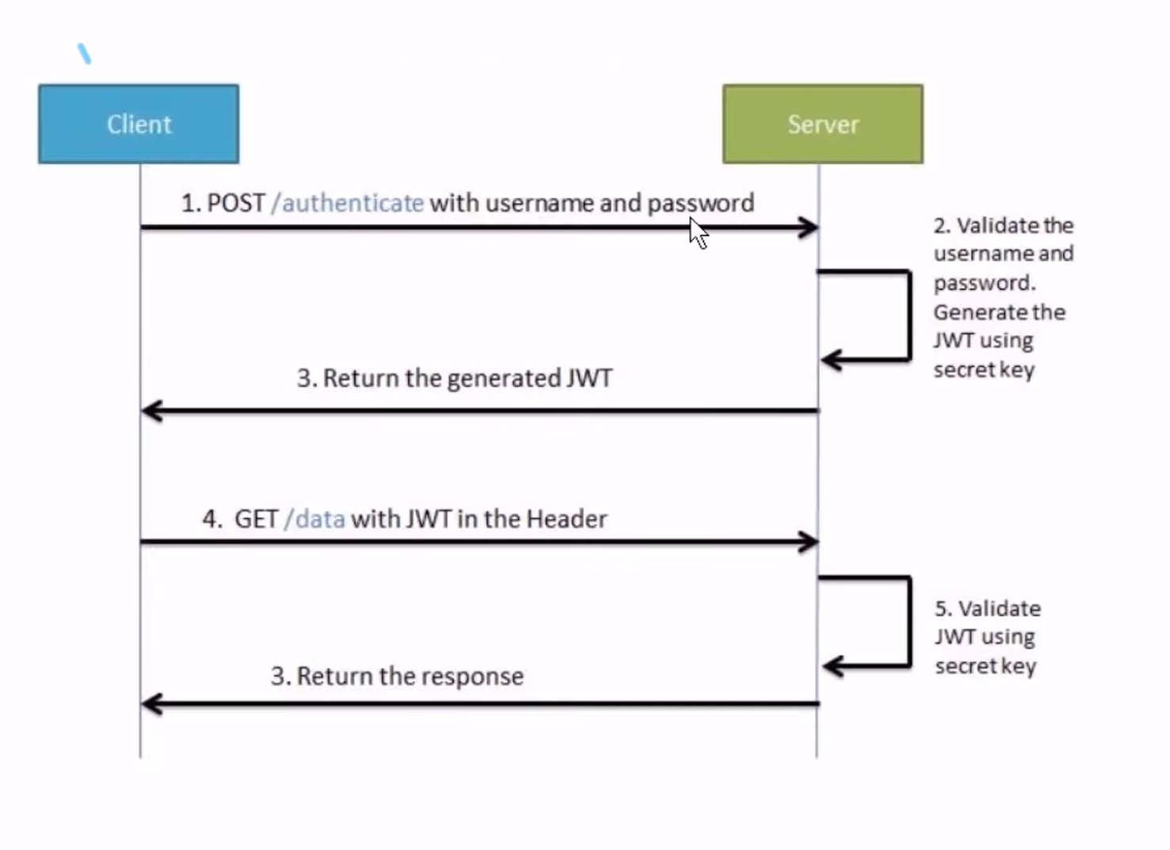
Working of JWT

Slide 7
Sending a mail properties
spring.mail.host=smtp.gmail.com
spring.mail.port=587
spring.mail.username=ashwini.moolya@isteer.com
spring.mail.password=gdptmaygfvauoknx
spring.mail.properties.mail.smtp.auth=true
spring.mail.properties.mail.smtp.starttls.enable=true

Slide 8
THANK YOU

