Slide 1

Edubridge Learning Pvt Ltd Pune
Topic: Employee Management System using Spring Boot.
Presented By:
Ms. Snehal Rakhonde.
Mr. Vivek Kumar.
Mrs. Pratibha Vijapure.
Ms. Ashwini Murhade.
Ms. Harshita JK.
Guided By:
Prof. Indrakka Mali

Slide 2
Contents
Introduction
ER Diagram
Working of Back-End
Annotations
APIs
Software Requirement
Features Of System
Conclusion

Slide 3
ER Diagram
Employee
empId
empName
empSalary
empJoingDate
empEmailId
empAge
empAddress
empCellNo
empExperince
empAdhar
deptId
userName
Password
managerId
Department
deptId
deptName
deptLocation
Employee

Slide 4
Introduction
Employee Management System application is used to store all type of employee data.
Director & Manager can access ,insert ,update , delete data of all the employees.
This application can be used to store employee data in secure form in company.

Slide 5
Working Of Back-End
There are mainly three stages –
Client
RestController
Repository
Service
Database

Slide 6
Work Flow
Client send a request to server for different options like inserting ,fetching ,update and delete a data.
When client hit on request .Request goes to the Contoller Class and use respective URL to take data .
Then control of URL goes to the service Class And Conditions get Executed.
For returning response to client use same sequence. Service To Controll Class.
Here Repository class is used to interact with database using Hibernate Technology.

Slide 7
Annotations ( @)
Annotations are used to provide supplemental information about a program.
Annotations start with ‘@’.
@Id: This id annotation is used to declare attribute as primary.
@GeneratedValue: Used to generate value automatically when use insert new record
@SequenceGenerator: used to assign initial value from where user want to generate .
@Column: When user want to add constraint on column that time this @ is used.
Fig. Process of Phishing websites.

Slide 8
@Email: used to compare email format
@Range: Used to assign rang for number type of input. Eg. age
@size: Used in collection
@length: Used to assign range like minimum and maximum for the string type data.
@NotNull: This gives manadatory filed to enter data.
@ManyToOne: To create the many-to-one relationship between the Employee and department entities.
@JoinColumn: helps us specify the column we'll use for joining.

Slide 9
@JsonIgnore: Is used to ignore the logical property used in serialization and deserialization.
@Entity: is used is used to mark this class as an Entity bean.
OneToMany: is used to create the one-to-many relationship between the Department and Employee entities
Cascadetype.All: ensure that all persistence events such as persist, refresh, merge and remove that occur on the parent, will be passed to the child.

Slide 10
@Configuration: Which indicates that the class has @Bean definition methods.
@Bean: Which is applied on a method to specify that it returns a bean to be managed by Spring context.
@override: Informs the compiler that the element is meant to override an element declared in a superclass.
@RestController: This annotation is used at the class level and allows the class to handle the requests made by the client.
@Autowired: Enables you to inject the object dependency implicitly.

Slide 11
@ControllerAdvice: Allows to handle exceptions across the whole application in one global handling component.
@ResponseStatus: To mark a method or an exception class with a status code and reason that should be returned.
@ExceptionaHandler : Used to handle the specific exceptions and sending the custom responses to the client.
@Service:It is used to mark the class as a service provider.

Slide 12
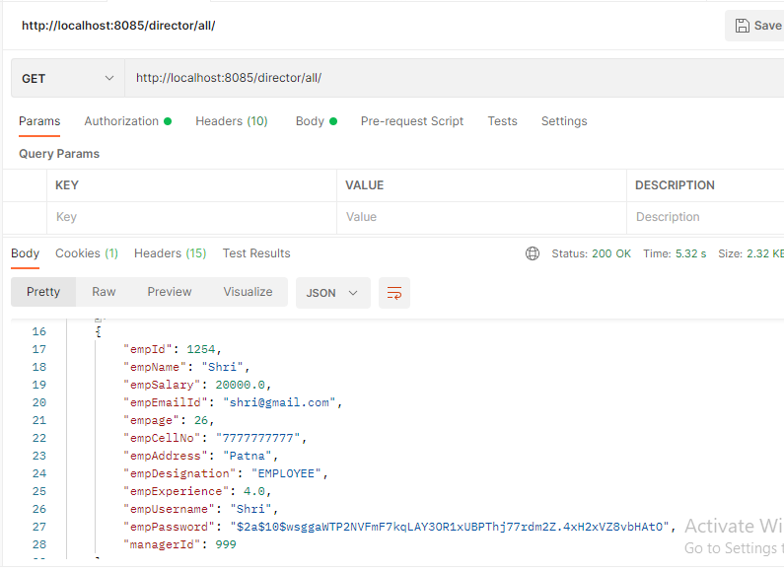
Application Programming Interface(APIs)
APIS Under Director To Do :
“director/all/” : Direct can access all employee details using this Url.

Slide 13
Application Programming Interface(APIs)
/director/getsingleemp/{empId}“: Director can access/get perticular employee record using perticular employee id.
"/director/{managerId}“:Director can get all employee records which is under perticular manger using manager ID.
"/director/departments“: Director can get all departments details.
"/director/department/{deptId}“: Director can get perticular department details using department Id.
"/director/addDept“: Director can Post/Add new Department record under department table.’
"/director/department/{deptId}“: Director can update/Put perticular department details using deptID.

Slide 14
"/director/department/{deptId}“: Director can delete perticular department using deptID.
"/director/addEmp/{deptId}“: Director can post/add new Employee in department using perticular department id.
"/director/user/{empId}“:Director can update perticular employee details using employee Id.
"/director/delete/{empId}“:Director can delete perticular employee record using employee iD.
"/director/updateself/{empId}“:Director also having permission to update perticular employee using Employee Id.

Slide 15
APIs Under Manger To Do:
"/manager/getemp/{mngrId}“:Manager can get all the employee records works under perticular manager using Manager ID,
"/manager/getsingleemp/{empId}“: Manager can access perticular employee details using employee Id.
"/manager/addemp/{deptId}“: Manager can add new employee record in perticular department using department Id.
"/manager/update/{empId}“: Manager can update employee record using employee id.
"/manager/updateself/{empId}“: Manger can update his own record .

Slide 16
"/manager/delete/{empId}“: Manager can delete perticular employee using employee Id.
Employee:
"/employee/update/{empId}“:Employee can update his/her own record.

Slide 17
Software & hardware used
Software Requirements
- Operating System : Windows 7 ,8,9,10.
- Language : Java
IDE : Spring Tool Suite
Client : PostMan
- Backend : MySQL
Hardware Requirements
- CPU : Intel Pentium IV processor
- RAM : 4 GB or above
- Hard Disk : 64 GB hard disk space or minimum

Slide 18
Features of system
To store employee, manager data under director.
This application which is hit the URL on post man and working on different task.

Slide 19
Conclusion
For accessing data and to store data in secure form.
Perfroming data crud opretions on database.
Create REST APIs.
Implementing spring security.
Handle exceptions.
Create association betweens entities.

Slide 20


