Slide 1


Insurance Analytics
Presented by: (group 6)
-POOJA JADHAV
-ASHWINI RATHOD
-SIDDHANT DIVEKAR
-TANUJA TOPARE
-ANISH MOHITE
-SHREYAS BARGE
-ABHISHEK SANAS

Slide 2
Introduction & Problem Statement
Business Objective
KPIs
Dashboard
Conclusion
AGENDA :

Slide 3
INTRODUCTION:
Insurance analytics is a project aimed at analyzing the performance of various branches and account executives of an insurance company. The goal of the project is to identify areas of improvement and help the company make data-driven decisions to increase revenue and customer satisfaction.
The problem statement for this project is to identify which branches and account executives are performing well and which ones need improvement. By analyzing various kpis such as number of invoices, yearly meeting count, and stage funnel by revenue, we can provide valuable insights to the company.
PRESENTED BY: ANUSHKA PRATAP

Slide 4

Business Objective :
Identify trends and patterns in insurance claims data to optimize claims processing efficiency.Expanding Market Reach: It allows businesses to reach customers beyond geographical limitations, tapping into a global market
Develop predictive models to forecast insurance claims and adjust pricing strategies accordingly.Reducing Costs: Operating online can reduce the need for physical stores and the associated costs, such as rent and utilities.
Analyze customer behavior to enhance retention rates and improve customer satisfaction.
Identify and mitigate potential fraudulent activities through data analysis and anomaly detection techniques.
Optimize underwriting processes by analyzing risk factors and refining risk assessment models.
PRESENTED BY: ANUSHKA PRATAP

Slide 5
KPI 1
No. of invoice by Account count
Measure the volume of invoices generated by each account executive within a specified time period.
Analyze trends and patterns in invoice generation to identify top-performing account executives.
Assess the impact of account executive performance on overall revenue and profitability
Use data visualization techniques to present findings in an easily understandable format.
Identify outliers or discrepancies in invoice counts to ensure accuracy in reporting.
PRESENTED BY: ANUSHKA PRATAP

Slide 6

KPI 2
Yearly meeting count
Insights from KPI 1:
We can clearly say that attrition rate of employees for every department is almost 50% which indicates that attrition rate of employees does not depends on department. So, irrespective of the department almost 50% of employees are leaving the company. The formula to calculate the attrition rate is as follow:
Attrition rate = (Number of employees who have “Yes” status/ Count of Total Employees
From this calculation and visualization we concluded that we must make strong strategies to minimize attrition rate and improve our company’s Employee retention so that we can balance the company’s growth and right talent.
Measure the total number of meetings held within the project team over the course of a year.
Include both scheduled and ad-hoc meetings to capture the full extent of collaboration.
Analyze trends in meeting frequency to assess project progress and team engagement.
Set benchmarks for meeting frequency based on project milestones and deliverables.
Evaluate the effectiveness of meetings in achieving project objectives and resolving issues.
PRESENTED BY: ANUSHKA PRATAP

Slide 7
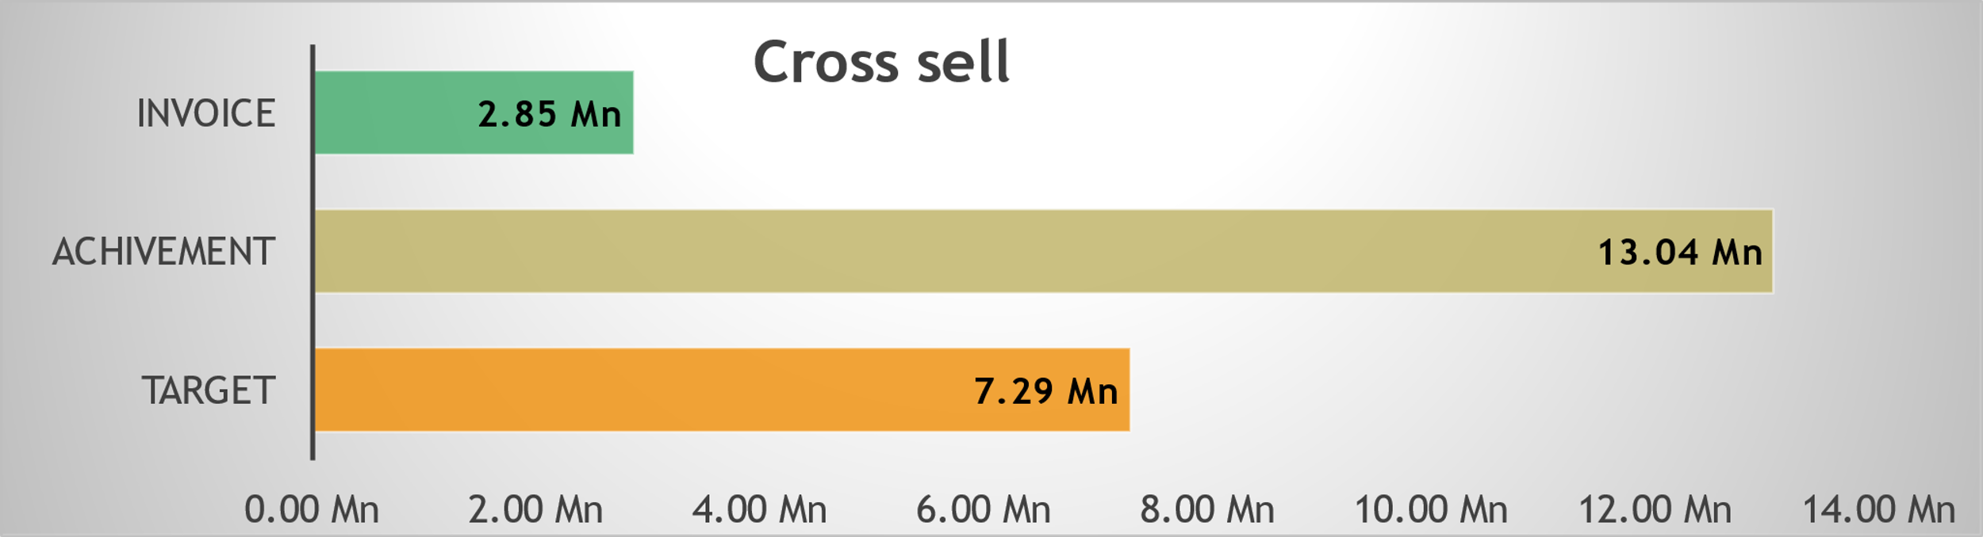
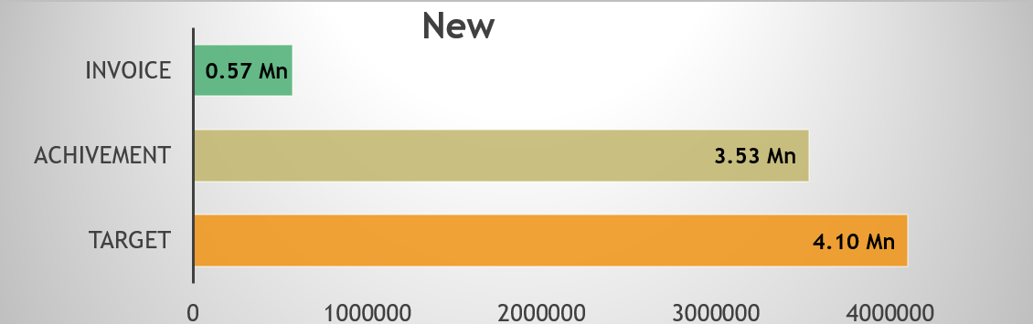
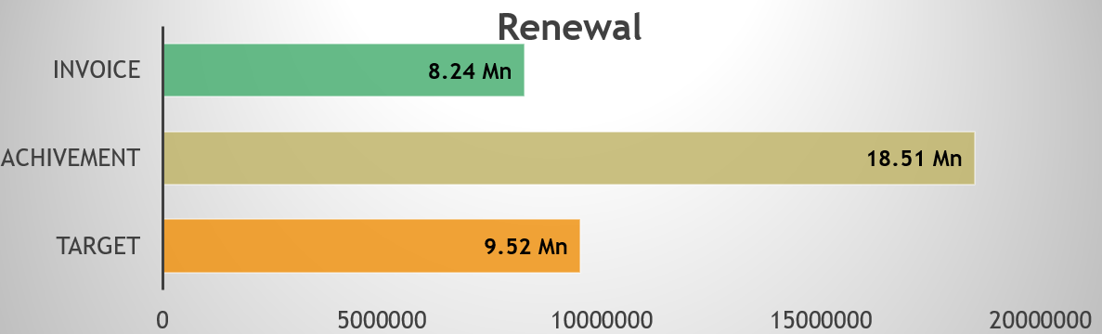
KPI 3
Cross Sell,
New &
Renewal
INSIGHTS FROM KPI 10
Based on our analysis and visualization I came to a conclusion regarding percentage of employees based on gender. In the given data there males are somewhat higher than females. There are 25059 males are present and count of females are 24941 and when it convers to percentage male employees percentage is nearly 50.12% and the female employees percentage is nearly 49.88%
PRESENTED BY: MAHESH

Slide 8
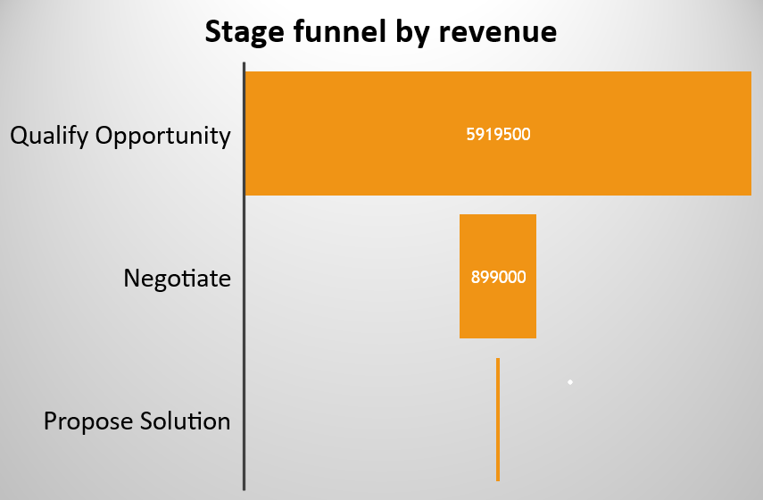
KPI 4
Stage Funnel by revenue
INSIGHTS FROM KPI 10
Based on our analysis and visualization I came to a conclusion regarding percentage of employees based on gender. In the given data there males are somewhat higher than females. There are 25059 males are present and count of females are 24941 and when it convers to percentage male employees percentage is nearly 50.12% and the female employees percentage is nearly 49.88%
In the context of a Stage Funnel by revenue for an insurance analytics project, KPIs are metrics used to measure the performance and effectiveness of the various stages in the sales or customer acquisition process, specifically focusing on revenue generation.
Here's how you might set up KPIs for each stage of the funnel:
PRESENTED BY: MAHESH

Slide 9
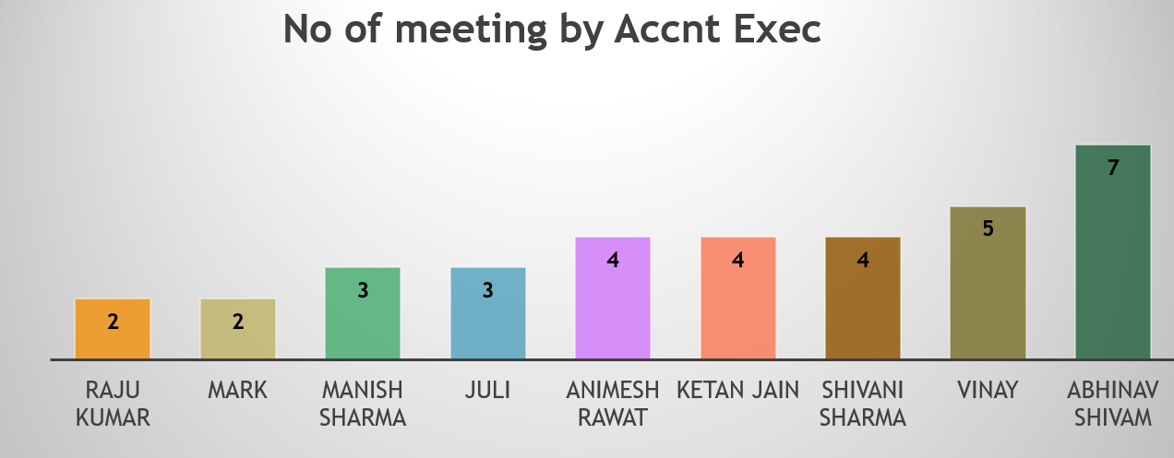
INSIGHTS FROM KPI 10
KPI 5
No. of meeting by account executive
Based on our analysis and visualization I came to a conclusion regarding percentage of employees based on gender. In the given data there males are somewhat higher than females. There are 25059 males are present and count of females are 24941 and when it convers to percentage male employees percentage is nearly 50.12% and the female employees percentage is nearly 49.88%
The Number of Meetings Generated by Account Executive for refers to the total count of meetings scheduled or initiated by the Account Executive with potential clients, stakeholders, or decision-makers specifically related to the insurance analytics project within a defined period.
PRESENTED BY: MAHESH

Slide 10
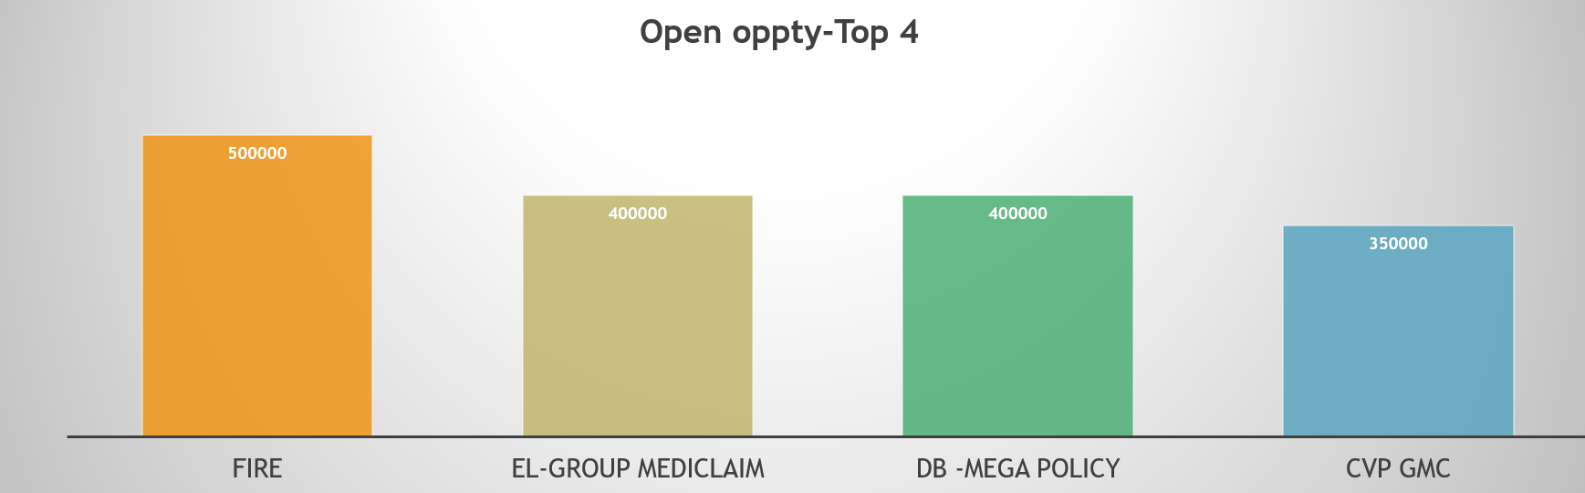
INSIGHTS FROM KPI 10
KPI 6top open opportunity
Based on our analysis and visualization I came to a conclusion regarding percentage of employees based on gender. In the given data there males are somewhat higher than females. There are 25059 males are present and count of females are 24941 and when it convers to percentage male employees percentage is nearly 50.12% and the female employees percentage is nearly 49.88%
Loss Ratio Optimization: Analyze claims data to identify patterns and trends, enabling proactive measures to minimize loss ratios and maximize profitability.
Customer Retention Insights: Utilize predictive modeling to understand customer behavior and preferences, enhancing retention strategies and fostering long-term client relationships.
Fraud Detection Enhancement: Implement advanced analytics techniques to detect fraudulent activities, reducing claim payouts and protecting the company's assets.
Operational Efficiency Improvements: Streamline processes through data-driven insights, optimizing resource allocation and reducing operational costs.
PRESENTED BY: MAHESH

Slide 11
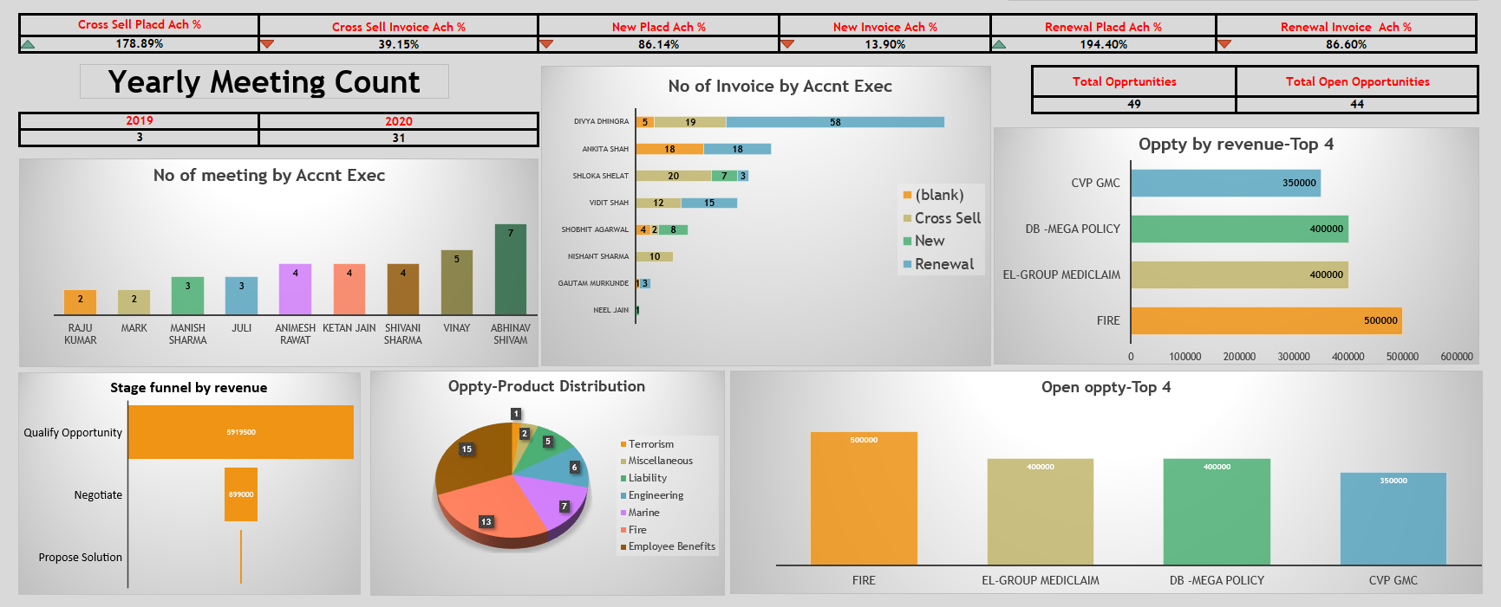
INSIGHTS FROM KPI 10
Based on our analysis and visualization I came to a conclusion regarding percentage of employees based on gender. In the given data there males are somewhat higher than females. There are 25059 males are present and count of females are 24941 and when it convers to percentage male employees percentage is nearly 50.12% and the female employees percentage is nearly 49.88%
PRESENTED BY: MAHESH

Slide 12
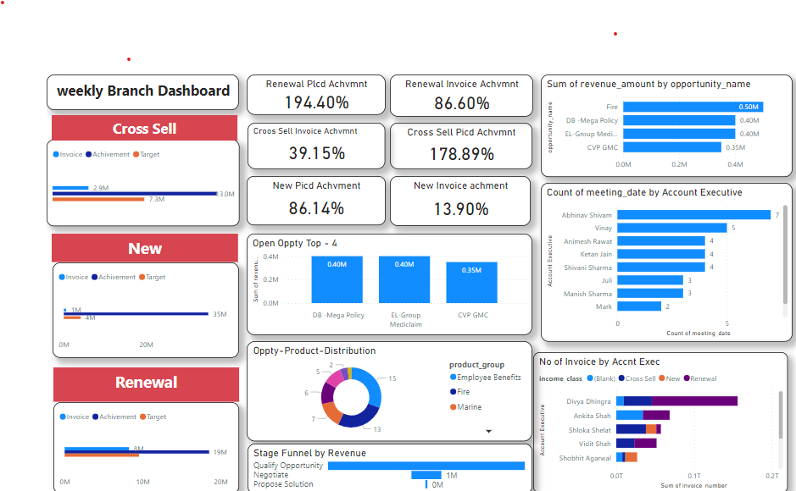
INSIGHTS FROM KPI 10
Based on our analysis and visualization I came to a conclusion regarding percentage of employees based on gender. In the given data there males are somewhat higher than females. There are 25059 males are present and count of females are 24941 and when it convers to percentage male employees percentage is nearly 50.12% and the female employees percentage is nearly 49.88%
PRESENTED BY: MAHESH

Slide 13
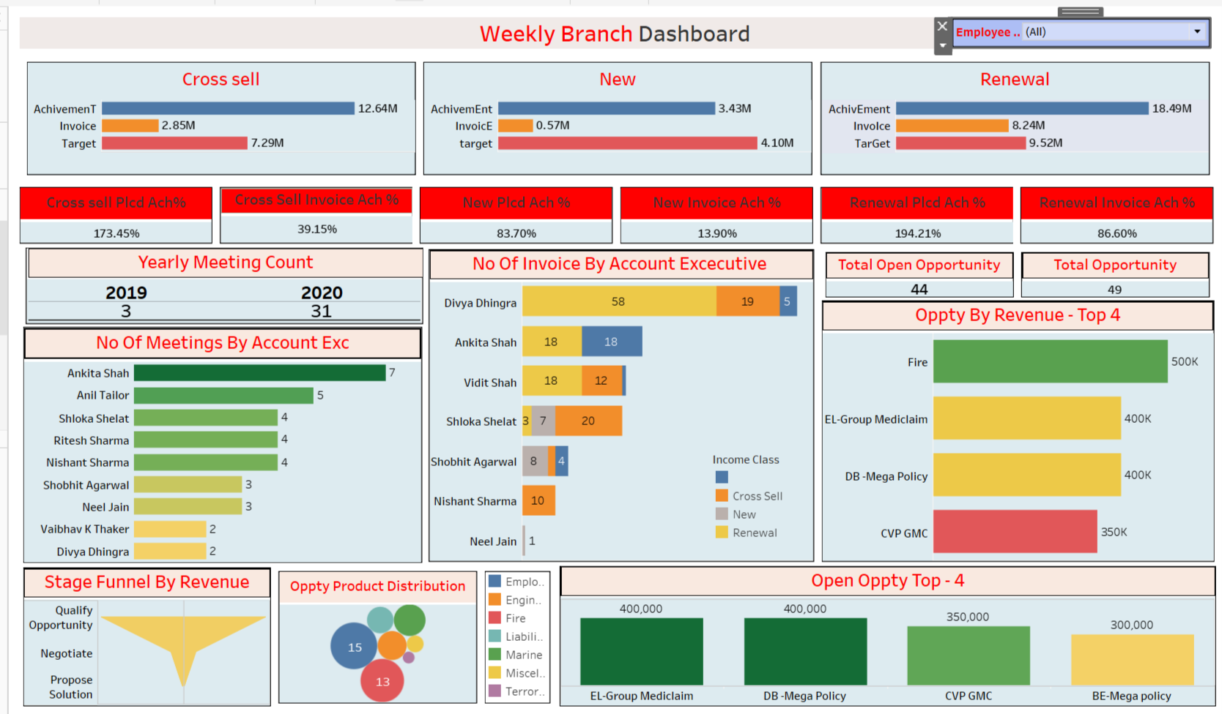
INSIGHTS FROM KPI 10
Based on our analysis and visualization I came to a conclusion regarding percentage of employees based on gender. In the given data there males are somewhat higher than females. There are 25059 males are present and count of females are 24941 and when it convers to percentage male employees percentage is nearly 50.12% and the female employees percentage is nearly 49.88%
PRESENTED BY: MAHESH

Slide 14
INSIGHTS FROM KPI 10
conclusion
Summarize the introduction, highlighting the importance of leveraging analytics to transform insurance risk assessment and set the stage for the subsequent sections of the project.
By leveraging advanced analytics, this project aims to empower insurance companies to make data-driven decisions, mitigate risk effectively, and ultimately enhance their competitive advantage in the market.
Based on our analysis and visualization I came to a conclusion regarding percentage of employees based on gender. In the given data there males are somewhat higher than females. There are 25059 males are present and count of females are 24941 and when it convers to percentage male employees percentage is nearly 50.12% and the female employees percentage is nearly 49.88%
PRESENTED BY: MAHESH

Slide 15
INSIGHTS FROM KPI 10
Based on our analysis and visualization I came to a conclusion regarding percentage of employees based on gender. In the given data there males are somewhat higher than females. There are 25059 males are present and count of females are 24941 and when it convers to percentage male employees percentage is nearly 50.12% and the female employees percentage is nearly 49.88%
Thank you
PRESENTED BY: MAHESH

