Slide 1
YouTube Song Analysis
Data Analyst
Now Playing
Presented By Ashwini Rathod, MIP-DA-03
1:23
2:36

Slide 2
Project Overview
review playing
Objective: Analyze YouTube song data to understand performance, popularity, and user engagement.
Tool Used: Utilizing Power BI for in-depth visualizations and reports.
Dataset Attributes: Includes video ID, channel title, video title, view count, like count, and more.
Goals:
Create insightful visualizations that highlight song performance on YouTube.
Uncover trends and patterns to aid content optimization.
Provide actionable insights for content creators and stakeholders.
Analysis Focus:
Examine how video characteristics affect engagement.
Identify factors contributing to high-performing content.
Explore viewer preferences and engagement trends.

Slide 3
Introduction
Album intro
Purpose: "This dashboard comprehensively analyzes song performances, listener preferences, and emerging trends across various platforms."
This project embarks on an insightful journey through YouTube song data using Power BI to illuminate the dynamics of video performance, audience engagement, and popularity trends. By dissecting attributes such as view counts, likes, and comments, we aim to deliver strategic insights for optimizing YouTube content. Through visual analytics, we explore the essence of what captivates viewers, enabling content creators to refine their offerings for maximal impact.

Slide 4
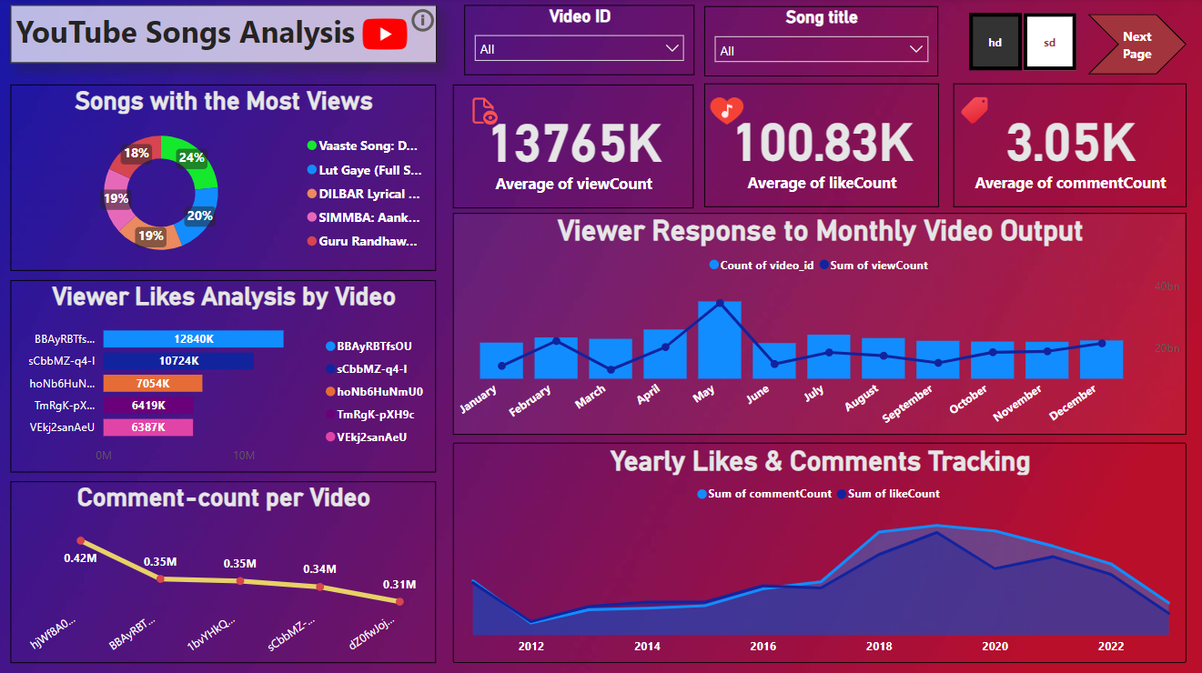
Dashboard Overview
Best hits
This vibrant dashboard offers a comprehensive snapshot of YouTube song performance, showcasing key metrics such as most-viewed songs, user engagement through likes and comments, and trends over time.

Slide 5
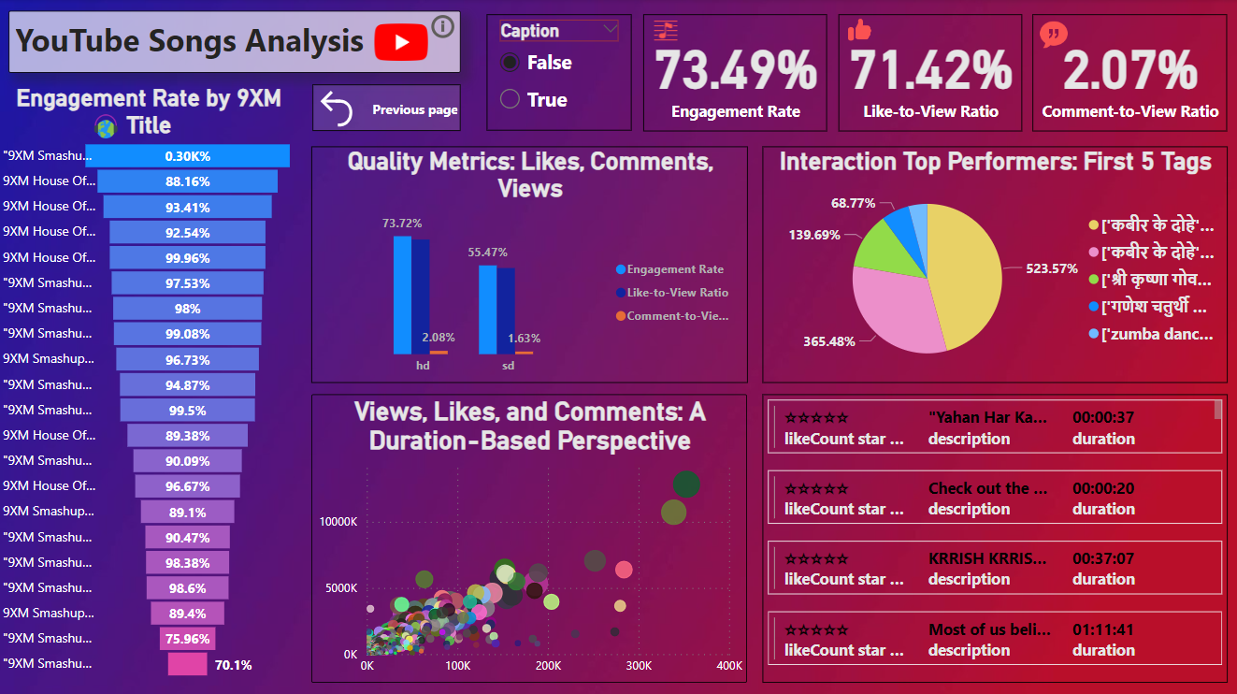
Dashboard Overview
Best hits
The second dashboard offers a nuanced view into engagement metrics for YouTube song videos, detailing the like-to-view ratio, comment-to-view ratio, and overall engagement rates, along with tag-based interaction performance, giving content creators a closer look at audience interaction and quality of viewer engagement

Slide 6
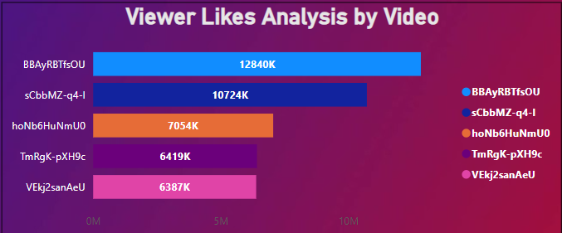
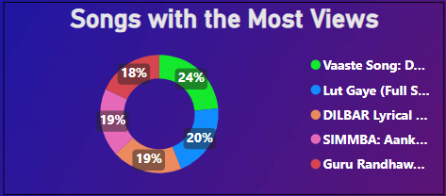
Top-Performing Songs
Popular songs
Vaaste Song" tops in viewership, highlighting its widespread appeal.
Viewer interest is diverse, as indicated by the close view percentages among top songs.
The song "BBayRBtfsOU" garners the highest number of likes, reflecting robust audience appreciation.
Discrepancy between views and likes suggests varied audience interactions.
Factors like artist recognition, song popularity, and cultural impact are likely success drivers

Slide 7
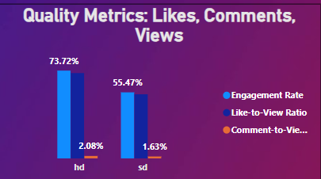
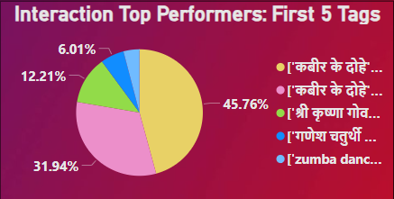
Best view
Viewer Interaction
HD content shows a marked lead in viewer engagement over SD, emphasizing the value of quality in attracting likes and comments.
This pie chart illustrates the proportion of viewer interactions for the top five tags, highlighting that "Kabir ke dohe" tags are the most engaging, claiming nearly half of the total interactions

Slide 8
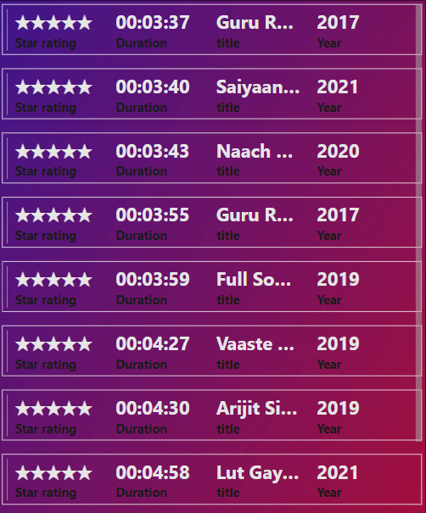
Trend Analysis
Song-Stars
The multi-row card chart presents song durations, titles, release years, and star ratings, enabling trend analysis to identify top-rated songs of each year and discern patterns in musical content and popularity based on viewer ratings.
This visual summary highlights the top-rated YouTube songs over different years, providing quick insights into annual favorites based on star ratings and indicating potential shifts in musical tastes and trends.
3

Slide 9
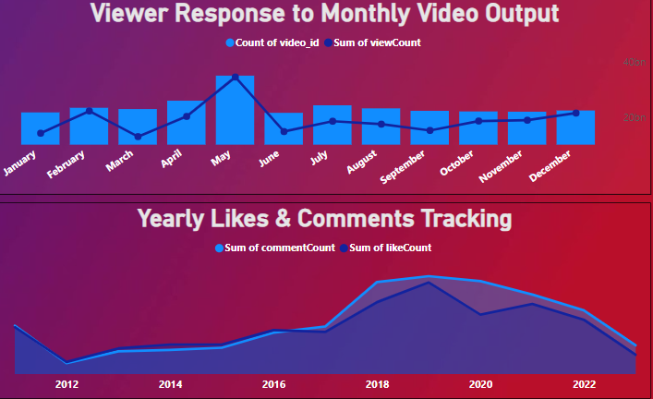
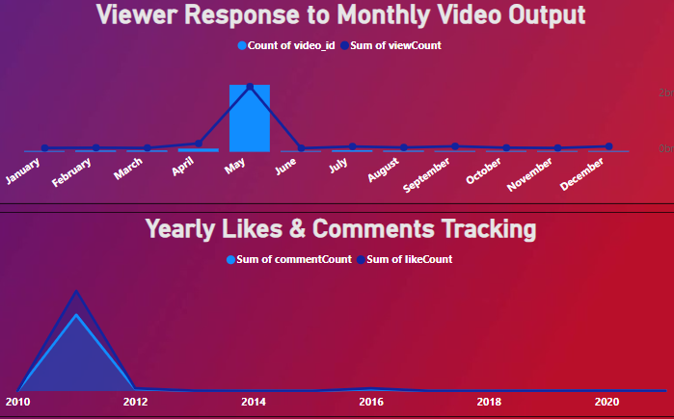
moment
Time-Based Trends
The first chart shows HD videos get steady views and likes over time, while the second reveals SD videos have more ups and downs in viewer reactions.
The HD video analysis indicates solid viewer engagement across months, with likes and comments maintaining a consistent pattern, whereas the SD video analysis shows fluctuating engagement levels, suggesting that video quality could be a key factor in audience interaction.

Slide 10
Best hits
Key Findings
Videos with higher view counts tend to also have higher like counts, suggesting a correlation between viewership and engagement.
HD videos show a higher engagement rate and like-to-view ratio compared to SD videos, indicating a preference for higher-quality content.
Monthly video output varies, with certain months like May and June seeing higher viewer counts, pointing to potential seasonal trends.
Specific tags, notably "Kabir ke dohe," drive significantly more engagement, highlighting the importance of effective tagging in content discoverability.
Viewer interactions, in the form of likes and comments, have varied over the years, with a notable pattern or trend visible in the data that could inform future content planning.

Slide 11
Recommendations
Best hits
Prioritize HD video content production to capitalize on higher engagement rates.
Schedule releases to align with peak engagement months, like May and June, for increased viewership.
Utilize high-performing tags such as "Kabir Ke Dohe" to improve content discoverability and engagement.
Review comments regularly for insights into viewer preferences to refine future videos.
Examine the causes behind the year-to-year variability in viewer interaction to stabilize and enhance content strategy.

Slide 12
Thank You
Gratitude
Thank you for the opportunity to delve into YouTube data analytics using Power BI, enhancing our understanding and strategy for content creation
Ashwini Rathod
Batch:-MIP_DA_03

