Slide 1
Splice Junction Classification from Sequences
Ashwini Koppula(CM93092)
Lahari Bandaru (UP66259)
MPS in Data Science
DATA 602 Intro to Data Analysis and Machine Learning
Instructor:Yalin Bastanlar

Slide 2
Problem Statement:
Splice Junction Classification from Sequences Instructions:
You will work on classifying DNA sequences (it is a 3-class classification problem). First, you need to preprocess the data. It contains string values, but you need to convert each sample to numerical values to be able to feed it into ML algorithms. Although normal sequence characters are A T G or C, there are some values as D N S, and R which were described in the dataset source. You need to handle them with care. Finally, you will apply machine learning models to make predictions and compare them with proper metrics.

Slide 3
Workflow:
Data preprocessing
Sequence Encoding
Model Selection
Model Evaluation
Model optimization
Advanced techniques

Slide 4
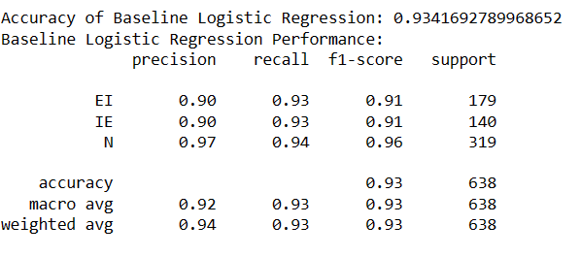
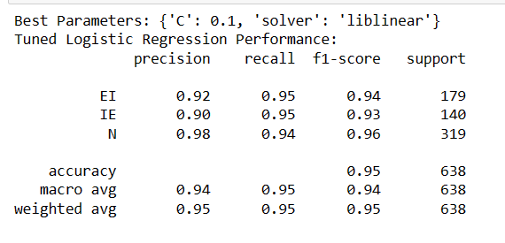
RESULTS:
Logistic Regression

Slide 5
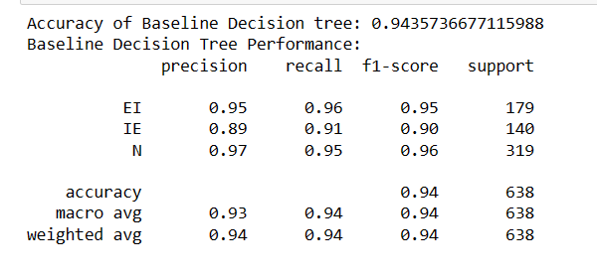
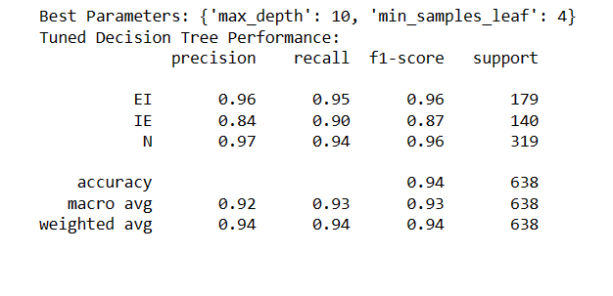
RESULTS:
Decision tree

Slide 6
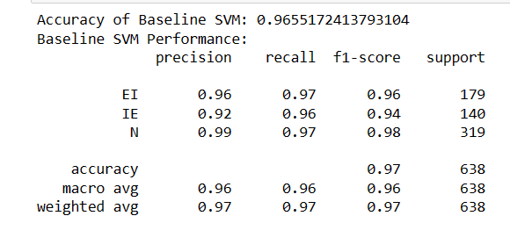
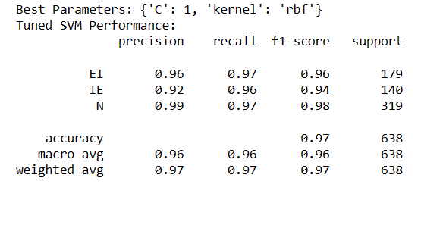
RESULTS:
SVM

Slide 7
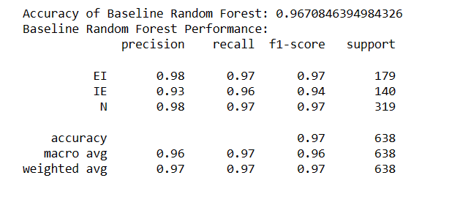
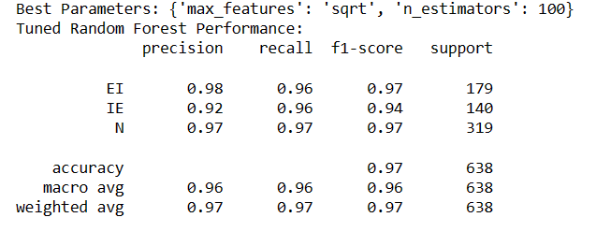
RESULTS:
Random Forest

Slide 8
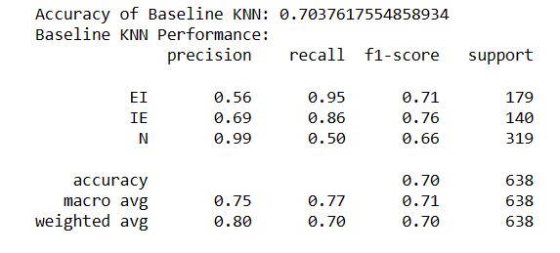
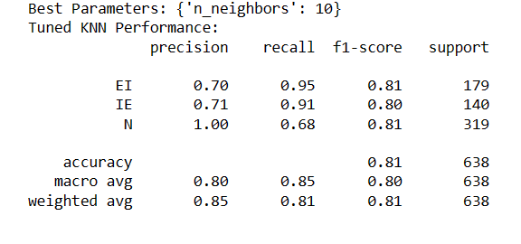
RESULTS:
KNN

Slide 9
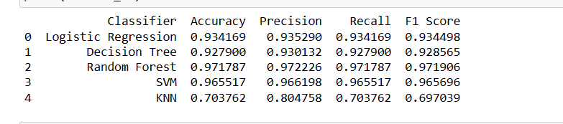
RESULTS:
Comparing all models

Slide 10
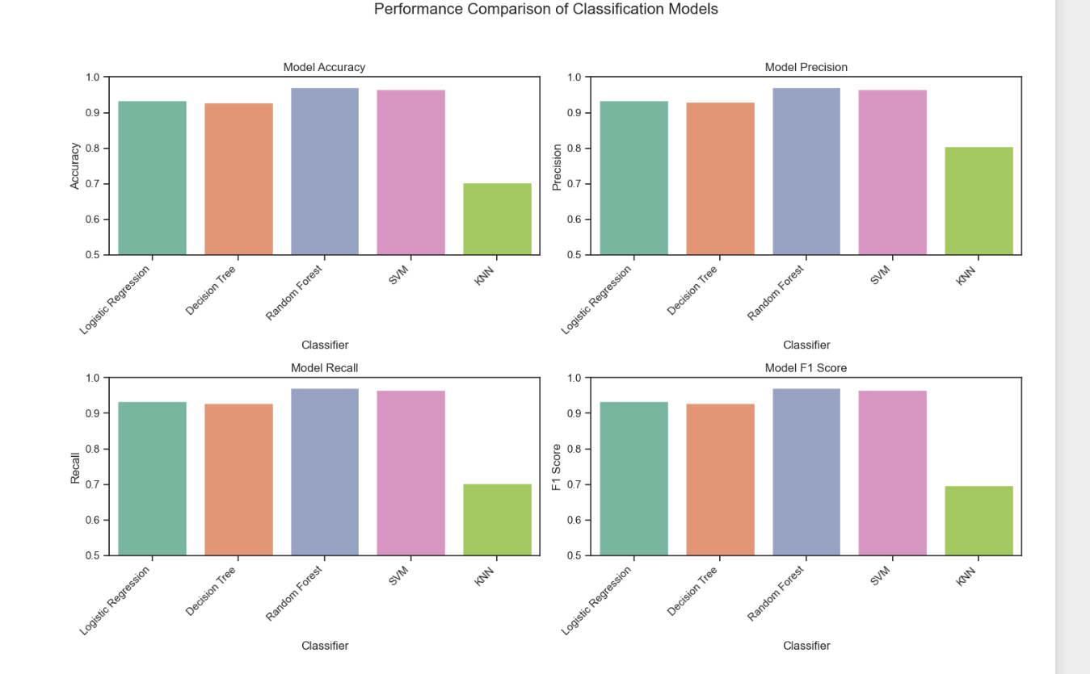
RESULTS:
Comparing all models

Slide 11
RESULTS:
Random forest classifier has high performance compared to all models with accuarcy of 97% and F1 score as 97%.
After random forest ,SVM shows strong performanc with accuarcy score of 96% and
KNN shows least performanace wth accuracy of 70%

Slide 12
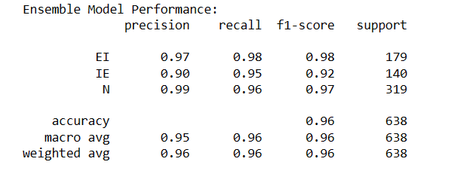
Ensembling: Combines Logistic Regression,Decision tree and Random Forest using a voting classifier to leverage their strengths.

