Slide 1
Neural Machine Translation by Jointly Learning to Align and Translate
Presented by - Ashwini Rangnekar
Nainy Sharma
Parul Jain
Rahil Sheth

Slide 2
Abstract
This paper proposes a model for language translation which improvises the basic encoder- decoder architecture (which generates fixed length source vector) by employing attention mechanism.

Slide 3
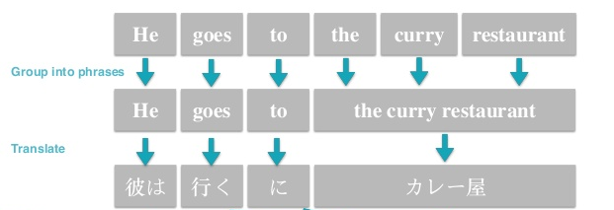
Traditional Architecture
Phrase based translation system
Drawbacks of this approach
  Disturbed alignment of phrases in target sentence.

Slide 4
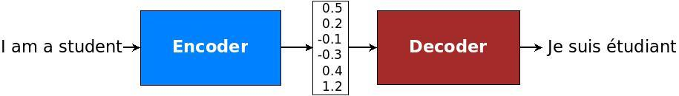
Basic Sequence to Sequence
For each translated word, focus on parts of source sentence to find most relevant information.
Source sentence encoded into fixed length vector

Slide 5
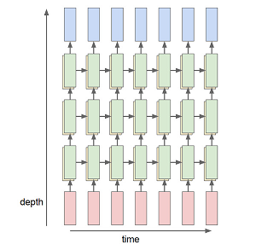
ENCODER-DECODER
The main network consists of two multi-layer RNNs
– an encoder for the source language and
– a decoder for the target language.
We are using many-to-many RNN architecture. The reason being the input and output sentences will not have fix length. So we will not constraint the length of sentences.

Slide 6
ENCODER-DECODER
The encoder-decoder RNN is an architecture where
  One set of LSTMs learn to encode input sequences into a fixed-length internal representation, and
  Second set of LSTMs read the internal representation and decode it into an output sequence.
A potential issue with this encoder–decoder approach is that a neural network needs to be able to compress all the necessary information of a source sentence into a fixed-length vector.
This makes it difficult for neural network to cope with long sentences.

Slide 7
Limitations of basic Seq2Seq model
Basic Sequence to sequence
  All necessary information of source sentence must be compressed into fixed length vector.
  With increase in length of sentence, fixed length vector cannot capture information of starting phrases properly and this results in worse performance for very long input sequences.

Slide 8
Attention Model

Slide 9
Sequence model & Attention Mechanism
Attention is the idea of freeing the encoder-decoder architecture from the fixed-length internal representation.
This is achieved by :
  Keeping the intermediate outputs from the encoder LSTM from each step of the input sequence
  Training the model to learn to pay selective attention to these inputs and relate them to items in the output sequence.
It encodes the input sentence into a sequence of vectors and chooses a subset of these vectors adaptively while decoding the translation.

Slide 10
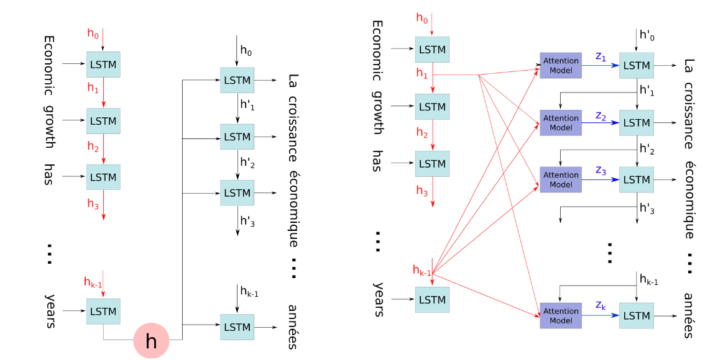
Without Attention vs With Attention

Slide 11
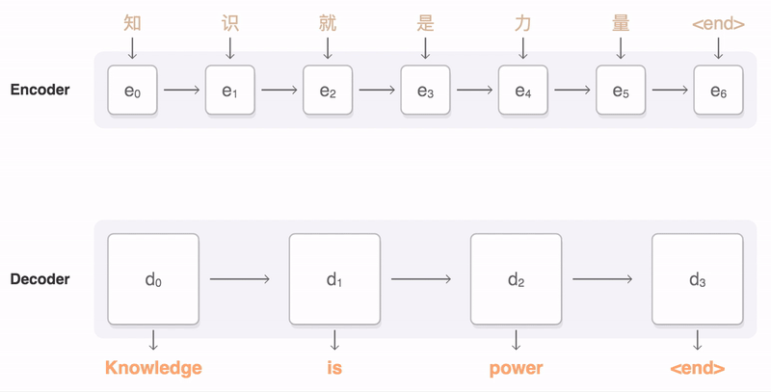

Slide 12
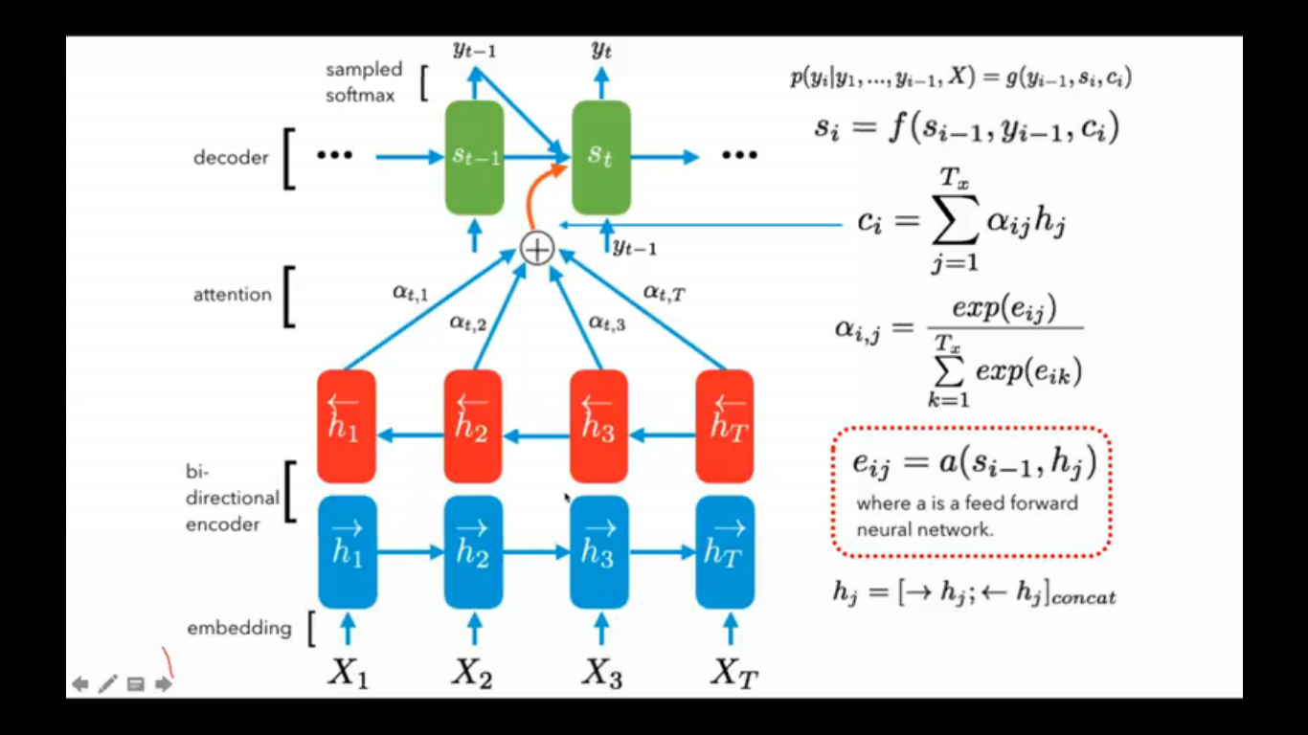
Attention Mechanism

Slide 13
Result Analysis

Slide 14
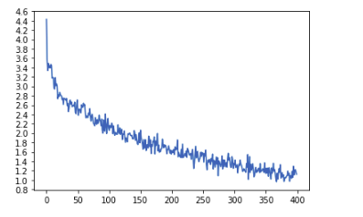
ANALYSIS OF RESULTS
Loss vs Epochs (x100)
Notes:
offer 5 compelling benefits:
It is quick and inexpensive to calculate.
It is easy to understand.
It is language independent.
It correlates highly with human evaluation.
It has been widely adopted.

Slide 15
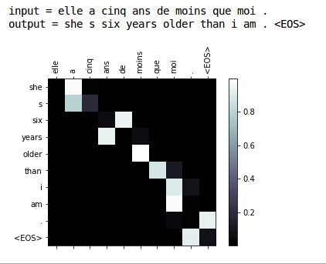
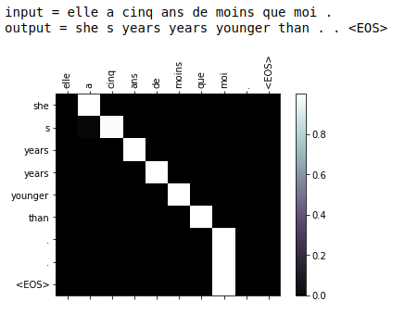
ANALYSIS OF RESULTS
Attention Matrix
128 hidden layers 256 hidden layers

Slide 16
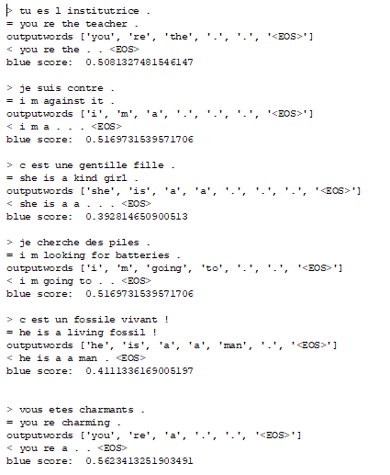
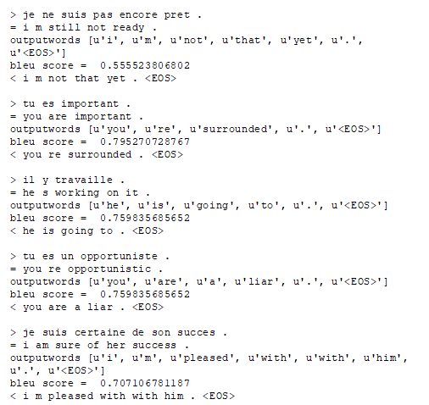
Comparison between Vanilla NMT vs Attention NMT

Slide 17
