Slide 1

KOMMURI PRATAP REDDY INSTITUTE OF TECHNOLOGY DEPARTMENT OF COMPUTER SCIENCE AND ENGINEERING
Intrusion Detection In Cyberscurity :
Machine Learning
Classifier Pefomance Evalution
Under the Guidence Of
Mrs.G.Sujatha
Sr.Asst.Professor
By:
N.HIMABINDU – 22RA1A0539
P.KAPILDEV – 22RA1A0550
B. ASHWINI – 22RA1A0519
G. KAMAL – 22RA1A0549

Slide 2

CONTENT :
ABSTRACT
INTRODUCTION
WORKING
PREVENTION
CLASSIFICATION
INTRUCTION IN -
CYBERSECURITY
UML DIAGRAM
BENEFITS
COMPARISON FIREWALLS
ALGORITHM DIAGRAM
ADVANTAGE
DISADVANTAGE
CONCLUSION

Slide 3
ABSTRACT
In today's interconnected world, the widespread adoption of Internet of Things (IoT) devices has brought forth a host of conveniences and opportunities. However, this technological revolution has also opened the door to a new type of cyber-attacks, with attackers exploiting vulnerabilities in IoT devices . This urgency has given rise to the development of a Machine Learning Model for Cyber Attack Detection and Classification in IoT Environments (ML-IoT-CD). In addition, the need for a robust cybersecurity solution in IoT environments has become paramount due to the increasing reliance on these devices for critical applications. Existing intrusion detection systems and conventional security measures often lack the scalability and agility needed to keep pace with rapidly evolving attack techniques. As a result, there is a pressing demand for an intelligent, automated, and proactive cyber defense mechanism capable of real-time detection and classification of emerging cyber attacks

Slide 4
INTRODUCTION
INTRUSTION DETECTION SYSTEM(IDS):
An Intrusion Detection System (IDS) is a security tool that monitors a computer
network or systems for malicious activities or policy violations. It helps detect
unauthorized access, potential threats, and abnormal activities by analyzing traffic
and alerting administrators to take action. An IDS is crucial for maintaining network
security and protecting sensitive data from cyber-attacks.
An Intrusion Detection System (IDS) maintains network traffic looks
for unusual activity and sends alerts when it occurs. The main duties of an
Intrusion Detection System (IDS) are anomaly detection and reporting,
however, certain Intrusion Detection Systems can take action when
malicious activity or unusual traffic is discovered. In this article, we will
discuss every point about the Intrusion Detection System.

Slide 5
WHAT IS AN INTRUSTION DETECTION SYSTEM ANALYSIS
A system called an intrusion detection system (IDS) observes network traffic for malicious transactions and sends immediate alerts when it is observed.
It is software that checks a network or system for malicious activities or policy violations. Each illegal activity or violation is often recorded either centrally using an SIEM system or notified to an administration.
IDS monitors a network or system for malicious activity and protects a computer network from unauthorized access from users, including perhaps insiders.
The intrusion detector learning task is to build a predictive model (a classifier) capable of distinguishing between ‘bad connections’ (intrusion/attacks) and ‘good (normal) connections’.

Slide 6
WORKING OF INTRUSTION DETECTION SYSTEM (IDS)
An IDS (Intrusion Detection System) monitors the traffic on a computer network to detect any suspicious activity.
It analyzes the data flowing through the network to look for patterns and signs of abnormal behavior.
The IDS compares the network activity to a set of predefined rules and patterns to identify any activity that might indicate an attack or intrusion.
If the IDS detects something that matches one of these rules or patterns, it sends an alert to the system administrator.
The system administrator can then investigate the alert and take action to prevent any damage or further intrusion.

Slide 7
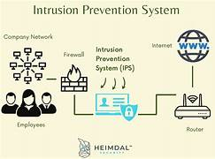

Slide 8
Detection Method of Intrusion Prevention System (IPS)
Signature-Based Method: Signature-based IDS detects the attacks on the basis of the specific patterns such as the number of bytes or a number of 1s or the number of 0s in the network traffic.
Signature-based IDS can easily detect the attacks whose pattern (signature) already exists in the system but it is quite difficult to detect new malware attacks as their pattern (signature) is not known
Anomaly-Based Method: Anomaly-based IDS was introduced to detect unknown malware attacks as new malware is developed rapidly.

Slide 9
CLASSIFICATION OF (IDS):
Intrusion Detection System are classified into 3types
Network Intrusion Detection System (NIDS):
Network intrusion detection systems (NIDS) are set up at a planned point within the network to examine traffic from all devices on the network system. Once an attack is identified or abnormal behavior is observed, the alert can be sent to the administrator. An example of a NIDS is installing it on the subnet where firewalls are located in order to see if someone is trying to crack the firewall.
2. Host Intrusion Detection System (HIDS):
Host intrusion detectionsystems (HIDS) run on independent hosts or devices on the network.

Slide 10
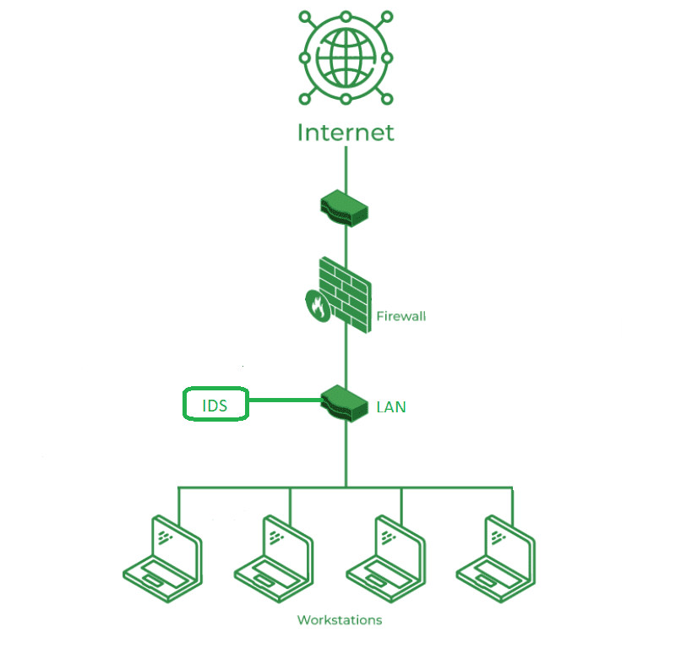
A HIDS monitors the incoming and outgoing packets from the device only and will alert the administrator if suspicious or malicious activity is detected. It takes a snapshot of existing system files and compares it with the previous snapshot. If the analytical system files were edited or deleted, an alert is sent to the administrator to investigate.

Slide 11
3. Hybrid Intrusion Detection System: Hybrid intrusion detection system is made by the combination of two or more approaches to the intrusion detection system.
In the hybrid intrusion detection system, the host agent or system data is
combined with network information to develop a complete view of the network system.
The hybrid intrusion detection system is more effective in comparison to the other intrusion detection system.

Slide 12
WHAT IS INTRUSTION IN CYBERSECURITY ?
Understanding Intrusion Intrusion is when an attacker gets unauthorized access to a device, network, or system. Cyber criminals use advanced techniques to sneak into organizations without being detected. Common methods include :
Address Spoofing: Hiding the source of an attack by using fake, misconfigured, or unsecured proxy servers, making it hard to identify the attacker.
Fragmentation: Sending data in small pieces to slip past detection systems.
Pattern Evasion: Changing attack methods to avoid detection by IDS systems that look for specific patterns.

Slide 13

Coordinated Attack: Using multiple attackers or ports to scan a network, confusing the IDS and making it hard to see what is happening.

Slide 14
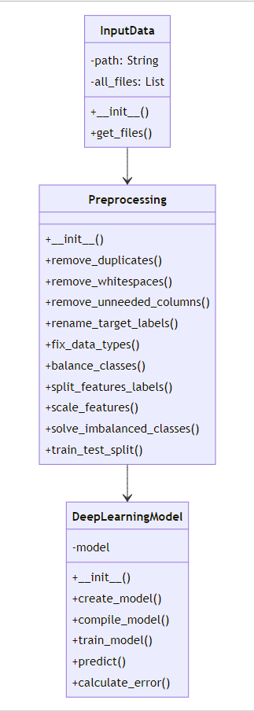
UML DIAGRAM

Slide 15
BENEFITS OF IDS
Detects Malicious Activity: IDS can detect any suspicious activities and alert the system administrator before any significant damage is done.
Improves Network Performance: IDS can identify any performance issues on the network, which can be addressed to improve network performance.
Compliance Requirements: IDS can help in meeting compliance requirements by monitoring network activity and generating reports.
Provides Insights: IDS generates valuable insights into network traffic, which can be used to identify any weaknesses and improve network security.

Slide 16
COMPARISON OF IDS WITH FIREWALLS
IDS and firewall both are related to network security but an IDS differs
from a firewalls as a firewall looks outwardly for intrusions in order to
stop them from happening. Firewalls restrict access between
networks to prevent intrusion and if an attack is from inside the
network it doesn’t signal. An IDS describes a suspected intrusion once
it has happened and then signals an alarm.

Slide 17
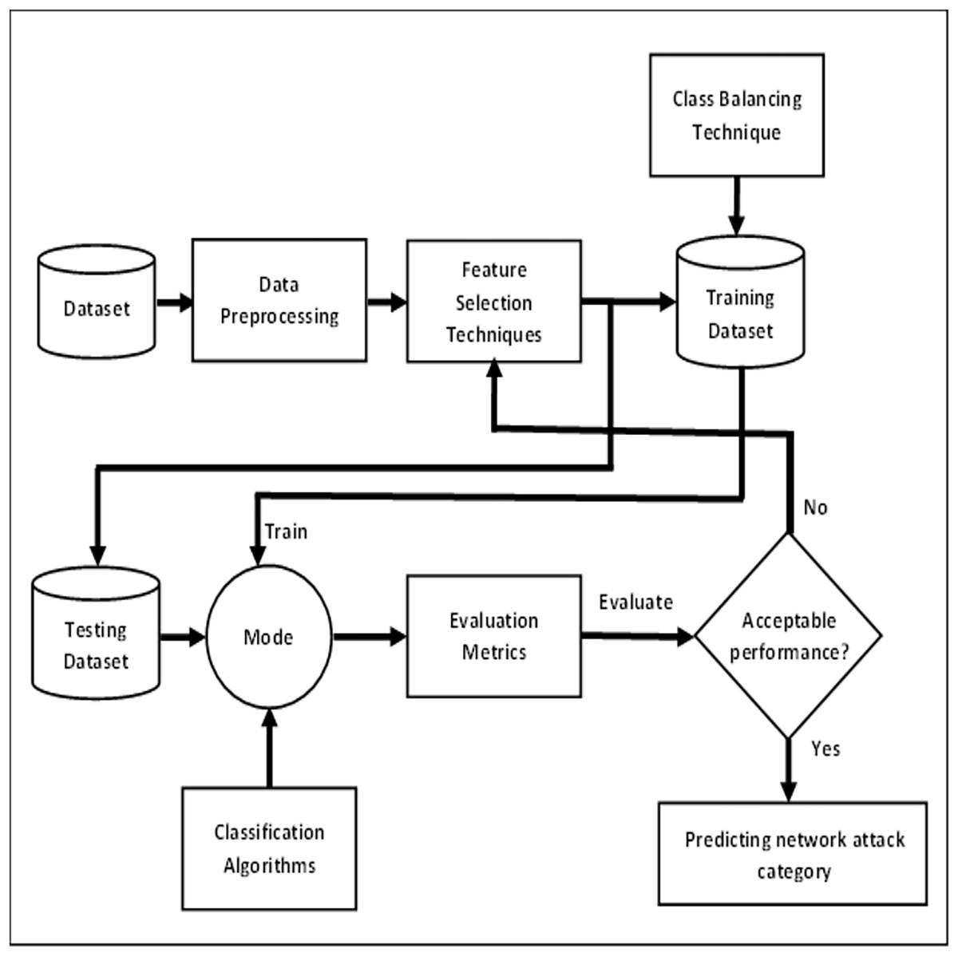
ALGORITHM FOR INTRUSION DEECTION :

Slide 18
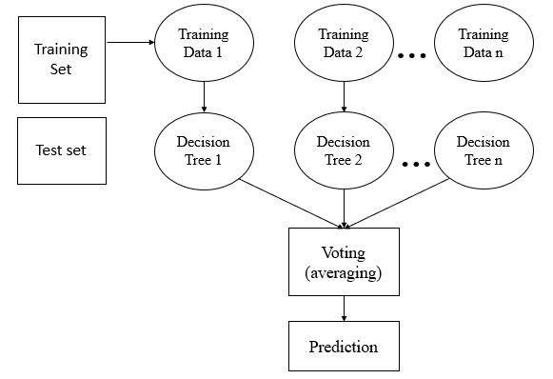
Random Forest Algorithm
Step 1: In Random Forest n number of random records are taken from the data set having number of records.
Step 2: Individual decision trees are constructed for each sample.
Step 3: Each decision tree will generate an output.
Step 4: Final output is considered based on Majority Voting or Averaging for Classification and regression respectively.

Slide 19
WHY ARE IDS IMPROTANT
An Intrusion Detection System (IDS) adds extra protection to your
cybersecurity setup, making it very important. It works with your
other security tools to catch threats that get past your main defenses.
So, if your main system misses something, the IDS will alert you to the threat.
The most optimal and common position for an IDS to be placed is behind
the firewall. Although this position varies considering the network. The
‘behind-the-firewall’ placement allows the IDS with high visibility Of
incoming network traffic and will not receive traffic between users and
network .The edge of the network point provides the network the
possibility of connecting to the extranet.

Slide 20
ADVANTAGES
Early Threat Detection: IDS identifies potential threats early, allowing for quicker response to prevent damage.
Enhanced Security: It adds an extra layer of security, complementing other cybersecurity measures to provide comprehensive protection.
Network Monitoring: Continuously monitors network traffic for unusual activities, ensuring constant vigilance.
Detailed Alerts: Provides detailed alerts and logs about suspicious activities, helping IT teams investigate and respond effectively.

Slide 21
DISADVANTAGES
False Alarms: IDS can generate false positives, alerting on harmless activities and causing unnecessary concern.
Resource Intensive: It can use a lot of system resources, potentially slowing down network performance.
Requires Maintenance: Regular updates and tuning are needed to keep the IDS effective, which can be time-consuming.
Doesn’t Prevent Attacks: IDS detects and alerts but doesn’t stop attacks, so additional measures are still needed.
Complex to Manage: Setting up and managing an IDS can be complex and may require specialized knowledge.

Slide 22
CONCLUSION
Intrusion Detection System (IDS) is a powerful tool that can help
businesses in detecting and prevent unauthorized access to their
network. By analyzing network traffic patterns, IDS can identify any
suspicious activities and alert the system administrator. IDS can be a
valuable addition to any organization’s security infrastructure,
providing insights and improving network performance.

Slide 23


