Slide 1
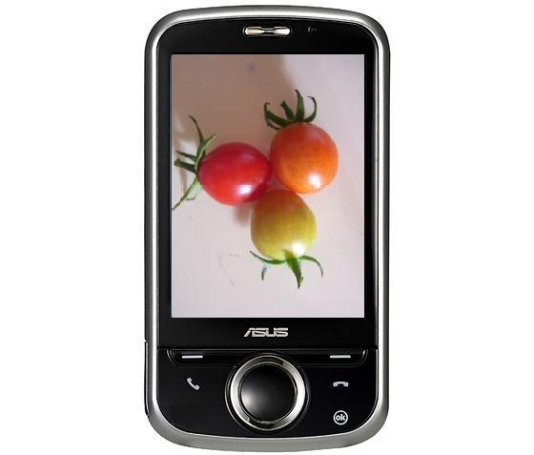

AGRIPHONE
By
Madhuri Vilas Gadhave
Ashwini Jogdand
Pournima Ambavale

Slide 2
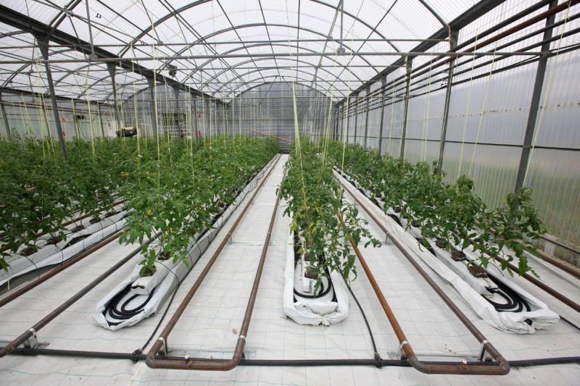
Objective:
Our objective is to make imaging-based inspection of the state of the crops for greenhouses with the help of mobile phones based on android operating system.

Slide 3
Problem statement :
Need for automation in the greenhouse
Use of multimedia android based phone
Monitor status of individual plant in greenhouse
Capture images of the plant and
Perform image processing on the phone itself
Send SMS to the user

Slide 4
Components:
Hardware:
Android OS Based Phone with version greater than 2.1 and inbuilt camera of 2MP with USB connector
PC with 2.4 GHz processor and 1 GB RAM
Software:
JDK1.6.0_23 and JRE6
Java Development Eclipse IDE
Android SDK

Slide 5
Project plan
Study about various automation technique for greenhouse
Study about ecilipse functionality
Install eclipse
Install android adt plugins
Implimentation and testing of alarm system
Implimentation and testing of ripeness degree of tomato

Slide 6

TASK | DISCRIPTION | RESPONSIBILITIES
Requirement gadhering | Study of existing system, advantages and disadvantages, working on it like where automation is needed. | Madhuri Gadhave Ashwini Jogdand
Coding | Coding using ecilips | Madhuri Gadhave Ashwini Jogdand Pournima Ambavle
Testing | Testing each and every step | Madhuri Gadhave Ashwini Jogdand
Documentation | Generating timely reports regarding activities | Madhuri Gadhave Ashwini Jogdand

Slide 7
Function
Workflow
Open Application
Set Alarm
Enter Value
Capture Photo
Save to SD Card
Process Photo
Generate Result
Send SMS
Close Application

Slide 8
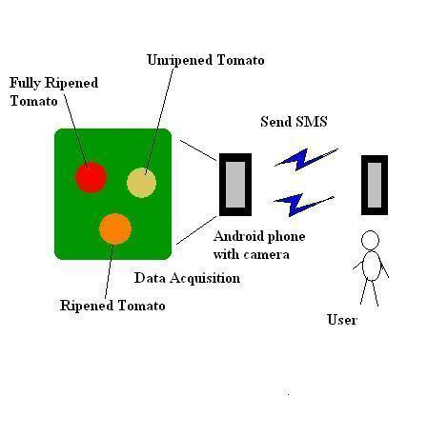
Architecture of Agriphone:

Slide 9
Challenges :
Dealing with varying lighting conditions
Performing image processing on android phone

Slide 10
INSTALLATION GUIDE:
STEP 2: Install Eclipse IDE for Java Developers
http://www.eclipse.org/downloads
STEP 3: Download SDK starter package and install it.
STEP 4: Install ADT plug-ins for Eclipse
STEP 5: Add platform(API level 8) and other packages
STEP 6: Linking Android Phone to Computer
STEP 1: Install JAVA

Slide 11
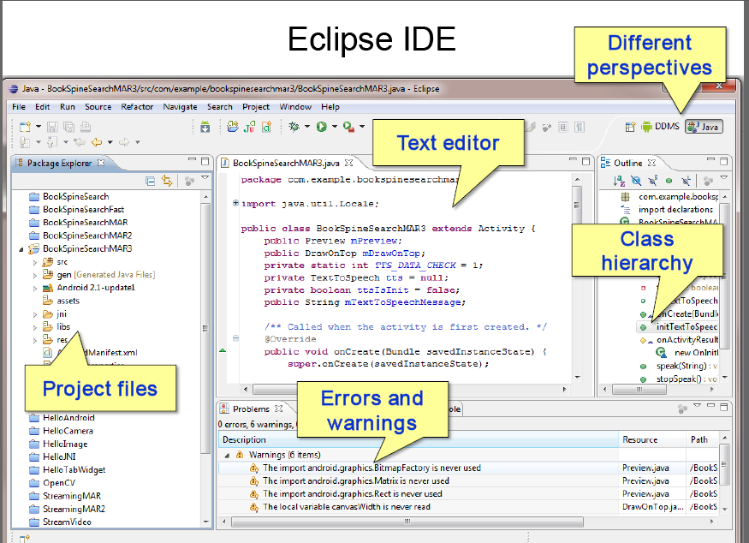

Slide 12
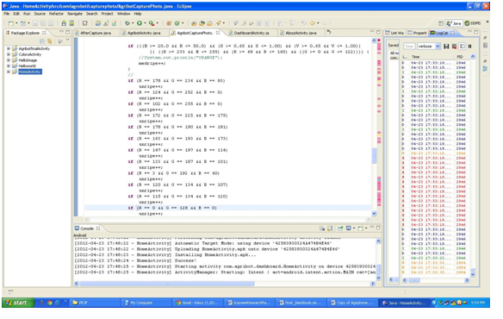
Sysem implimentation

Slide 13
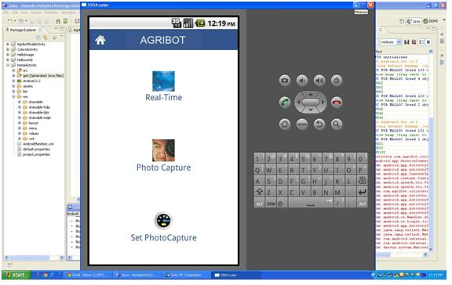

Slide 14
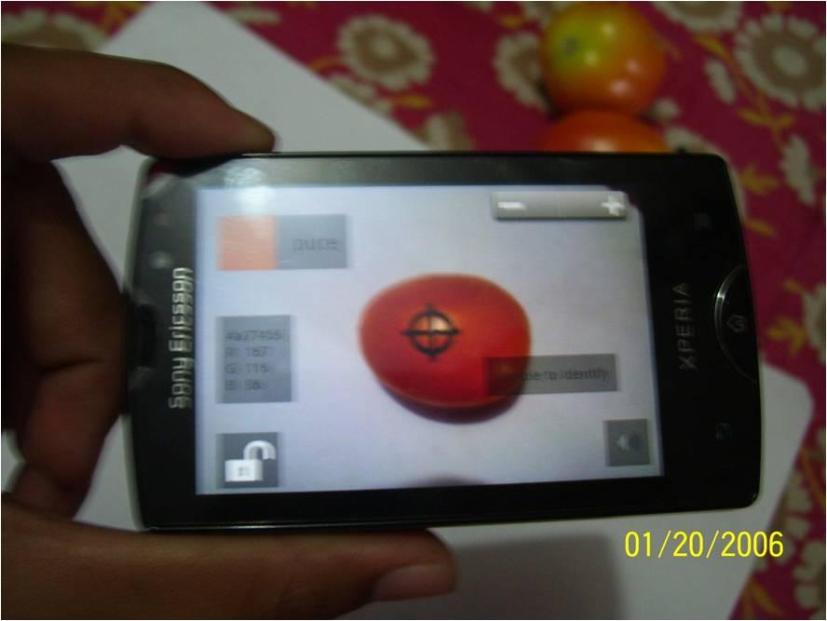

Slide 15
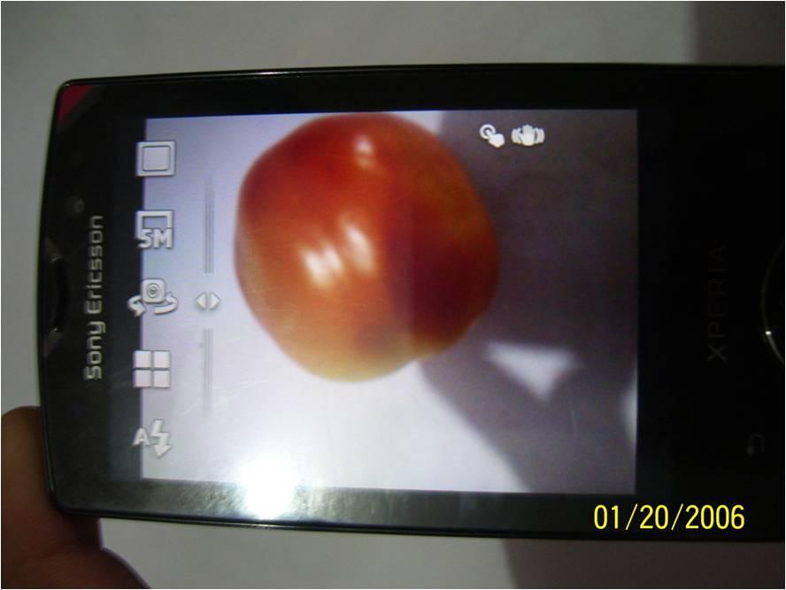
PROCESSING

Slide 16

Send SMS to user with percentage of ripe, medium ripe and unripe part

Slide 17
Test case
TestCase No. | Test Case | SMS Received
1 | Riped tomato | RIPE : 100% UNRIPE : 0% MEDRIPE :0%
2 | Meduim riped tomato | MEDRIPE: 100%
3 | Unripe tomato | UNRIPE :100%
4 | Ripe and Unripe tomato | RIPE :70 % UNRIPE : 20% MEDRIPE :10%

Slide 18
Conclusion
Automation is performed
Alarm is used for automation
Photo is captured at specified time
Photo is saved automatically and processed
Result is generated
SMS is sent to user

Slide 19
Future Work:
More work on image processing part
Making feasible to use in greenhouse
Development for different plants with different ripening conditions
The limitations of phone must be taken into consideration

Slide 20
Reference
www.developer.android.cutorialom
www.standford.edu/class/ee368/Android /Tutorial

Slide 21


