Slide 1
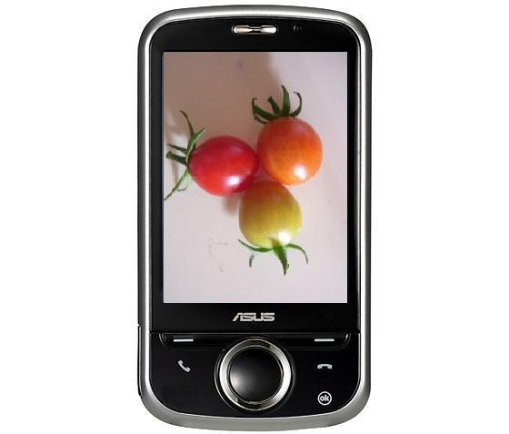

AGRIPHONE
By
Madhuri Vilas Gadhave
Ashwini Jogdand
Pournima Ambavale

Slide 2
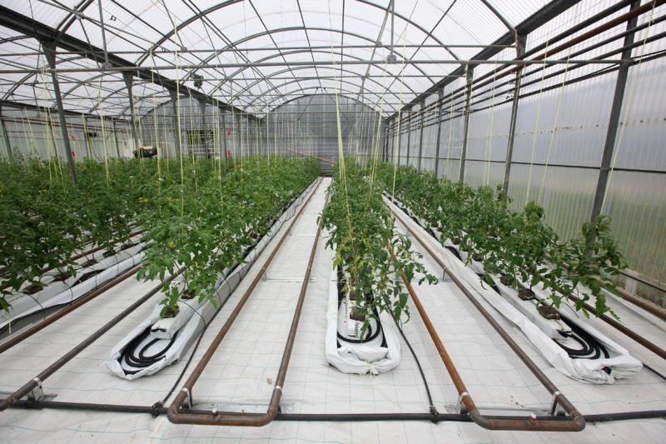
Objective:
Our objective is to make imaging-based inspection of the state of the crops for greenhouses with the help of mobile phones based on android operating system.

Slide 3
Problem statement :
Need for automation in the greenhouse
Use of multimedia android based phone
Monitor status of individual plant in greenhouse
Capture images of the plant and
Perform image processing on the phone itself
Send SMS to the user

Slide 4
Components:
Hardware:
Android OS Based Phone with version greater than 2.1 and inbuilt camera of 2MP with USB connector
PC with 2.4 GHz processor and 1 GB RAM
Software:
JDK1.6.0_23 and JRE6
Java Development Eclipse IDE
Android SDK

Slide 5

TASK | DISCRIPTION | RESPONSIBILITIES
Requirement gadhering | Study of existing system, advantages and disadvantages, working on it like where automation is needed. | Madhuri Gadhave Ashwini Jogdand
Coding | Coding using ecilips | Madhuri Gadhave Ashwini Jogdand Pournima Ambavle
Testing | Testing each and every step | Madhuri Gadhave Ashwini Jogdand
Documentation | Generating timely reports regarding activities | Madhuri Gadhave Ashwini Jogdand

Slide 6
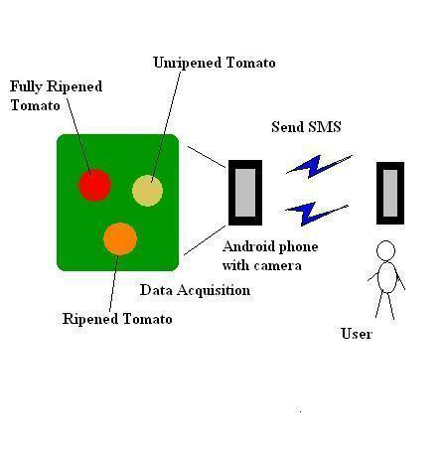
Architecture of Agriphone:

Slide 7
Challenges :
Performing image processing on android phone
Dealing with varying lighting conditions

Slide 8
INSTALLATION GUIDE:
STEP 2: Install Eclipse IDE for Java Developers
http://www.eclipse.org/downloads
STEP 3: Download SDK starter package and install it.
STEP 4: Install ADT plug-ins for Eclipse
STEP 5: Add platform(API level 8) and other packages
STEP 6: Linking Android Phone to Computer
STEP 1: Install JAVA

Slide 9
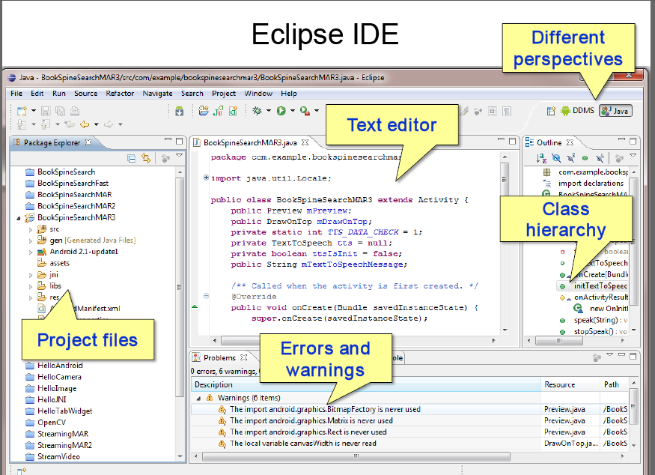

Slide 10
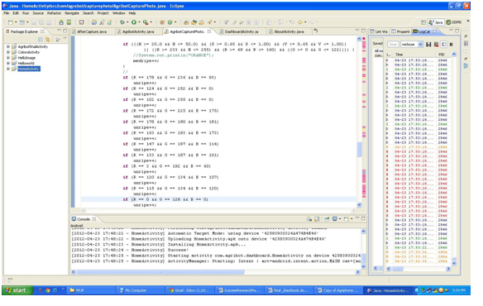
Sysem implimentation

Slide 11
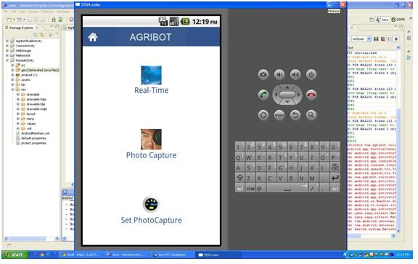

Slide 12
Function
Workflow
Open Application
Set Alarm
Enter Value
Capture Photo
Save to SD Card
Process Photo
Generate Result
Send SMS
Close Application

Slide 13
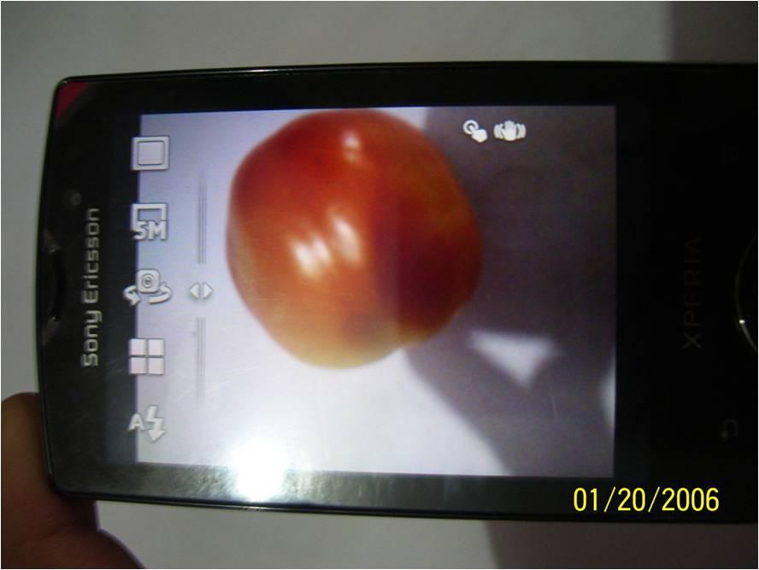
PROCESSING

Slide 14
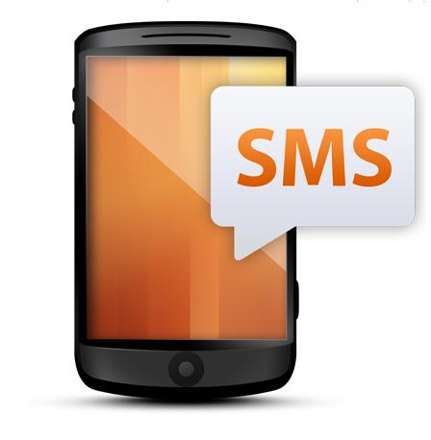
Send SMS to user with percentage of ripe, medium ripe and unripe part

Slide 15
Test case
TestCase No. | Test Case | SMS Received
1 | Riped tomato | RIPE : 100% UNRIPE : 0% MEDRIPE :0%
2 | Meduim riped tomato | MEDRIPE: 100%
3 | Unripe tomato | UNRIPE :100%
4 | Ripe and Unripe tomato | RIPE :70 % UNRIPE : 20% MEDRIPE :10%

Slide 16
Conclusion
Automation
Image processing
Result
SMS

Slide 17
Future Work:
More work on image processing part
Making feasible to use in greenhouse
Development for different plants with different ripening conditions
The limitations of phone must be taken into consideration

Slide 18
Reference
www.developer.android.cutorialom
www.standford.edu/class/ee368/Android /Tutorial

Slide 19


Slide 21
Task
Set alarm
Capture photo
Process image and calculate ripeness degree
Take preview
sms

Slide 22

ripe | R G B | 175 0 0 | 250 25 10
midripe | R G b | 160 100 0 | 200 175 60
unripe | R G b | 182 203 22 | 152 139 80

Slide 23
ripe | R G B | 175 0 0 | 250 25 10
midripe | R G b | 160 100 0 | 200 175 60
unripe | R G b | 182 203 22 | 152 139 80

