Slide 1

Nature-Based Prediction Model of Bug Reports Based on Ensemble Machine Learning Model
Team 3: 1. B. Sai Charan (21R01A6678)
2. K. Ashwini (21R01A6689)
3. KB. Aakash (21R01A6690)
Guide:Dr. L. Arokia Jesu Prabhu,
Assoc Prof, CSE (AI&ML)
CMRIT, Hyderabad.

Slide 2

ABSTRACT
A bug report is a document or a record created to describe an issue, flaw, or problem in a software program that causes it to behave unexpectedly or incorrectly. Bug reports are essential tools in software development and maintenance, providing developers with the information needed to identify, understand, and fix bugs.
In earlier the researchers might aims to automate the analysis of bug reports to predict the nature of bugs, which helps in accelerating the maintenance phase by classifying bugs into some categories like Program Anomaly, GUI, Network or Security, Configuration, Performance, and Test-Code. The system was tested on a publicly available dataset from two online software bug repositories, Mozilla and Eclipse.
The model may face several difficulties while generalizing other datasets or bug tracking systems due to their nature and structure. Extracting meaningful features from textual data is complex. To improve these work on bug reports analysis we propose a model of using Advanced Natural Language Processing methodologies are BERT, GPT and also it can be extracted by applying classification algorithms like Ensemble Learning and adaptive algorithms that can adjust to different datasets and bug tracking systems dynamically.

Slide 3
INTRODUCTION
Software maintenance is a critical phase in the software development lifecycle, with bug fixing being one of the most time-consuming and resource-intensive tasks.
Effective bug report classification is essential for prioritizing and addressing software issues efficiently.
This study leverages ensemble machine learning techniques to enhance the accuracy and reliability of bug classification.
By incorporating natural language processing (NLP), text mining, and data augmentation, the model improves its predictive performance over conventional classification approaches.
The proposed model aims to reduce manual effort, streamline the bug triaging process, and provide software engineers with a more structured and insightful classification system. Future improvements may include deep learning models, real-time bug classification, and integration with existing bug tracking tools.

Slide 4
LITERATURE SURVEY
S.NO | Title of the Paper | Publication and Year | Author | Methodology or Algorithm | Inference
1 | Predicts each bug report as (Configuration) or (Non-configuration) bug reports and if it is configurable, outputs the associated configuration names | 2016 IEEE 27th International Symposium | Wei Wen, Tingting YuJane, Huffman Hayes | Weka, NLTK, and Sklearn software programs | Accurancies of relating configuration bug reports with configurations are: Mozilla 0.92 Apache 0.88 MySQL 0.74
2 | Predicts each bug report to be either a Corrective (defect fixing) report or a Perfective (major maintenance) report | 9th International Conference in 2019 | Otoom, A. F. ,Al-jdaeh, | NB-SVM-RT | Achieve higher accuracy using SVM, which is about 93.1%
3 | Predicts the severity of bug reports | MDPI in 2021 | Anh-Hien Dao and Cheng-Zen Yang | N-gram, CNN, and Random forest with Boosting | The average accuracy is 96.34% The average F-measure is 96.43%
4 | Classifies bug reports according to ODC | Springer, 2022 | Sarfraz Khurshid, Mariano Moscato | NB,SVM,KNN,RNN, nearest centroid, and RF | The size of the dataset affects the accuracy of the classifiers

Slide 5
.
S.NO | Title of the Paper | Publication and Year | Author | Methodology or Algorithm | Inference
5 | Predicts and assigns a priority level in binary classification (high or low) | 12th International Conference on Intelligent Systems Design and Applications in 2012. | M. Sharma, P. Bedi, K.K. Chaturvedi, and V.B. Singh, | Multinomial Naïve Bayes(MNB), Linear Support Vector with Stochastic Gradient Desecnt learning(SGDC), Logistic Regression(LRC) | Accuracy is 0.908, AUC is 0.95, and F-measure is 0.892
6 | A model for bug assignment recommendation | 2023 in the journal Computers. | Mina Samir, Nada Sherief, and Walid Abdelmoez | Stacked Generalization(SG) which is an ensemble learning technique(NB,SVM,KNN,DT and Bayes Net) | Accuracies are from 50% to 89%
7 | Web-based tool for Bug assignment recommendation | SANER 2023 | Caterina De Marco | SVM, Naïve Bayes, C$.5 and Rules | The achieved accuracies are from 50% to 95%,from 20% to 80% and from 10% to 70%for top-1,top-3,and top-5 recommendations, respectively.

Slide 6
PROBLEM STATEMENT
Software development teams often face challenges in efficiently managing and prioritizing bug reports. Traditional methods of bug tracking can be reactive rather than proactive, leading to delayed responses and unresolved issues. This project aims to develop a Nature-Based Prediction Model utilizing ensemble machine learning techniques to analyze patterns in historical bug reports.
By incorporating natural phenomena and patterns, the model seeks to enhance the accuracy of predicting future bug occurrences and their potential severity. Ultimately, this approach aims to improve software quality and streamline the bug resolution process, thereby reducing downtime and enhancing user satisfaction.

Slide 7
METHODOLOGY
1. Data Collection:
Source Identification: Identify and gather bug report data from open-source repositories, bug tracking systems, or organizational databases. Examples include bug reports from GitHub, Kaggle.
Preprocessing: Clean the data by removing irrelevant, duplicated, or incomplete bug reports. Standardize the format of the reports to ensure consistency.
2. Text Processing:
Convert textual data to numerical form using methods like Term Frequency-Inverse Document Frequency (TF-IDF) or Word Embeddings (e.g., Word2Vec, BERT).
3.Model Selection:
Implement a variety of machine learning models such as Decision Trees, Random Forests, Support Vector Machines (SVM), and Ensemble techniques.
4. Model Training:
Split the dataset into training, validation, and testing sets.
Train individual base models on the training set.

Slide 8
5. Model Evaluation:
Evaluate the model on the validation and test datasets using metrics such as accuracy and F1 score.
6. Model Deployment:
Continuously monitor the model's performance and update it with new bug reports as they come in to maintain its accuracy and relevance.

Slide 9
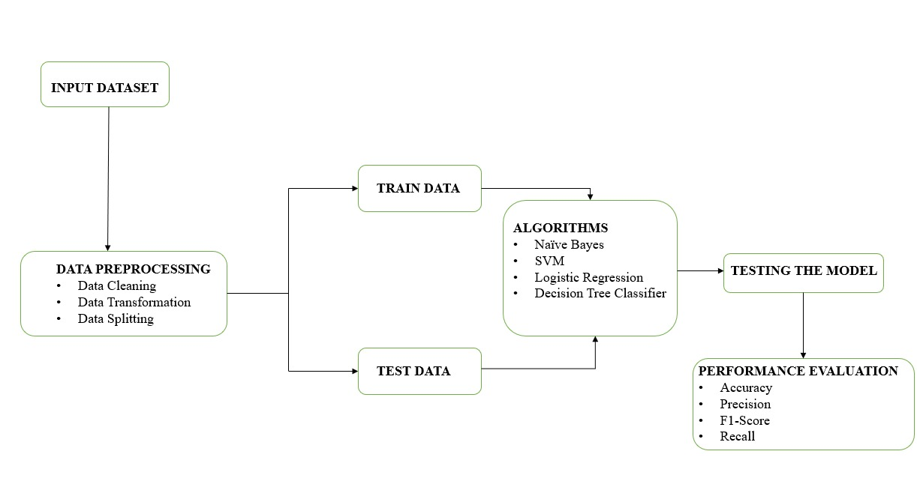
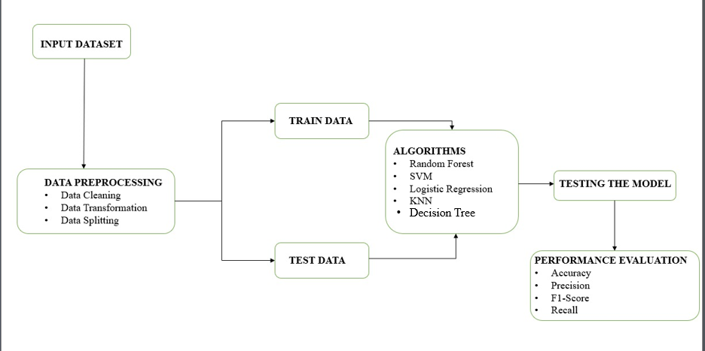
ARCHITECTURE
.

Slide 10
RESULT
This model able to predict the nature of bug reports by using following machine learning algorithms and techniques.
Model type | Accuracy
SVM | 71.68%
Logistic Regression | 75.32%
Decision Tree Classifier | 71.20%
KNeighbors Classifier | 75.63%
Random Forest | 77.22%

Slide 11
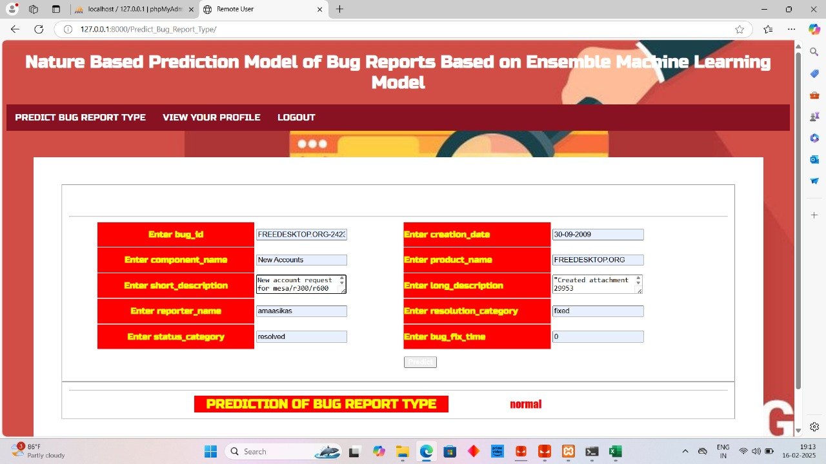
.
The model able to predict the nature of bug reports by the following data.
PREDICTION OF NATURE BASED BUG REPORTS !

Slide 12
CONCLUSION
The proposed system addresses limitations in existing methods by automating bug classification more accurately and efficiently.
It provides a promising direction for software maintenance and defect management, reducing the manual effort required to analyze bug reports. .
This model consists of four base machine learning algorithms, Random Forest, Support Vector Classification, Logistic Regression, and Multinomial Naïve Bayes.
The accuracy of the model is 90.42%. Moreover, it utilizes a text augmentation technique to increase accuracy. Therefore, the highest accuracy achieved by the proposed model increased to 96.72%.
Unlike existing methods that focus on severity and priority classification, the proposed model introduces a nature-based classification system, categorizing bugs into six classes: Program Anomaly, GUI, Network or Security, Configuration, Performance, and Test-Code.

Slide 13
FUTURE ENHANCEMENTS
Real time bug classification.
Expansion of training data.
Automated feature engineering.
Security and privacy enhancements.
Self-learning and adaptive models.

Slide 14
Thank You

