Slide 1
SNAPSHOTS OF A FILE SYSTEM
Ashwini Rangnekar
Himanshi Sharma
Parul Jain
Shipta Golechha

Slide 2
Snapshots to a File System
Definition:
A snapshot is a read-only, point-in-time copy of the filesystem state used for restoring data in the event of failure.
Snapshot vs Copying:
Snapshotting only requires as much disk space as the changed blocks require while copying requires the number of copies times the size of the file.

Slide 3
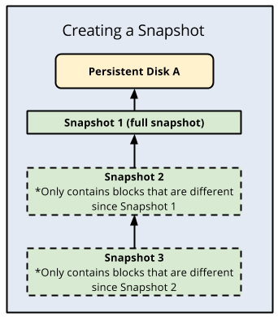

Slide 4

Snapshot Technologies

Slide 5
Challenges
The challenges that can occur with snapshots,
-- use the right kind of snapshots,
-- get their data in the right state prior to taking the snapshot, and
-- have something to control, manage, configure and report on the snapshot process.

Slide 6
Backup Algorithm
Rsync algorithm is used for updating a file on one machine to be identical to a file on another machine. We assume that the two machines are connected by a low-bandwidth high-latency bi-directional communications link. The algorithm identifies parts of the source file which are identical to some part of the destination file, and only sends those parts which cannot be matched in this way. So, this algorithm is appropriate for the purpose of taking backup of a filesystem.

Slide 7
How Rsync detect differences?
The computer holding the newest version of the file is here called NEW, and the computer holding the oldest file is called OLD.
OLD divides the oldest version of the file into blocks of, say 1024 or 2048 bytes. The file is not divided on the disk. It's just something OLD does logically, internally in the memory.
For each block OLD calculates a checksum and the list of block checksums are then sent to NEW.
NEW searches the newest version of the file for blocks of data that has the same checksum as those found in the old version of the file. This is done by fist calculating the checsum for the very first block of data (1024 or 2048 bytes). If this checksum does not match any checksum in the old file, NEW moves 1 byte down the new file and calculates the checsum for this 1024 checksum. NEW thus calculates checksums for every possible 1024 (or 2048) byte block in the new file, to search for matches to blocks in the old file.

Slide 8
How Rsync detect differences?
If NEW finds a 1024 byte block with the same checksum as one of the checksums received from OLD, then it considers that block to exist in the old version. It doesn't matter if the sequence of blocks is not the same as in the old version. NEW now skips to the end of this block and continues searching for checksum matches from there.
NEW will thus find X blocks of data matching checksums in the old file. This is the data that has not changed between the old and the new version of the file. In between these blocks will be data that was not part of a 1024 block that matched a checksum in the old file. This data is CHANGES, either new or modified data.
NEW sends back instructions to OLD on how to create a copy of the newest version of the file. NEW does this by sending a list of block references in the old file for the sections of the newest file that has not changed. For the parts that has changed NEW sends back the changed data in full.
OLD receives the list of block references and literal data (the changes), and from the old file and the literal data, constructs the new version of the file.

Slide 9
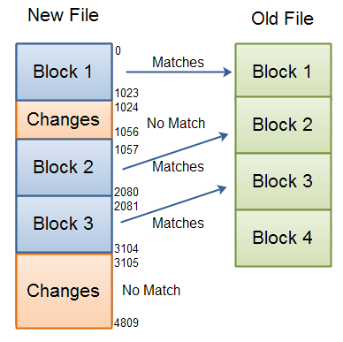
Detecing differences between files using block checksums.

Slide 10
Rolling Checksum
The weak rolling checksum used in the rsync algorithm needs to have the prop-erty that it is very cheap to calculate the checksum of a buffer X₂...X _{n+1} given the checksum of buffer X₁...X_{n} and the values of the bytes X ₁ and X_{n+1} .
Our checksum is defined by:
a ( k, l ) = ∑ (X_{i}) mod M , where i = l to k
b ( k,l ) = (∑ ( l - i + 1) X_{i}) mod M , where i = l to k
s ( k,l ) = a ( k,l )+ b(k,l)
where s ( k,l ) is the rolling checksum of the bytes X_{k}...X_{l} .

Slide 11
Rolling Checksum
For simplicity and speed, we use M =
The important property of this checksum is that successive values can be computed very efficiently using the recurrence relations
a ( k + 1, l + 1) = ( a ( k,l) , X_{k} + X _{l+1} ) mod M
b ( k + 1 , l + 1) = ( b ( k, l ) - ( l - k + 1) X_{k} + a ( k + 1 , l + 1)) mod M

