Slide 1

Regularization

Slide 2
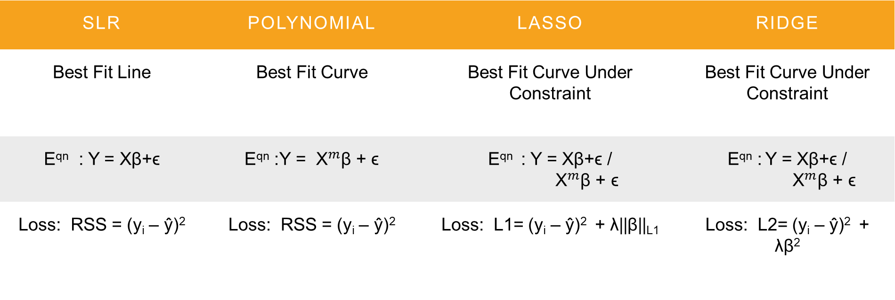
Types Of Linear Regression
SLR | POLYNOMIAL | Lasso | Ridge
Best Fit Line | Best Fit Curve | Best Fit Curve Under Constraint | Best Fit Curve Under Constraint
E^{qn} : Y = Xβ+ϵ | E^{qn} :Y = ${\text{X}}^{m}$β + ϵ | E^{qn} : Y = Xβ+ϵ / ${\text{X}}^{m}$β + ϵ | E^{qn} : Y = Xβ+ϵ / ${\text{X}}^{m}$β + ϵ
Loss: RSS = (y_{i} – ŷ)² | Loss: RSS = (y_{i} – ŷ)² | Loss: L1= (y_{i} – ŷ)² + λ||β||_{L1} | Loss: L2= (y_{i} – ŷ)² + λβ²

Slide 3
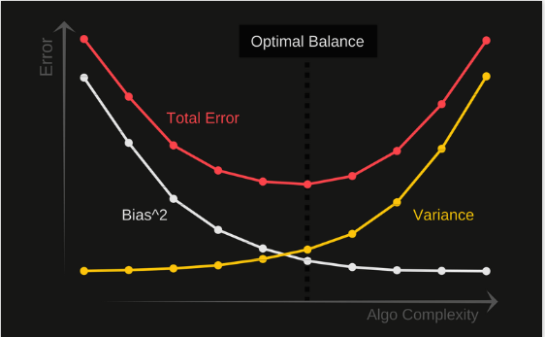
The Why?
Regularization deals with the classic problem of overfitting and underfitting.
Regularization Reduces the model coefficients by shrinking them to zero.
This is done by adding a penalty term.
Meaning we trade bias for a reduction in variance.

Slide 4
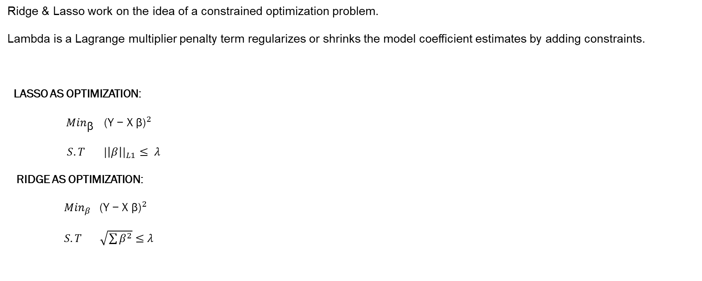
The How?
Ridge & Lasso work on the idea of a constrained optimization problem.
Lambda is a Lagrange multiplier penalty term regularizes or shrinks the model coefficient estimates by adding constraints.
LASSO AS OPTIMIZATION:
${ Min}_{\text{β}} {\text{(}\text{Y}\text{ − }\text{X} \text{β}\text{)}}^{2}$
$S.T$ ${ |\left|β\right||}_{L1}$ $≤ λ$
RIDGE AS OPTIMIZATION:
${Min}_{β}$ ${\text{(}\text{Y}\text{ − }\text{X} \text{β}\text{)}}^{2}$
$S.T$ $\sqrt{\sum{β^{2}}}$ $≤$ $λ$

Slide 5
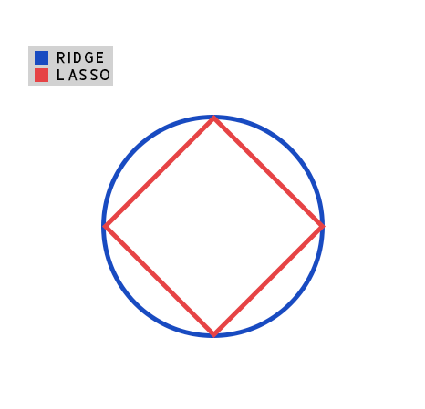

Constrain Regions
Assuming we have a 2D Problem and set $λ$ to 1 and square both sides of L2 Equation.
We get ;
$β_{1}^{2 }$+ $β_{2}^{2}$ = 1
This Equation is that of he unit circle and represents the Constraint Boundary for Ridge.
Similarly for L1
We Get;
$\left|β_{1}\right|+|β_{\begin{aligned}2 \\ \end{aligned}}$| = 1
This Equation is that of the unit diamond and represents the Constraint Boundary for Lasso.

Slide 6
Optimality Of Coefficients
Lambda the Lagrange multiplier decides where the contour line of the given cost function & the constraint region overlap for L1 & L2 respectively.
So the optimal coefficient values will be those that lie on the tangent drawn where the two regions touch gives us those coefficient values that produce the lowest RSS given the constraint

Slide 7
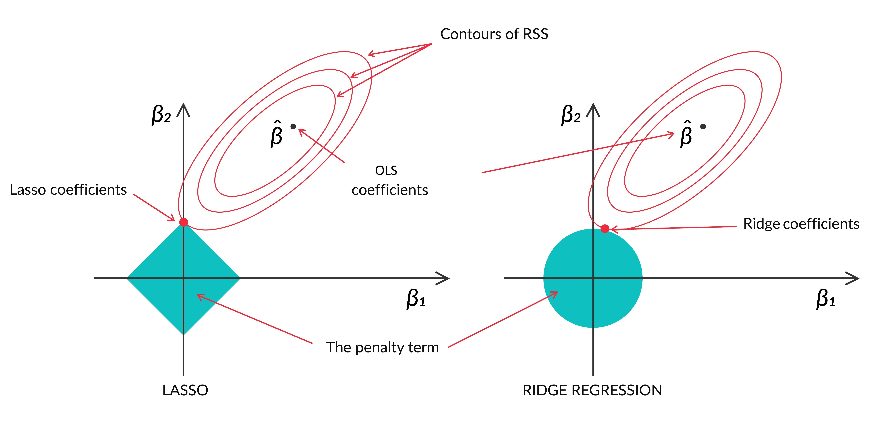
Geometrical Representation

Slide 8
How is Lasso unique
Lasso performs feature selection?
Yes, observing the geometrical plot we can see that Ridge has no sharp points, the ellipse will generally not touch the circular constraint region at the axis the coefficients can become very small but would not become 0.
Lasso regression has a corner at each axis, the ellipse would touch the constraint at any of its corners often, resulting in that coefficient becoming 0. This is the reason Lasso regression can perform feature selection

Slide 9
References:
Ridge and Lasso: https://towardsdatascience.com/lasso-increases-the-interpretability-and-accuracy-of-linear-models-c1b340561c10
Lagrange Multipliers: https://medium.com/@andrew.chamberlain/a-simple-explanation-of-why-lagrange-multipliers-works-253e2cdcbf74
Bias Variance Tradeoff: https://www.youtube.com/watch?v=EuBBz3bI-aA&t=50s
Source code : https://colab.research.google.com/drive/1dzoLW7kwhaK99CP8pmigfOOXUv2uWdS6?usp=sharing

Slide 10
Thank You

