Slide 1


OmniLabel AI
Enterprise Medical Device Label Change Intelligence Platform
Case Study 4: Healthcare & Life Sciences
Eliminating Silent Scope Omission via Uncertainty-Aware Dual Discovery & 21 CFR Part 11 Audit Ledger
Team Leader: Ashwin Kumar (Lead AI & Systems Engineer)
Competition: Tata Elxsi TELEPORT Season 4

Slide 2


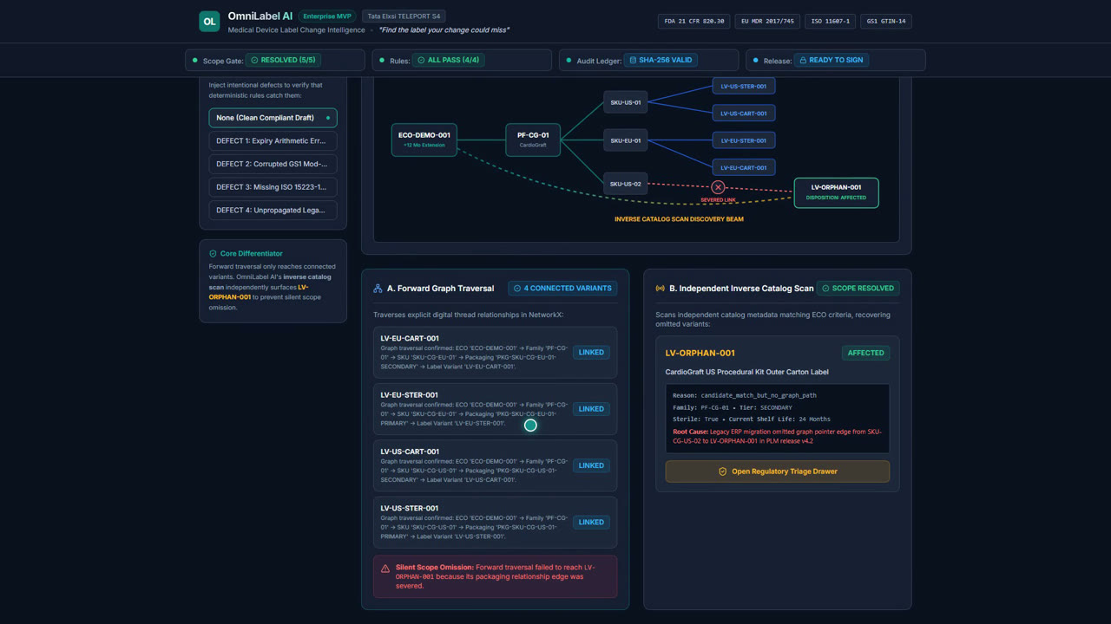
OmniLabel AI: Enterprise Medical Device Label Change Intelligence
Eliminating Silent Scope Omission in Engineering Changes • 21 CFR Part 11 Audit Trail • 43/43 Passing Tests
The Crisis: Silent Scope Omission
• Engineering Change Orders (ECO): Extending sterile shelf life (24m → 36m) requires updating all global packaging.
• Broken PLM/ERP Links: Severed digital threads silently omit unlinked secondary & regional labels.
• Catastrophic Risk: Obsolete labels printed → FDA Class II recalls, 483 warnings, hospital quarantine.
End-to-End 5-Stage Clinical Pipeline
▸ 1. Intake & Provenance: Bounded character spans & SHA-256 raw text hash.
▸ 2. Dual Discovery: Forward thread traversal + Heuristic inverse catalog scan.
▸ 3. Safe Scope Gate: Hard regulatory hold blocks release until human triage.
▸ 4. Controlled SVG Drafting: Zero-hallucination Jinja2 vector parameterization.
▸ 5. Rules & CV Verification: GS1 Mod-10, ISO symbols, and OpenCV pixel delta.
▸ 6. 21 CFR Part 11 Audit: SHA-256 forward hash-chain ledger & dual e-signature.
Deterministic Math & Algorithms
• GS1 GTIN-14 Mod-10 Math: S = Σ(D_i × w_i), D_14 = (10-(S mod 10)) mod 10. Rejects invalid barcodes instantly.
• Inverse Heuristic Scoring: Score(k,F) = 0.40(Fam) + 0.25(Sterile) + 0.20(Life) + 0.15(Jaccard). Flags cutoff ≥ 0.65.
• SHA-256 Recursive Ledger: H_n = SHA-256(H_{n-1} || Event_n || Payload_n). Cryptographically tamper-evident.
• OpenCV Computer Vision: Sub-pixel image registration & contour heatmaps.
43 / 43 Automated Pytest Suite
✔ 100% Pass Rate: 43 unit, integration & failure-mode stress tests in 3.44s.
✔ Negative Stress Testing: Rejects corrupted GTINs & blocks scope gate bypass.
✔ Tamper Detection: Traps direct SQLite modifications with exact block #.
✔ GitHub CI/CD: Automated multi-stage pipeline (✓ 3/3 green checkmarks).
The Tripartite Operating Principle
• Probabilistic AI Extracts: Bounded spans + SHA-256 raw text provenance.
• Deterministic Rules Decide: GS1 Mod-10 checksum math + ISO 15223-1 symbols + Jinja2 SVG (Zero Hallucination).
• Qualified Humans Sign: Safe Scope Gate blocks releases until all candidates triaged + 21 CFR 11 e-signatures.
Regulatory Compliance Matrix
• FDA 21 CFR Part 11: §11.10 closed system controls + §11.50 intent-bearing electronic signatures.
• FDA 21 CFR Part 820: §820.30/120 labeling controls; eliminates silent scope omission.
• EU MDR 2017/745: Annex I safety requirements, expiry arithmetic & GS1 UDI traceability.
• ISO 15223-1:2021: Symbol 5.2.3 (Sterile), 5.4.2 (Single-use), 5.1.4 (Expiry) vector geometry checks.
Business ROI & Integration
• 100% Risk Elimination: Zero unreviewed labels reach hospitals; avoids Class II recalls.
• 85% Time Savings: Shrinks ECO packaging review from weeks to minutes.
• Enterprise PLM Ready: FastAPI microservice connects to Siemens Teamcenter, Windchill, & SAP.
• Production Packaging: Dockerized + React SaaS + 1080p demo walkthrough.
Team Leader: Ashwin Kumar | Project: OmniLabel AI | GitHub: https://github.com/Ashwinkumar-k10/omnilabel-ai | Release: v1.0.0 | All 43 Tests Passing

