Slide 1

Project Title : Seasonal Agriculture Performance Analysis
Student Name : Ashwinkumar Jotiram Sutar
College Name : Dr. D. Y. Patil College of Engineering & Technology, Kasaba Bawada, Kolhapur
AICTE STU ID : STU669bcc3ac1d321721486394

Slide 2

PROBLEM STATEMENT
Agricultural performance changes with seasonal environmental conditions, farming practices, resource availability and market conditions. This project analyzes the supplied agricultural dataset to identify seasonal differences in yield, production, resource usage and economic performance. The goal is to uncover meaningful patterns, relationships and variations that can support evidence-based seasonal agricultural planning.

Slide 3
Project Description
This project analyses agricultural performance across Kharif, Rabi, and Zaid seasons using environmental, farming, resource, production, and economic data. Through data cleaning, statistical analysis, visualization, correlation analysis, and seasonal comparisons, the project identifies important patterns and relationships affecting crop yield, water efficiency, revenue, cost, and profit. The findings are used to provide data-driven recommendations for better agricultural planning and resource management.

Slide 4

WHO ARE THE END USERS?
• Farmers and farm managers – compare seasonal yield, irrigation and profitability.
• Agricultural planners – identify seasonal resource and production patterns.
• Government/agri-support organizations – use evidence for planning and interventions.
• Researchers and analysts – investigate crop, region and environmental relationships.
• Students – demonstrate practical data analytics on a real-world dataset.

Slide 5

Technology Used
  Python
  • Pandas – data loading, cleaning and aggregation
  • NumPy – numerical analysis
  • Matplotlib – data visualization
  • Seaborn – exploratory visualization
  • Jupyter Notebook – complete analysis and documentation
  Methods
  • Descriptive statistics
  • IQR outlier analysis
  • Univariate, bivariate and multivariate analysis
  • Correlation analysis
  • Seasonal and group comparisons

Slide 6
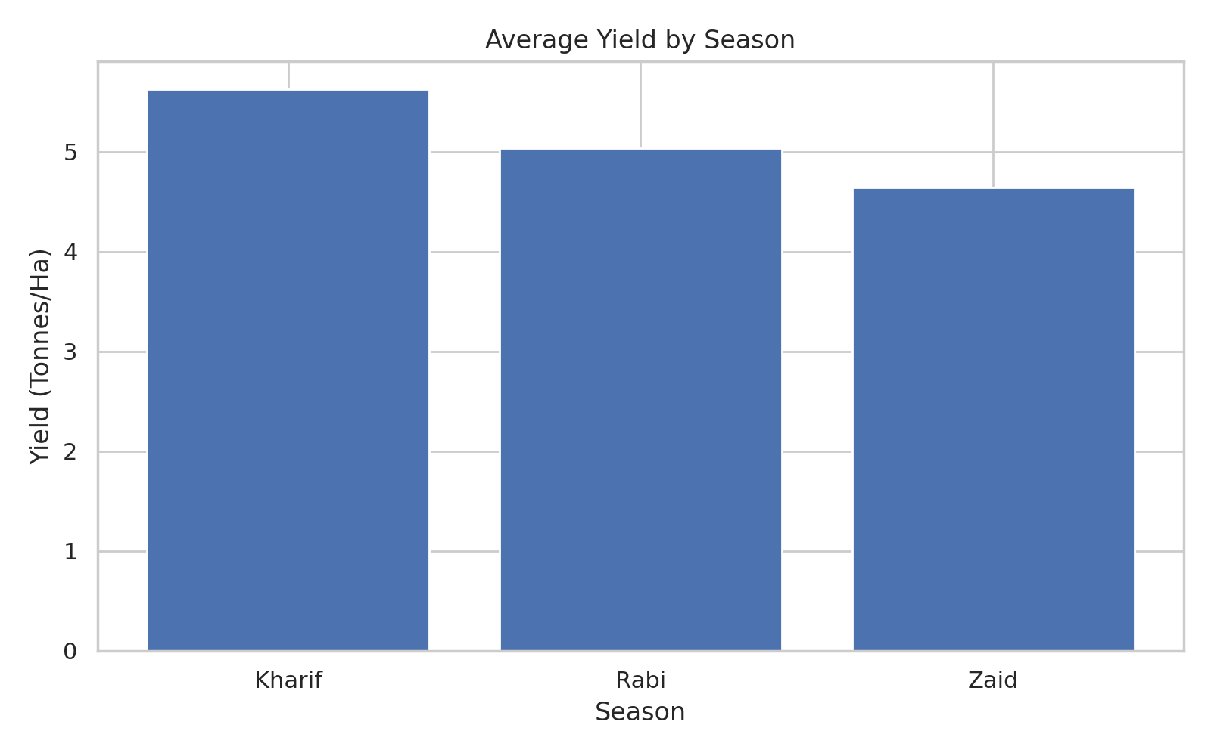
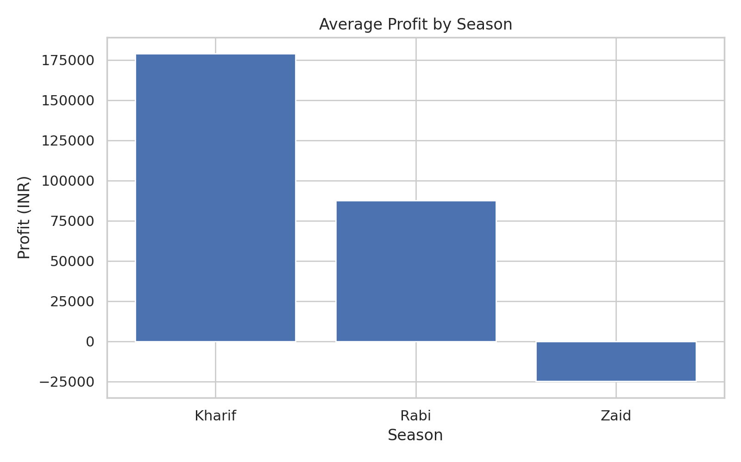
RESULTS
Average Yield by Season
Average Profit by Season

Slide 7
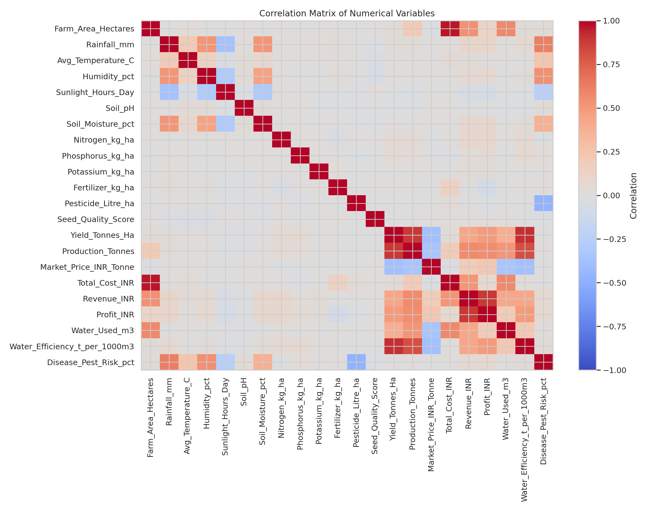
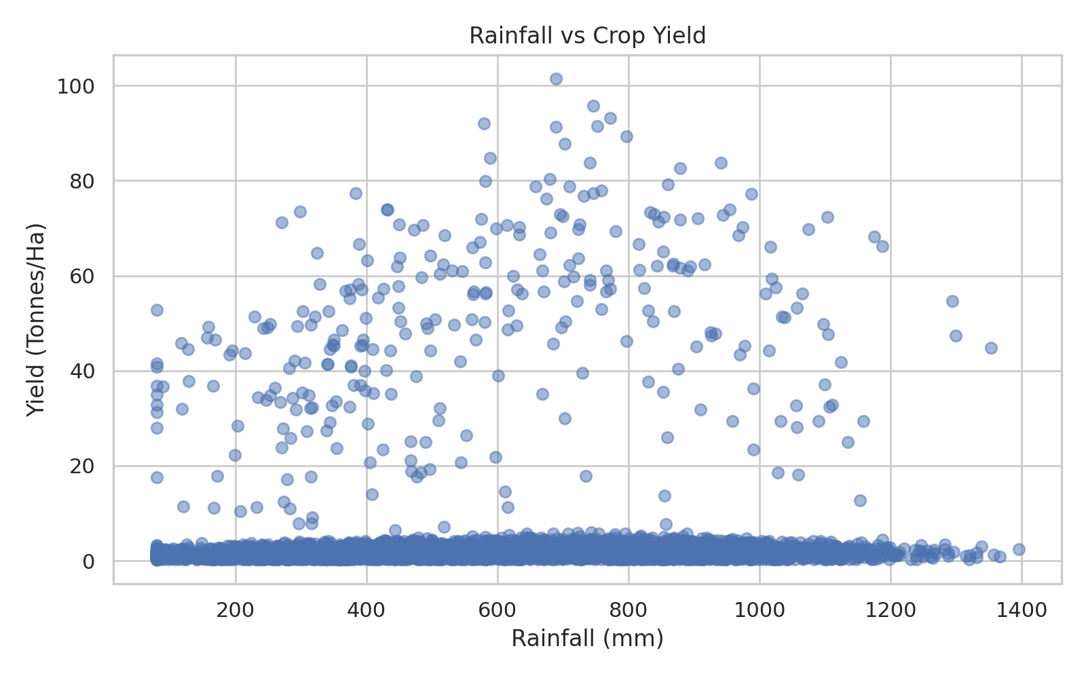
RESULTS
Rainfall vs Yield
Correlation Matrix
`

Slide 8
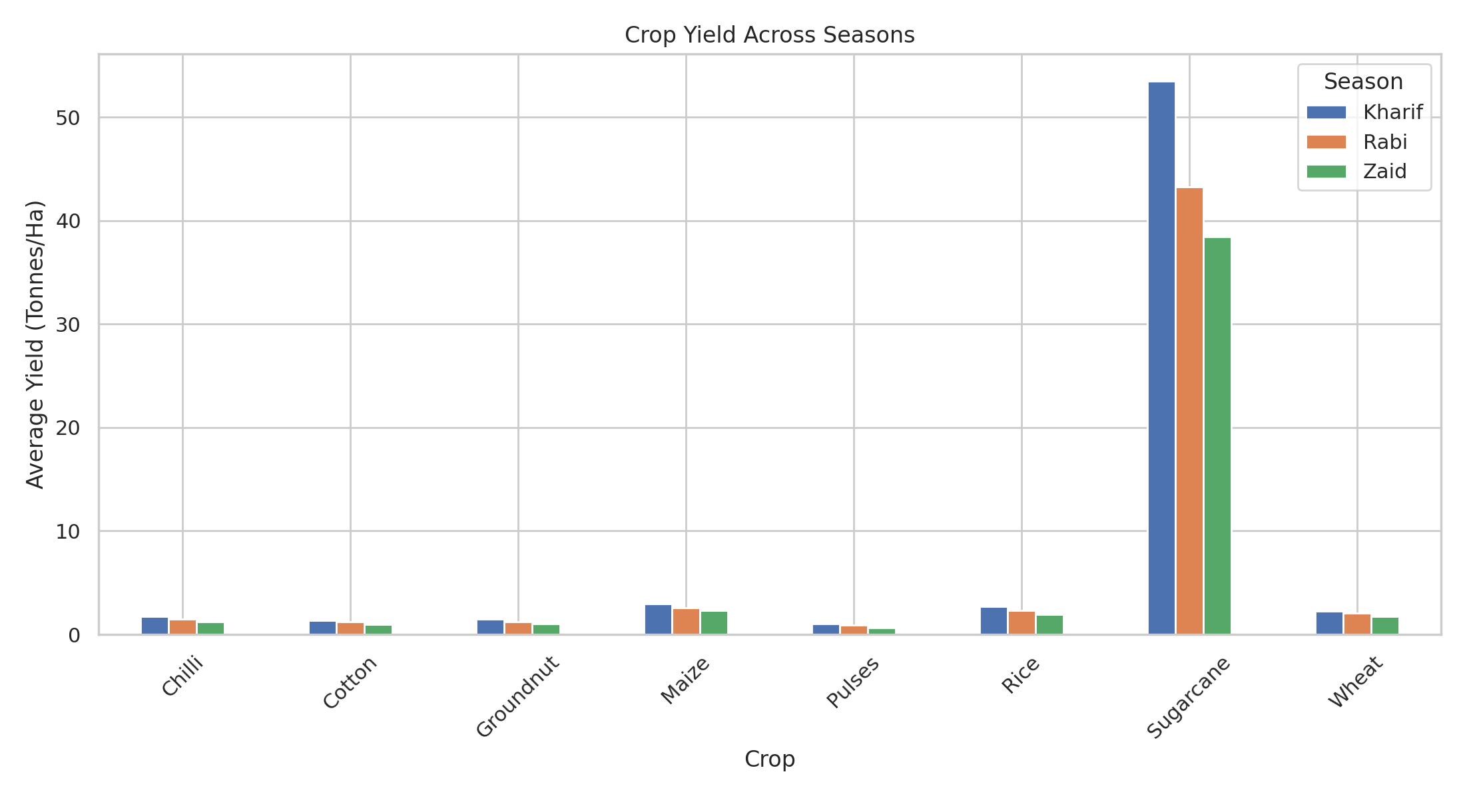
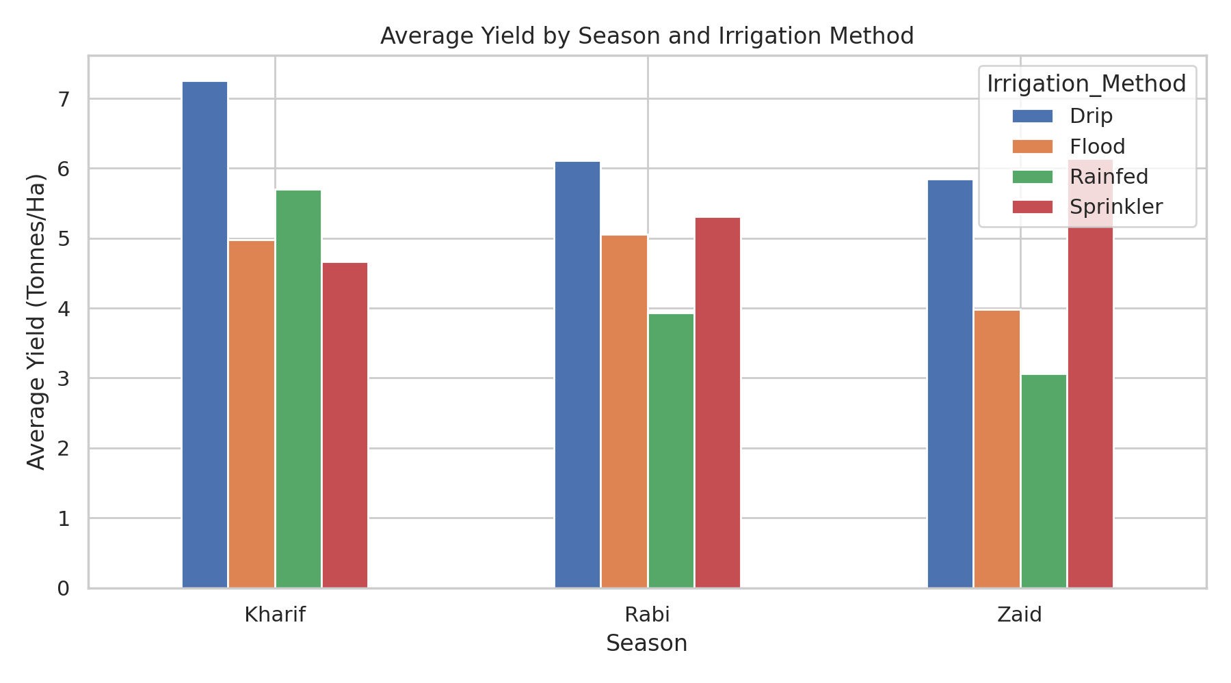
RESULTS
Crop yield across seasons
Season × Irrigation yield

Slide 9
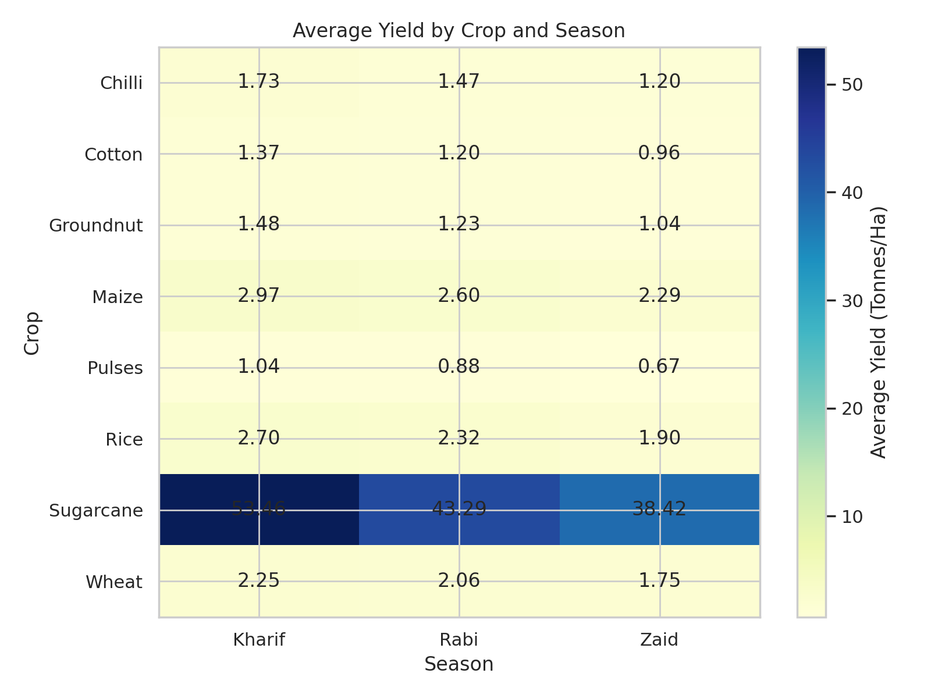
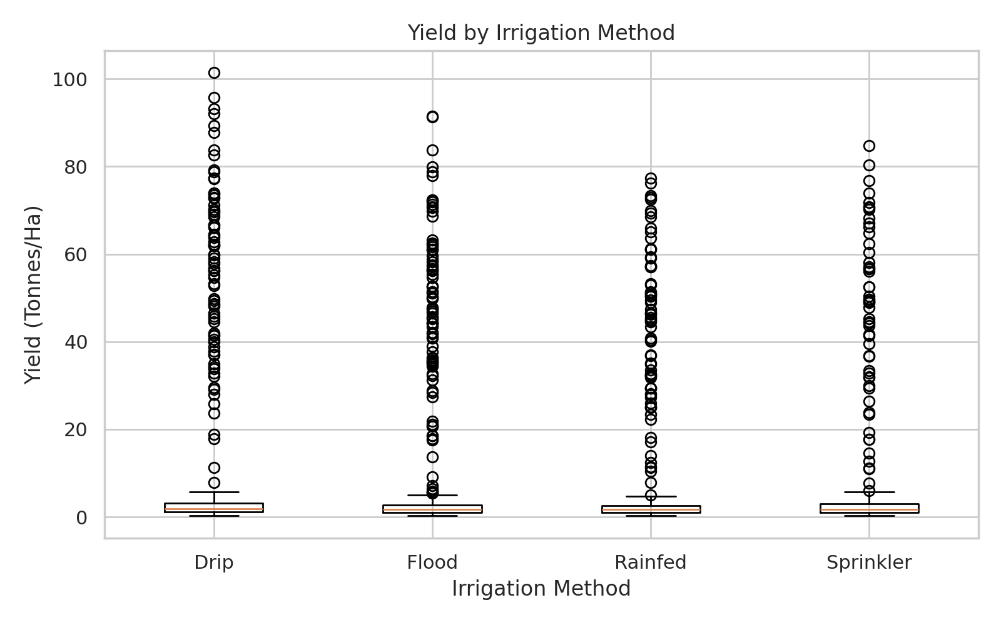
RESULTS
Yield by Irrigation Method
Crop × Season Heatmap

Slide 10
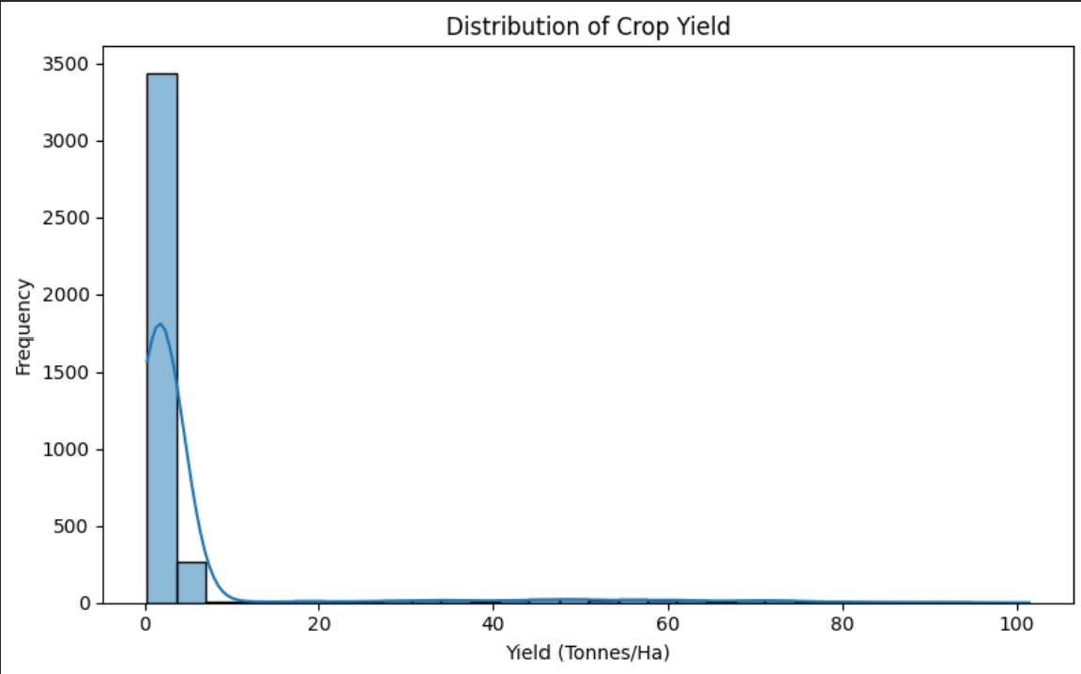
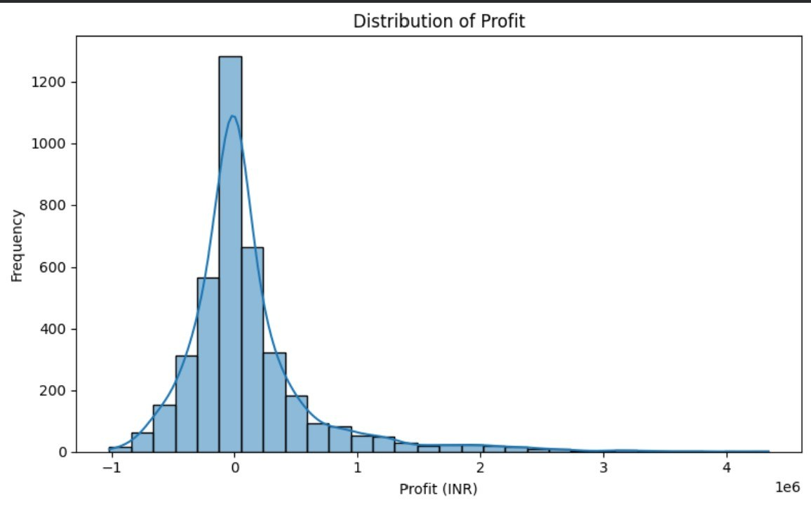
RESULTS
Distribution of crop field
Distribution of profit

Slide 11
Future scope
• We can add a multi-year historical data to study long-term seasonal trends.
• Include weather forecasts and market-price time series.
• Build an interactive Power BI/Tableau dashboard.
• Develop predictive models for yield and profitability.
• We can also add soil, pest, satellite and remote-sensing indicators.

Slide 12
GitHub Link
https://github.com/AshwinkumarStr/Major-Project-Seasonal-Agriculture-Performance-Analysis-.git
Click here to Open GitHub

Slide 13

VOIS Course completion certificate -
Course name- Data Visualization

Slide 14
Thank you
.
.

