Slide 1

Bike Sales Customer Behavior Analysis
An Excel-based analytical project examining customer demographics, purchasing patterns, and business insights — presented by Ashwin M |Data Analyst Batch · November 2025

Slide 2

PROJECT OVERVIEW
What This Project Is About
Overview :
This project analyzes customer bike purchasing behavior using Excel. The dataset captures demographics and lifestyle variables — age, gender, income, education, occupation, region, and commute distance.
Objectives :
Analyze customer buying behavior and identify key drivers
Build interactive dashboards with slicers and Pivot Charts
Use Pivot Tables to uncover purchase trends
Generate actionable business insights from raw data

Slide 3
DATA PREPARATION
Dataset & Preparation Steps
Dataset Variables
Preparation Steps
01
Demographics
Financial
Data Cleaning
Age, Gender, Marital Status, Education, Region
Income, Home Ownership, Cars Owned
Checked for missing values and removed duplicates
02
Behavioral
Formatting
Occupation, Commute Distance, Purchased Bike
Formatted income and numerical columns for consistency
03
Age Brackets
Created age categories using Excel IF formula
04
Structuring
Converted raw data into a table-ready format for Pivot analysis

Slide 4
FORMULA ANALYSIS
Age Bracket Formula
A nested IF formula was used to segment customers into meaningful age groups, improving the depth and readability of Pivot Table analysis.
=IF(L2>54,"Old",IF(L2>=31,"Middle Age",IF(L2<31,"Adolescent","Invalid")))
🧒 Adolescent
🧑 Middle Age
👴 Old
Age below 31 — younger, early-career customers
Age 31 to 54 — primary target segment for bike purchases
Age above 54 — senior customers with distinct buying patterns

Slide 5


PIVOT ANALYSIS
Pivot Tables & Charts
Pivot Tables Created
Key Findings
Average Income per Purchase
Middle-aged customers (31–54) recorded the highest bike purchase volume
Age Bracket Purchase Distribution
Higher income customers showed significantly greater purchase likelihood
Commute Distance vs. Purchase Rate
Purchase Distribution by Gender
Customers with short commute distances were most likely to purchase a bike

Slide 6




DASHBOARD
Interactive Dashboard Overview
Slicers
Pivot Charts
Filter by Marital Status, Region, and Education dynamically
Avg Income, Age Brackets, and Commute Distance visualized
Interactivity
All charts update instantly when slicer selections change

Slide 7
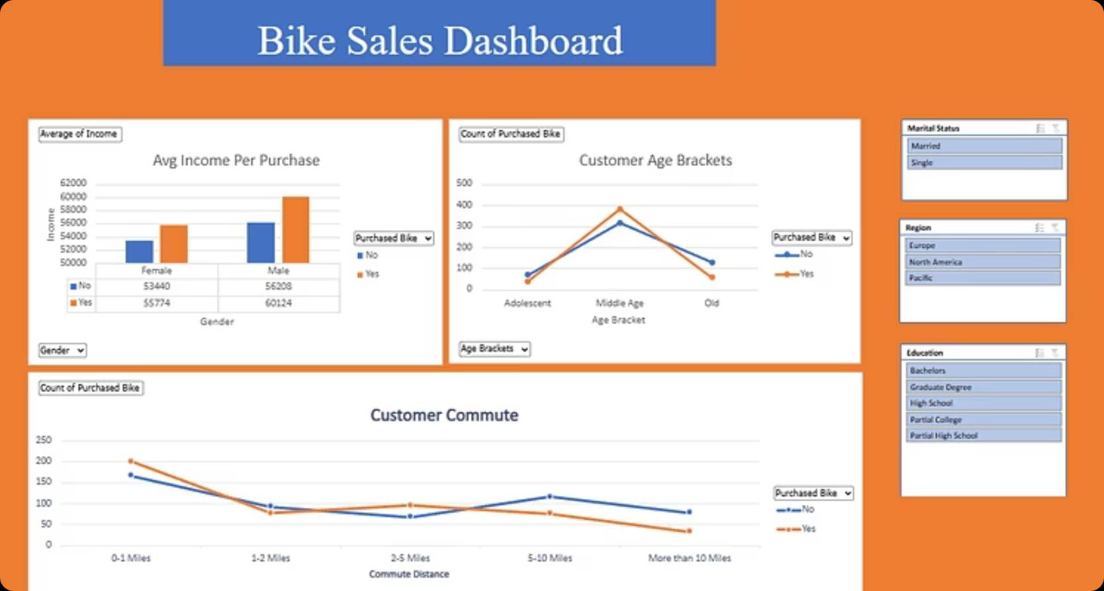
DASHBOARD PREVIEW
Dashboard Snapshots
Visual previews of the Excel dashboard — showcasing the Pivot Charts, slicer panels, and customer analysis views built in this project.

Slide 8
INSIGHTS & CONCLUSION
Key Insights & Takeaways
Top Findings
Age
Commute
Income
Region & Education
Middle-aged customers (31–54) were the most likely to purchase bikes
Shorter commutes strongly correlated with higher bike purchase rates
Higher-income customers converted at significantly greater rates
Purchase behavior varied meaningfully across regions and education levels

Slide 9

Thank You
Presented by Ashwin M

