Slide 1


ICSBE25_452
The 16th International Conference on Sustainable Built Environment and Next-Generation Innovation & Advancement - DIAMOND 75
Earl’s Regency Hotel, Kandy, Sri Lanka
12th - 14th December 2025
TITLE: SMART SENSOR NETWORK SYSTEM FOR SHM
Presented By : Shadhurshan N. Affiliation : Department of Electrical and Electronic Engineering, University of Peradeniya
Country : Sri Lanka
Authors: Sarusan S. , Ashwinthan G.K. and Shadhurshan N.

Slide 2
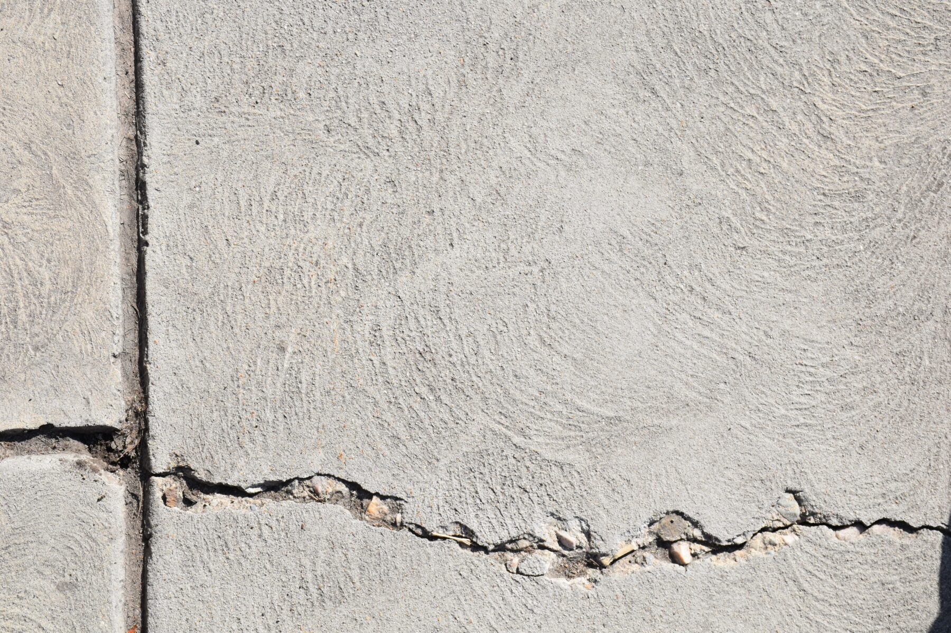
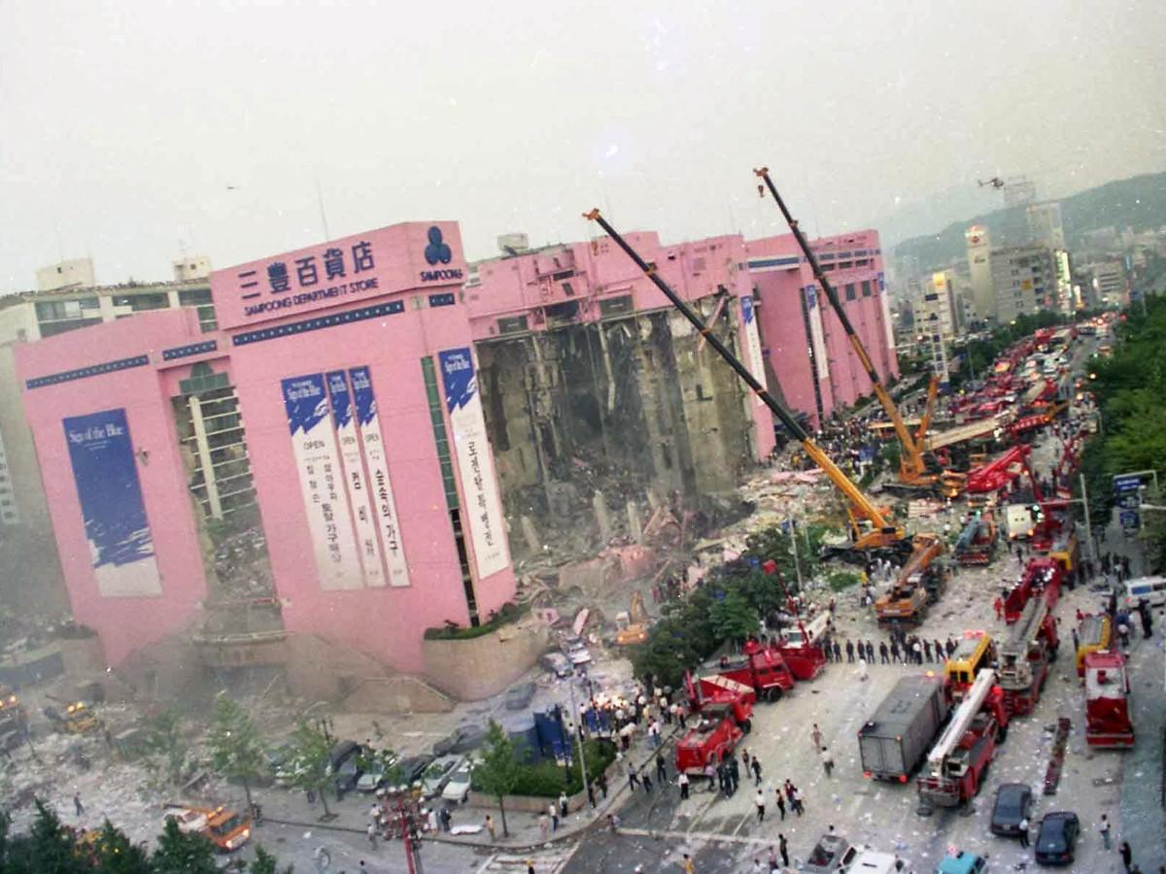
ICSBE25_452
Introduction
Why we need crack monitoring ?
if it Ignored ???
CRACK MONITORING IS MUCH IMPORTANT !!!
Aging concrete structures
Seoul, South Korea - 1995 June 29
Unreliable
Problems in Manual Inspection
Need a Automated, reliable and a low cost setup
Complex
Continuous ??
Cost ??
1

Slide 3
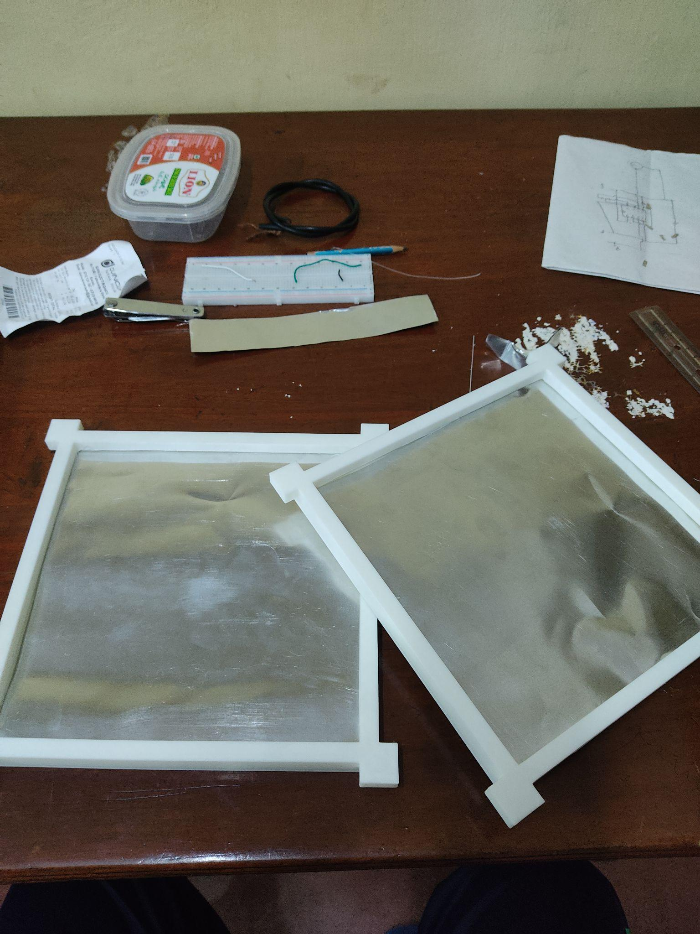
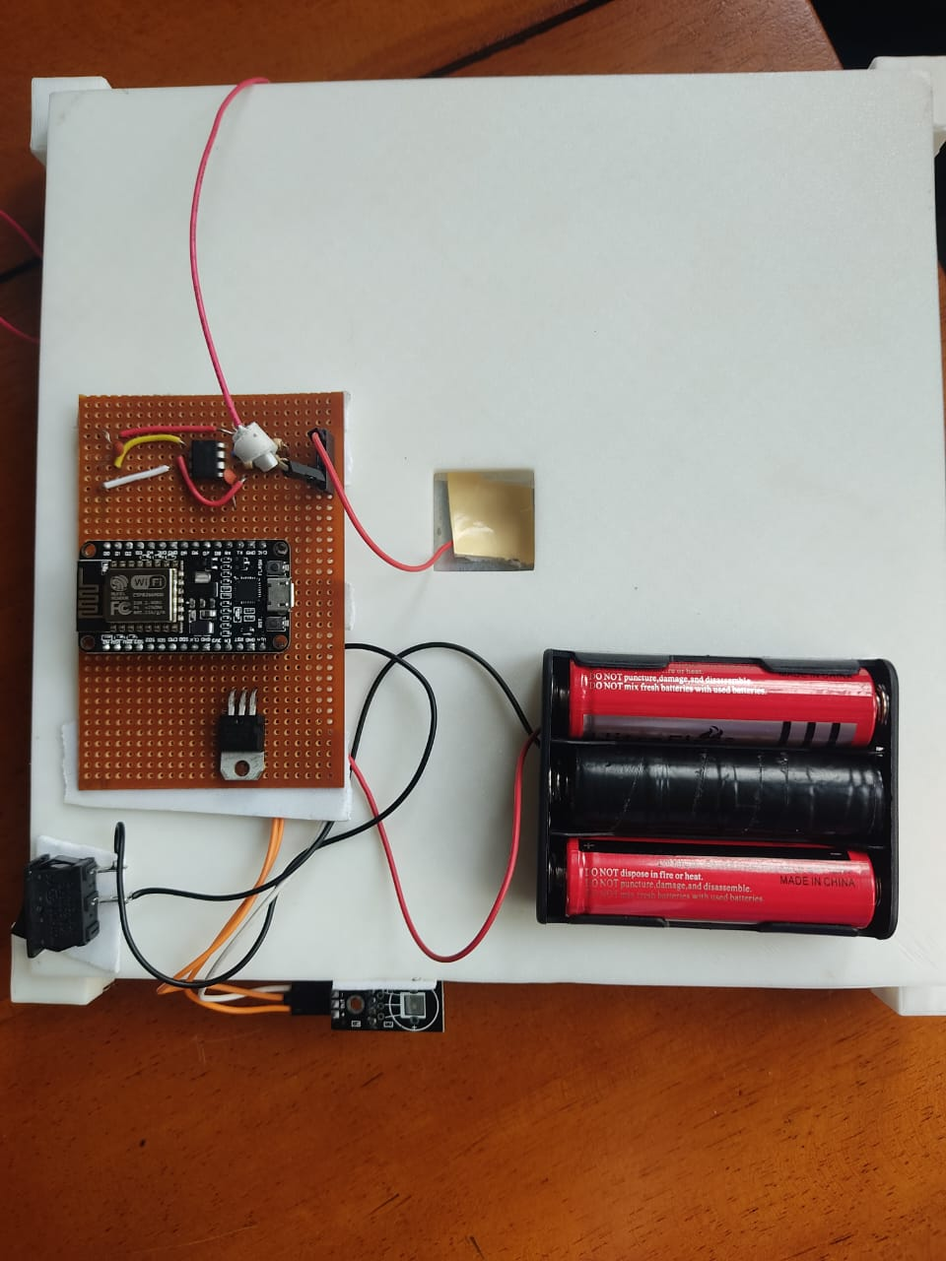
Methodology
ICSBE25_452
ICSBE25_452
Capture crack photographs
Image Processing and
Crack localization
Deploy Sensor
setup
Collect multi-sensor
data
Train ML models
Limited Samples
Temperature Variation
Overfitting
Challenges while Training ML models
Challenges on Sensor setup
Biased performance
Estimate
Vibrations
Class Imbalance
Air flow through Al plates
Own-customized Capacitive sensor & DHT11
The 16th International Conference on Sustainable Built Environment – 2025, Kandy, Sri Lanka | 12th - 14th December 2025
2

Slide 4
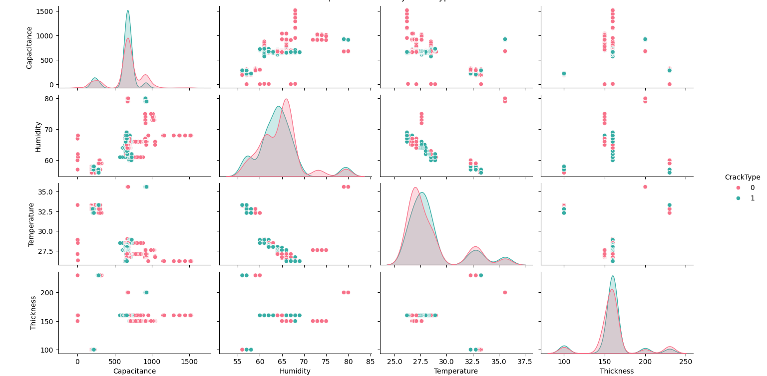
Results and Discussions
ICSBE25_452
Pairplot
DATA DIVERSITY !!!
The 16th International Conference on Sustainable Built Environment – 2025, Kandy, Sri Lanka | 12th - 14th December 2025
3

Slide 5
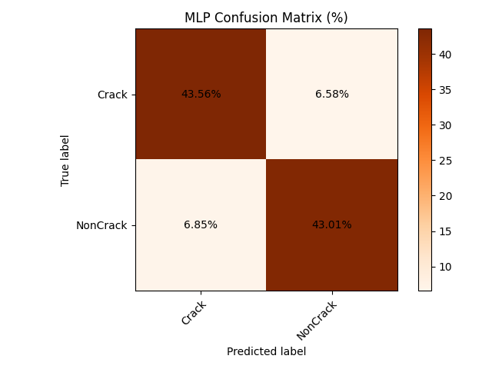
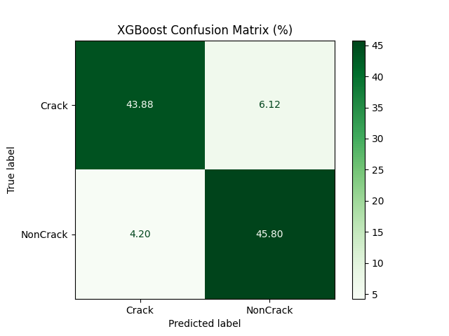
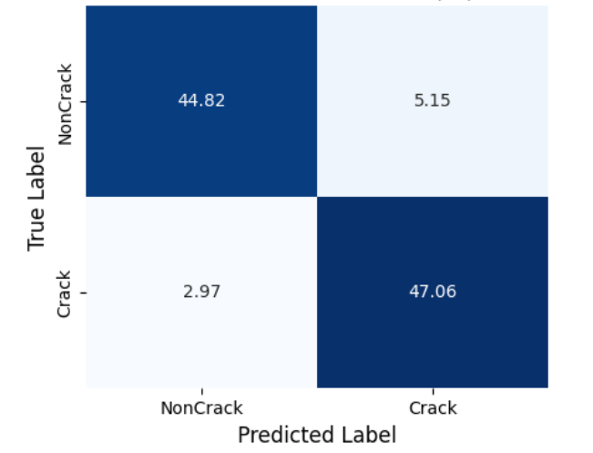
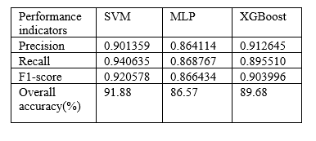
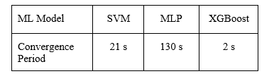
Results and Discussions
ICSBE25_452
Confusion Matrices
Convergence time ???
Accuracy ???
XGBoost
The 16th International Conference on Sustainable Built Environment – 2025, Kandy, Sri Lanka | 12th - 14th December 2025
4

Slide 6
Conclusion and Future works
ICSBE25_452
Crack Localization
Multi Sensor SHM System
ML Analysis
DHT11
Capacitive
Thickness
Real Time Monitoring
Deploy with multiple nodes
The 16th International Conference on Sustainable Built Environment – 2025, Kandy, Sri Lanka | 12th - 14th December 2025
5

Slide 7
ICSBE25_452
Acknowledgements & References
Acknowledgements
Supervisor - Prof.Maheshi Dissanayake (Department of Electrical and Electronic Engineering, UoP)
Co Supervisor - Dr.H.A.D.Samith Buddhika (Department of Civil Engineering, UoP)
References
[1] E. T. Júnior, A. Cury, and J. L. Júnior, "Assessment of Low-Cost Wireless Sensors for Structural Health Monitoring Applications,"Research, Society and Development, vol. 10, no. 4, 2021. doi: 10.33448/rsd-v10i4.14197
[2] Jin Yan et al., "Concrete Crack Detection and Monitoring Using a Capacitive Dense Sensor Array,"
Sensors, vol. 22, no. 4, 2022.
[3] J. Chinna Babu et al., "IoT-Based Intelligent System for Internal Crack Detection in Building Blocks,"
Journal of Sensors, vol. 2022, Article ID 2332271.
[4] Ahmed Badawy et al., "Structural Health Monitoring Using Wireless Sensor Networks: A Comprehensive Survey,"
Computer Communications, vol. 121, 2018, pp. 1–16. doi: 10.1016/j.comcom.2018.03.012
[5] J. F. Canny, "A computational approach to edge detection," IEEE Transactions on Pattern Analysis and Machine Intelligence, vol. PAMI-8, no. 6, pp. 679–698, Nov. 1986.
[6] A. Author et al., "Crack detection in concrete surfaces using convolutional neural networks," Journal of Structural Engineering, vol. 145, no. 3, pp. 04019012, Mar. 2019.
[7] T. Author et al., "Real-time crack detection in infrastructure using TensorFlow," Automation in Construction, vol. 102, pp. 1–10, Dec. 2019.
6

Slide 8

ICSBE25_xxx

