Slide 1
Market Entry Analysis Upgrad Capstone Project Name: Ashwin Venugopal
Notes:
Problem Statement

Slide 2
Problem Statement
XYZ Mobiles believes that the Indian market is quite similar to the Chinese market where the company currently operates. Before entering the new market, the company wants to be sure that the whole process will be profitable for them. You are given the task of checking for the following conditions that must be fulfilled in the Indian market for the company to enter:
Sale of a minimum of 12,000 phones over the sample data in one year
Collection of at least ₹20 crore over the sample data in one year
Notes:
Problem Statement

Slide 3
Task I : Analysis Of Datasets
1. Chinese Dataset:
From the Chinese customer data it is clear that purchase decision depends on 4 factors. Customer age, Gender, last phone life, and annual income. The following changes were made on the raw data
The phone life was classified into 4 category as below:
Then after dataset is converted into training and test set with 70:30 Rule and then K-Means Clustering Modelling Is Performed On both of them.
And then ROC Curve, Beta Values and Confusion Matrix (Including Accuracy, Sensitivity, Precision etc.) is Computed from train and test data through K-means Clustering.
Days | Segment
<200 | 1
200-360 | 2
360-500 | 3
>500 | 4

Slide 4
Task I : Analysis Of Datasets
1. Chinese Dataset:
Table: 1 Gender Category
Table: 2 Phone Age Category
Note :
1.From Table 1 we came to know that conversion rate for Males as high as compared to Females that is, 59.21 %.
2.From Table 2 we understand that category 4 (i.e., Phone Age > 500) is having highest conversion Rate that is, 83.96 %.
Row Labels | Count of ID | Sum of PURCHASE | Conversion Percentage
0 | 17715 | 9836 | 55.52
1 | 22285 | 13195 | 59.21
Grand Total | 40000 | 23031 | 57.58
Row Labels | Count of ID | Sum of PURCHASE | Conversion Percentage
1 | 6459 | 2351 | 36.40
2 | 16545 | 7023 | 42.45
3 | 11697 | 9208 | 78.72
4 | 5299 | 4449 | 83.96
Grand Total | 40000 | 23031 | 57.58

Slide 5
Task I : Analysis Of Datasets
1. Chinese Dataset:
The logistic regression was made on the formatted data by considering the factors like age, gender, income, phone life and purchase.
The coefficients B0 to B4 and ROC Curve of training Data are computed as follows:
 | Coeff
B0 | -1.51841
B1 | -0.01186
B2 | 0.217181
B3 | 2.25E-06
B4 | 0.004185
Accuracy | 0.67
Precision | 0.69
Recall | 0.77
F1-Score | 0.68
Sensitivity | 0.77
Specificity | 0.53
TPR | 0.77
FPR | 0.47

Slide 6
Task I : Analysis Of Datasets
Chinese Dataset:
The coefficients B0 to B4 and ROC Curve of test Data are computed as follows:
From the coefficient it is clear that age has a negative impact. Old people are less likely to buy a phone.
Gender plays a significant role, which is evident in the pivot analysis.
The annual income plays an insignificant role as the coefficient is very small.
The phone life also plays an important role and the categorial variation has an impact of its own.
 | Coeff
B0 | -1.65777
B1 | -0.01239
B2 | 0.251535
B3 | 2.73E-06
B4 | 0.004235
Accuracy | 0.68
Precision | 0.70
Recall | 0.79
F1-Score | 0.69
Sensitivity | 0.79
Specificity | 0.52
TPR | 0.79
FPR | 0.48

Slide 7
Task I : Analysis Of Datasets
2. Indian Dataset:
The data set is formatted such that gender is converted into a binomial model and the phone age is calculated by considering the purchase date as 1st July 2019.
The phone life is converted into 4 categories as follow:
The probability is computed based on coefficients (B0 to B4) obtained from the Chinese dataset and the no of potential customers in India based on a cut-off 0.5 is 31573 with a conversion ratio of 45.10%.
DAYS | SEGMENT
<200 | 1
200-360 | 2
360-500 | 3
>500 | 4

Slide 8
Task 2 : Customer Segmentation
1. Indian Dataset:
Clustering analysis was conducted on both 3 and 4 clusters using scaled and standardized data, and the corresponding error terms were computed. The centroid values derived from this analysis were utilized for further insights.
In our examination, we focused on the results obtained from 3 clusters and proceeded with predictive analysis. Subsequently, exploratory data analysis (EDA) was performed on each cluster, along with the associated centroid values. The following outcomes were observed:
The decision was made to consider centroid value 1, in K=3 cluster classification, for business decisions due to its favorable characteristics, such as a current age of 49, an annual income of around 1656427, and an age of the phone around 368 days. Notably, the error terms for centroid value 2 are positive, indicating a robust clustering of individuals around this centroid.
Centroid | 1 | 2 | 3
CURR_AGE | 49.136 | 42.814 | 44.226
GENDER | 0.610 | 0.476 | 0.436
ANN_INCOME | 1656427.422 | 1151935.376 | 697639.031
PHONE AGE | 368.111 | 366.427 | 367.821
Centroid | 1 | 2 | 3
CURR_AGE | 0.484744 | 0.961709 | -0.94878
GENDER | 0.328154 | -0.13725 | -0.17681
ANN_INCOME | 1.076915 | -0.85354 | -0.34218
PHONE AGE | 0.028885 | -0.00601 | -0.01915

Slide 9
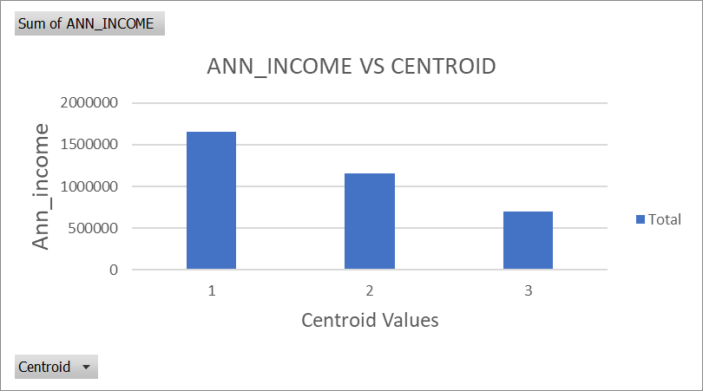
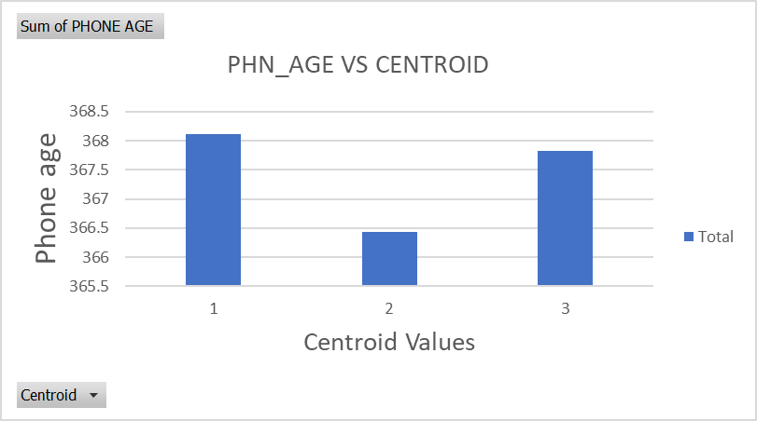
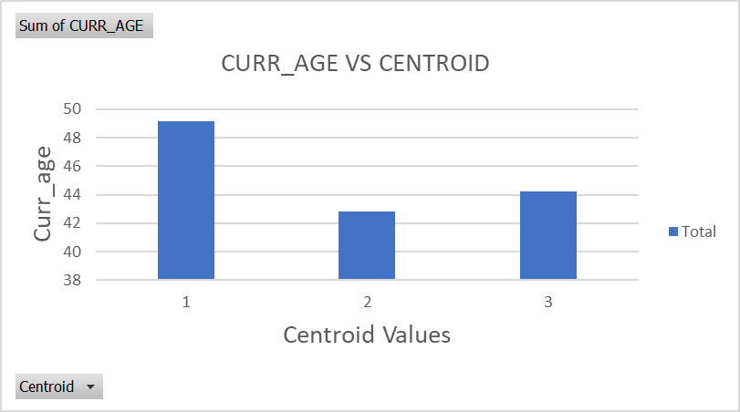
Task 2 : Customer Segmentation
1. Indian Dataset: EDA for Potential Customers

Slide 10
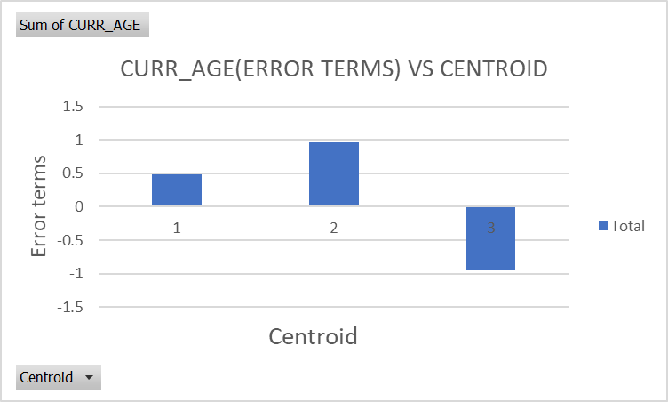
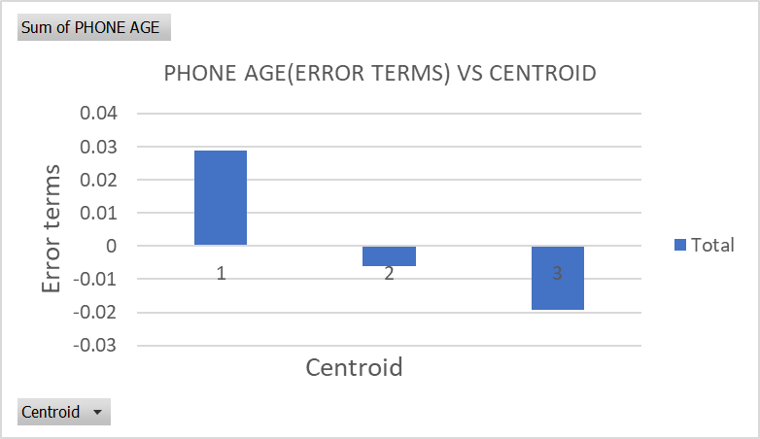
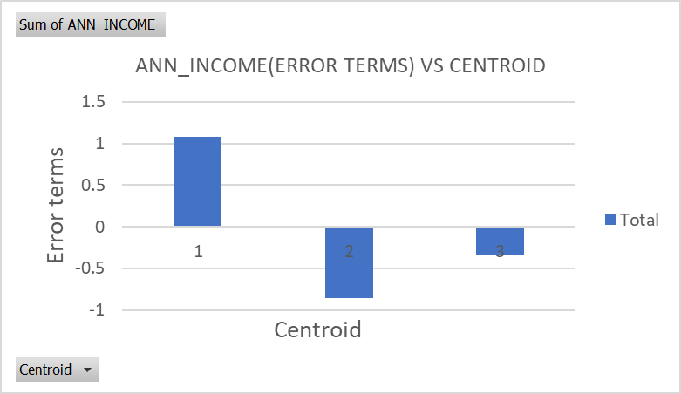
Task 2 : Customer Segmentation
1. Indian Dataset: EDA for Error Residuals

Slide 11
TASK 3 : Business Decision
For Final task from the data set, the expected revenue which can be generated by sales is calculated using the formula:
Expected revenue = Cost of Phone * Sum of customers
Two Criteria for XYZ company to fulfill to enter the Indian market:
-Sales of a minimum of 12,000 phones over the sample data in one year
-Collection of at least ₹20 crore over the sample data in one year.
In order to understand which segment customers can be targeted a column which segments customers age has been created.
The following segments are:
Furthermore, the segmented age groups have are again classified based on their incomes and amount they are willing to pay to buy a phone.
 | Segments | Age Criteria
Young Age | 1 | 25-35
Mid Age | 2 | 35-55
Old Age | 3 | 55-65

Slide 12
TASK 3 : Business Decision
The Segmented age groups are split into : 1. High Income
2. Medium Income
3. Low Income
The table for each income clusters are given below along with their Average Budget and Expected revenue the company needs to set their base in India.
Young Aged Customers
 | Average Budget | Expected Revenue | IF >20 CRORE
Low Income | 8000 | 61280000
Medium Income | 10000 | 76600000
High Income | 12500 | 95750000
 | SUM | 233630000 | YES
Mid Aged Customers
 | Average Budget | Expected Revenue | IF >20 CRORE
Low Income | 12250 | 187216750
Medium Income | 22375 | 341957125
High Income | 31250 | 477593750
 | SUM | 1006767625 | YES
Old Aged Customers
 | Average Budget | Expected Revenue | IF >20 CRORE
Low Income | 9500 | 81985000
Medium Income | 22375 | 193096250
High Income | 31250 | 269687500
 | SUM | 544768750 | YES

Slide 13
TASK 3 : Business Decision
From all the tables it can be inferred that:
1.Expected revenue from all customer segments add up to more than RS 20 crore.
And from below table
2.The total number of phones that can be sold in India comes upto 31573 phones,
with middle age buyers accounting the majority with 15283 phones, 44.97%.
Row Labels | Count of SEGMENTED CUSTOMER AGE | Sum of PURCHASE | Conversion %
1 | 17021 | 7660 | 45.003
2 | 34207 | 15283 | 44.678
3 | 18772 | 8630 | 45.973
Grand Total | 70000 | 31573 | 45.104

Slide 14

TASK 3 : Business Decision
To conclude :
1. XYZ company can potentially sell 31,573 phones in Indian Market.
2. Total expected revenue from selling phones in Indian market add upto
RS 1,78,51,66,37/-.
Company Requirements:
-Sale of a minimum of 12,000 phones over the sample data in one year.
-Collection of at least ₹20 crore over the sample data in one year.
“XYZ Company can strategically enter the Indian market with a confident expectation of achieving profitable outcomes.”

