Slide 1














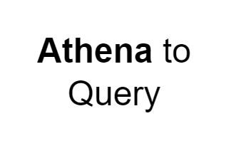
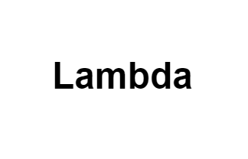
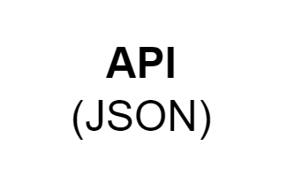




Rough Architecture 1
AWS Cloud
FETCHING & FILTERING
Cloud Trail
Cloud watch
IAM
IAM role with S3 read write access and access to SNS
Source data
Lambda 1 (Retrieves and extracts only the essential data from the Canadian Vigilance Product zip file, storing it in S3.)
Input bucket
(The S3 bucket contains the drug name and report drug in a .txt file as input)
Salesforce
Event bridge
(To trigger the scheduled lambda )
Lambda 2
(designed to fetch and filter the data provided by the client)
SNS
(A notification will be triggered if the specified drug name is not available)
Output bucket
(Storing the filtered
data in S3)
Lambda 3
(Lambda function to trigger an Email notification alert to Send mail to Client)
SES
(To send mail to Client)
Client Mail

Slide 2
Rough Architecture 2
AWS Cloud
FETCHING & FILTERING
Cloud Trail
Cloud watch
IAM
IAM role with S3 read write access and access to SNS
Source data
Lambda 1 (Retrieves and extracts only the essential data from the Canadian Vigilance Product zip file, storing it in S3.)
Input bucket
(The S3 bucket contains the drug name and report drug in a .txt file as input)
Event bridge
(To trigger the scheduled lambda )
Lambda 2
(designed to fetch and filter the data provided by the client)
SNS
(A notification will be triggered if the specified drug name is not available)
Output bucket
(Storing the filtered
data in S3)
Lambda 3
(Lambda function to trigger an Email notification alert to Send mail to Client)
SES
(To send mail to Client)
Client Mail

Slide 3
Rough Architecture 2
AWS Cloud
FETCHING & FILTERING
Cloud Trail
Cloud watch
IAM
Input bucket
(The S3 bucket contains the drug name and Data extracts from the Canada Vigilance adverse reaction online database(.txt files) as input)
Output bucket
(Storing the filtered
data in S3)
Client Mail
Source data
IAM role with S3 read write access and access to SNS
Event bridge
(To trigger the scheduled lambda )
Lambda 4
(Lambda function to trigger an PDF creation and store it in s3)
Output bucket
(Storing the filtered
data in S3)
Lambda 1
(designed to fetch and filter the data provided by the client)
SNS
(A notification will be triggered if the specified drug name is not available)
Lambda 2
(Designed to convert the output data into HTML pages.)
Lambda 3
(Lambda function to trigger an Email notification alert to Send mail to Client)
SES
(To send mail to Client)

Slide 4
Rough Architecture 2
AWS Cloud
FETCHING & FILTERING
Cloud Trail
Cloud watch
IAM
Client Mail
MAIL SERVICE & PDF GENRATION
Lambda 2
(Designed to convert the output data into HTML pages.)
SNS
(A notification will be triggered if the specified drug name is not available)
Lambda 3
(Lambda function to trigger an Email notification alert to Send mail to Client)
SES
(To send mail to Client)
Event bridge
(To trigger the scheduled lambda )
Source data
Input bucket
(The S3 bucket contains the drug name and Data extracts from the Canada Vigilance adverse reaction online database(.txt files) as input)
Lambda 1
(designed to fetch and filter the data provided by the client)
Output bucket
(Storing the filtered
Data and PDF report in S3)
Lambda 4
(Lambda function to trigger an PDF creation and store it in s3)
Event bridge
(To trigger the scheduled lambda )

