Slide 1
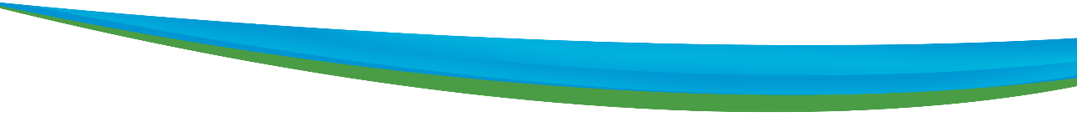













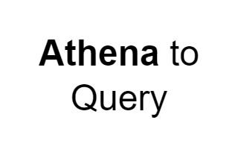
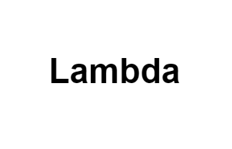
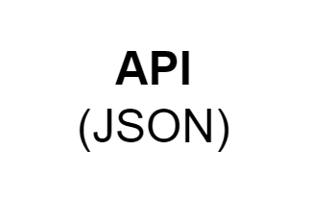




Rough Architecture 1
AWS Cloud
FETCHING & FILTERING
Cloud Trail
Cloud watch
IAM
IAM role with S3 read write access and access to SNS
Source data
Lambda 1 (Retrieves and extracts only the essential data from the Canadian Vigilance Product zip file, storing it in S3.)
Input bucket
(The S3 bucket contains the drug name and report drug in a .txt file as input)
Salesforce
Event bridge
(To trigger the scheduled lambda )
Lambda 2
(designed to fetch and filter the data provided by the client)
SNS
(A notification will be triggered if the specified drug name is not available)
Output bucket
(Storing the filtered
data in S3)
Lambda 3
(Lambda function to trigger an Email notification alert to Send mail to Client)
SES
(To send mail to Client)
Client Mail

Slide 2
Rough Architecture 2
AWS Cloud
FETCHING & FILTERING
Cloud Trail
Cloud watch
IAM
IAM role with S3 read write access and access to SNS
Source data
Lambda 1 (Retrieves and extracts only the essential data from the Canadian Vigilance Product zip file, storing it in S3.)
Input bucket
(The S3 bucket contains the drug name and report drug in a .txt file as input)
Event bridge
(To trigger the scheduled lambda )
Lambda 2
(designed to fetch and filter the data provided by the client)
SNS
(A notification will be triggered if the specified drug name is not available)
Output bucket
(Storing the filtered
data in S3)
Lambda 3
(Lambda function to trigger an Email notification alert to Send mail to Client)
SES
(To send mail to Client)
Client Mail

