Slide 1
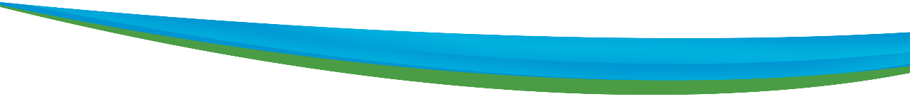













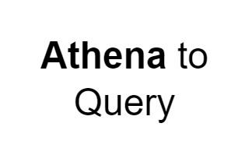
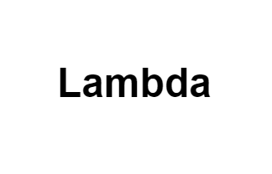
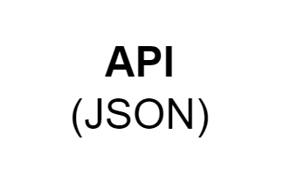




Rough Architecture 1
AWS Cloud
FETCHING & FILTERING
Cloud Trail
Cloud watch
IAM
IAM role with S3 read write access and access to SNS
Source data
Lambda 1 (Retrieves and extracts only the essential data from the Canadian Vigilance Product zip file, storing it in S3.)
Input bucket
(The S3 bucket contains the drug name and report drug in a .txt file as input)
Salesforce
Event bridge
(To trigger the scheduled lambda )
Lambda 2
(designed to fetch and filter the data provided by the client)
SNS
(A notification will be triggered if the specified drug name is not available)
Output bucket
(Storing the filtered
data in S3)
Lambda 3
(Lambda function to trigger an Email notification alert to Send mail to Client)
SES
(To send mail to Client)
Client Mail

Slide 2
AWS Cloud
FETCHING & FILTERING
Cloud Trail
Cloud watch
IAM
Source data
Lambda 1 (Retrieves and extracts only the essential data from the Canadian Vigilance Product zip file, storing it in S3.)
Client Mail
Input bucket
(The S3 bucket contains the drug name and report drug in a .txt file as input)
IAM role with S3 read write access and access to SNS
Event bridge
(To trigger the scheduled lambda )
Lambda 4
(Lambda function to trigger an PDF creation and store it in s3)
Output bucket
(Storing the filtered
data in S3)
Lambda 2
(designed to fetch and filter the data provided by the client)
SNS
(A notification will be triggered if the specified drug name is not available)
Lambda 3
(Designed to transform the output data to an aligned format)
Output bucket
(Storing the filtered
data in S3)
Lambda 3
(Lambda function to trigger an Email notification alert to Send mail to Client)
SES
(To send mail to Client)

