Slide 1
Performance Analysis of InGaAs based Double Gate MOSFETs: Impact of Gate Dielectric Material and Thickness

Slide 2
Abstract
As conventional silicon-based MOSFETs approach their scaling limits, issues such as short-channel effects, increased leakage current, and degraded electrostatic control significantly hinder further improvements in device performance. To address these challenges, this work presents a comprehensive simulation-based analysis of Double Gate (DG) MOSFETs using both silicon and Indium Gallium Arsenide (InGaAs) as channel materials, employing Synopsys Sentaurus TCAD. Initially, a silicon-based DG MOSFET is designed and evaluated, revealing limitations in current drive and switching efficiency due to lower carrier mobility. Subsequently, an InGaAs-based DG MOSFET is developed, demonstrating superior performance through enhanced electron mobility and improved carrier transport.

Slide 3
Introduction
This project investigates the impact of gate dielectric material and oxide thickness on the performance of a Double Gate MOSFET. As device dimensions scale down into the nanometer regime, controlling short-channel effects and leakage currents becomes increasingly critical. By varying dielectric materials such as SiO₂ and high-k materials, along with different oxide thicknesses, the electrical characteristics of the device are analyzed. Key performance parameters including threshold voltage, ON/OFF current ratio, and subthreshold slope are evaluated through simulation. The study aims to identify the optimal dielectric material and thickness combination for enhanced device performance and improved scalability.

Slide 4
Objectives
Design and simulate both silicon-based and InGaAs-based Double Gate MOSFETs using Synopsys Sentaurus TCAD.
Perform comparative analysis of transfer characteristics (IDS–VGS): ON-current, switching behaviour, and overall device efficiency.
Investigate the effect of gate oxide thickness (Tox) on threshold voltage (VT) and subthreshold swing (SS).
Study the effect of gate dielectric materials with varying dielectric constants (k): SiO₂, Si₃N₄, Al₂O₃, HfO₂.

Slide 5
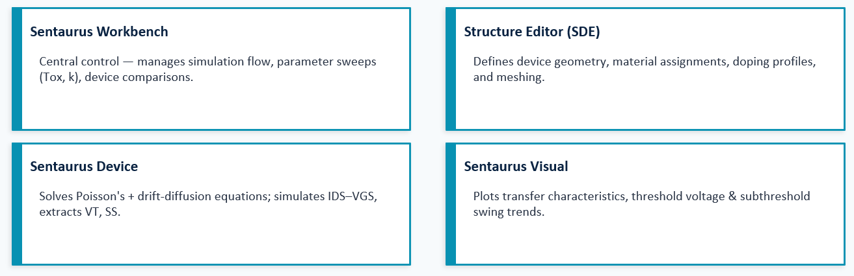
Software components
Tool used: Synopsys Sentaurus TCAD

Slide 6
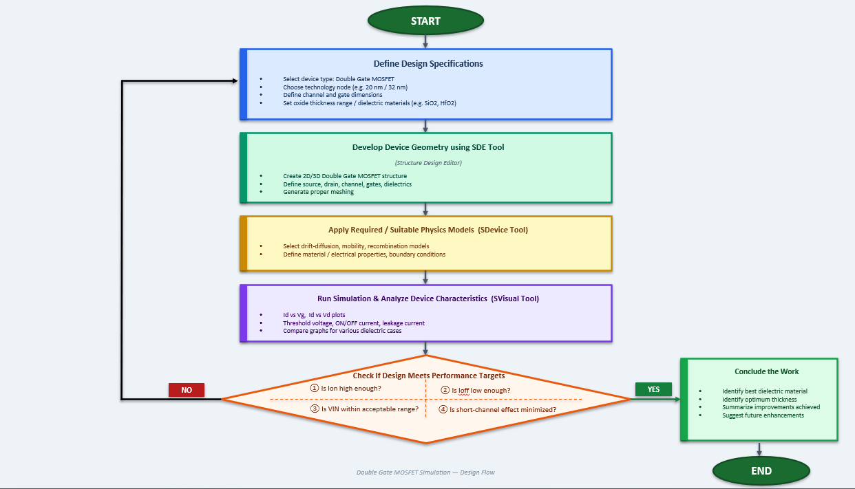
Flow Chart

Slide 7
Methodology /Working principle
Define Device Specifications- Select DG-MOSFET structure, channel dimensions, dielectric materials, thickness range, and bias conditions.
Design Device Structure- Create the Double Gate MOSFET geometry using SDE with defined source, drain, channel, and gate dielectric layers.
Apply Physical Models- Implement appropriate models (drift-diffusion, mobility, recombination) in SDevice.
Perform Simulations- Run DC simulations to obtain transfer (Id–Vg) and output (Id–Vd) characteristics.
Extract Performance Parameters- Determine threshold voltage, ON/OFF current ratio, subthreshold slope, and leakage current.
Compare Different Cases- Analyze the effect of varying dielectric material and oxide thickness on device performance.
Optimization & Conclusion- Identify the optimal dielectric material and thickness for improved DG-MOSFET performance

Slide 8
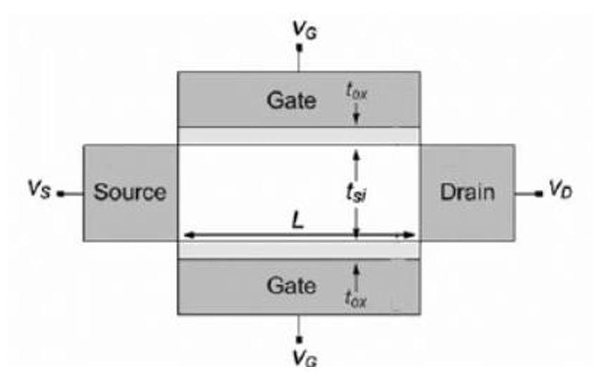
Fig: Schematic of a Double Gate MOSFET

Slide 9
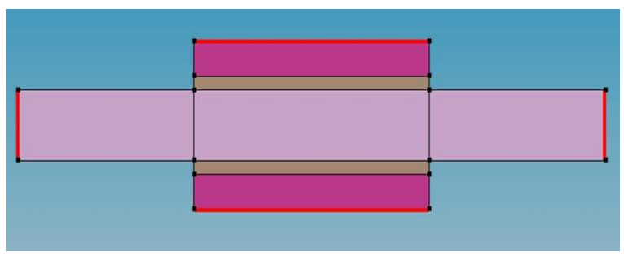
Sentarus Structure Editor(SDE) Result
Fig: Sample Design made with SDE Tool

Slide 10
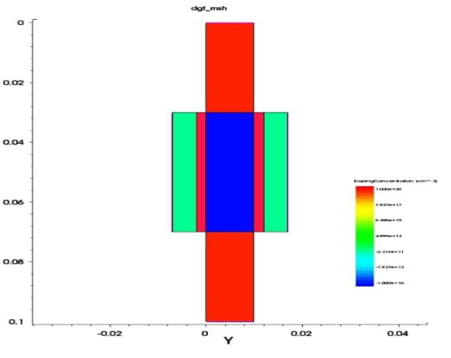
Sentarus Device(SDEVICE) Result
Fig: Model Structure viewed using Sinspect tool

Slide 11
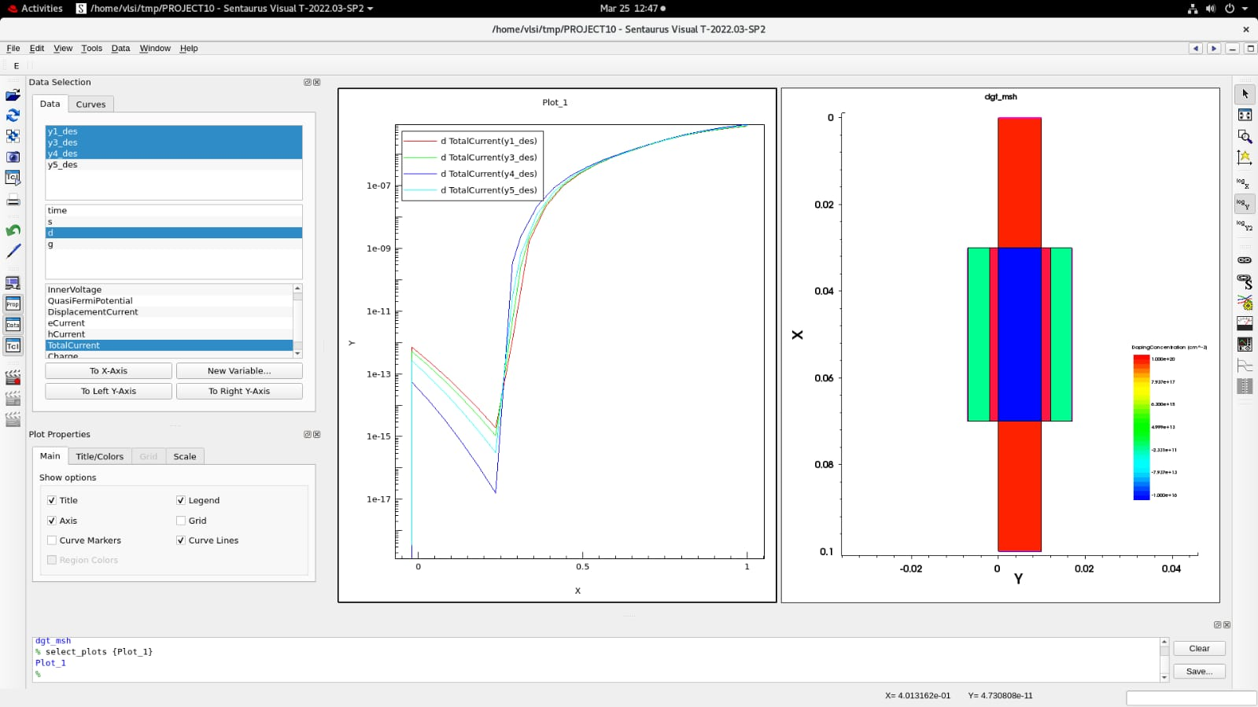
Fig: Transfer Characteristics obtained for different gate dielectric thickness
Sentarus Visual Results

Slide 12
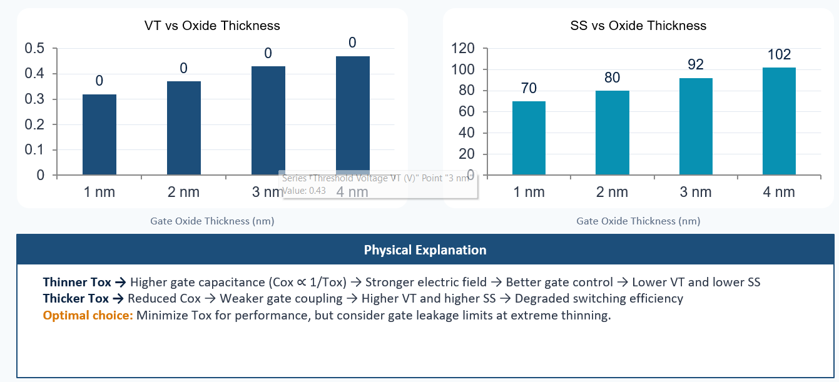
Effect of Gate Oxide Thickness(Tox)

Slide 13
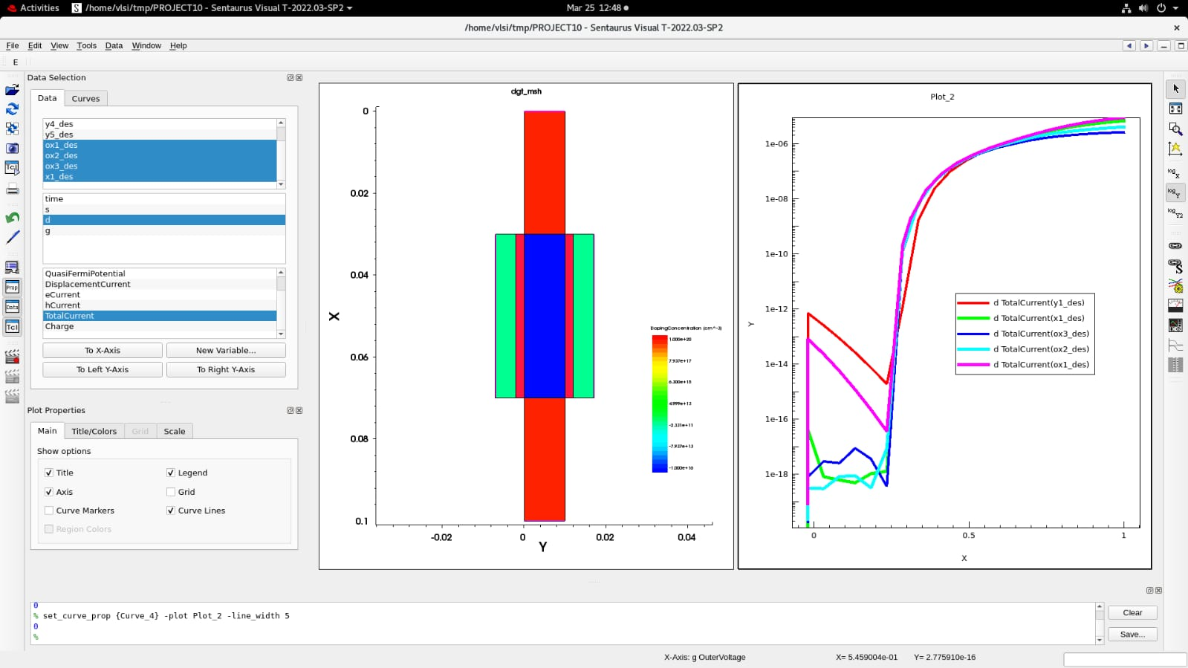
Fig: Transfer Characteristics obtained for different gate dielectric materials

Slide 14
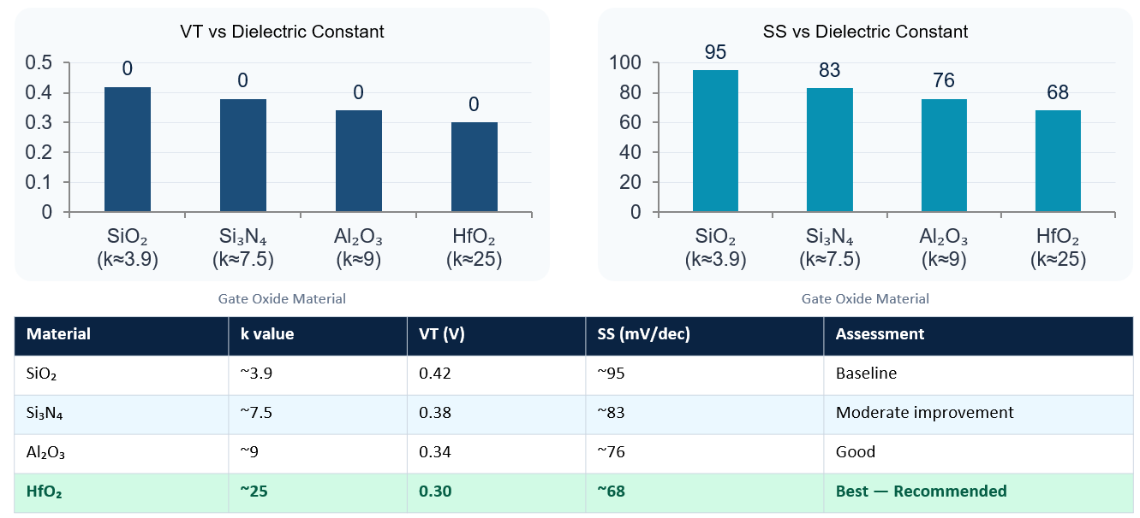
Effect of Dielectric Material (k-value)

Slide 15
Transfer Characteristics (IDS–VGS): Si vs InGaAs DG MOSFET
Transfer characteristics show variation of drain current (IDS) with gate voltage (VGS) and indicate switching behavior of the device.
InGaAs DG MOSFET exhibits significantly higher ON-current (~10⁻⁴ A) compared to Silicon (~10⁻⁵ A) due to higher electron mobility.
Both devices maintain very low OFF-current (~10⁻¹⁴ A), indicating good leakage control.
InGaAs device shows a steeper IDS–VGS curve, resulting in:
Lower subthreshold swing (SS)
Faster switching behavior
Threshold voltage (VT) is lower in InGaAs (~0.30 V) than Silicon (~0.42 V), enabling operation at lower voltages.
Conclusion: InGaAs DG MOSFET provides better current conduction, sharper switching, and improved efficiency compared to Silicon, making it suitable for high-speed and low-power applications.

Slide 16
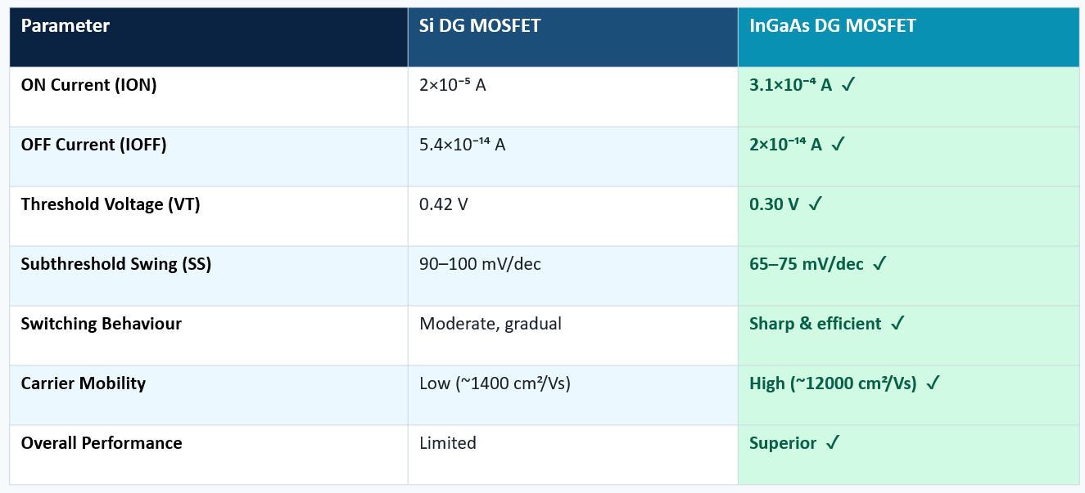
Comparative Analysis: Si vs InGaAs DG MOSFET

Slide 17
Conclusions
InGaAs DG MOSFET achieves ~15x higher ON-current (3.1×10⁻⁴ A vs 2×10⁻⁵ A) than Si DG MOSFET, while maintaining equally low OFF-current (~10⁻¹⁴ A).
InGaAs delivers lower threshold voltage (0.30 V vs 0.42 V) and improved subthreshold swing (65–75 vs 90–100 mV/dec) — enabling low-power operation.
Reducing gate oxide thickness (Tox) improves gate capacitance and electrostatic control: VT drops from 0.47 V → 0.32 V and SS from 102 → 70 mV/dec as Tox decreases from 4 nm to 1 nm.
High-k dielectric HfO₂ (k≈25) outperforms SiO₂ (k≈3.9) by delivering the lowest VT (0.30 V) and SS (~68 mV/dec) among all dielectric candidates tested.
The combined approach of DG structure + InGaAs channel + HfO₂ gate dielectric + thin Tox represents an optimal design strategy for next-generation nanoscale MOSFETs.
InGaAs-based DG MOSFETs are strong candidates for high-speed, low-power applications in sub-40 nm technology nodes.

Slide 18
References
1. Boucart, K., & Ionescu, A. M. (2007). IEEE Trans. Electron Dev., 54(7), 1725–1733.
2. Ramesh, P., & Choudhuri, B. (2023). Microelectronics Journal, 142, 105990.
3. del Alamo, J. A. et al. (2011). InGaAs MOSFETs for CMOS at the end of the roadmap. IEDM.
4. Rajan et al. (2022). Performance Analysis of III-V Double Gate Hetero Material NC-TFET. Silicon, 14(14), 8529–8541.
5. Bhardwaj et al. (2025). Oxide material variation on vertical nanowire TFET. Semiconductors, 59(5).

