Slide 1
Aggregation pipelines in V2
By Abdul Ashwood
Date: Aug 6

Slide 2
Aggregation Pipelines
What is It:
a framework that processes, transforms, and returns results from documents.
To rephrase:
It’s a script that mongo-db runs using its facilities and returns a result.

Slide 3

Migration Work of V1 -> V2

Slide 4
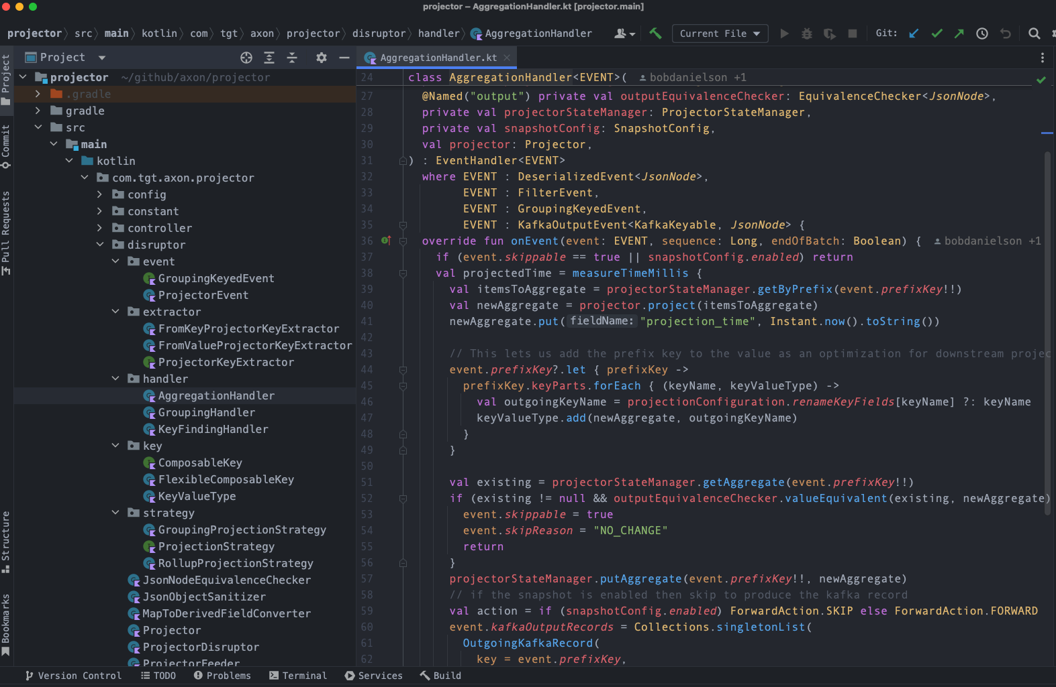
Problem with V1
All aggregations use the same app (template app)
One change affects all other aggregations
Limited testing
Resource intensive on tap (i.e: memory, CPU, etc.)
App has an expansive file count for aggregating processes
And many other issues

Slide 5
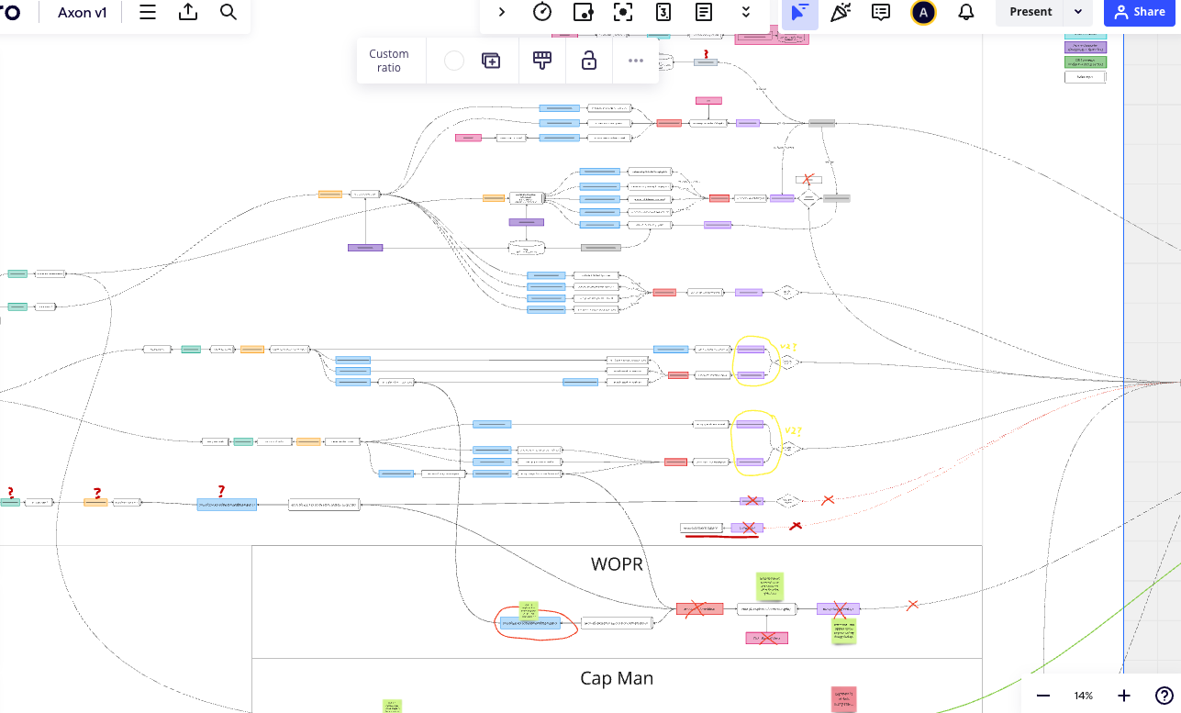
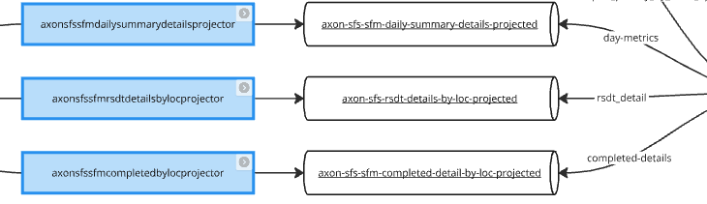
Focus Example

Slide 6
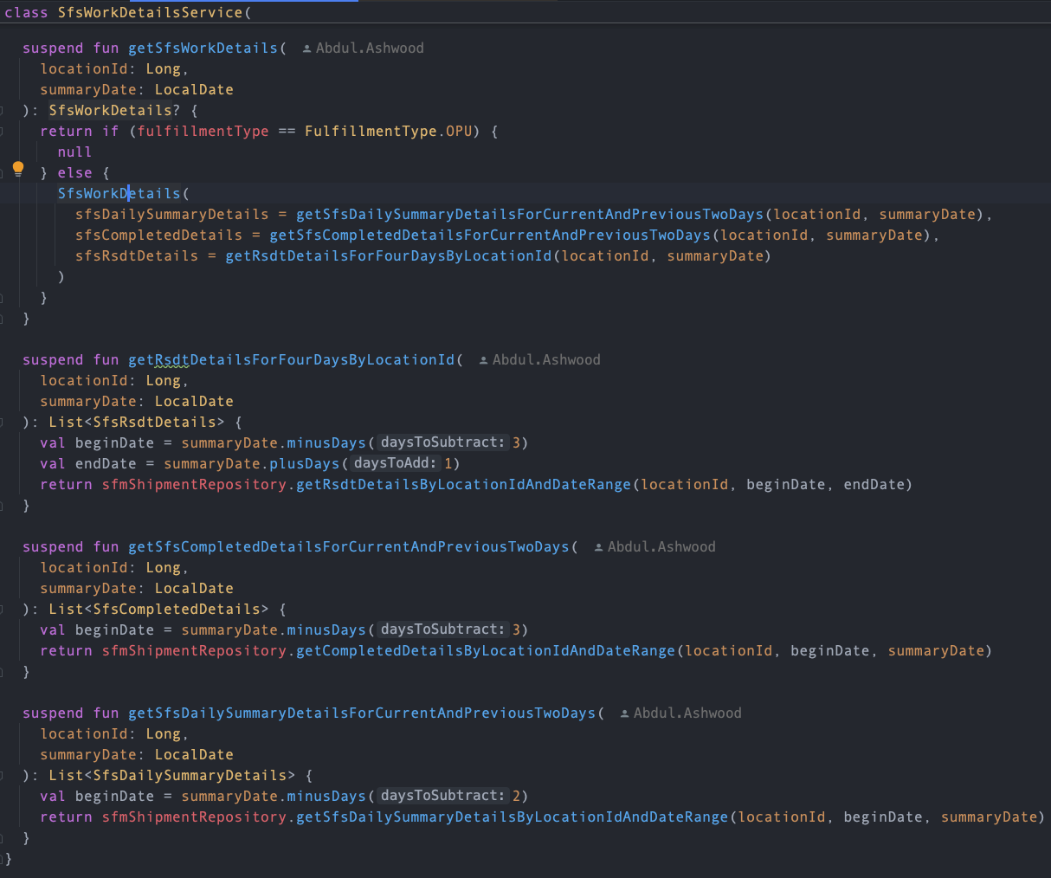
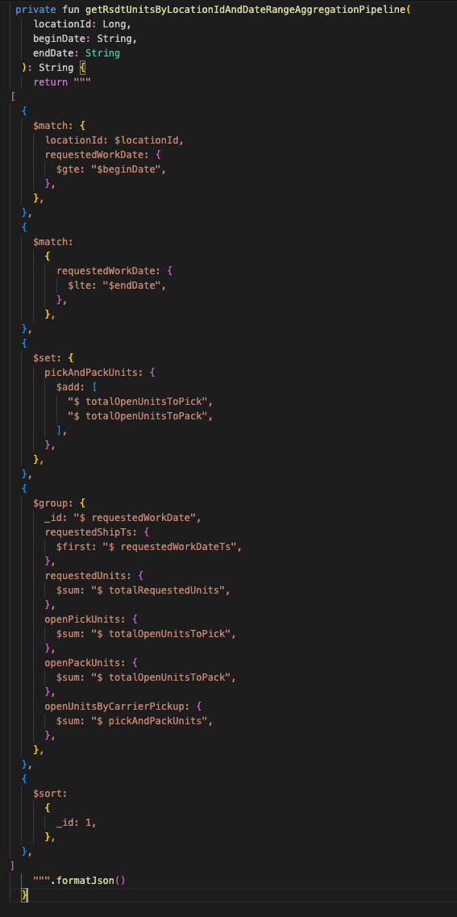
Axon V2 – RSDT Implementation

Slide 7
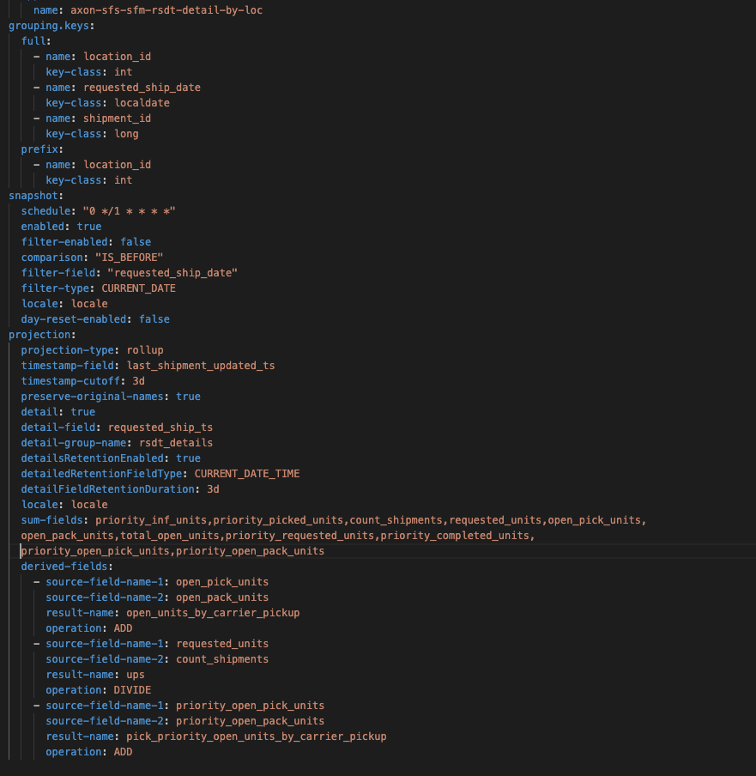
Axon V1 – RSDT Implementation

Slide 8
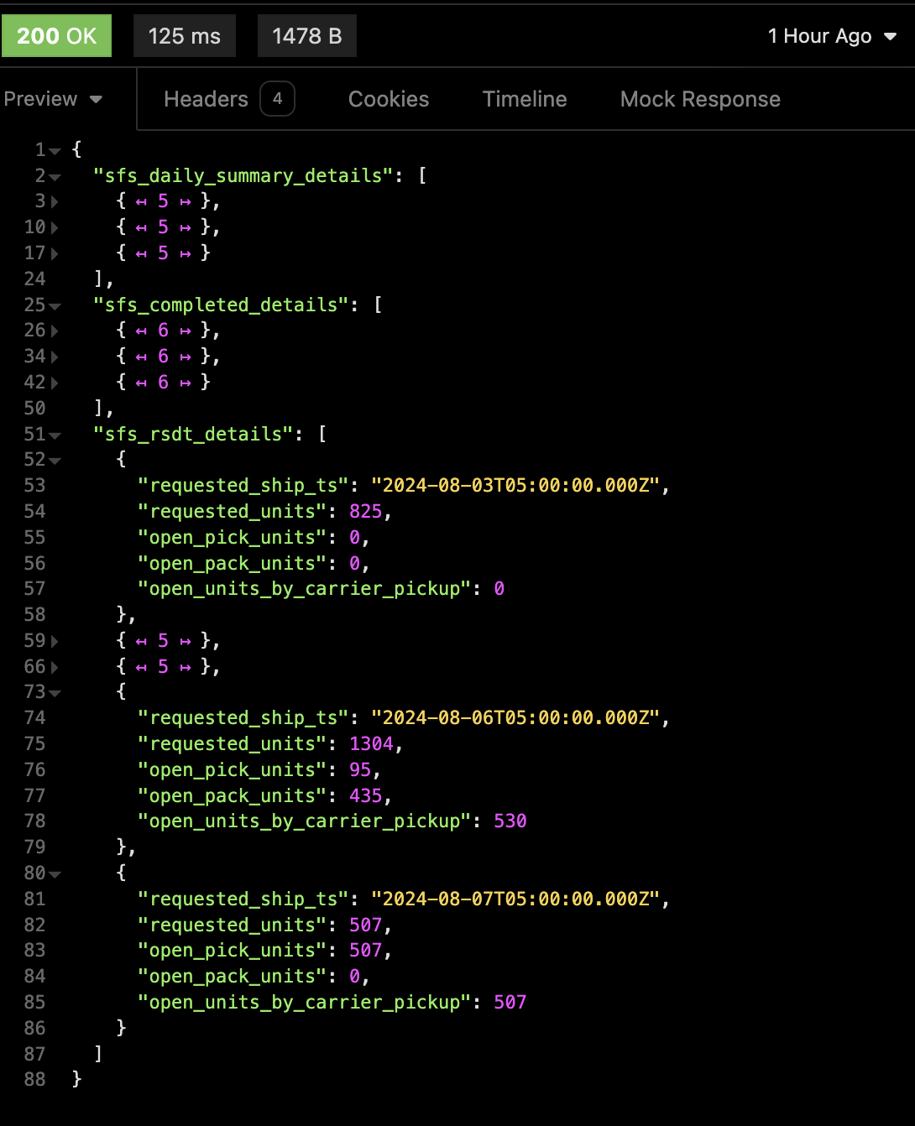
Axon v2 output

Slide 9

Summary
All aggregations are simplified to functions
All aggregations are now independent
Intensive testing
Tap resources are lessened
Mongo has its own library and supporting architecture so we don’t have hand write processes for aggregations

Slide 10

Thank you

